Slide 1

Unit 2: Every Day
Lesson 2i: Progress Check
Page 50

Slide 2
Lesson Outline
Warm-up
Vocabulary
Grammar
Everyday English
Consolidation
Wrap-up

Slide 3
Objectives
By the end of this lesson, students will be able to…
review vocabulary about daily routines and free time activities.
review Present Simple tense.
make an invitation.

Slide 4

WARM-UP

Slide 5
Choose the word whose underlined part is pronounced differently from that of the others.
1. A. time B. fish C. bike D. child
/taɪm/ /fɪʃ/ /baɪk/ /tʃaɪld/
2. A. plan B. can C. play D. hang
/plæn/ /kæn/ /pleɪ/ /hæŋ/
3. A. cut B. run C. put D. shut
/kʌt/ /rʌn/ /pʊt/ /ʃʌt/

Slide 6
Choose the word whose main stress is placed differently from that of the others.
1. A. reduce B. collect C. relax D. cycle
/rɪˈdʒuːs/ /kəˈlekt/ /rɪˈlæks/ /ˈsaɪkəl/
2. A. email B. event C. problem D. nature
/ˈiːmeɪl/ /ɪˈvent/ /ˈprɒbləm/ /ˈneɪtʃər/
3. A. charity B. family C. pollution D. neighbourhood
/ˈtʃærəti/ /ˈfæməli/ /pəˈluːʃən/ /ˈneɪbəhʊd/

Slide 7
PAIRWORK
List verb phrases beginning with:
go: go bowling, …
have: have breakfast, …
watch: watch TV, …
play: play football, …
do: do homework, …

Slide 8

It’s time to learn …

Slide 9
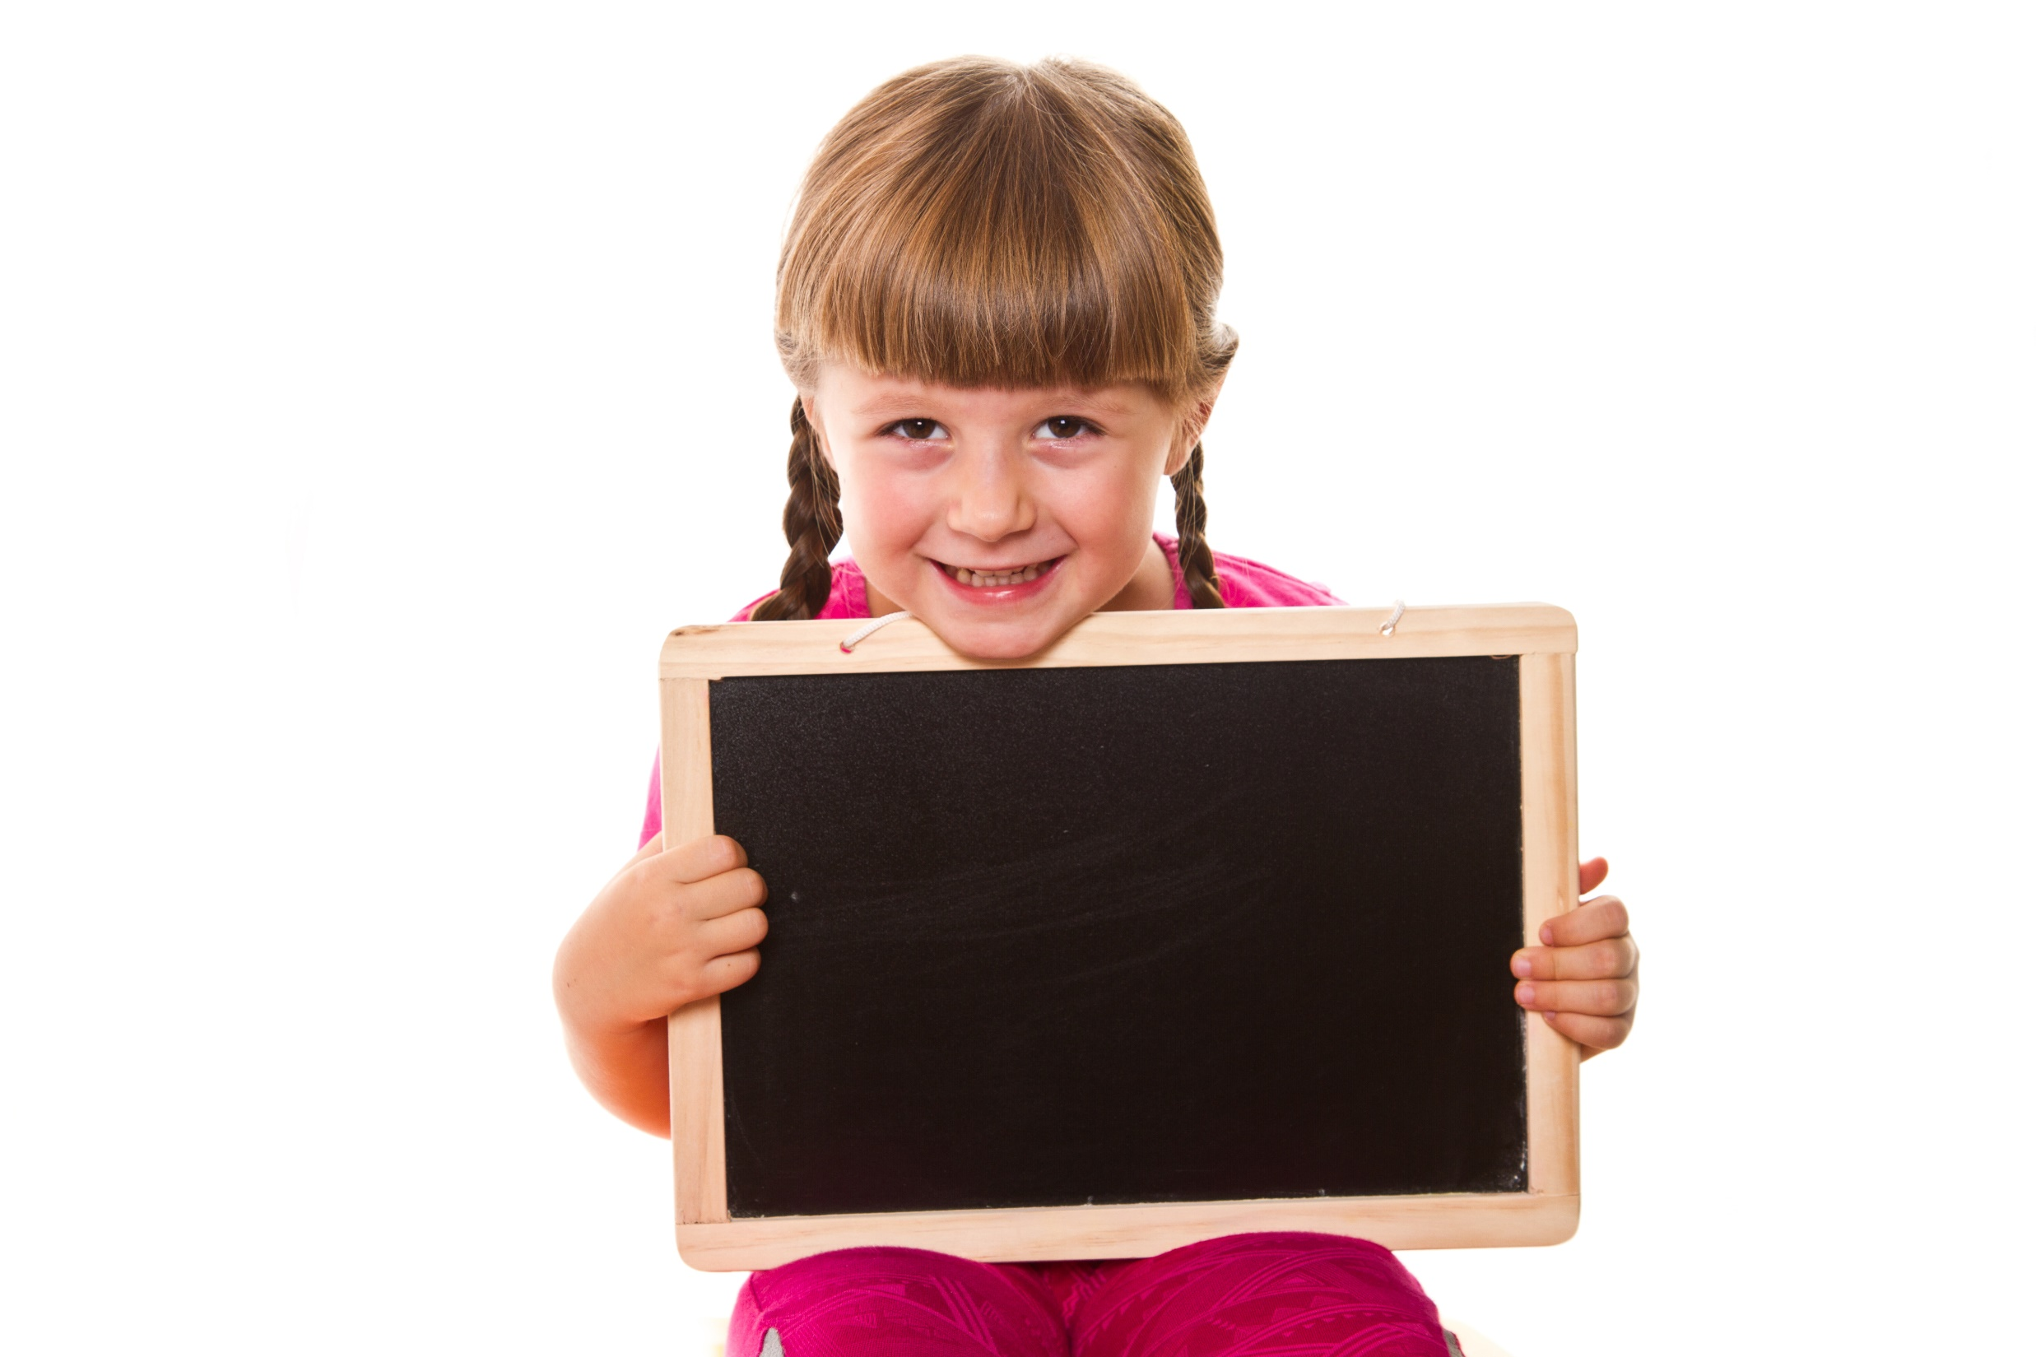
Vocabulary

Slide 10
1. Underline the correct word.
1 He goes/gets up at 8:00.
2 We usually have/do lunch at 1:00.
3 Tom has/does his homework in the afternoon.
4 We walk/take back home after school.
5 She helps/watches a charity for children.

Slide 11
2. Fill in the gaps with take, play, go, watch and brush.
1 In the evening, I ________ video games.
2 We ________ TV in the afternoon.
3 I always ________ a shower in the morning.
4 We ________ our teeth in the morning.
5 They ________ to the gym in the evening
play
watch
take
brush
go

Slide 12
3. Fill in the gaps with amusement, hanging, puzzles, board and shopping.
1 Ann likes playing ______________ games.
2 He hates doing jigsaw ______________ .
3 Keith likes ______________ out with his friends at weekends.
4 We don’t like going ______________ at the mall.
5 They love going to the ______________ park every Saturday evening.
board
puzzles
hanging
shopping
amusement

Slide 13
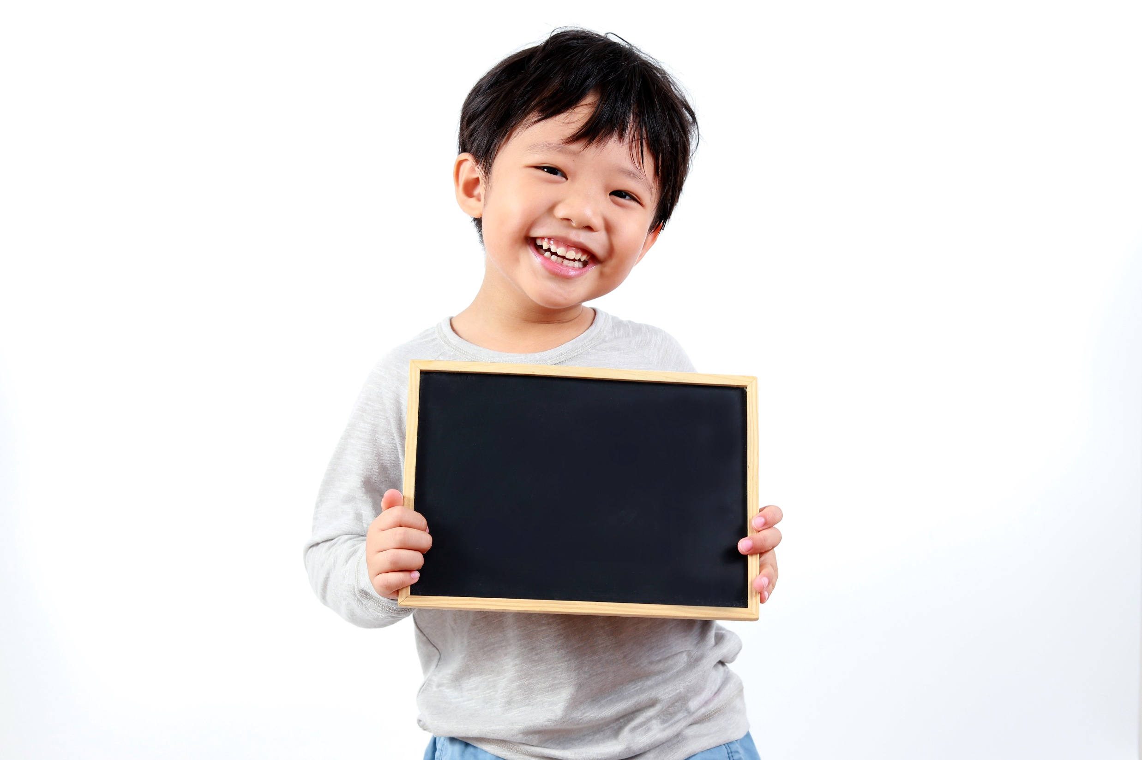
Grammar

Slide 14
Present Simple tense
 | Formation
Affirmative
Negative
Interrogative
Subject + verb (s/es)
Subject + don’t/doesn’t + verb (bare infinitive)
Do/Does + subject + verb (bare infinitive)?

Slide 15
4. Write the third-person singular.
1 She ________________ (work) as a teacher.
2 He _________________ (buy) books online.
3 She ________________ (wash) the car every Friday.
4 He _________________ (chat) online in the evenings.
5 She _________________ (study) English on Mondays.
works
buys
washes
chats
studies

Slide 16
5. Choose the correct item.
1 Does Anna live/lives in Madrid? No, she does/doesn’t.
2 Paul and I don’t/doesn’t play tennis.
3 Do/Does you walk to school? Yes, I do/ does.
4 My mum tidy/tidies the house every day.
5 She doesn't/don't go to work on Saturdays.
6 He live/lives in Hanoi.

Slide 17
6 Put the words in the right order.
1 We/school/walk/to/every day/.
__________________________________________
2 late/Tom/is/for school/never/.
__________________________________________
3 always/We/at/dinner/8:00/have/.
__________________________________________
4 evening/in/watch/They/TV/the/.
__________________________________________
5 have/Mondays/We/music lessons/on/.
__________________________________________
We walk to school every day.
Tom is never late for school.
We always have dinner at 8:00.
They watch TV in the evening.
We have music lessons on Mondays.

Slide 18
Pair work
Tell your friend about your father/mother’s routines.
My mother gets up early every morning. Then, she prepares breakfast for everyone in my family. Next, she goes to work at 7:30. She finishes her work at 4:30 p.m. When she comes back home, she takes a shower. After that, she cooks dinner and enjoys the meal with us. After dinner, she reads books and goes to bed at 10:00 p.m.

Slide 19
Everyday English

Slide 20
Making invitation:
Would you like + to Verb (infinitive)?
Let’s + Verb (bare infinitive).
How about + noun/V-ing?
Ex: Would you like to go to the theatre tonight?
Let’s play football after school.
How about watching a movie this weekend?
Accepting
Great. That’s a good idea.
Sure, I’d love to.
Refusing
I’m sorry. I can’t make it.
I’m afraid I can’t.

Slide 21
7. Complete the dialogue with:
• Sure. • Are you free on Saturday? • Why?
• How about 3:00 then? • Let’s meet at 1 o’clock.
A: Hi Justin! 1) ______________________
B: I think so. 2) _________
A: Can you come to my house?
B: 3) _____________ What time?
A: 4) ____________________________
B: Sorry, I can’t make it at 1:00. I have a piano lesson.
A: 5) _______________________________
B: 3 o’clock is fine. See you there.
Are you free on Saturday?
Why?
Sure.
Let’s meet at 1 o’clock.
How about 3:00 then?

Slide 22
Pair work
Make a similar dialogue with your friend, using the information in the box.
Student A invites Student B to go to the cinema on Saturday evening.
A: Hi! Are you free this Saturday evening?
B: I think so. Why?
A: Would you like to go to the cinema?
B: Sure. What time?
A: Let’s meet at 5 o’clock.
B: Sorry, I can’t make it at 5:00. I have a Maths lesson.
A: How about 7:00 then?
B: 7 o’clock is fine. See you then.

Slide 23
Student B invites Student A to play football at after school today.
B: Hi! Are you free after school today?
A: I think so. Why?
B: Let’s play football.
A: Sure. What time?
B: How about 5 o’clock?
A: Sorry, I can’t make it at 5:00. I have to see our teacher.
B: Is 5:30 OK?
A: 5:30 is fine. See you then.

Slide 24

CONSOLIDATION

Slide 25
Write a short paragraph (about 60 words) about a school day of a Vietnamese student, using the vocabulary you have learnt and Present Simple tense.

Slide 26

WRAP-UP

Slide 27
Today’s lesson
Vocabularies
Daily routines
Free time activities
Grammar
Present Simple tense
Everyday English
Make invitation

Slide 28
Homework
Practise the vocabularies and grammar by making sentences using them.
Prepare the next lesson (p. 51 SB)
Do Unit 2 Test 2 in Bài Tập Bổ Trợ TA 6 Right on (pp. 22-23)

Slide 29
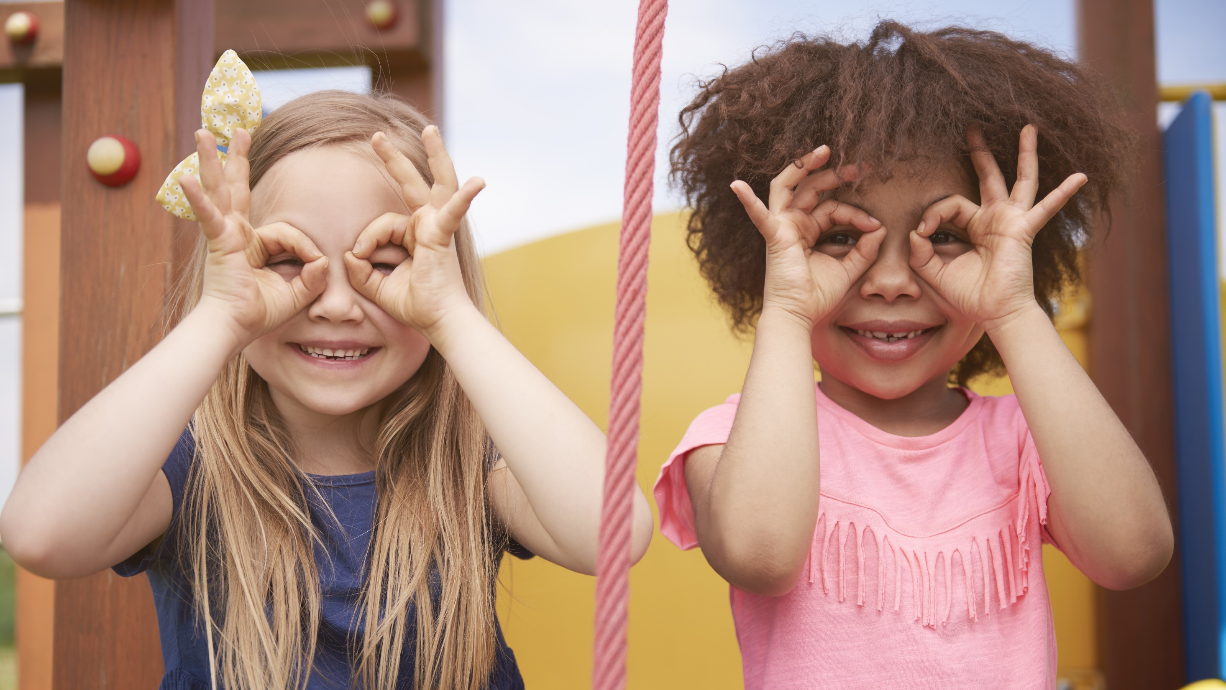
Enjoy your day!

