Slide 1

UNIT 3: SHOPPING
Lesson 1.3 – Pronunciation and Speaking
Page 22

Slide 2




Unit 3 Lesson 1.3
Lesson 1.3
LESSSON OUTLINE
Consolidation

Slide 3

Unit 3 Lesson 1.3
By the end of this lesson,
students will be able to:
- to practice word stress for two-syllable nouns.
- to talk about shopping habits.

Slide 4



Slide 5

Work in pairs.
Choose the word whose main stress is placed
differently from the others.
A. budget B. habit C. support D. doctor
2. A. approve B. produce C. include D. settle
3. A. quality B. customer C. manager D. volunteer
/ˈbʌdʒɪt/
/ˈhæbɪt/
/səˈpɔ:rt/
/ˈdɑ:ktə/
/əˈpru:v/
/prəˈdu:s/
/ɪnˈklu:d/
/ˈsetəl/
/ˈkwɑ:ləti/
/ˈkʌstəmə/
/ˈmænədʒə/
/ˌvɑ:lənˈtɪr/

Slide 6
Work in pairs.
Choose the word whose underlined part is
pronounced differently from that of the other words.
A. offered B. refused C. agreed D. minded
2. A. promised B. wanted C. needed D. started
3. A. laughed B. walked C. fixed D. tried
/ˈɑ:fəd/
/rɪˈfju:zd/
/əˈɡri:d/
/maɪndɪd/
/ˈprɑ:mɪst/
/ˈwɑ:ntɪd/
/ˈni:dɪd/
/stɑ:rtɪd/
/læft/
/wɑ:kt/
/fɪkst/
/traɪd/

Slide 7

Unit 3 Lesson 1.3
Work in pairs.
Where do you usually go shopping?
What do you often buy when going shopping?
I usually/ often go shopping at ….
I often buy ….

Slide 8



Slide 9



Unit 3 Lesson 1.3
a. Stress the first syllable for most two-syllable nouns.
b. Listen to the words and focus on the underlined letters.
service
shopping
Notes:
Please, click on each phrase to hear the sound

Slide 10
Unit 3 Lesson 1.3
c. Listen and cross out the one that has the wrong word stress.
sneakers
bookstore
money
money – Wrong. The stress is on the second syllable.
Notes:
Please, click on each phrase to hear the sound

Slide 11
Unit 3 Lesson 1.3
d. Read the words with the correct stress to a partner.
sneakers
bookstore
money
Notes:
Please, click on each phrase to hear the sound

Slide 12



Slide 13

Unit 3 Lesson 1.3
Practice the conversation. Swap roles and repeat.
Thanh: Hey, Huy, can I ask you some questions? I'm doing a survey for my class.
Huy: Hi, Thanh. Sure.
Thanh: What do you spend most of your money on?
Huy: Comic books and video games.
Thanh: Where do you buy your comic books?
Huy: Usually from the shopping mall.
Thanh: Why? Is it cheaper than other stores?
Huy: No, but it has more choices.
Thanh: And video games? Do you buy them at the shopping mall too?
Huy: I buy them online because it’s less expensive.
Thanh: What’s the most expensive thing you’ve ever bought?
Huy: I bought a phone.
Thanh: Great. Thank you.

Slide 14










Unit 3 Lesson 1.3
b. Make another conversation
using the ideas on the right.
Thanh: Hey, Huy, can I ask you some questions? I'm doing a survey for my class.
Huy: Hi, Thanh. Sure.
Thanh: What do you spend most of your money on?
Huy: Comic books and video games.
Thanh: Where do you buy your comic books?
Huy: Usually from the shopping mall.
Thanh: Why? Is it cheaper than other stores?
Huy: No, but it has more choices.
Thanh: And video games? Do you buy them at the shopping mall too?
Huy: I buy them online because it’s less expensive.
Thanh: What’s the most expensive thing you’ve ever bought?
Huy: I bought a phone.
Thanh: Great. Thank you.

Slide 15



Slide 16

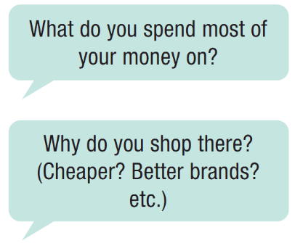
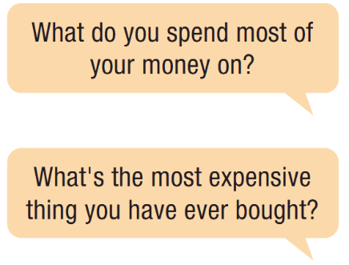
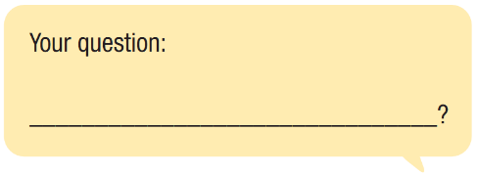
Unit 3 Lesson 1.3
HOW DO YOU SPEND YOUR MONEY?
a. Add one more question. In fours: Discuss the questions.

Slide 17
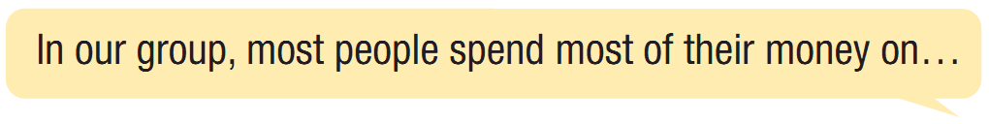
Unit 3 Lesson 1.3
HOW DO YOU SPEND YOUR MONEY?
b. Report the results to your class.

Slide 18

Consolidation

Slide 19
Unit 3 Lesson 1.3
Write a short paragraph about your shopping habit. You can use the cues below:
Where do you usually go shopping?
How often do you go shopping?
Who do you often go with?
What do you often buy?
…….

Slide 20
Unit 3 Lesson 1.3
Wrap-up
Today’s lesson
Pronunciation: word stress for two-syllable nouns
Speaking: starting a friendly conversation asking and answering about shopping habits.

Slide 21


Slide 22
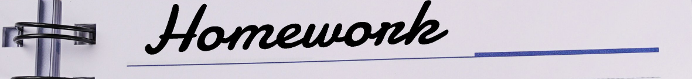
Unit 3 Lesson 1.3
Make sentences about doing the chores/ Write a short passage about you/ your family members’ shopping habits.
Practice the conversation in SB on page 22.
Prepare the next lesson – Listening on page 23 in SB.
Play the consolidation games in Tiếng Anh 10 i-Learn Smart World DHA App on www.eduhome.com.vn

Slide 23

Have a nice day!

