Slide 1
Unit 3:
Protecting the Environment
Lesson 2.2 – Grammar
Pages 29 & 30

Slide 2
Lesson Outline
Warm-up
Grammar
Consolidation
Wrap-up

Slide 3
By the end of this lesson, students will be able to…
practice and use Compound sentences with ‘and’ and complex sentences with ‘so that’ correctly.

Slide 4
Lesson 1
WARM UP

Slide 5
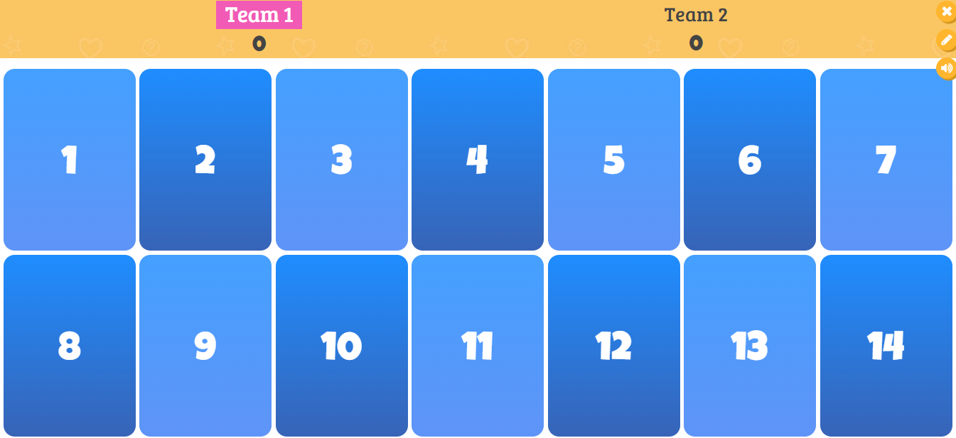
Let’s baaboozle with “and” or “but!
Click here!
Notes:
https://www.baamboozle.com/classic/591003

Slide 6
Presentation

Slide 7
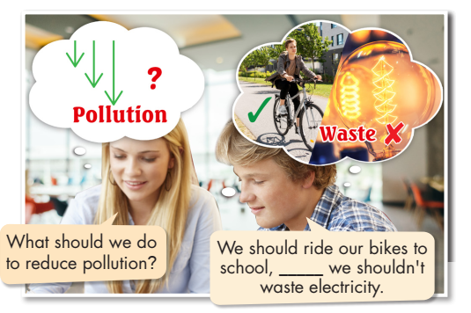
Task a. Read about compound and complex sentences and fill in the blanks

Slide 8
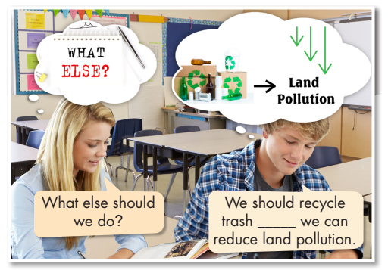
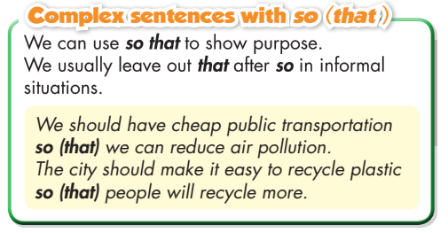
Task a. Read about compound and complex sentences and fill in the blanks

Slide 9
Task b. Listen and check your answers. Listen again and repeat.
and
so

Slide 10
Compound and complex sentences.
Compound sentences with “and”
An independent clause can stand by itself as a simple sentence. A compound sentence has at least two independent clauses. We use a comma (,) before the conjunction to separate independent clauses.

Slide 11
Compound and complex sentences.
Example:
Compound sentence
We should tell our friends about recycling
we can ask our school to save spare paper.
, and
Independent clause
Independent clause

Slide 12
Compound and complex sentences.
Example:
Compound sentence
They should reuse water bottles
, and
they shouldn’t waste paper
Independent clause
Independent clause

Slide 13
Compound and complex sentences.
Complex sentences with “so (that)”
A complex sentence has an independent clause and at least one dependent clause. Dependent clauses can’t stand alone. We use so (that) to talk about the purpose of an action. We don’t use a comma before so (that). We can use so to make compound sentences to show result. These sentences have a comma before so.

Slide 14
Compound and complex sentences.
Example:
Complex sentence
We should reuse plastic bottles
so that
we can reduce land pollution.
Independent clause
Dependent clause

Slide 15
Compound sentences with “and” | Complex sentences with “so (that)”
An independent clause can stand by itself as a simple sentence. A compound sentence has at least two independent clauses. We use a comma (,) before the conjunction to separate independent clauses. | A complex sentence has an independent clause and at least one dependent clause. Dependent clauses can’t stand alone. We use so (that) to talk about the purpose of an action. We don’t use a comma before so (that). We can use so to make compound sentences to show result. These sentences have a comma before so.

Slide 16
Practice

Slide 17
☒
We should take the bus or subway to school so that we can help reduce air pollution.
✓
☒
We should recycle plastic, and we shouldn’t through trash into rivers.
☒
We should stop giving away plastic bags for free so (that) we can reduce plastic trash.

Slide 18
We should recycle things so (that) we can reduce land pollution.
We should recycle plastic bottles, and we can reuse glass bottles.
We shouldn’t throw trash into the sea, and we should help clean up beaches.
We should turn off air conditioners when we leave a room so (that) we can save electricity.

Slide 19
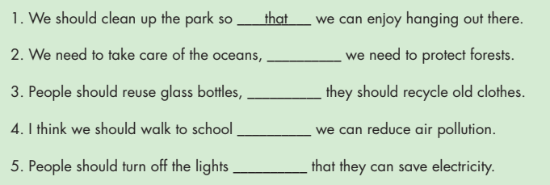
Extra Practice
WB page 35
and
so
and
so that

Slide 20
Production:
Speaking

Slide 21
What should people do to reduce pollution in your town?
My town should clean up the beaches, and people shouldn’t throw trash on the beach.

Slide 22
Share with your class!
Example:
A: What should people do to reduce pollution in your town?
B: My town should clean up the beaches, and people shouldn’t throw trash on the beach.
A: What else?
B: And people should turn off the air condition when leaving the room.

Slide 23
CONSOLIDATION

Slide 24
Write 2 sentences with compound and complex sentences. Share with your classmates.

Slide 25
WRAP-UP

Slide 26
Today’s lesson
Grammar:
using compound sentences with ‘and’ and complex sentences with ‘so that’ correctly.
Speaking:
- sharing ideas about how to reduce pollution.

Slide 27
Homework
Make three sentences, using compound and complex sentences.
Do the exercises in WB: Grammar (page 17).
Play the consolidation games in Tiếng Anh 8 i-Learn Smart World DHA App on www.eduhome.com.vn
Do the exercises in TA 8 i-Learn Smart World Notebook, page 25.
Prepare: Lesson 2.3 – Pronunciation and Speaking (pages 30 & 31 – SB).

Slide 28
Lesson 3
Stay positive and have a nice day!

