Slide 1

Unit 5: London Was Great!
Progress Check (Cont.)
Page 101

Slide 2
Lesson Outline
Warm-up
Reading
Listening
Writing
Wrap-up

Slide 3
Objectives
By the end of this lesson, students will be able to…
- practise test-taking skills (Reading, Listening, and Writing).

Slide 4

WARM-UP

Slide 5
Work in groups. List down as many things you can remember about the UK so far.
London
UK
Queen Elizabeth

Slide 6

It’s time to learn …

Slide 7
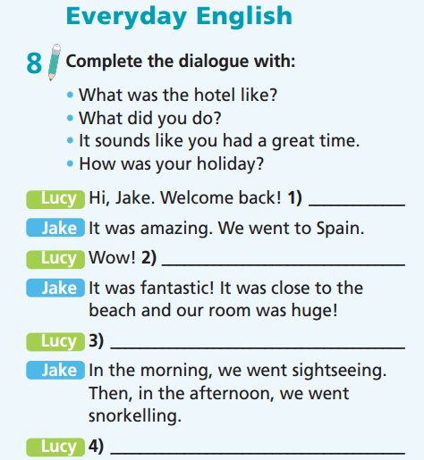
How was your holiday?
What was the hotel like?
What did you do?
It sounds like you had a great time.

Slide 8
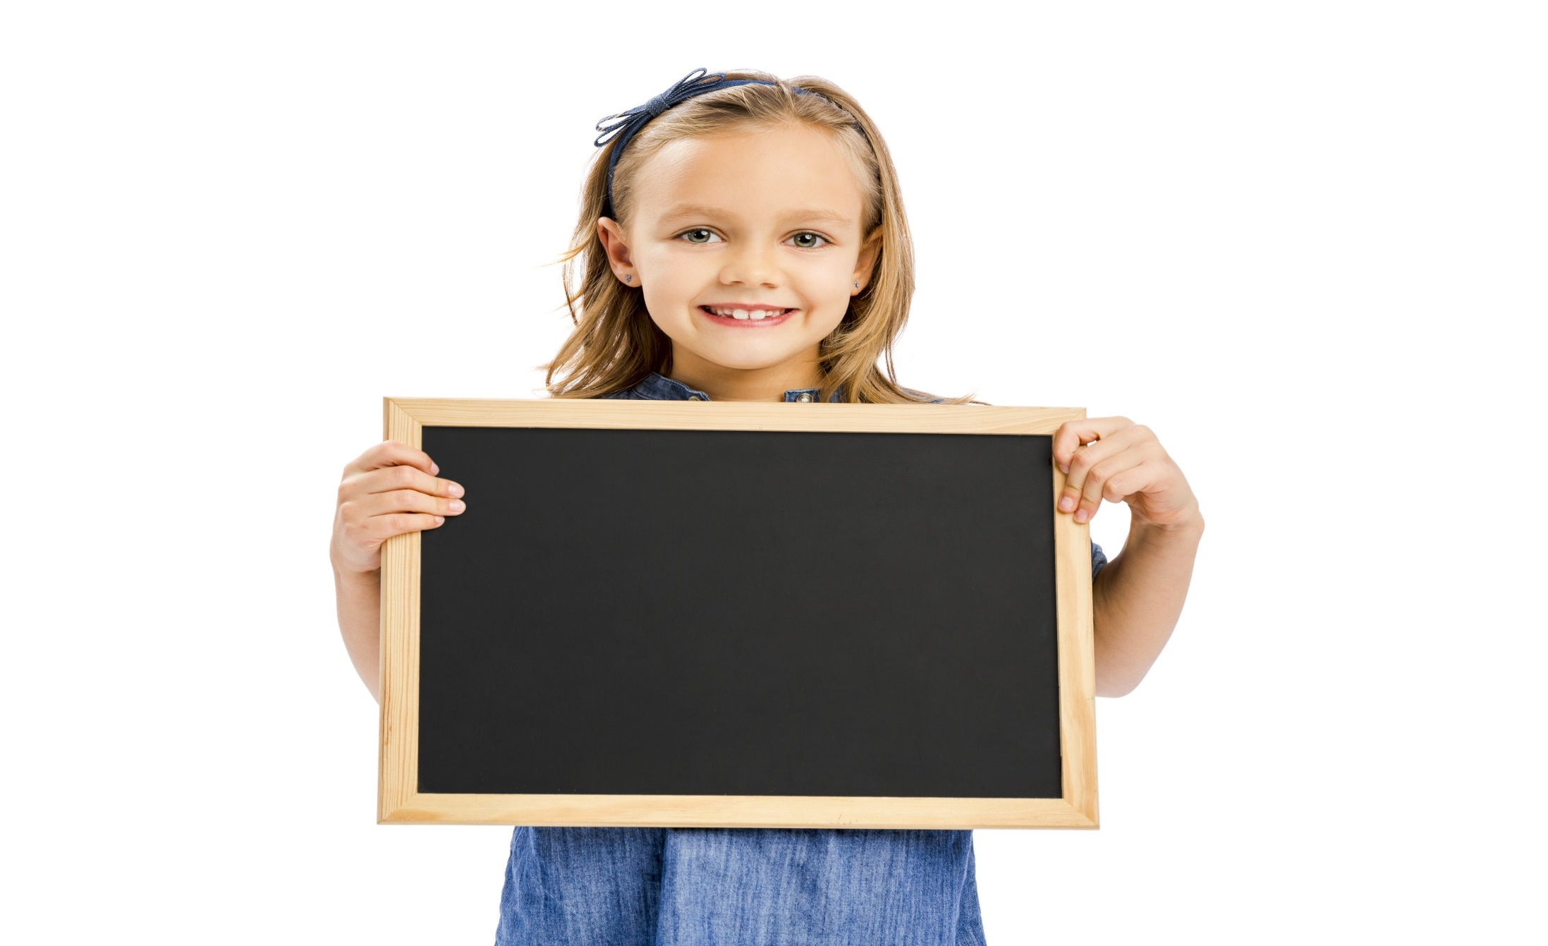
Reading

Slide 9
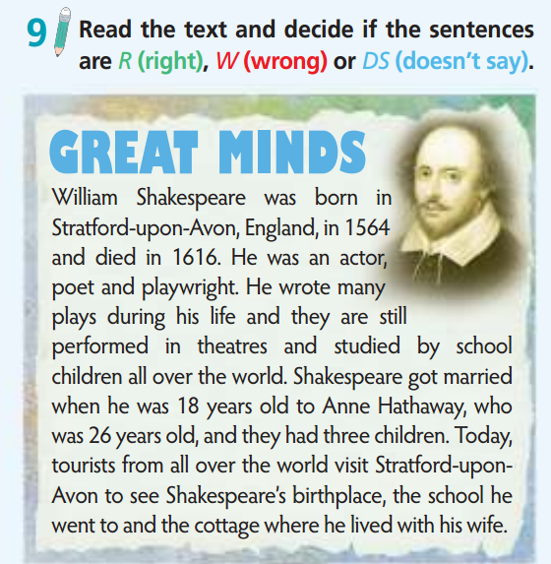
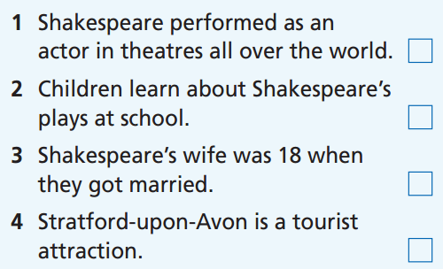
Pre-reading
Underline the key words

Slide 10
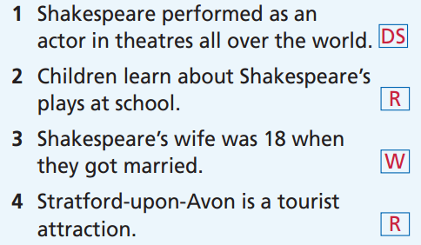
What is your answer?
While-reading

Slide 11

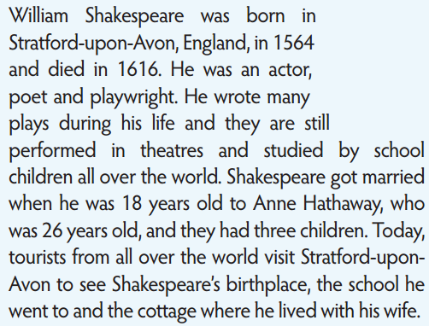

Slide 12


Slide 13


Slide 14


Slide 15
Extra-Reading
Read the text again and choose the best answer.
How old was Shakespeare when he died?
26 B. 18 C. 52
2. Which is NOT Shakespeare’s job?
teacher B. poet C. actor
3. What can visitors do in Stratford-upon-Avon?
see the first stage that Shakespeare performed on.
see the place where Shakespeare was born.
see the school where Shakespeare worked as a teacher.

Slide 16
Post-reading
Work in groups. Find out information about a famous author/poet/actor. Present the information to the whole class.
What is his/her name?
Where is he/she from?
What is his/her job?
When was he/she born?
When did he/she die?
Some interesting facts about him/her.

Slide 17
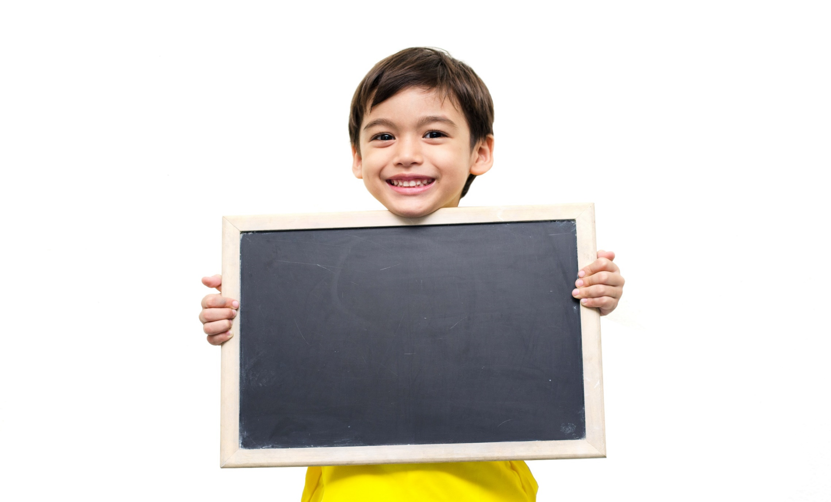
Listening

Slide 18
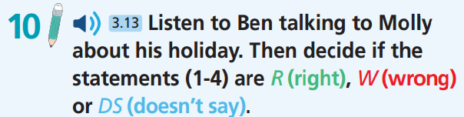
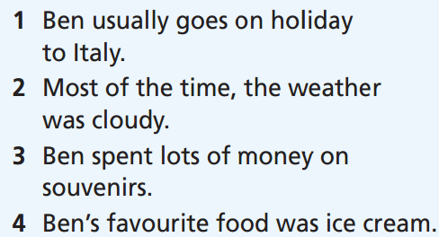
Pre-Listening
Underline the key words

Slide 19
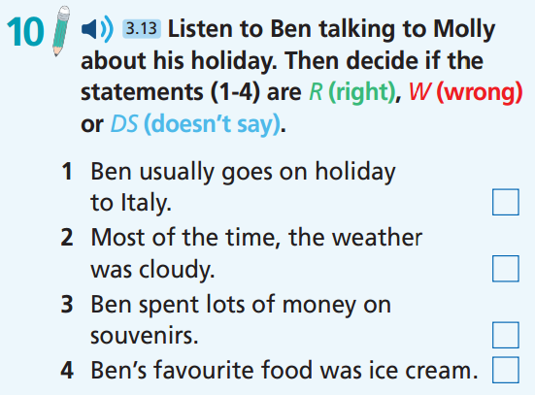

Now listen.  FIRST TIME
While-Listening
☞ WHAT ARE YOUR ANSWERS?

Slide 20
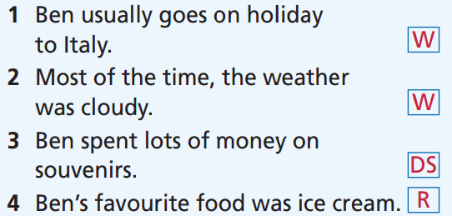
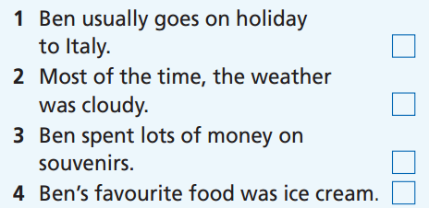
While-listening
Now listen again.  SECOND TIME
☞ WHY ARE THESE ANSWERS?

Slide 21

Now listen again and check.  THIRD TIME
Usually, I go to France or Spain with my family.

Slide 22

Now listen again and check.  THIRD TIME
Molly: What was the weather like?
Ben: It was warm and sunny, except for one day when it was very cloudy and cold.

Slide 23

Now listen again and check.  THIRD TIME
They have lots of shops to buy different things, like clothes, souvenirs and food. Mum and Dad bought lots of Italian clothes, but I just got some souvenirs. → no information about the money

Slide 24
Now listen again and check.  THIRD TIME
Ben: We ate lots of Italian dishes, including pasta and pizza. They were delicious, but the best of all was the ice cream.

Slide 25
Molly: Hi, Ben! How was your holiday?
Ben: I had a great time. Usually, I go to France or Spain with my family, but this year we went to Italy. We stayed in a hotel in Rome.
Molly: What was the weather like?
Ben: It was warm and sunny, except for one day when it was very cloudy and cold.
Molly: So what did you do there?
Ben: Well, Rome’s beautiful and there’s so much to see! In the mornings, we visited museums and art galleries, and in the afternoons, we went shopping.
They have lots of shops to buy different things like clothes, souvenirs, and food. Mum and Dad bought lots of Italian clothes, but I just got some souvenirs.
Molly: How about the food? Did you try any Italian dishes?
Ben: We ate lots of Italian dishes, including pasta and pizza. They were delicious, but the best of all was the ice cream.
Molly: It sounds like you had a great time.
Ben: It really was the trip of a lifetime!

Slide 26

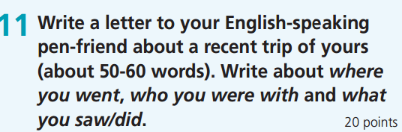

Slide 27
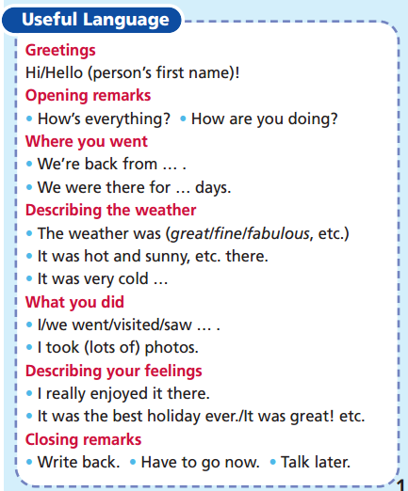

Slide 28
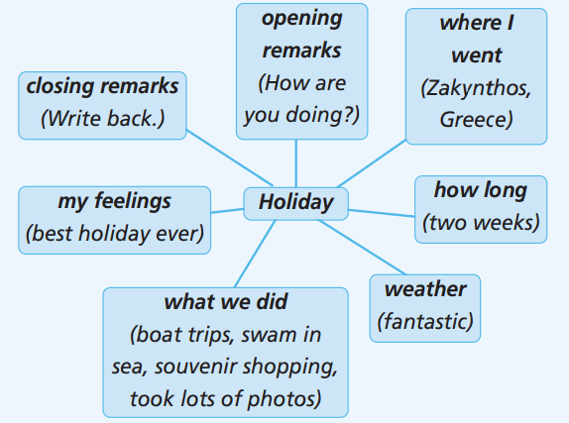
Complete the spidergram

Slide 29
Sample letter
Hi Jessica, How are you doing? Did you enjoy your holiday? We went to Zakynthos in Greece. We stayed in a big hotel for two weeks. The weather was fantastic. We went on boat trips, swam in the sea, and went souvenir shopping. I took lots of photos. It was the best holiday ever!
Write back.
Allison

Slide 30
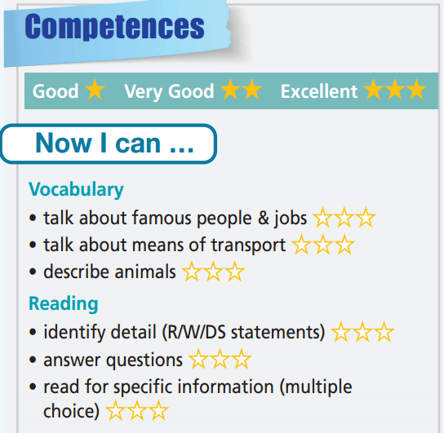
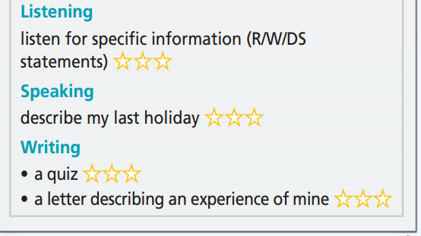

Slide 31

WRAP-UP

Slide 32
Today’s lesson
Practise test-taking skills (Reading, Listening, and Writing).

Slide 33
Homework
Review the vocabularies and grammar and make sentences using them.
Do Unit 5 Test 2 in Bài Tập Bổ Trợ TA 6 Right on (pp. 48-49).
Prepare the next lesson (p. 102 SB).

Slide 34
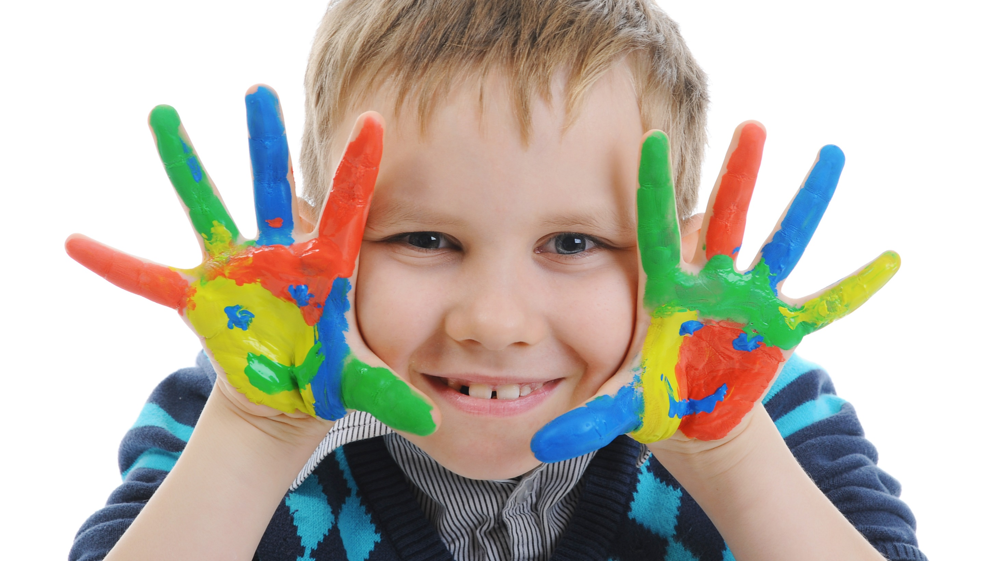
Enjoy your day!

