Slide 2
Unit 10
Lifelong learning
LESSON VIII
LOOKING BACK AND PROJECT
REVISION

Slide 3
LESSON VIII
LOOKING BACK AND PROJECT
WARM-UP
Game: Sling shot
Pronunciation: Mark the intonation in the following questions. Then listen and check. Practise saying them in pairs.
Vocabulary: Complete the text. Use the correct forms of the words and phrases in the box.
Grammar: Choose the sentence that has the closest meaning to the given sentence.
LOOKING BACK
PROJECT
A leaflet about a lifelong learning habit
CONSOLIDATION
Wrap-up
Homework

Slide 4

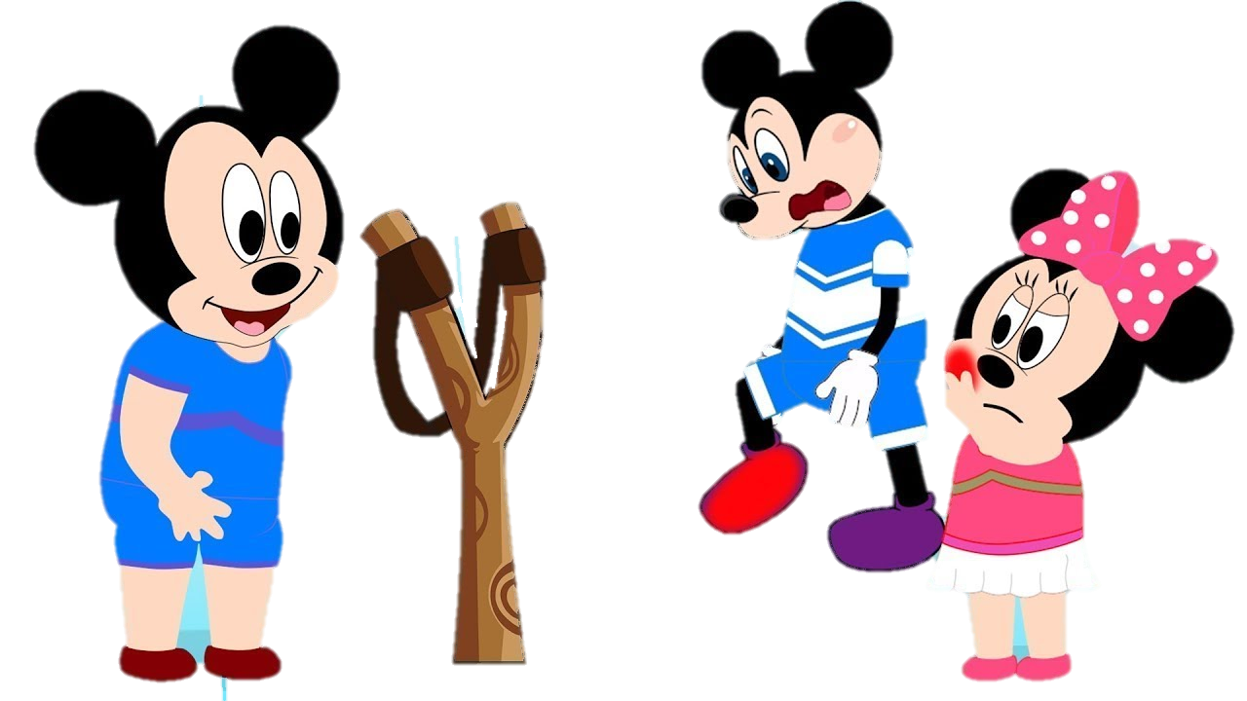


Choose the correct word or phrase with the given meaning

Slide 5


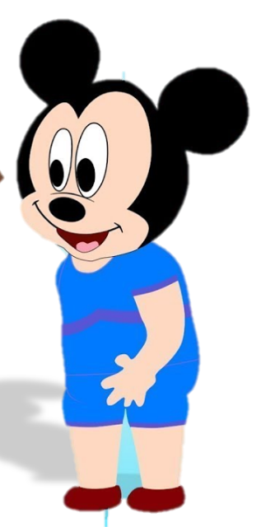

valuable and useful
relevant
distance learning
learning community
relevant

Slide 6
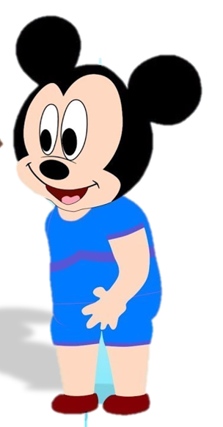

education for adults that is available outside schools and universities
adult education
relevant
well-rounded
adult education

Slide 7
a method of education in which people study at home and send their work to their teachers
distance learning
adult education
distance learning
night school

Slide 8
a group of learners who share learning goals and often connect with one another
learning community
learning community
remote education
night school

Slide 9
having a variety of experiences and a range of skills and interests
well-rounded
well-rounded
decoration
worshipping

Slide 10

LOOKING BACK
PRONUNCIATION
Mark the intonation in the following questions. Then listen and check. Practise saying them in pairs.
1. When was the last meeting of your reading club?
2. Is lifelong learning important for career development?
3. You don’t attend night school classes, do you? I've never seen you before.
4. Is the course held on weekdays or at the weekend?

Slide 11
LOOKING BACK
VOCABULARY
Complete the text. Use the correct forms of the words and phrases in the box.
learning community well-rounded relevant
adult education distance learning
relevant
Lifelong learning is especially (1) ________________ in today’s fast-changing world. There are many ways to engage in lifelong learning. First, you can attend courses at (2) _________________ institutions. Second, you can also take remote or (3) _________________ courses with the help of technology. Third, you can join a (4) ___________________ of people who share common learning goals. And, finally, you can learn by reading widely and researching topics. This will help you become (5) _________________ and prepare you to face future challenges.
adult education
distance learning
learning community
well-rounded

Slide 12
LOOKING BACK
GRAMMAR
Choose the sentence that has the closest meaning to the given sentence.
1. ‛You should continue learning after leaving school,’ my grandfather said.
A. My grandfather advised me to continue learning after leaving school.
B. I advised my grandfather to continue learning after leaving school.
C. My grandfather didn’t want me to continue learning after leaving school.
D. I didn’t want my grandfather to continue learning after leaving school.
=> Report Advice

Slide 13
LOOKING BACK
GRAMMAR
Choose the sentence that has the closest meaning to the given sentence.
=> Report an offer
2. ‘I’ll help you register for the course,’ my sister said.
A. My sister forced me to register for her course.
B. My sister offered to help me register for the course.
C. I wanted to help my sister register for the course.
D. I wanted my sister to register for the course.

Slide 14
LOOKING BACK
GRAMMAR
Choose the sentence that has the closest meaning to the given sentence.
3. ‛Can you show me how to download this video?’ my mother asked.
A. I asked my mother to show me how to download that video.
B. I showed my mother how to download that video.
C. My mother asked me to show her how to download that video.
D. My mother showed me how to download that video
=> Report request

Slide 15
LOOKING BACK
GRAMMAR
Choose the sentence that has the closest meaning to the given sentence.
=> Report order
4. ‛Don’t enter your sister’s room. She is studying,’ my father told me.
A. My sister ordered me not to enter her room because she was studying.
B. My sister ordered my father not to enter her room because she was studying.
C. I ordered my father not to enter my sister’s room because she was studying.
D. My father ordered me not to enter my sister’s room because she was studying

Slide 16


Slide 17













Enemies will kill you! Lose all points!
1 point
Double your points
2 points
Steal other team’s points.
3 points
Lose all points!
4 points
5 points

Slide 18

A
B
C
D
E
F

Slide 19
Choose the sentence that has the closest meaning to the given sentence.
1. ‛You should continue learning after leaving school,’ my grandfather said.
A. My grandfather advised me to continue learning after leaving school.
B. I advised my grandfather to continue learning after leaving school.
C. My grandfather didn’t want me to continue learning after leaving school.
D. I didn’t want my grandfather to continue learning after leaving school.
=> Report Advice

Slide 20


Slide 21
Choose the sentence that has the closest meaning to the given sentence.
=> Report an offer
2. ‘I’ll help you register for the course,’ my sister said.
A. My sister forced me to register for her course.
B. My sister offered to help me register for the course.
C. I wanted to help my sister register for the course.
D. I wanted my sister to register for the course.

Slide 23
Choose the sentence that has the closest meaning to the given sentence.
=> Report request
3. ‛Can you show me how to download this video?’ my mother asked.
A. I asked my mother to show me how to download that video.
B. I showed my mother how to download that video.
C. My mother asked me to show her how to download that video.
D. My mother showed me how to download that video

Slide 25
Choose the sentence that has the closest meaning to the given sentence.
=> Report order
4. ‛Don’t enter your sister’s room. She is studying,’ my father told me.
A. My sister ordered me not to enter her room because she was studying.
B. My sister ordered my father not to enter her room because she was studying.
C. I ordered my father not to enter my sister’s room because she was studying.
D. My father ordered me not to enter my sister’s room because she was studying

Slide 27


Slide 28

Steal other team’s points.

Slide 29
Double your points.

Slide 30
Lose all points.

Slide 31
PROJECT
A leaflet about a lifelong learning habit
Work in groups. Do some research and choose a lifelong learning habit such as reading, self-education, taking courses or having a variety of hobbies.
Create a leaflet about the habit and share it with the class. Use these questions as cues.
• What does the lifelong learning habit involve?
• How can this habit be developed?
• What are the benefits of this habit?
• Does this habit present any challenges?

Slide 32
CONSOLIDATION
1
Wrap-up
What have you learned today?
Pronunciation: Rising and falling intonation in questions.
Vocabulary: Phrases related to lifelong learning.
Grammar: Reported speech to report orders, requests, offers, and advice.

Slide 33
CONSOLIDATION
2
Homework
Do exercises in the workbook.
Prepare for the next lesson.

Slide 34
Website: hoclieu.vn
Fanpage: facebook.com/www.tienganhglobalsuccess.vn

