Slide 1


Slide 2

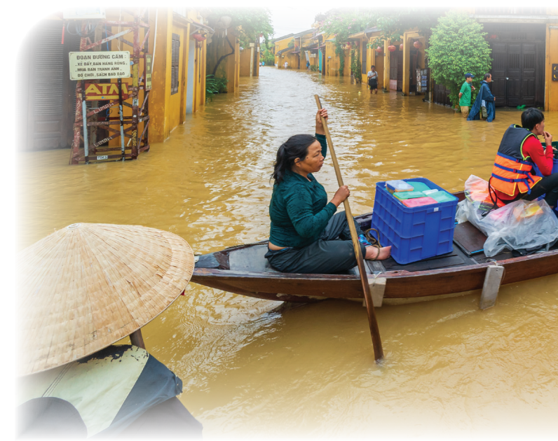
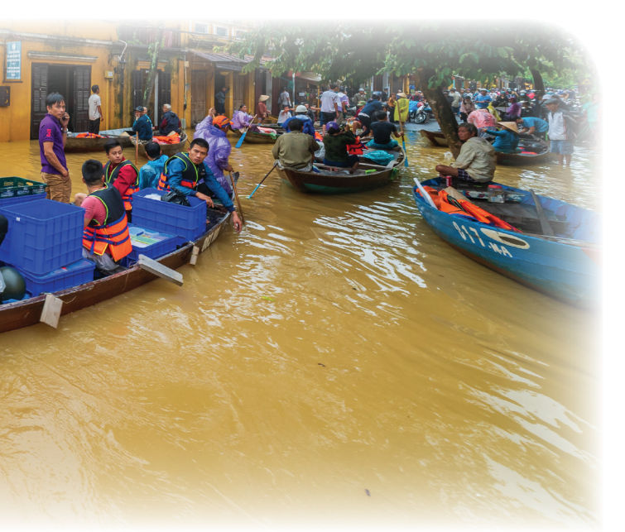
Unit
9
NATURAL DISASTERS
Unit
ETHNIC GROUPS OF VIET NAM
LESSON 1: GETTING STARTED
We are all safe!
Unit

Slide 3
LESSON 1: GETTING STARTED
LESSON 1: GETTING STARTED
WARM-UP
Q&A about natural disasters
PRESENTATION
Vocabulary
Task 1: Listen and read.
Task 2: Complete each sentence with no more than TWO words from the conversation.
Task 3: Write the natural disasters from the box under the pictures. Then listen, check, and repeat.
Task 4: Choose the correct answer to complete each sentence.
PRACTICE
PRODUCTION
Task 5: Complete the web with the words and phrases related to natural disasters you know.
CONSOLIDATION
Wrap-up
Homework

Slide 4
WARM-UP
Answer the questions:
1. Can you name some natural disasters in Viet Nam?
2. Are there often natural disasters in Viet Nam?
3. How can you know when there is an
incoming natural disaster?
4. What would you do if you were notified of an incoming earthquake?
NATURAL DISASTERS

Slide 5
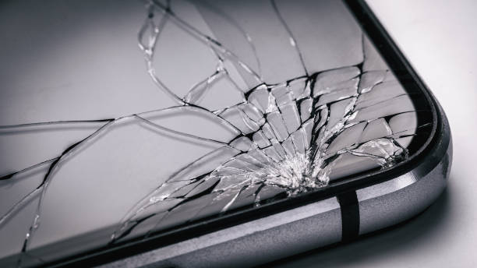

PRESENTATION
damage (n,v)
/ˈdæmɪdʒ/
thiệt hại,
gây tổn hại

Slide 6
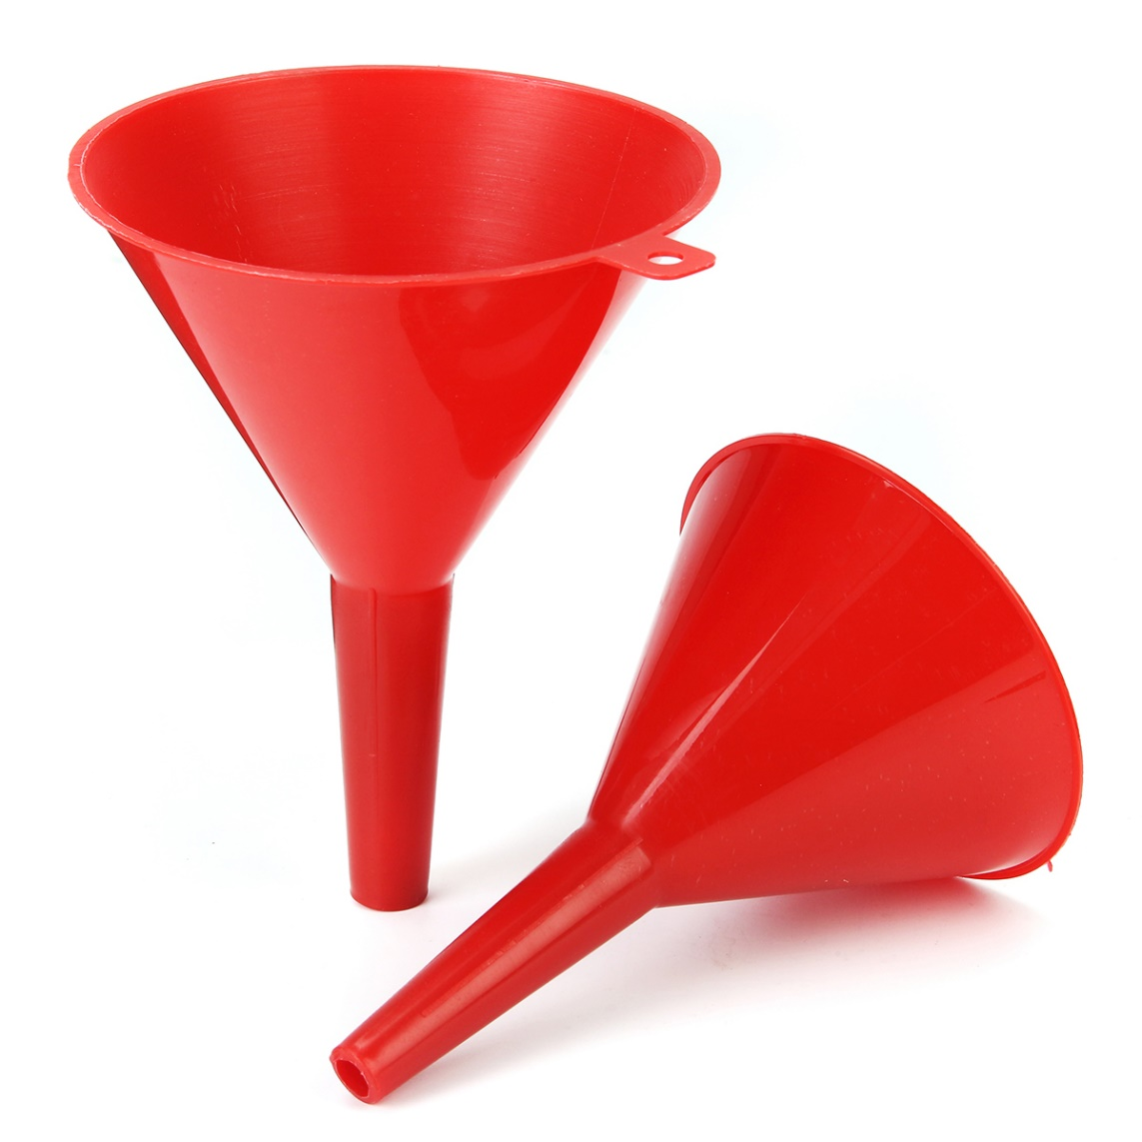
PRESENTATION
funnel (n)
/ˈfʌnl/
cái phễu

Slide 7
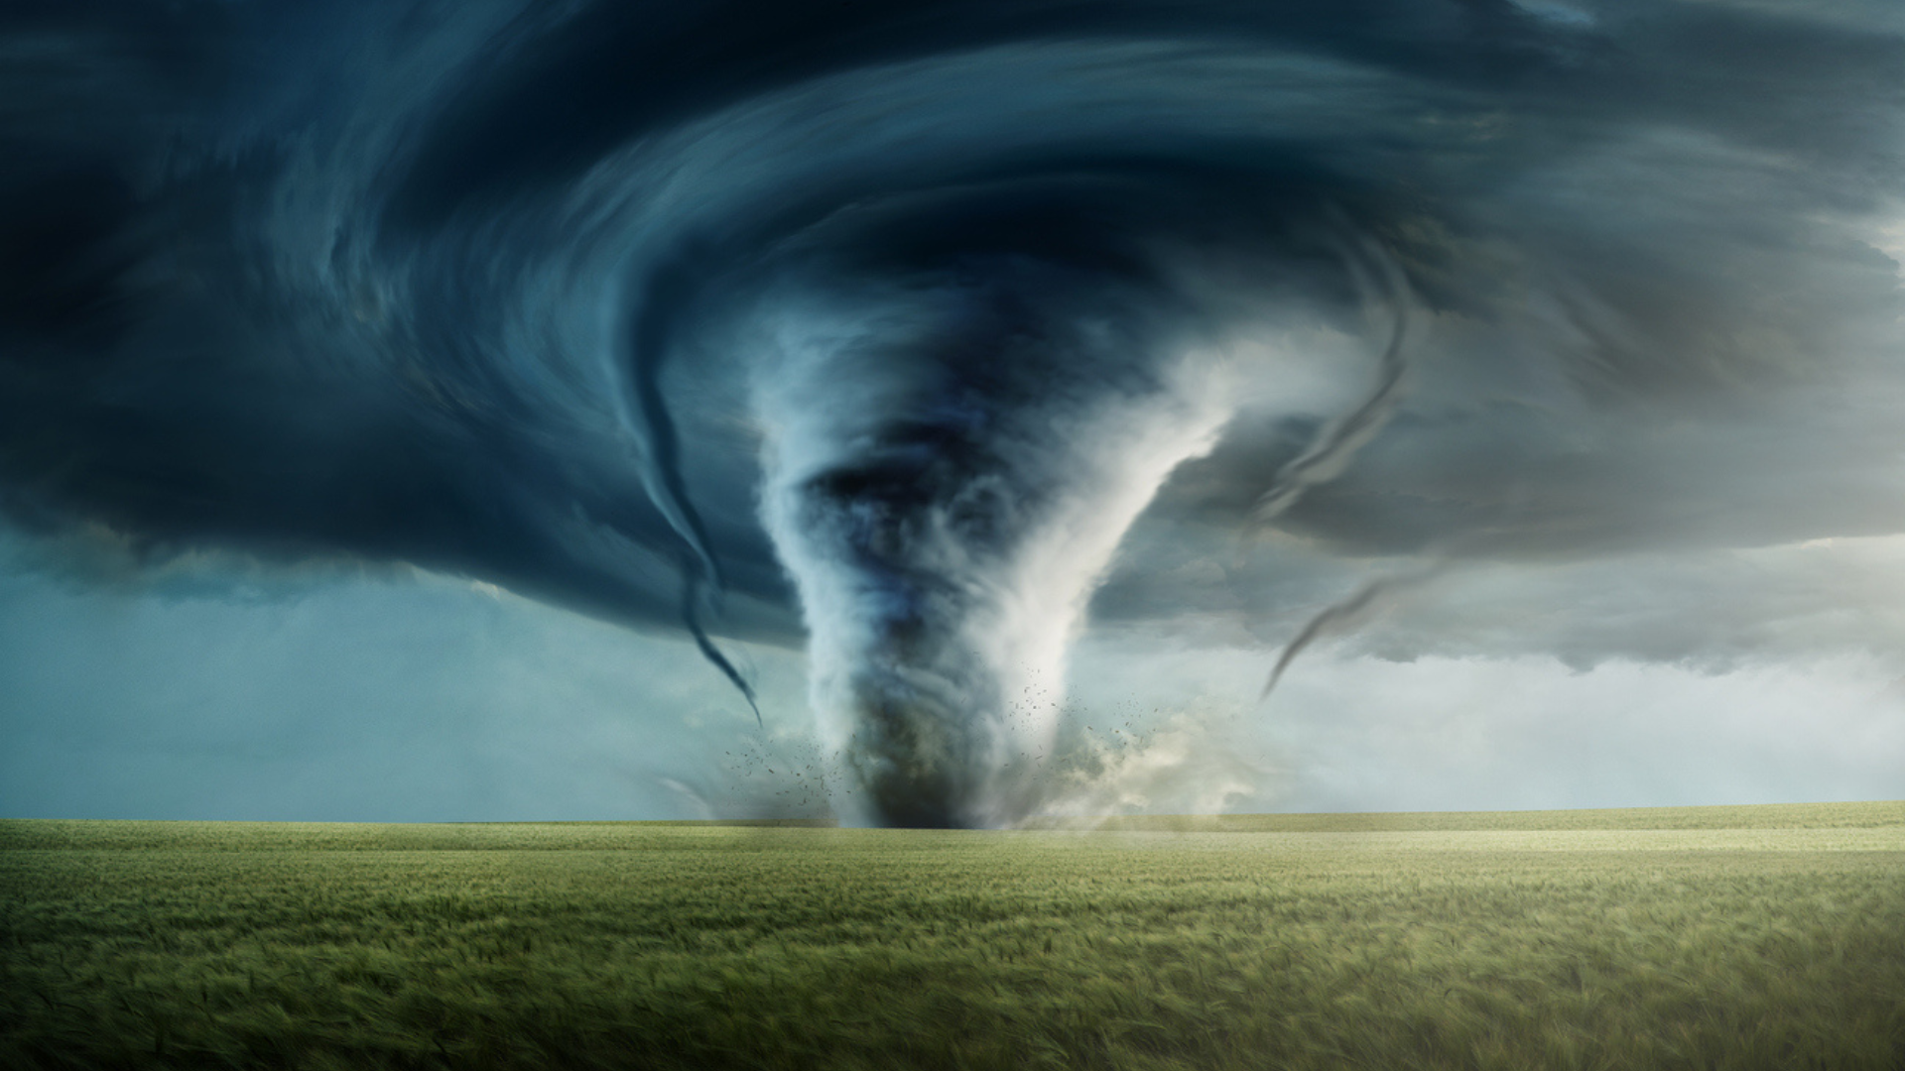
PRESENTATION
tornado (n)
/tɔːˈneɪdəʊ/
lốc xoáy

Slide 8
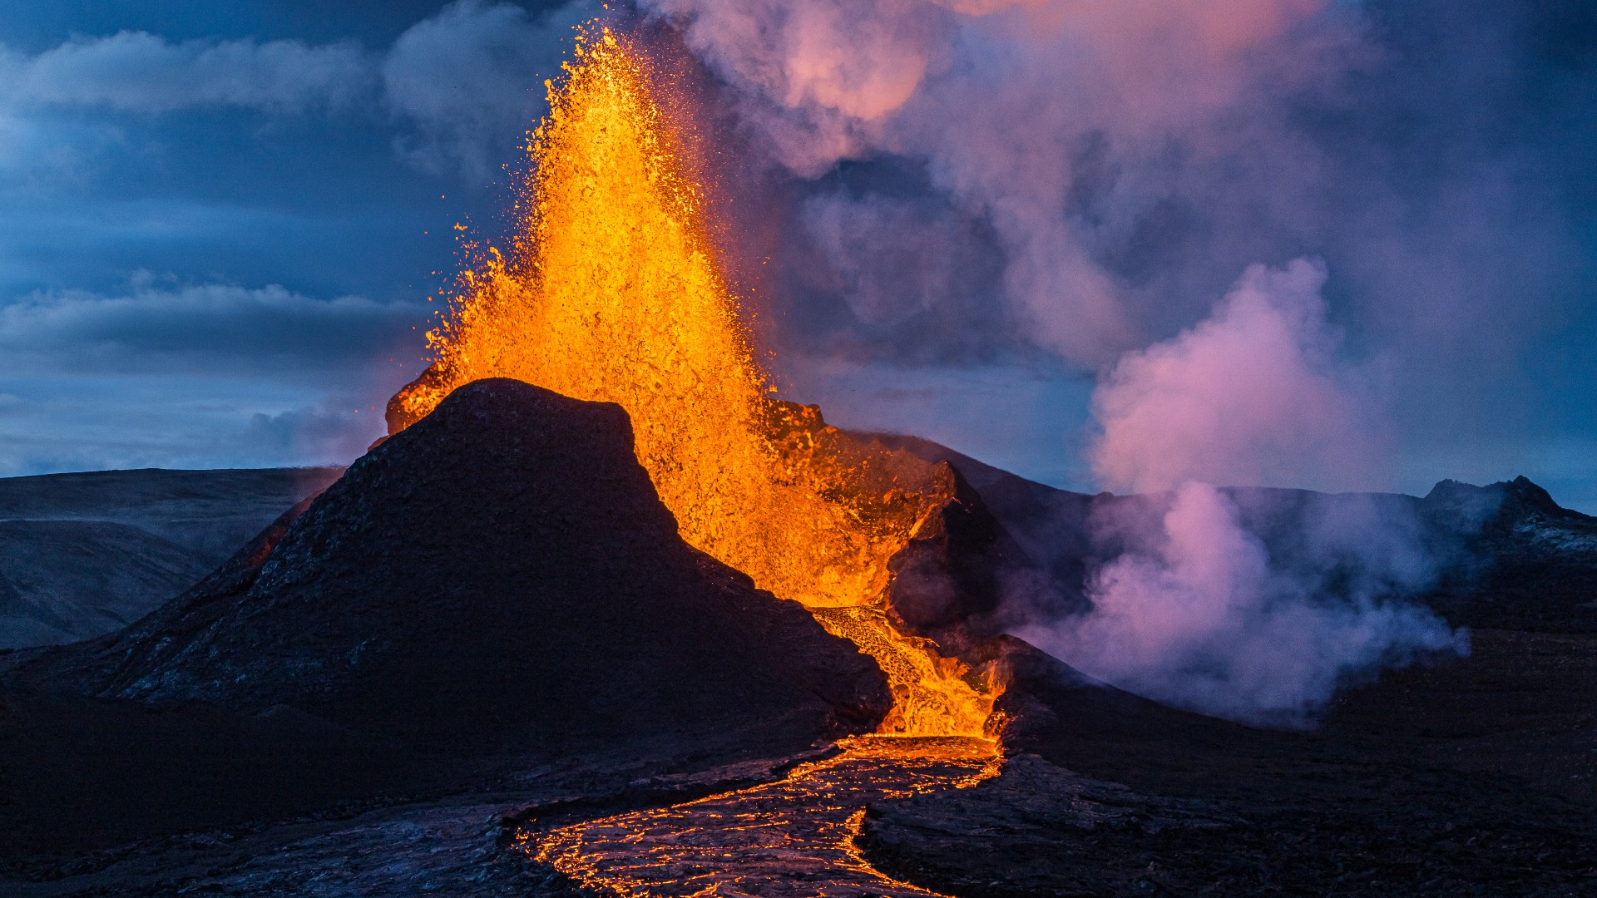
PRESENTATION
eruption (n)
/ɪˈrʌpʃn/
sự phun trào

Slide 9
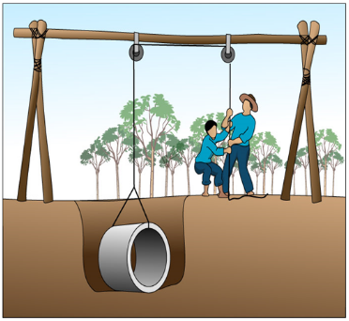
PRESENTATION
pull up
/pʊl ʌp/
kéo lên, nhổ lên,
lôi lên

Slide 10
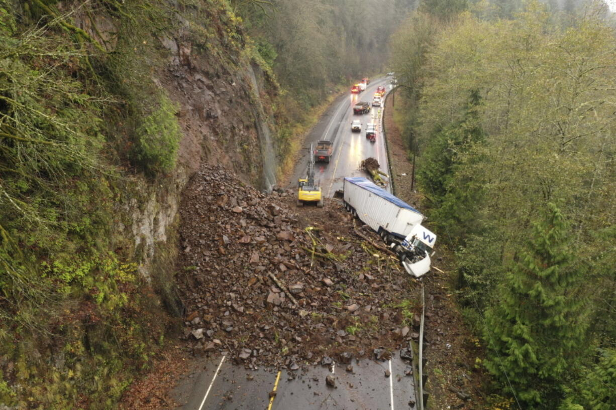
PRESENTATION
landslide (n)
/ˈlændslaɪd/
vụ sạt lở

Slide 11
PRESENTATION: VOCABULARY
New words | Pronunciation | Meaning
1. damage (n,v) | /ˈdæmɪdʒ/ | thiệt hại, gây tổn hại
2. funnel (n) | /ˈfʌnl/ | cái phễu
3. tornado (n) | /tɔːˈneɪdəʊ/ | lốc xoáy
4. eruption (n) | /ɪˈrʌpʃn/ | sự phun trào
5. pull up | /pʊl ʌp/ | kéo lên, nhổ lên, lôi lên
6. landslide (n) | /ˈlændslaɪd/ | vụ sạt lở

Slide 12
PRESENTATION: VOCABULARY
Word |  | Vietnamese equivalent
1. damage (n,v) |  | lốc xoáy
2. funnel (n) |  | sự phun trào
3. tornado (n) |  | thiệt hại, gây tổn hại
4. eruption (n) |  | cái phễu
5. pull up |  | vụ sạt lở
6. landslide (n) |  | kéo lên, nhổ lên, lôi lên

Slide 13
PRACTICE
- What can you see in the picture?
- What natural disaster is it?

Slide 14
PRACTICE
1
Listen and read.
Tom: You look pretty sad, Mi. What’s the matter?
Mi: My uncle called us this morning. Our home town has been affected by a flood. It’s the second time this year.
Tom: I’m sorry to hear that. How are things there now?
Mi: My uncle, his wife, and his children are all safe. They moved everything to the second floor of their house last night. Are there natural disasters in your home town in the US?
Tom: Yes, we sometimes have tornadoes.
Mi: Tornadoes? Sounds strange. What’s a tornado?
Tom: It’s a violent storm that moves in a circle with very strong winds. I still remember the tornado we had last year.
Mi: What happened?
Tom: One evening my parents and I were having dinner. Suddenly we heard a very loud noise. When we looked out of the window, we saw a big funnel of wind moving towards us.
Mi: Did it cause any damage?
Tom: Yes, a lot. It damaged the roof of our house and pulled up some trees in our yard. Fortunately, no one was hurt.

Slide 15
PRACTICE
2
Read the conversation again. Complete each sentence with no more than TWO words from it.
1. There is a _____ in Mi’s home town.
2. Her uncle’s family had to move everything to the ___________ last night.
3. A tornado is an example of a _______________.
4. Tom’s family ___________ dinner when the tornado came.
5. The tornado damaged their roof and _______ up some trees in their yard.
flood
second floor
natural disaster
was having
pulled

Slide 16
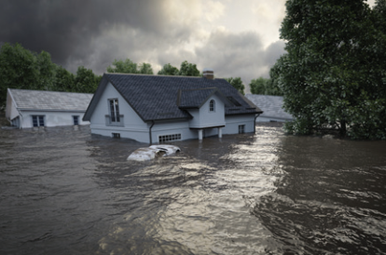
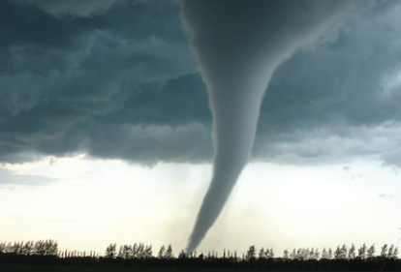
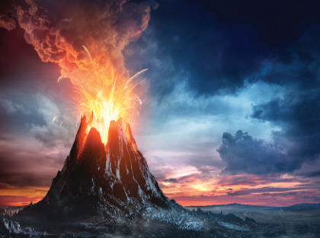
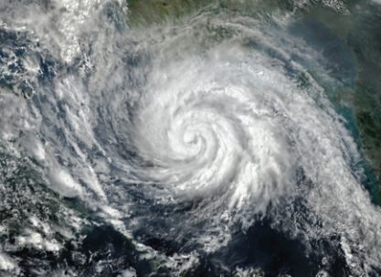
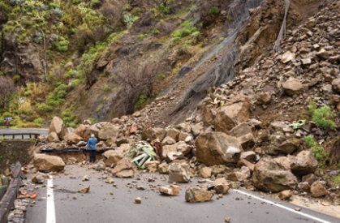
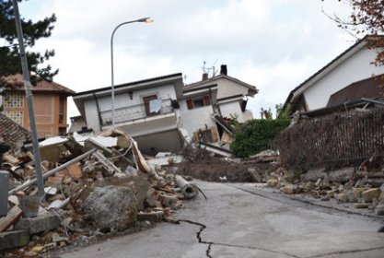
PRACTICE
3
Write the natural disasters from the box under the pictures. Then listen, check, and repeat.
volcanic eruption
earthquake
landslide
storm
tornado
flood
1. ………………………....
2. ………………………....
3. ………………………....
4. ………………………....
5. ………………………....
6. …………………………..

Slide 17
PRACTICE
4
Choose the correct answer to complete each sentence.
1. When there is a(n) earthquake / volcanic eruption, hot gases and liquid rock pour out from a mountain.
2. Oh, the house is shaking! I think we’re having a(n) earthquake / flood.
3. We wanted to travel to Ha Giang, but there was a tornado / landslide. Some big rocks and mud came down the mountains.
4. Every year more than ten floods / storms with strong winds and rain cause damage in our country.
5. A tornado / storm looks like a huge funnel and causes a lot of damage. Its strong winds can reach 480 km per hour.

Slide 18
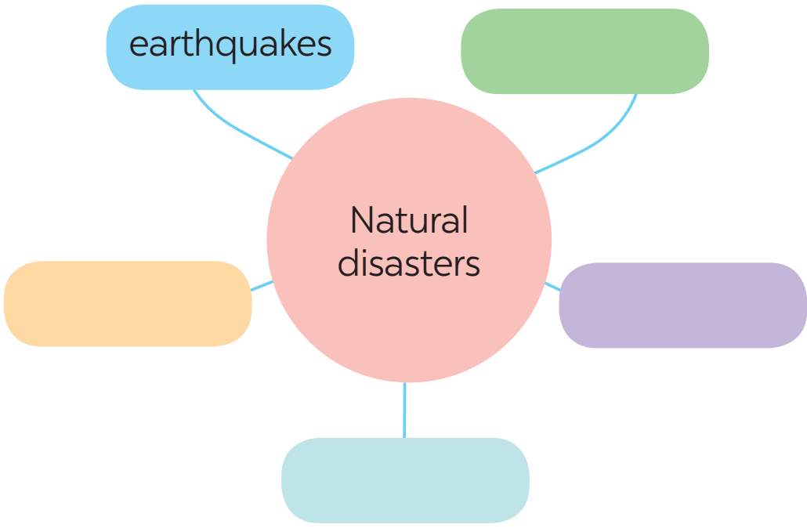
PRODUCTION
5
Work in groups. Complete the web with all of the words and phrases related to natural disasters you know.

Slide 19
CONSOLIDATION
1
Wrap-up
About natural disasters
Vocabulary
Topic of the unit
NATURAL DISASTERS

Slide 20

CONSOLIDATION
2
Homework
- Learn the new words by heart.
- Do exercises in the workbook.
- Start preparing for the Project of the unit.

Slide 21

Website: hoclieu.vn
Fanpage: facebook.com/tienganhglobalsuccess.vn/

