Slide 1

UNIT 2:
ENTERTAINMENT & LEISURE
Lesson 2.2 – Grammar
Page 16

Slide 2



Lesson .
LESSSON OUTLINE
Consolidation

Slide 3

By the end of this lesson,
students will be able to:
use to + infinitives after certain verbs.
to make, accept, and refuse invitations.
talk about habits and preferences.

Slide 4



Slide 5

promise (v) /ˈprɑːmɪs / hứa
decide (v) / dɪˈsaɪd / quyết định
arrange (v) / əˈreɪndʒ / sắp xếp
refuse (v) / rɪˈfjuːz / từ chối
agree (v) / əˈgriː / đồng ý
offer (v) / ˈɑːfə / đề nghị
Review the Vocabulary in the previous lesson.
Listen and repeat.







Slide 6
Test your memory. Which word can you define?
(Click on each word to see the answer)
say you will definitely do something to someone
think carefully about different options and choose
one of them
organize or prepare for something, especially an event to meet other people
say no to something very strongly.
have the same opinion as another person, or say you will do what they asked you
say that you are willing to do something for someone
agree
refuse
offer
promise
decide
arrange
☞
☞
☞
☞
☞
☞

Slide 7
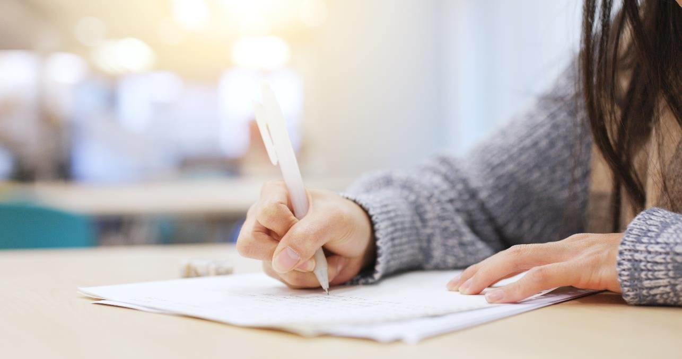


Slide 8

Presentation

Slide 9
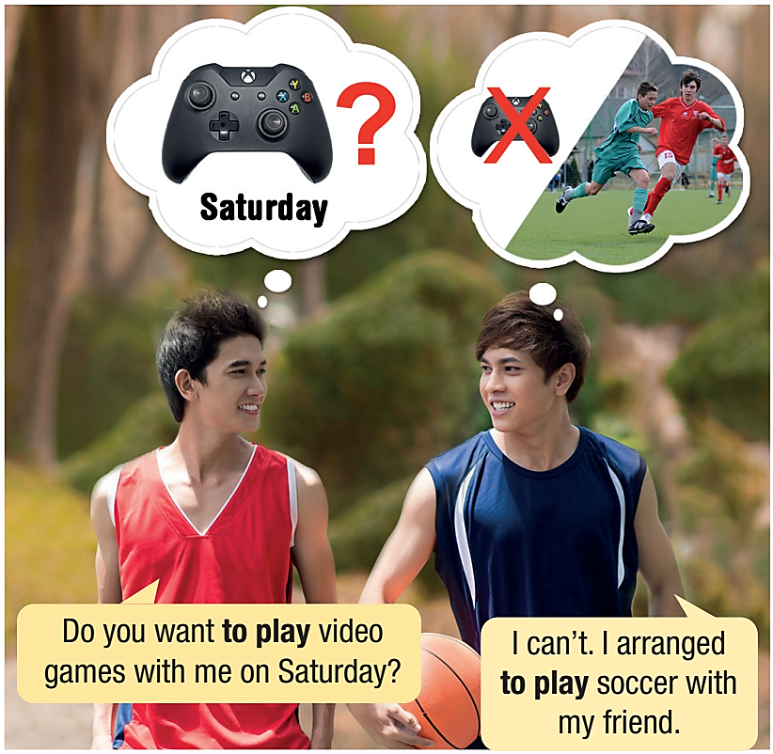


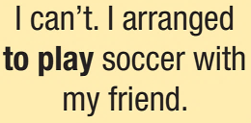




Slide 10

Look and read the sentences:
Meaning and Use
We can use to-infinitives to make, accept, and refuse invitations, and to talk about habits and preferences. They are commonly used after verbs like promise, decide, offer, arrange, refuse, and agree.
I promised to meet my friends.
You didn't agree to help clean the yard.
We promised to pay for lunch.
They promised to help Ben with his homework.
He refused to help Ben with his homework.
She refused to help clean the yard.
They didn't agree to go swimming.
Did she offer to pay for lunch?
I promised to help Ben with his homework.
You didn't agree to help clean the yard.
We promised to pay for lunch.
They promised to go swimming.
He refused to help Ben with his homework.
She refused to help clean the yard.
They didn't agree to go swimming.
Did she offer to pay for lunch?

Slide 11
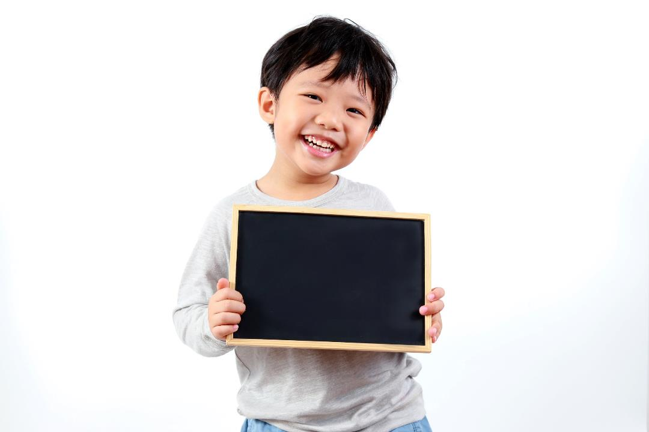
Practice

Slide 12
b. Fill in the blanks. Use the Past Simple and to-infinitives.
Did
arrange to meet
1. __________ they _______________________ at the party? (arrange/meet)
2. My teacher ______________________ us a test. (decide/give)
3. They _____________________ together on the project.
(agree/work)
4. My mom _________________________ me a new laptop for my birthday. (promise/buy)
5. ___________ you ______________________ your grandpa clean
the yard? (offer/help)
6. Peter _________________________ me use his cell phone. (refuse/let)
decided to give
agreed to work
promised to buy
Did
offer to help
refused to let

Slide 13
c. Circle the correct verbs.
Hi, Jessie,
Sorry I can't go to the movies on Saturday morning. I refused/promised to take my little sister to the swimming pool. She wants to learn to swim. I asked my brother to do it, but he refused/agreed to take her. I offered/decided to
do all his chores for him, but he still said no. He wants to play video games with his friends.
Can we offer/arrange to go to the movies another time? I really want to see this movie. I love Parker Ranger. He's my favorite actor. If you decide/agree to see it anyway, let me know. I'll watch it online instead.
Speak to you soon,
Adam

Slide 14
WB, page 11
Write the correct forms of the verbs in the brackets.
1. Yesterday, Jake (decide/see) a movie with his friends instead of playing video games. _____________________
2. Marina (offer/help) her teacher clean up after the class finished. _____________________
3. Everyone (agree/buy) pizza instead of burgers for the class party. _____________________
4. We (arrange/have) a party for my sister's birthday. _____________________
5. I (promise/take) my little cousin to the zoo because she loves animals. _____________________
6. Ben (refuse/let) me read his new comic book. _____________________
decided to see
offered to help
agreed to buy
arranged to have
promised to take
refused to let

Slide 15
WB, page 11
Write the sentences in the Past Simple using the prompts.
1. Caroline/promise/buy/sister/cake.
_________________________________________________________
2. Chris/offer/do the shopping/party/because/Peter/be/busy.
_________________________________________________________
3. They/arrange/book club meeting/7 p.m./tomorrow.
_________________________________________________________
4. Josh/agree/go mountain climbing/although/he/be not/very interested.
_________________________________________________________
5. Mandy and Jenny/agree/go/beach/instead/shopping mall.
_________________________________________________________
6. Abigail/decide/sign up/karate class.
_________________________________________________________
Caroline promised to buy her sister a cake.
Chris offered to do the shopping for the party because Peter was busy.
They arranged a book club meeting at 7 p.m. tomorrow.
Josh agreed to go mountain climbing although he was not very interested.
Mandy and Jenny agreed to go to the beach instead of the shopping mall.
Abigail decided to sign up for a karate class.

Slide 16

Production

Slide 17

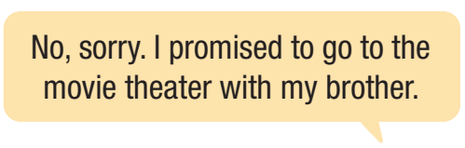
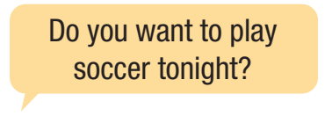

Slide 18

Consolidation

Slide 19

Extra Practice, WB page 11.
1. What did you decide to do this weekend?
_______________________________________________________
2. Do you often offer to help your family? What kinds of things do
you help them with?
_______________________________________________________
3. What did you plan to do this month?
_______________________________________________________
4. Did someone promise to do something for you before? What did they promise to do?
_______________________________________________________
5. Would you agree to do an extreme sport such as bungee jumping? Why? Why not?
_______________________________________________________

Slide 20
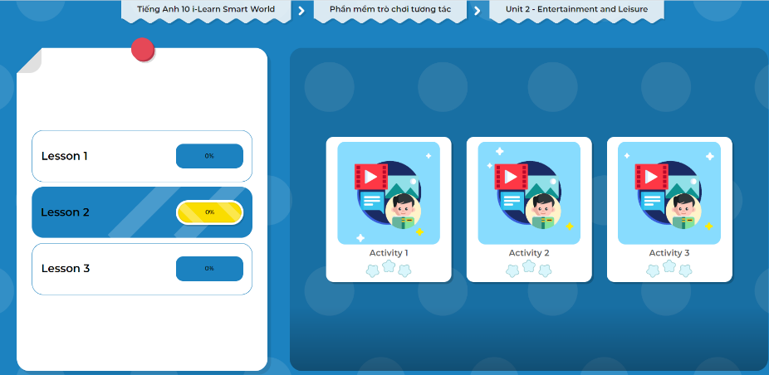
LET’S PLAY!
Click here to play the games.

Slide 21
Today’s lesson
Wrap-up
Grammar: using to + infinitives after verbs like promise, arrange, decide, offer, agree, and refuse.
Speaking: making, accepting, and refusing invitations, and talking about habits and preferences.

Slide 22

Complete the grammar notes in Tiếng Anh 10 i-Learn Smart World Notebook on page 11.
Prepare the next lesson on page 18, SB.
Play the consolidation games in Tiếng Anh 10 i-Learn Smart World DHA App on www.eduhome.com.vn

Slide 23

Have a nice day!

