Slide 1

Unit 2: Every Day
Lesson 2a: Vocab Expansion
Page 39

Slide 2
Lesson Outline
Warm-up
Vocabulary
Listening
Writing
Consolidation
Wrap-up

Slide 3
Objectives
By the end of this lesson, students will be able to…
Learn vocabulary about time and school subjects.
Practise listening to a timetable.
Write their timetable.

Slide 4

WARM-UP

Slide 5
Choose the words whose main stress is placed differently from the others.
A. canteen B. student C. lesson D. practice
/kænˈtiːn/ /ˈstjuːdnt/ /ˈlesn/ /ˈpræktɪs/
2. A. football B. dinner C. shower D. routine
/ˈfʊtbɔːl/ /ˈdɪnə/ /ˈʃaʊə/ /ruːˈtiːn/
3. A. museum B. uniform C. basketball D. family
/mjuːˈziːəm/ /ˈjuːnɪfɔːm/ /ˈbɑːskɪtbɔːl/ /ˈfæməli/

Slide 6



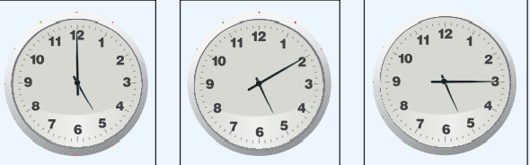






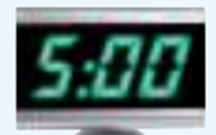
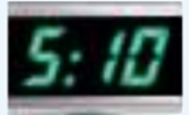
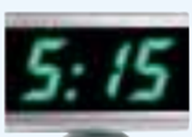
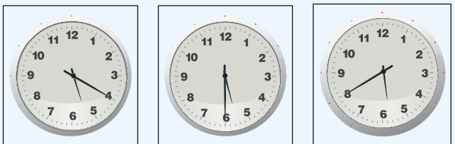
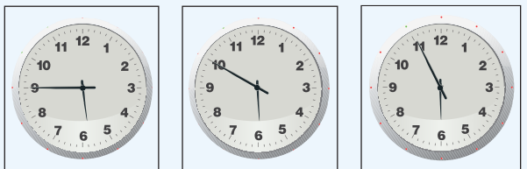
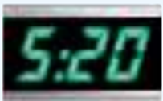
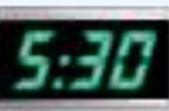
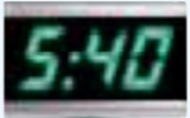
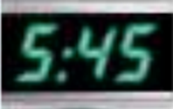
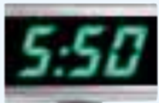
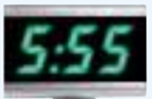
Match the clocks with the correct time.

Slide 7

It’s time to learn …

Slide 8

Vocabulary

Slide 9

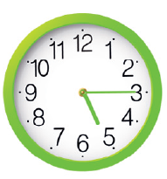



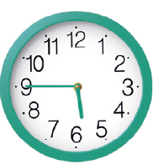
Match the clocks to the correct times.
1. A quarter past five
2. Half past five
3. Twenty past five
4. Five o’clock
5. A quarter to six
6. Twenty to six
A quarter past five
Twenty past five
five o’clock
Half past five
Twenty to six
A quarter to six

Slide 10
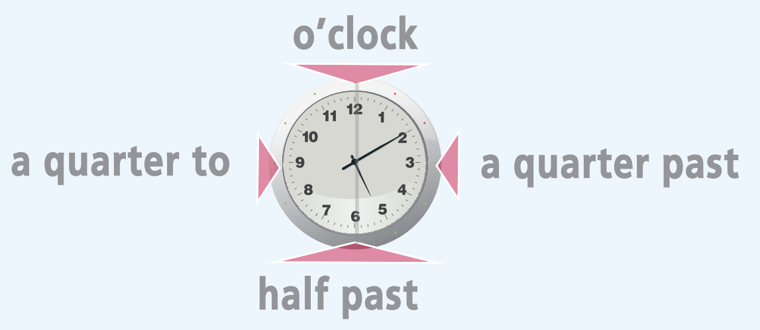
A quarter = 15 minutes
Half = 30 minutes
TELLING TIME

Slide 11


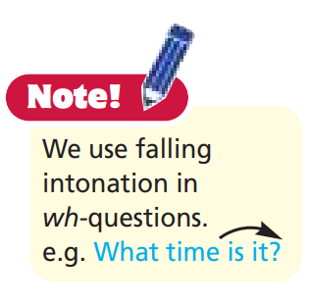
4.Listen and repeat.
Then ask and answer.
A quarter past five
Twenty past five
five o’clock
Half past five
Twenty to six
A quarter to six

Slide 12
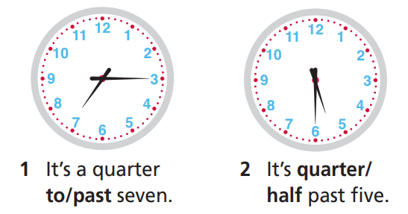
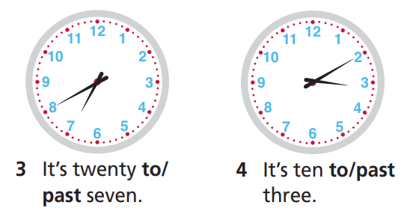
Circle the correct word

Slide 13
Pair work
Ask and answer about when you do your routines.
What time do you get up?
What time do you go to school?
What time do you come back home?
What time do you have dinner?
What time do you go to bed?

Slide 14
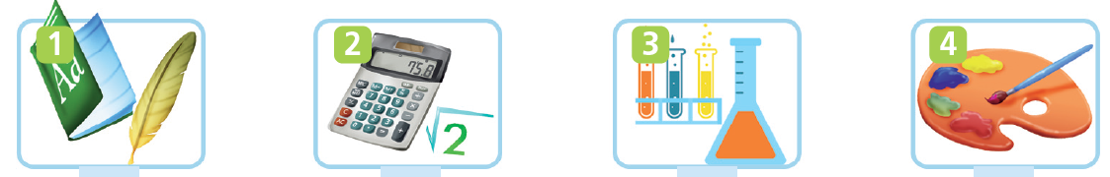

Fill in the gaps with the missing letters carrying vowels: u, e, o, a, i.
M_ths
_nglish
a
E
e
Sci_nce
_rt
A
Phys_cal
Educ_tion (PE)
i
M_sic
o
i
u
Ge_graphy
H_story
a

Slide 15
5. Listen and repeat. Click on each word/phrase to hear the sound.
English (n) /ˈɪŋɡlɪʃ/: môn tiếng Anh
Maths (n) /mæθs/: môn toán
Science (n) /ˈsaɪəns/: môn khoa học
Art (n) /ɑːt/: môn mỹ thuật
Physical Education (P.E.) (n) /ˌfɪzɪkl edʒuˈkeɪʃn/: môn thể dục
Geography (n) /dʒiˈɒɡrəfi/: môn địa lý
History (n) /ˈhɪstri/: môn lịch sử
Music (n) /ˈmjuːzɪk/: môn âm nhạc
Notes:
Focus on the words that may be new to your students. Review / go through quickly those which are familiar to them.

Slide 16
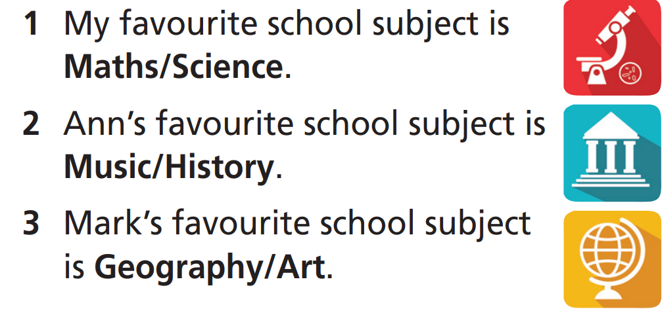
Underline the correct school subject.

Slide 17
PAIRWORK
Ask and answer about your favorite school subject.
What are your favourite school subjects?
My favourite subjects are Maths and English.

Slide 18

Listening

Slide 19
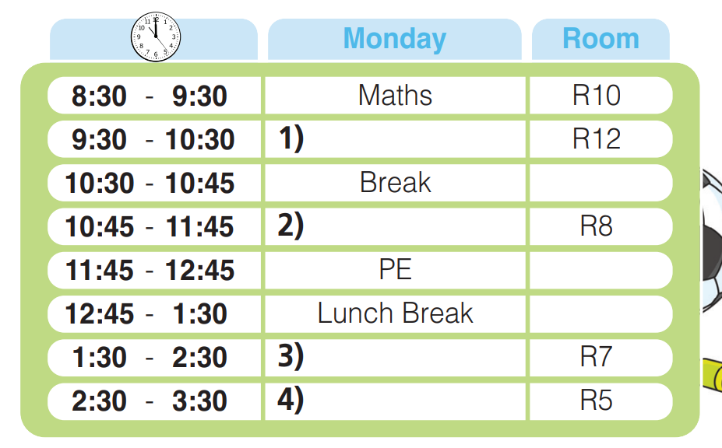
6. Listen to Tony talking about his school timetable for Monday and complete the gaps (1-4).
Music
English
Science
Art

Slide 20
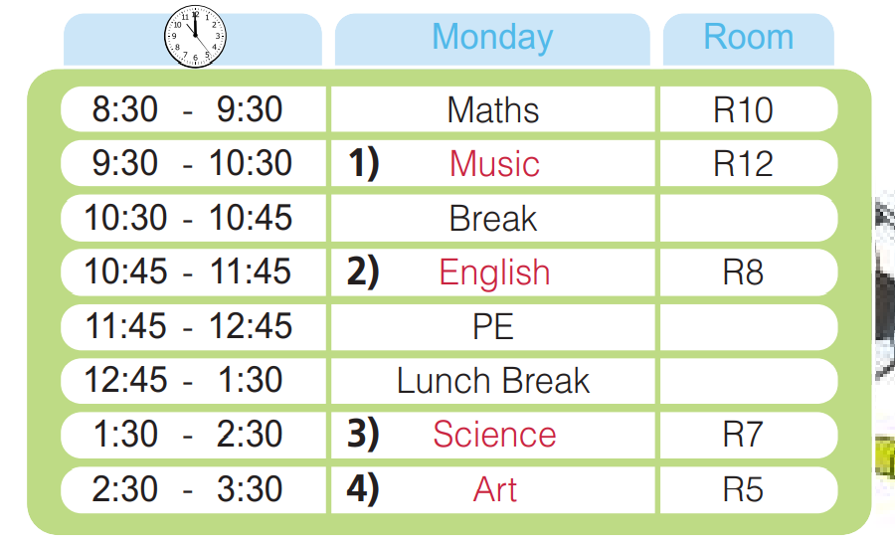
PAIRWORK
Ask and answer about Tony’s school timetable for Monday.
What time does Tony have music class?
He has music class at 9:30.

Slide 21
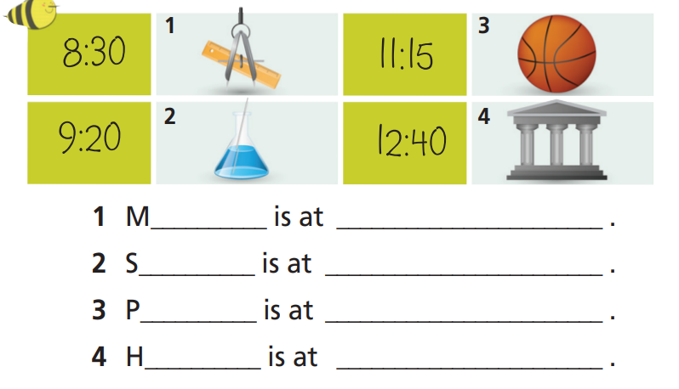
Look at the table and complete the sentences.
aths
half past eight
cience
twenty past nine
E
(a) quarter past eleven
istory
twenty to one

Slide 22
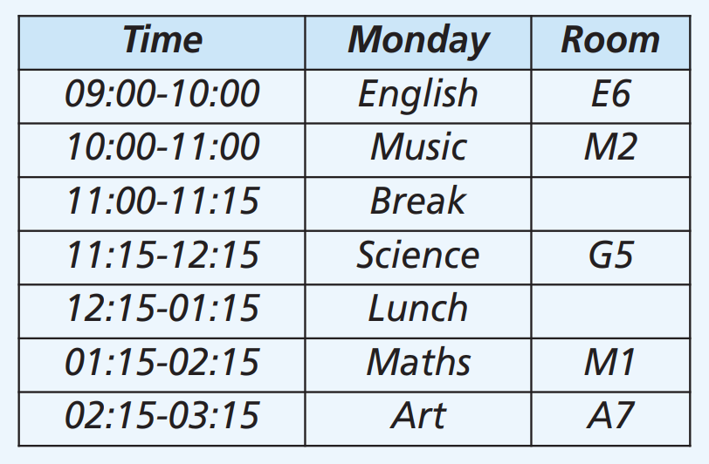
7. Write your school timetable for Monday. Compare it to Tony’s.
SAMPLE
My first lesson is English, but Tony’s is Maths…

Slide 23

CONSOLIDATION

Slide 24
Write six sentences (about 50 words) about your timetable on Friday, using the vocabulary you have studied today.

Slide 25

WRAP-UP

Slide 26
Today’s lesson
Vocabularies
English
Maths
Science
Geography
History
Physical Education
Music
Art
Listening
Listen to a timetable.
Practice listening and completing a table.
Writing
Write a timetable.

Slide 27
Homework
Practise the vocabularies and make sentences using them.
Do exercise 5 in TA 6 Right on WB (p. 22).
Do the exercises in TA 6 Right on Notebook (pp. 20-21).
Prepare the next lesson (p. 40 SB).

Slide 28
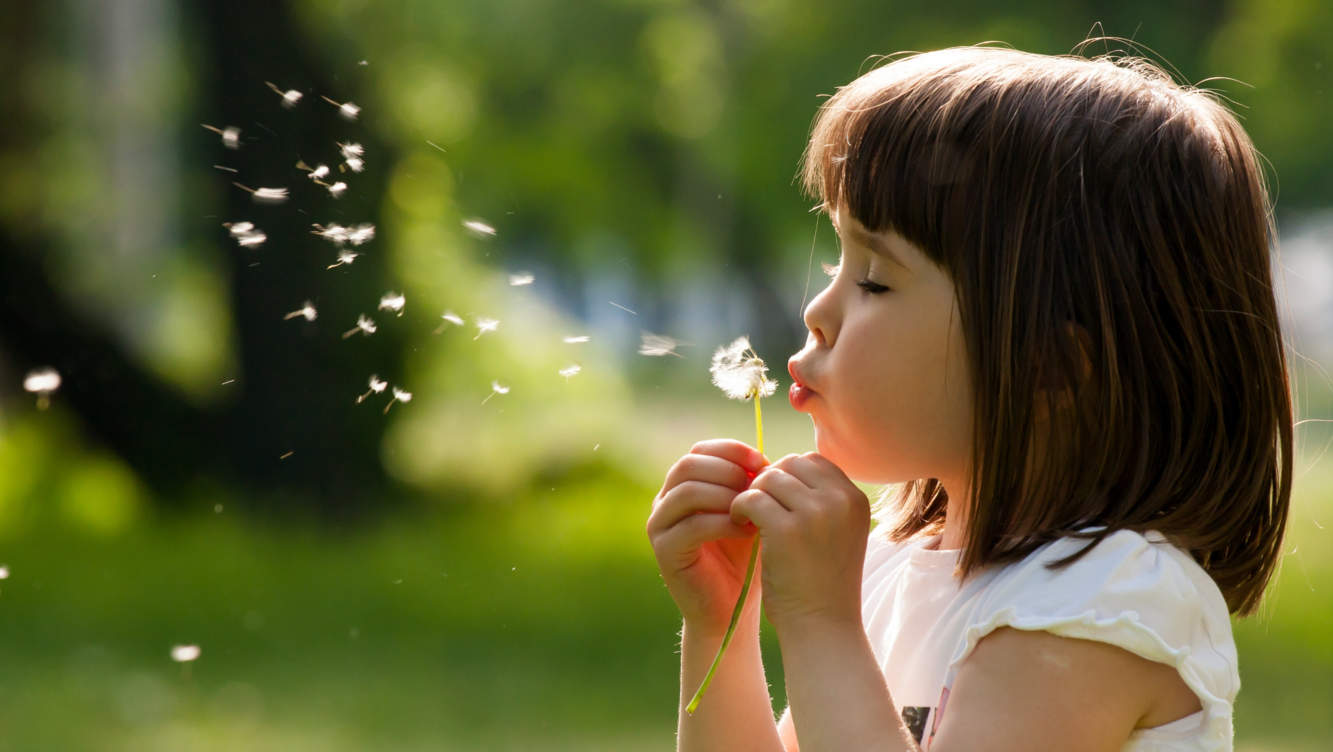
Enjoy your day!

