Slide 1


Slide 2
GLOBAL WARMING
Unit
5
Unit
FAMILY LIFE
Lesson 2
LANGUAGE
Student Book – page 53

Slide 3
LESSON 2
LANGUAGE
WARM-UP
Video watching
PRONUNCIATION
Task 1: Listen and repeat.
Task 2: Underline the stressed words.
VOCABULARY
Task 1: Match the words with their meanings.
Task 2: Complete the sentence.
GRAMMAR
Task 1: Find and correct the mistakes.
Task 2: Rewrite these sentences.
Task 3: Make sentences.
CONSOLIDATION
Wrap-up
Homework

Slide 4
WARM-UP
WATCH THE VIDEO AND ANSWER THE QUESTIONS
According to the video,
Which game was mentioned?
What else do we call Carbon Dioxide?
Why do people cut down trees?
How much have the amount of CO₂ increased in the atmosphere since 1750?

Slide 5

WARM-UP
WATCH THE VIDEO
Notes:
https://ed.ted.com/lessons/climate-change-earth-s-giant-game-of-tetris-joss-fong

Slide 6
WARM-UP
WATCH THE VIDEO AND ANSWER THE QUESTIONS
According to the video,
1. Which game was mentioned?
2. What else do we call Carbon Dioxide?
Tetris
Greenhouse gas

Slide 7
WARM-UP
WATCH THE VIDEO AND ANSWER THE QUESTIONS
According to the video,
3. Why do people cut down trees?
4. How much have the amount of CO₂ increased in the atmosphere since 1750?
To make room for agriculture
By 40%

Slide 8
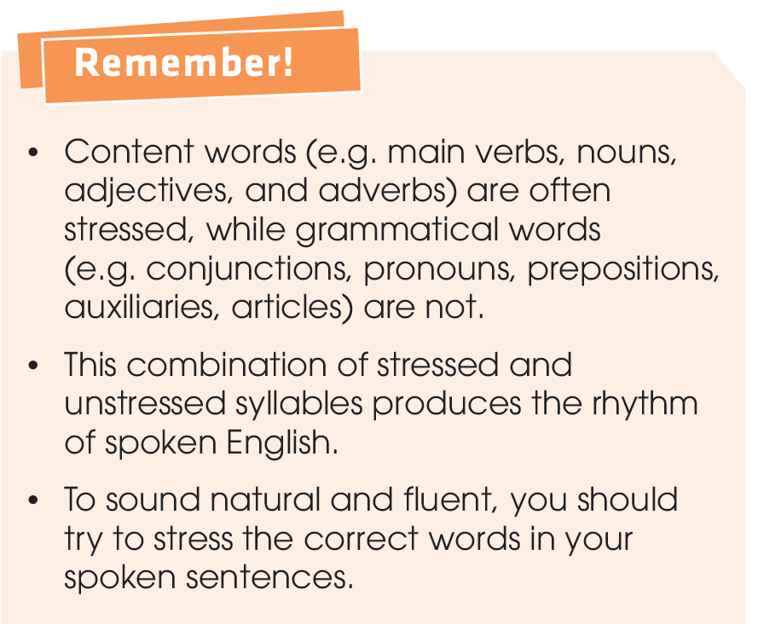
PRONUNCIATION
Sentence stress
and rhythm

Slide 9

PRONUNCIATION
1
Listen and repeat. Pay attention to the sentence stress and rhythm.
1. The planet is getting hotter and hotter.
2. We talked about the causes of flooding.
3. Burning coal is bad for our health.
4. Why is farming a big source of greenhouse gases?

Slide 10
PRONUNCIATION
2
Underline the stressed words in the sentences. Listen and check. Then practise saying the sentences with a natural rhythm.
1. The village was completely destroyed by floods.
2. Some gases are released into the air through human activities.
3. Has the earth's temperature increased in the past few years?
4. Some environmental disasters will become more frequent.
1. The village was completely destroyed by floods.
2. Some gases are released into the air through human activities.
3. Has the earth's temperature increased in the past few years?
4. Some environmental disasters will become more frequent.

Slide 11
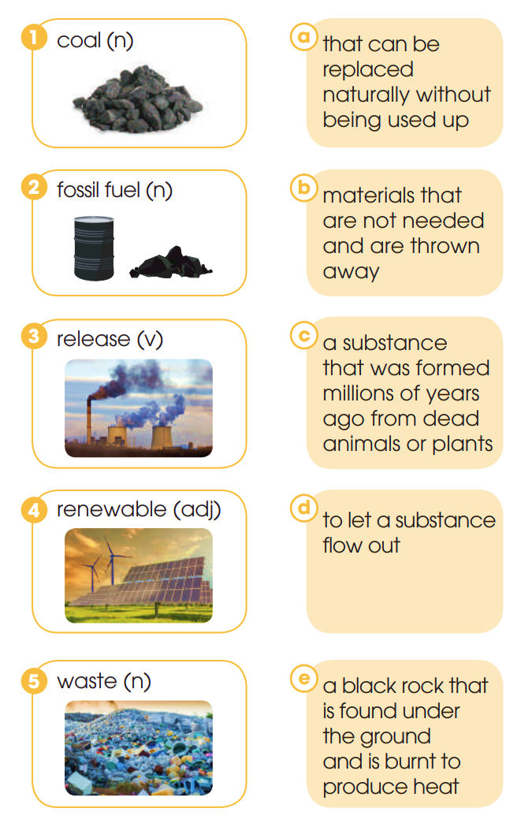
VOCABULARY
1
Match the words with their meanings.
Global warming
*Answer Keys
1 – e
2 – c
3 – d
4 – a
5 – b

Slide 12
VOCABULARY
2
Complete the sentences using the correct forms of the words in Task 1.
renewable
1. Wind and sunlight are examples of _________ sources of energy.
2. The world produces more than two billion tonnes of solid _________ every year.
3. Governments need to limit the amount of greenhouse gases that is _________ into the air.
waste
released

Slide 13
VOCABULARY
2
Complete the sentences using the correct forms of the words in Task 1.
4. Her grandpa is now suffering from ill health after many years of working in the _________ industry.
5. The burning of _________ like coal and gas has led to an increase in the amount of Co2 in the atmosphere.
coal
fossil fuels

Slide 14
GRAMMAR
1
Find and correct the mistakes in the following sentences.
1. Was waiting for the train, I read some articles about global warming.
2. Saw the forest fire, the children immediately called the police.
3. The students took part in green activities, were planting more than 100 trees
**Answer Keys:
1. Was waiting → Waiting
2. Saw → Seeing
3. were planting → planting

Slide 15
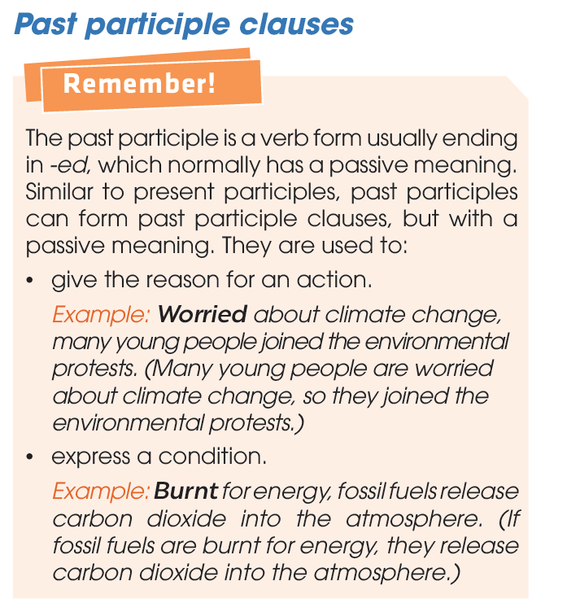
GRAMMAR

Slide 16
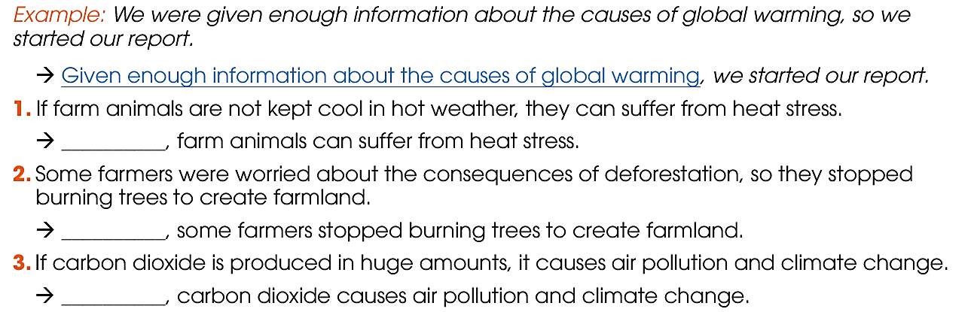
GRAMMAR
2
Rewrite these sentences using past participle clauses.

Slide 17
GRAMMAR
2
Rewrite these sentences using past participle clauses.
Answer Keys: Not kept cool in hot weather, farm animals can suffer from heat stress. Worried about the consequences of deforestation, some farmers stopped burning trees to create farmland. Produced in huge amounts, carbon dioxide causes air pollution and climate change.

Slide 18
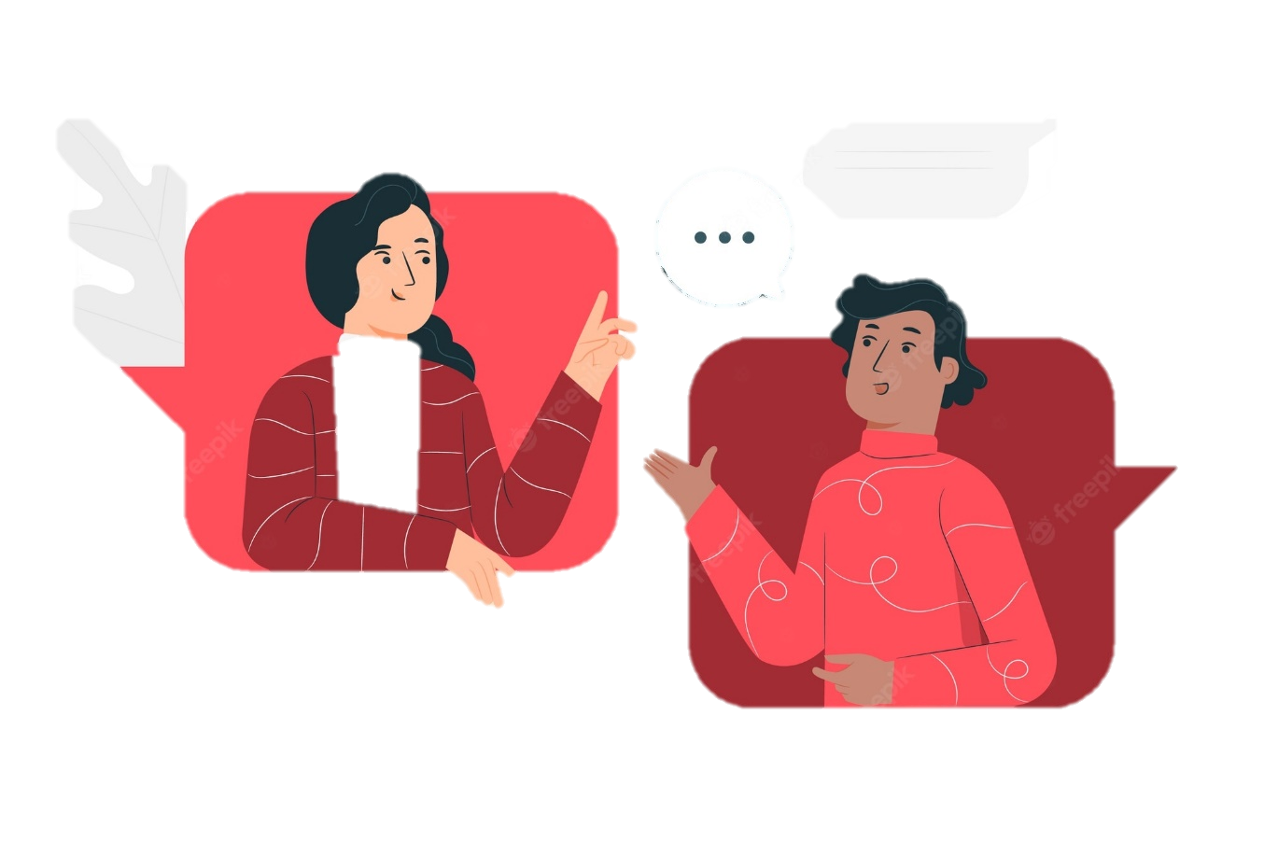
GRAMMAR
3
Work in pairs. Make sentences, using present participle and past participle clauses.
Example: We were given enough information about the causes of global warming, so we started our report.
→ Given enough information about the causes of global warming, we started our report.

Slide 19
What have you learnt today?
CONSOLIDATION
1
Wrap-up
Sentence stress and rhythm
Words and phrases related to global warming
Present participle and past participle clauses

Slide 20
CONSOLIDATION
2
Homework
Do exercises in the workbook.
Prepare for Lesson 3 - Unit 5.

Slide 21

Website: hoclieu.vn
Fanpage: facebook.com/www.tienganhglobalsuccess.vn/

