Slide 1

Unit 2: Family
Lesson 3.1
Page 30

Slide 2
Lesson Outline
Warm-up
Vocabulary
Structure
Consolidation
Wrap-up

Slide 3
Objectives
By the end of this lesson, students will be able to follow simple instructions.
Vocabulary: do your homework, clean your room, wake up, go to bed
Structure: Clean your room!

Slide 4

WARM UP

Slide 5

LET’S PLAY!
What’s missing?
Notes:
Put three or four FLASHCARDS (family members) on the board and tell your child to look at them. Ask them to close their eyes and take one card away. When your child opens their eyes, ask them to guess what is missing.

Slide 6

It’s time to learn …

Slide 7
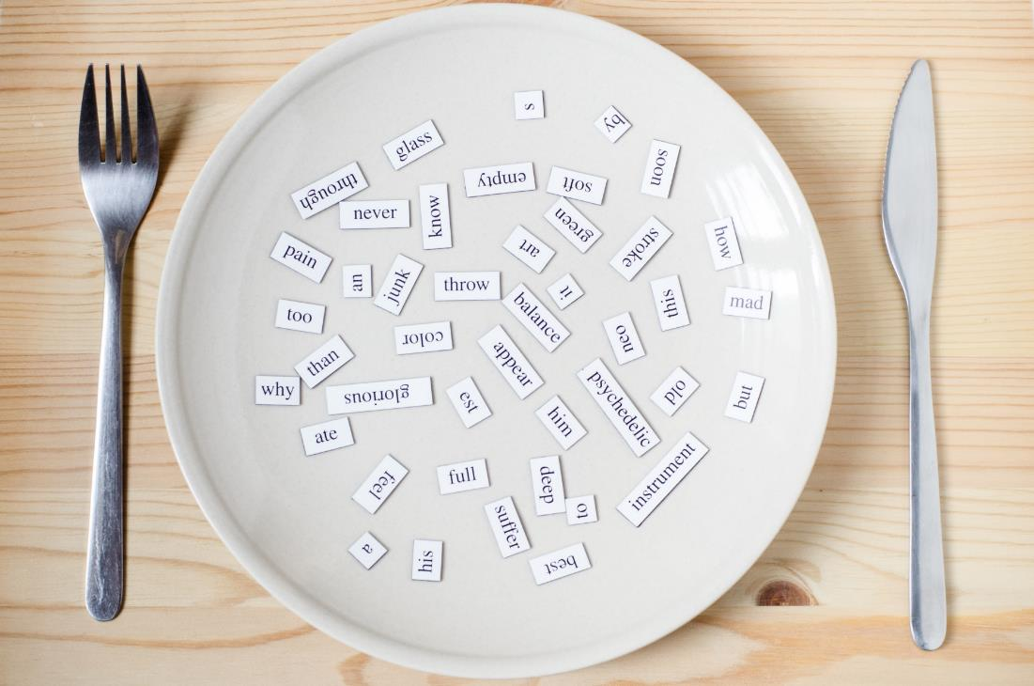
New words
do your homework,
clean your room,
wake up,
go to bed

Slide 8


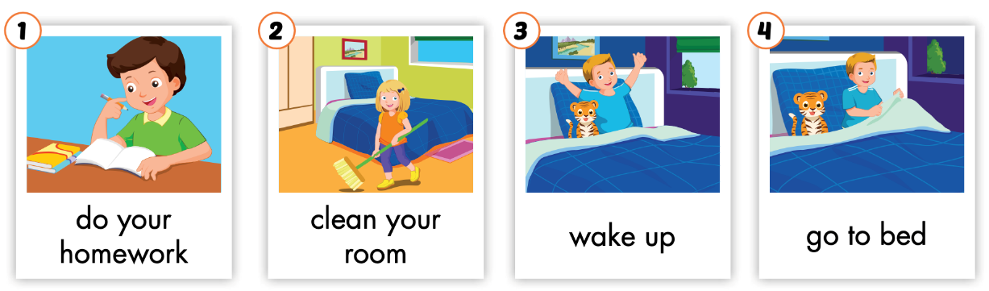
Listen and point.
Click the icon to hear the sound.

Slide 9


Listen and repeat.
Click each picture to hear the sound.
do your homework
/du jər ˈhəʊmwɜːrk/
làm bài tập về nhà

Slide 10
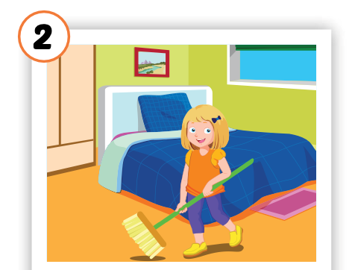
Listen and repeat.
Click each picture to hear the sound.
clean your room
/kliːn jər ruːm/
dọn phòng

Slide 11
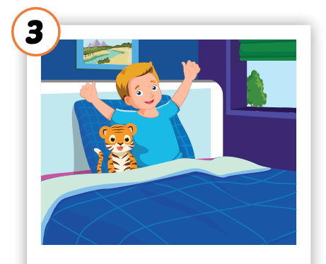
Listen and repeat.
Click each picture to hear the sound.
wake up
/weɪk ʌp/
thức dậy

Slide 12
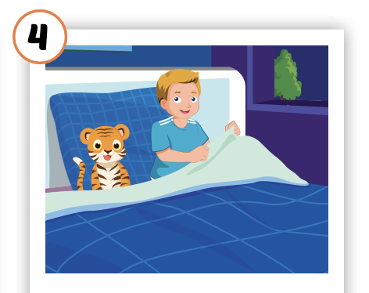
Listen and repeat.
Click each picture to hear the sound.
go to bed
/ɡəʊ tə bed/
đi ngủ

Slide 13

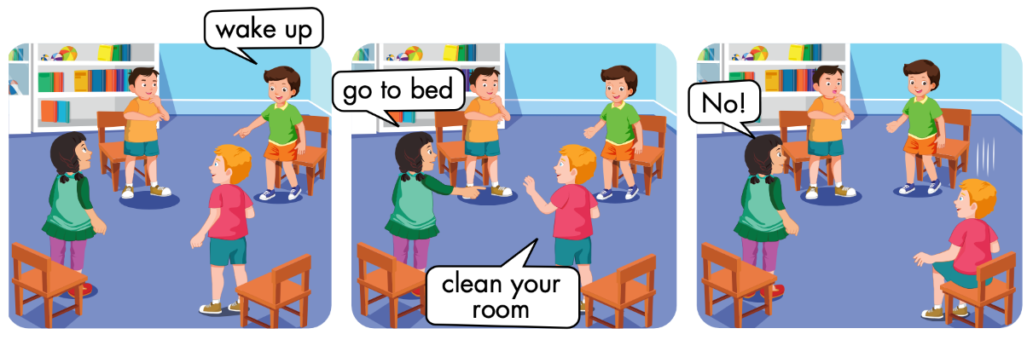

Slide 14
Let’s play!

Slide 15

Jigsaw Puzzle

Slide 16
How to play
Choose a color
Look and guess
Check by clicking on the speaker

Slide 17


Slide 18


Slide 19


Slide 20
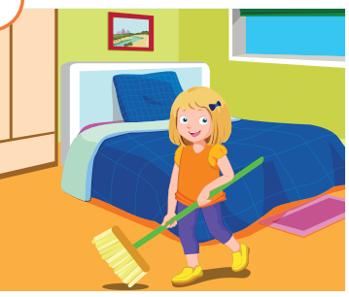

Slide 21
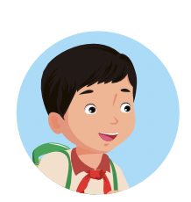
Good job!

Slide 22
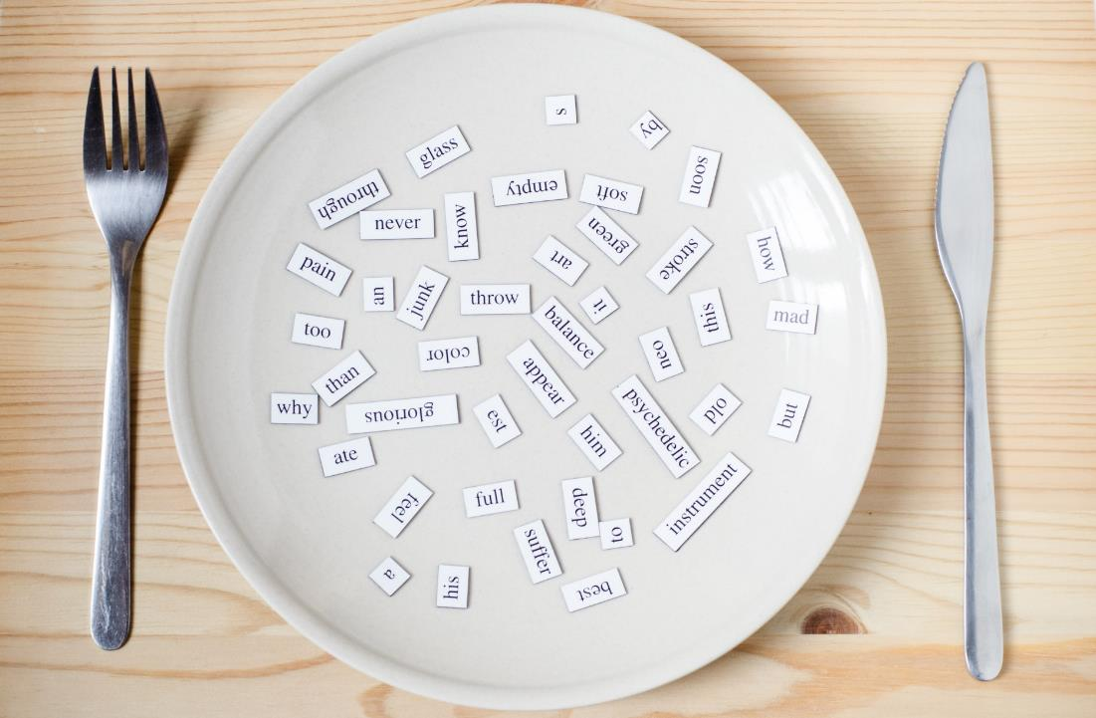
Structures
Clean your room!

Slide 23

Presentation

Slide 24

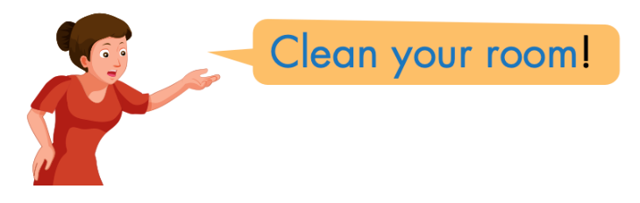
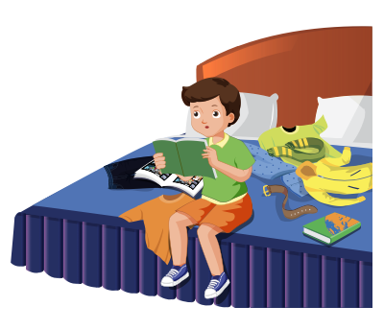
Click the icon to hear the sound.

Slide 25

Practice

Slide 26
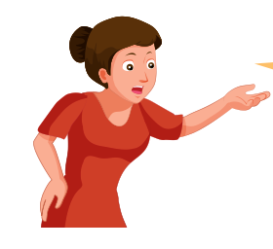

LET’S PRACTICE!
Do your homework!

Slide 27

LET’S PRACTICE!
Go to bed!

Slide 28
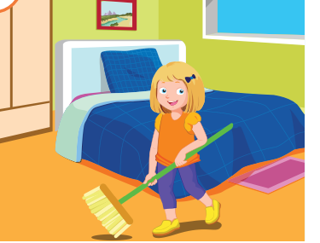
LET’S PRACTICE!
Clean your room!

Slide 29

LET’S PRACTICE!
Wake up!

Slide 30

Production

Slide 31

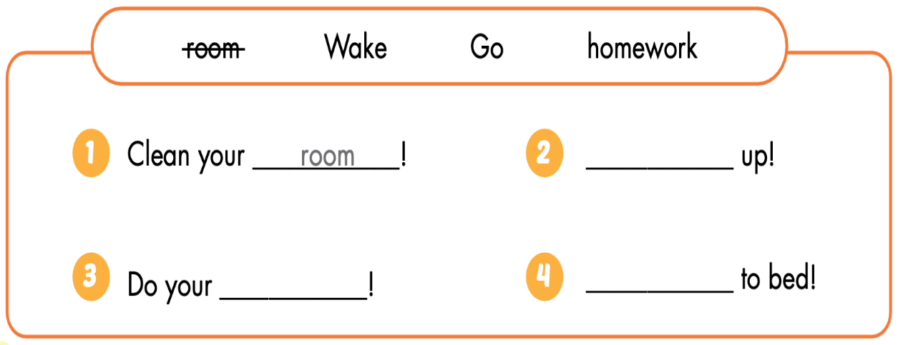

Slide 32

Wake

Slide 33

homework

Slide 34

Go

Slide 35

CONSOLIDATION

Slide 36

Let’s play!
Simon says
Notes:
Teacher calls out the actions. Everyone else must follow the leader and do the action, but only when he says “Simon says.” For example, Simon says, wake up. Everyone must wake up.
Then the teacher has to try and get everyone to do an action without saying Simon says. If someone does the action and the leader did not say Simon says, that person is out of the game.

Slide 37

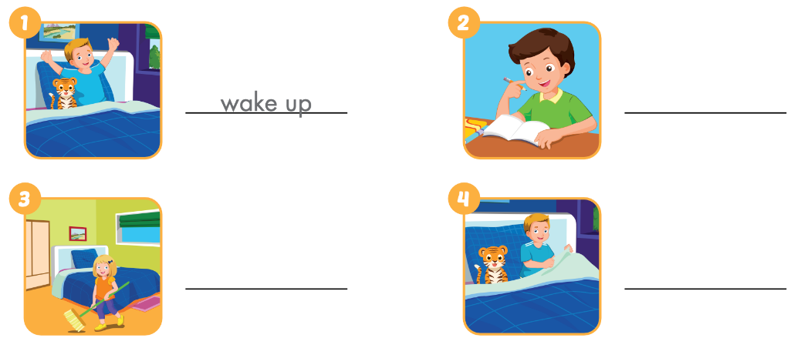
Extra Practice
WB p. 22

Slide 38

do your homework

Slide 39

clean your room

Slide 40

go to bed

Slide 41
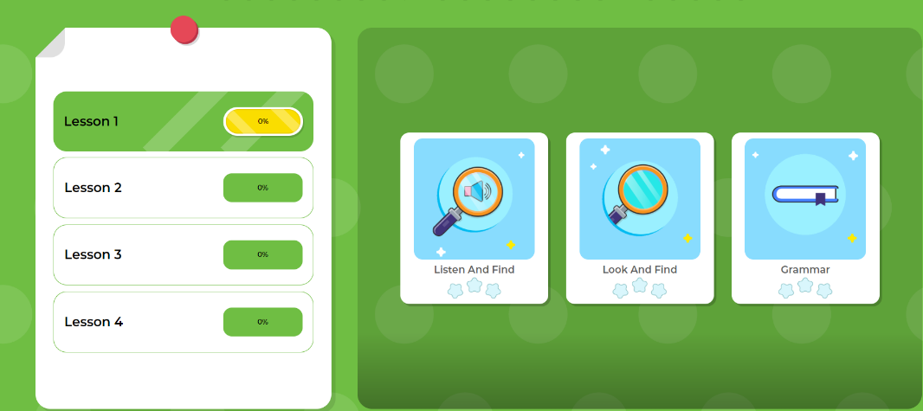
Extra Practice
DHA App
Let’s play!
Click on the picture below

Slide 42

WRAP-UP

Slide 43
Lesson 3
Today’s lesson
Vocabularies
do your homework, clean your room, wake up,
go to bed
Structures/ Sentence patterns
Do your homework!

Slide 44
Lesson 3
Homework
Learn by hearts vocabularies and make sentences using them.
Do the exercises on page 22 WB
Do exercises in Tiếng Anh 3 i-Learn Smart Start Notebook on page 18.
Prepare the next lesson (page 31 SB)

Slide 45

Have a nice day!

Slide 46

Lesson 3
Stay positive and have a nice day!

