Slide 1
Unit 3:
Protecting the Environment
REVIEW 2
Page 91

Slide 2
Lesson Outline
Warm-up
Vocabulary
Grammar
Pronunciation
Writing
Consolidation
Wrap-up

Slide 3
By the end of this lesson, students will be able to…
-review vocabularies and grammar points in Unit 3.
- practice listening, reading, and speaking skills.
- practice test-taking skills.

Slide 4
WARM UP

Slide 5
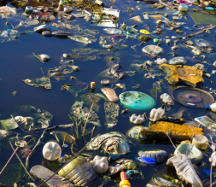
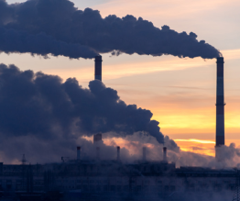
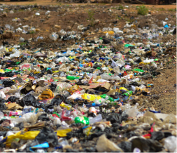
In pairs: Look at the pictures and discuss about kinds of pollution.

Slide 6
Vocabulary

Slide 7
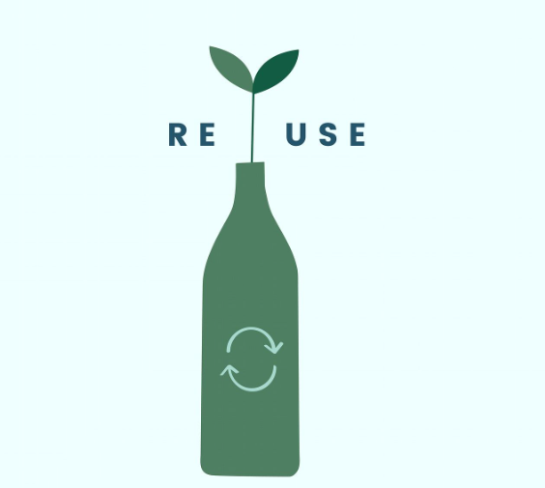
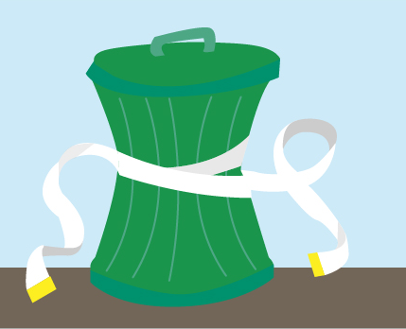
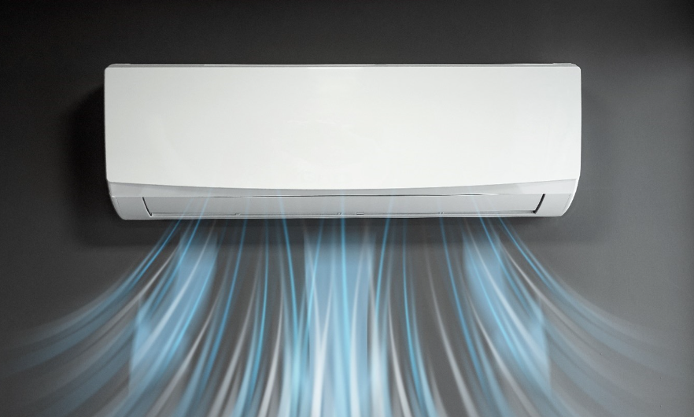
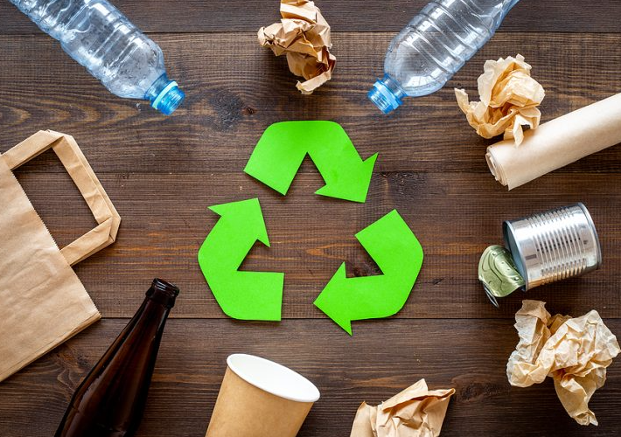
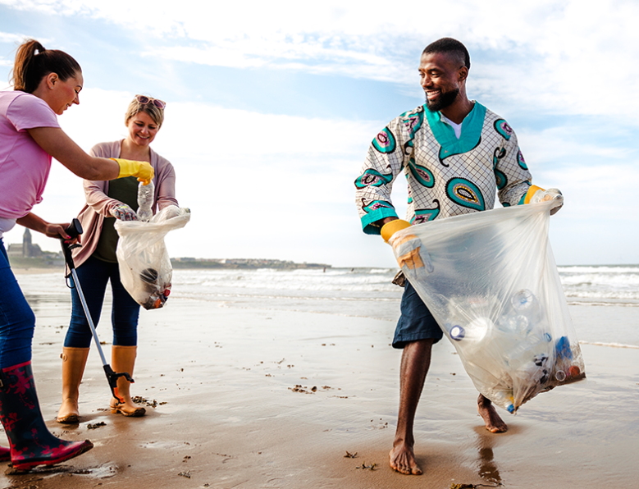
Look at pictures and guess the words
recycle
reuse
reduce
air conditioner
waste
clean up
electricity
save

Slide 8
Practice saying aloud these words with your partner.
recycle (v) /ˌriːˈsaɪkl/: tái chế
reuse (v) /riːˈjuːz/: tái sử dụng
reduce (v) /rɪˈduːs/: cắt giảm
save (v) /seɪv/: tiết kiệm
waste (v) /weɪst/: lãng phí
clean up (v) /kliːn ʌp/ : làm sạch, dọn dẹp
electricity (n) /ɪˌlekˈtrɪsəti/ : điện
air conditioner (n) /ˈer kəndɪʃənər/: máy lạnh, điều hòa
Notes:
GV click vào từng cụm nghe âm thanh

Slide 9
W
A
T
E
A V E
A
N
D
R C Y C
E
L
C
T
R
C
I
T
Y
C
E
A
N
U
P
W I L D I F
H
A
L
T
H
R
E
D
U
C
D S A S S

Slide 10
Grammar

Slide 11
If we don’t save water, there won’t be enough clean water.
We will affect wildlife badly if we cut down trees.
If we don’t clean up beaches, it affects tourism.
Your health gets worse if you breathe polluted air.
The Earth gets very hot if we don’t reduce air pollution.

Slide 12
We should put more recycling bins. They will encourage people to recycle.
We should stop using plastic bags. We shouldn’t waste water.
We can walk to school and work. We can reduce air pollution.
We should save electricity. We can reduce air pollution.
We should help clean up rivers. We shouldn’t waste paper.
We should put more recycling bins so (that) they will encourage people to recycle.
We should stop using plastic bags, and we shouldn’t waste water.
We can walk to school and work so (that) we can reduce air pollution.
We should save electricity so (that) we can reduce air pollution.
We should help clean up rivers, and we shouldn’t waste paper.

Slide 13
Pronunciation

Slide 14
Circle the word that differs from the other three in the position of primary stress in each of the following questions.
1. A. climate B. protect C. damage D. forest 2. A. reduce B. reuse C. pollute D. happen 3. A. recycle B. energy C. tourism D. animal

Slide 15
Writing

Slide 16
Can you remember how to write a guide?

Slide 17
Write about how we should help the environment, and why. Write 80 to 100 words.

Slide 18
There are many things we can do to help the environment. First, we should turn off the lights to save electricity. If we save electricity, we will reduce the amount of pollution. Another thing we should do is recycling more. If we recycle, there will be less trash and pollution. It will make the city a healthier place to live. We shouldn't damage the environment for tourism. If we cut down too many trees to build hotels, there won't be enough places for animals to live. We should take care of the environment.
Suggested Writing

Slide 19
Check your answers with a partner, using the feedback form.

Slide 20
CONSOLIDATION

Slide 21
Work in pairs.
Make three solutions for kinds of pollution.

Slide 22
WRAP-UP

Slide 23
Today’s lesson
Review:
- Grammar of Unit 3: First Conditional, Compound and Complex sentences.
Vocabulary of Unit 3: Words of the topic “Protecting the Environment”
Vocabulary, Grammar, Pronunciation and Writing Practice to review the topic “Protecting the Environment”

Slide 24
Lesson 3
Homework
- Review vocabulary, grammar and language skills of unit 3.
- Do the exercises in WB: Unit 3 Review - Part 2 (page 52).
- Prepare: Unit 4 – New words and Listening (pages 42 – 43, SB).

Slide 25
Lesson 3
Stay positive and have a nice day!

