Slide 2



Unit
3
MY FRIENDS
LESSON 5: SKILLS 1
1

Slide 3
LESSON 5: SKILLS 1
LESSON 1: GETTING STARTED
Listen to the song and list the adjectives
WARM-UP
Task 1: Look at the advertisement above and answer the questions.
Vocabulary teaching
Task 2: Read the text and write T (True) or F (False). Correct the false statements.
READING
Task 3: Work in groups. Read about the three students below. Is the Superb Summer Camp suitable for all of them? Why or Why not?
Task 4: Think about yourself. Do you want to go to this kind of camp? Why or Why not?
SPEAKING
CONSOLIDATION
Wrap-up
Homework

Slide 4
WARM-UP
Listen and list the adjectives

Slide 5
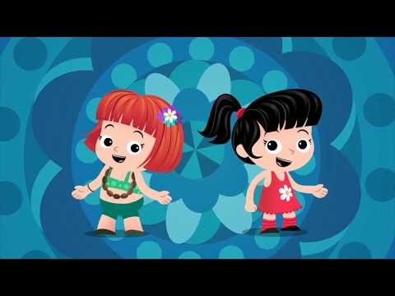
Notes:
Video link: https://www.youtube.com/watch?v=LWQn3mbignQ

Slide 6

READING
1
Look at the advertisement above and answer the questions.
1. Who is the superb summer camp for?
2. What can people do at this summer camp?
It’s for kids between 10 and 15 years old.
They play sports and games, draw pictures, play music, learn life skills, go on field trips, etc.

Slide 7
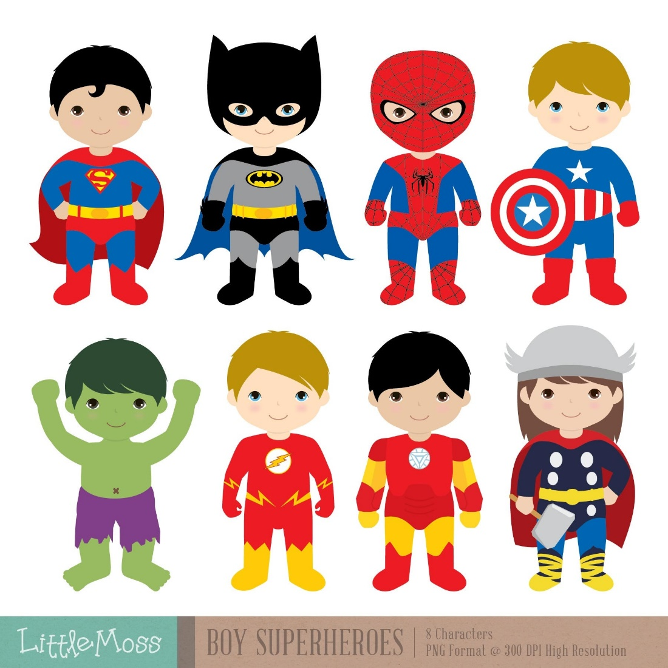

READING
superb (adj)
/suːˈpɜːb/
siêu đẳng

Slide 8

READING
perfect (adj)
/ˈpɜːfɪkt/
hoàn hảo

Slide 9

READING
leadership (n)
/ˈliːdəʃɪp/
kĩ năng lãnh đạo

Slide 10

READING
field trip (n)
/fiːld trɪp/
chuyến tham quan

Slide 11
READING
Form | Example | Meaning
1. superb (adj) | /suːˈpɜːb/ | siêu đẳng
2. perfect (adj) | /ˈpɜːfɪkt/ | hoàn hảo
3. leadership (n) | /ˈliːdəʃɪp/ | kĩ năng lãnh đạo
4. field trip (n) | /fiːld trɪp/ | chuyến tham quan

Slide 12
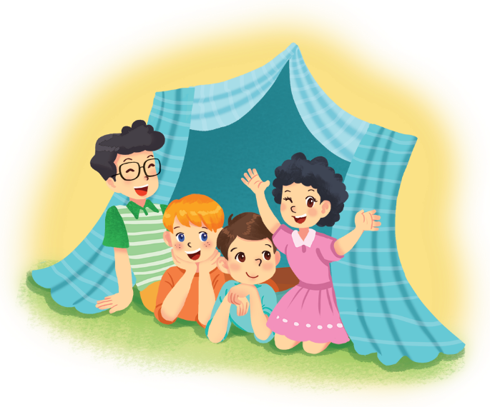
READING
2
Read the text and write T (True) or F (False). Correct the false statements.
To: My parents <parents.nguyen@webmail.com>
Subject: My first day at the superb summer camp
Hi Mum and Dad,
Here I am at the Superb Summer Camp. Mr Black asked us to write emails in English! Wow, everything here is in English! I have some new friends: Jimmy, Phong, and Nhung. They’re in the photo. Jimmy has blonde hair and blue eyes. He’s clever and creative. He likes taking photos. Phong is the tall boy. He’s sporty and plays basketball very well. Nhung has curly black hair. She’s kind. She shared her lunch with me today.
We’re having fun. Jimmy’s taking photos of me. Phong’s reading a comic book, and Nhung’s playing the violin. I must go now.
Please write soon.
Love,
Nam

Slide 13
READING
2
Read the text and write T (True) or F (False). Correct the false statements.
Example:
Nam is writing to his teacher. F
(his parents)
1. The children can speak Vietnamese at the camp.
F
They speak English only.
2. Nam has four new friends.
F
He has three.

Slide 14

READING
2
Read the text and write T (True) or F (False). Correct the false statements.
3.
Phong likes taking photos.
F
Jimmy likes taking photos.
4.
Nam thinks Nhung is kind.
T
5.
Phong is tall and sporty.
T

Slide 15
SPEAKING
3
Work in groups. Read about the three students below. Is the Superb Summer Camp suitable for all of them? Why or Why not?
1. Mi is 12 years old. She likes drawing and writing stories.
She’s good at English. She’s creative and friendly.
The camp is suitable for her because it suits her age and she can use English. She can also develop her creativity at the camp.
Suggested answers

Slide 16
SPEAKING
3
Work in groups. Read about the three students below. Is the Superb Summer Camp suitable for all of them? Why or Why not?
2. An is 16 years old. He doesn’t know English. He’s funny and kind.
The camp does not seem to suit Nam. He may be too old for the camp and he can’t speak English.
Suggested answers

Slide 17
SPEAKING
3
Work in groups. Read about the three students below. Is the Superb Summer Camp suitable for all of them? Why or Why not?
3. Vy is 14 years old. She likes playing sports. Her English isn’t very good. She’s clever, but she isn’t active.
The camp suits Vy. It suits her age and it can help her improve her English.
Suggested answers

Slide 18
SPEAKING
4
Think about yourself. Do you want to go to this kind of camp? Why or Why not?
Example:
I want to go to this camp because I can speak English there.

Slide 19

CONSOLIDATION
1
Wrap-up
What have we learnt in this lesson?
Read for specific information about friends and a summer camp
Talk about friends and a summer camp

Slide 20

CONSOLIDATION
2
Homework
Do exercises in the workbook

Slide 21






Website: hoclieu.vn
Fanpage: facebook.com/www.tienganhglobalsuccess.vn/

