Slide 1
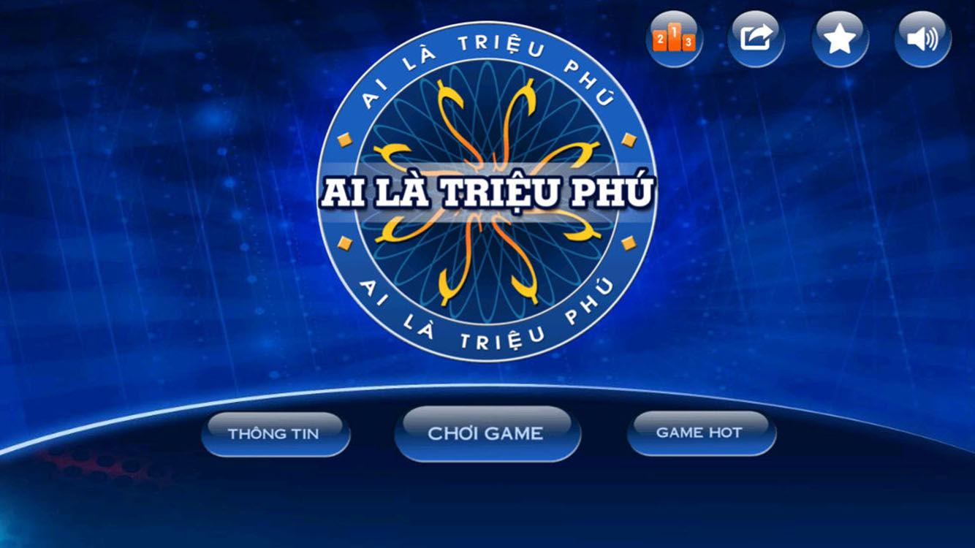
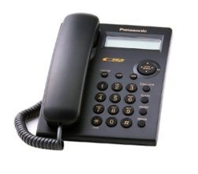
15 150,000
14 100,000
13 80,000
12 50,000
11 30,000
10 20,000
9 12,000
8 9,000
7 6,000
6 3,000
5 1,000
4 800
3 600
2 400
1 200
Imformation
Play
Skip

Slide 2
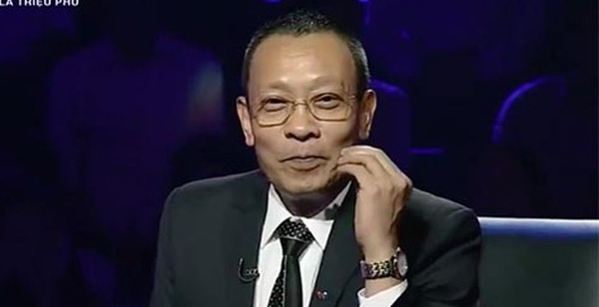
C
D
A
B
200.000
Number 1
Answer
What is your name?
They are Tom
His name is Tom
A
B
My name is Tom
Her name is Tom
C
D
Stop
Next

Slide 3
A
D
C
B
400.000
Number 2
My skin is white, You with the blackboard, Take me up, I follow you - What is it?
Answer
Chalk
Whiteboard
A
B
Hall
Pen
C
D
Stop
Next

Slide 4
B
D
A
600.000
C
Number 3
Answer
Which place has many books?
Supermarket
Library
A
B
Home
Restaurant
C
D
Stop
Next

Slide 5
D
A
C
B
800.000
Number 4
Where do students learn at school?
Answer
Home
Hospital
A
B
Museum
Classroom
C
D
Stop
Next

Slide 6
C
D
A
B
1.000.000
Number 5
Answer
What has A hundered limbs, but cannot walk?
a centipede
a stick
A
B
a tree
a hedgehong
C
D
Stop
Next

Slide 7
A
D
C
B
3.000.000
Number 6
At which restaurant would you be able to order Chicken McNuggets?
Answer
Burger King
Wendy’s
A
B
McDonald’s
Taco Bell
C
D
Stop
Next

Slide 8
B
D
A
6.000.000
C
Number 7
Answer
Which team won the AFC Asian Cup 2011 in Qatar?
Australia
Japan
A
B
Korea
Thailand
C
D
Stop
Next

Slide 9
D
A
C
B
9.000.000
Number 8
Who was the first Vietnamese composer to write an opera with "Auntie" and then "The sculptor"?
Answer
Hoàng Vân
Trọng Đài
A
B
Trần Hoàn
Đỗ Nhuận
C
D
Stop
Next

Slide 10
A
D
C
B
12.000.000
Number 9
After years of war, the nation would want to make [...] with the enemies
Answer
peace
piece
A
B
pace
pair
C
D
Stop
Next

Slide 11
C
D
A
B
20.000.000
Number 10
Answer
Choose word of the first syllable stressed
create
effective
A
B
cycle
device
C
D
Stop
Next

Slide 12
A
D
C
B
30.000.000
Number 11
The village was …... Visible through the dense fog.
Answer
barely
only
A
B
hard
mostly
C
D
Stop
Next

Slide 13
D
A
C
B
50.000.000
Number 12
Answer
Last Sunday, Bob decided to call it a day? means
Bob gave the previous Sunday a name
Bob played truant that day
A
B
Bob was absent from work that day
Bob stopped working to relax
C
D
Stop
Next

Slide 14
A
D
C
B
80.000.00
Number 13
What has three hands but only one face?
Answer
A clock
Face
A
B
Animals
A pen
C
D
Stop
Next

Slide 15
C
D
A
B
100.000.000
Number 14
Answer
The bank has more than 100 branches, …. In a major urban area.
Each locating
The location of which
A
B
Each located
And are located
C
D
Stop
Next

Slide 16
A
D
C
B
150.000.000
Number 15
What has a face and two hands but no arms, legs or head?
Answer
A clock
A shirt
Face
A
B
Jeans
Armchair
C
D
Stop
Next

Slide 17
Your reward is
150,000,000 Vnđ

Slide 18
WISH YOU LUCK

Slide 19
PLAY GAME
There are 15 questions with respective awards.
There are 3 important milestones: 5, 10, 15.
There are 3 help for players.
The correct answer will automatically move to the next sentence and add the corresponding amount.
If the wrong answer returns the result is the previous fixed landmark.
Players have the right to stop the game when passing sentence number 5.

Slide 20
SƯU TẦM: ĐOÀN VĂN DOANH, NAM TRỰC, NAM ĐỊNH
LINK NHÓM DÀNH CHO GV BỘ MÔN VẬT LÝ TRAO ĐỔI TÀI LIỆU VÀ CHUYÊN MÔN CT 2018
https://www.facebook.com/groups/299257004355186

