Slide 2

LOOKING BACK AND PROJECT
Unit 9
CAREER PATHS
Unit
FAMILY LIFE
REVISION
Lesson 8

Slide 3
LESSON 8
LOOKING BACK AND PROJECT
WARM-UP
Quiz: Watch the video and answer the questions.
Pronunciation: Listen and underline
Vocabulary: Complete the text
Grammar: Choose the correct answer
LOOKING BACK
SCHOOL LEAVER’S CAREER PLANS
PROJECT
Wrap up
Homework
CONSOLIDATION

Slide 4

WARM-UP
https://www.youtube.com/watch?v=zhpcgpqWc1Q&t=1s

Slide 5

1. What is the benefit of talking to industry experts when exploring potential careers?
To gain insight into the day-to-day aspects of the job
To find out their favorite hobbies
To impress them with your knowledge
To convince them to hire you immediately

Slide 6
2. Why is researching the job market important in the career exploration process?
To understand the competition in the field
To find the highest-paying job available
It's not important; job markets are always the same
To determine the most popular career among your peers

Slide 7
3. How can identifying your core values help in finding the right career?
Core values have no impact on career decisions
Core values change frequently
Employers are not interested in employees' core values
It helps align your career with companies that share similar values

Slide 8
4. Where can you find additional career advice and opportunities, as mentioned in the script?
On social media
CareerAddict.com
By asking your friends
In a cookbook

Slide 9

LOOKING BACK
1
Underline the parts where assimilation occurs. Listen and check. Then practice saying these sentences in pairs.
1. I saw a new job advert on the school notice board.
2. They’re seeking a volunteer for their new project.
3. The heritage site wants to hire a tour guide with the relevant work experience.
4. My brother doesn’t want to apply for a job that requires working with people.

Slide 10
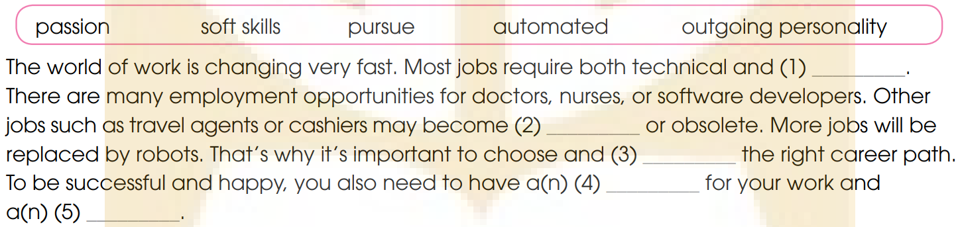
LOOKING BACK
2
Complete the text. Use the correct words and phrases in the box.
soft skills
automated
pursue
a passion
an outgoing personality

Slide 11
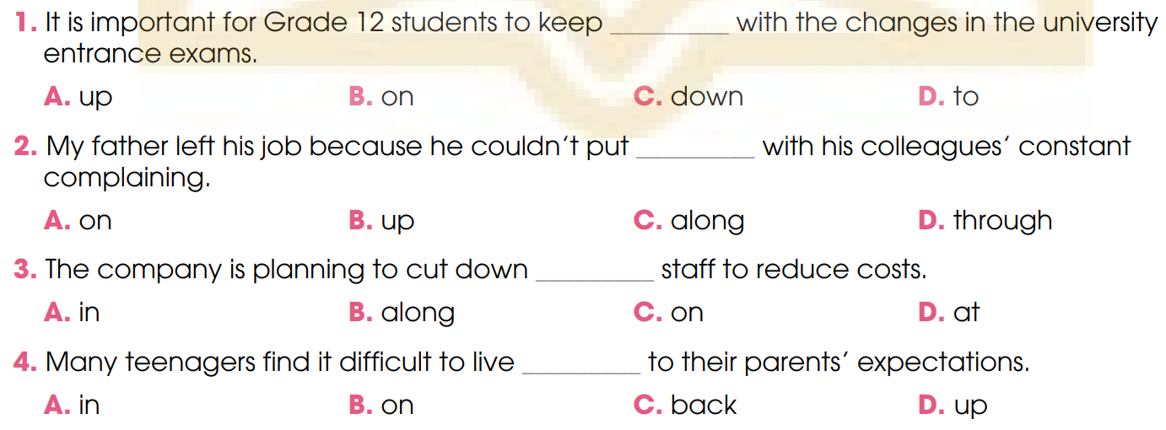
LOOKING BACK
3
Choose the sentence that best combines each pair of the following sentences.

Slide 12
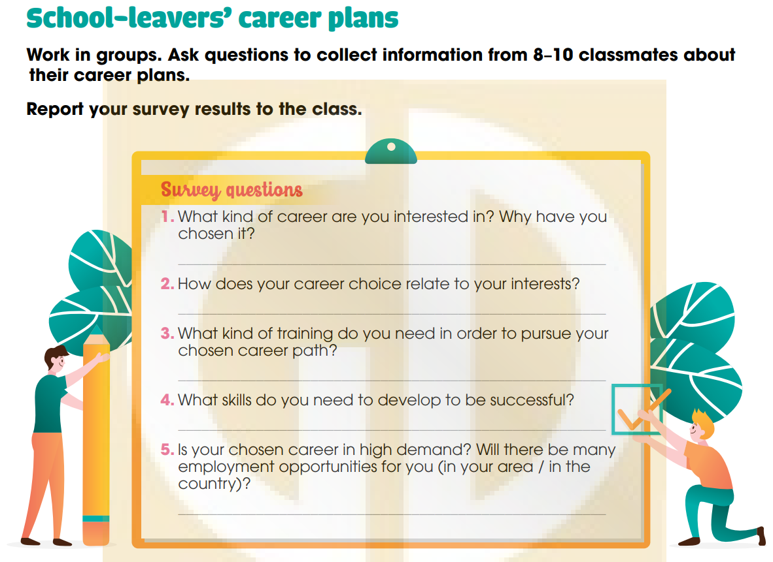
PROJECT

Slide 13
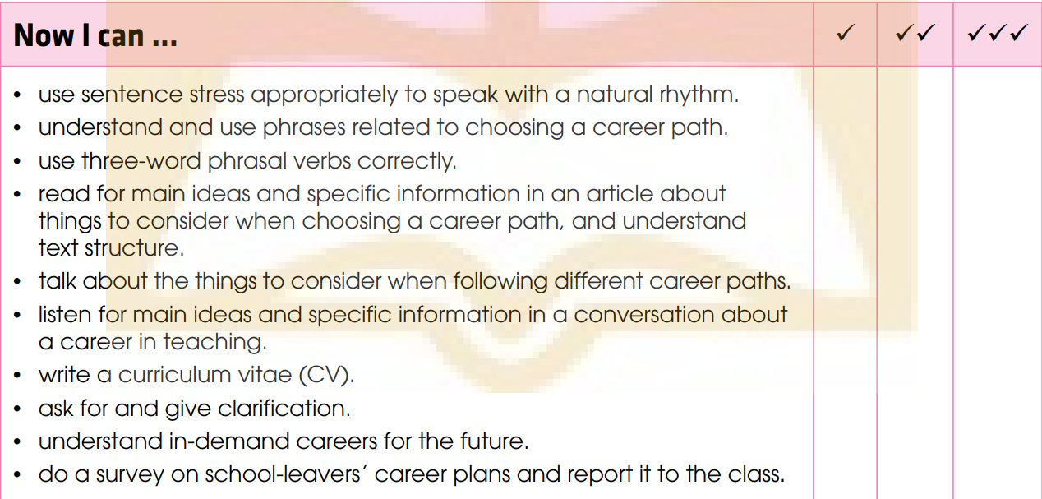
PROJECT

Slide 14


CONSOLIDATION
Review the vocabulary and grammar of Unit 9.
Understand and use phrases related to choosing a career path.
How to write a curriculum vitae (CV).
Understand in-demand careers for the future.
Do a survey on school-leavers’ career plans and report it to the class.

Slide 15


CONSOLIDATION
Do exercises in the workbook.
Prepare for Unit 10.

Slide 16
Website: hoclieu.vn
Fanpage: facebook.com/www.tienganhglobalsuccess.vn

