Slide 1


Slide 2
Unit
10
The ecosystem
Unit
FAMILY LIFE
LESSON 5
LISTENING
Human impact on ecosystems

Slide 3
LESSON 5
LISTENING
WARM-UP
Game: Food chain
PRE-LISTENING
Task 1: Choose the correct meanings.
Task 2: Choose the correct answer.
Task 3: True or false.
WHILE-LISTENING
POST-LISTENING
Discussion
CONSOLIDATION
Wrap-up
Homework

Slide 4
WARM-UP
FOOD CHAIN
- Ss work in groups.
- Put the animals in the correct positions in the food chain.
- Stick the animals on their paper and put the paper on the board.

Slide 5






WARM-UP
2
3
1
4
5

Slide 6
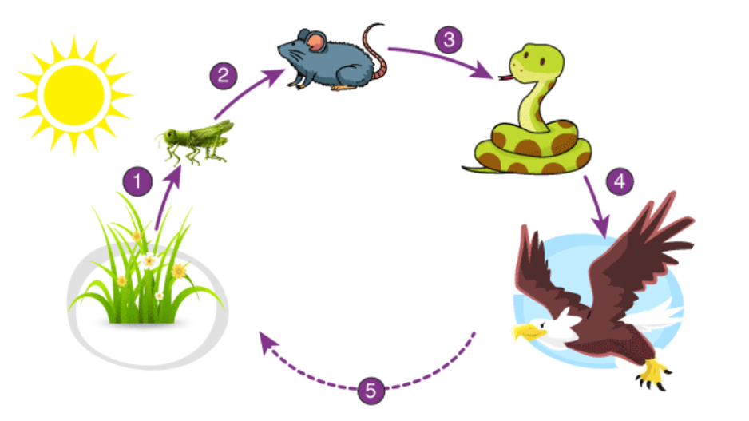
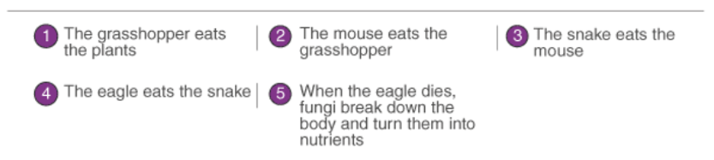
WARM-UP
KEY

Slide 7
PRE-LISTENING
1
Choose the correct meaning of these words
1. coral reef
A. a plant that grows in the sea
B. a line of hard rock formed by coral, found in warm sea water
2. food chain
A. the order in which living things depend on each other for food
B. the order in which food is provided
3. run out
A. to use all of something
B. to experience something unexpectedly
4. break down
A. to make smaller
B. to stop working

Slide 8
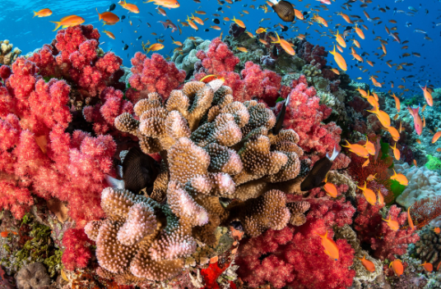

PRE-LISTENING
coral reef (n)
/ˈkɒrəl riːf/
a hard substance that is red, pink or white in colour, and that forms on the bottom of the sea from the bones of very small creatures

Slide 9

PRE-LISTENING
expert (n)
/ˈekspɜːt/
a person with special knowledge, skill or training in something

Slide 10
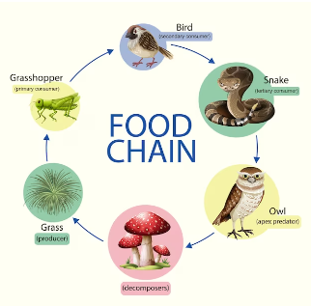
PRE-LISTENING
food chain (n)
/ˈfuːd tʃeɪn/
a series of living creatures in which each type of creature feeds on the one below it in the series

Slide 11
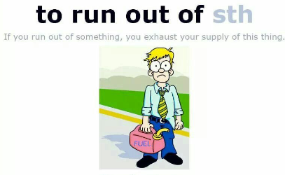
PRE-LISTENING
run out of
(phr.v)
to use up or finish a supply of something

Slide 12

PRE-LISTENING
restore (v)
/rɪˈstɔː(r)/
to bring back a situation or feeling that existed before

Slide 13
Form | Pronunciation | Meaning
1. coral reef (n) | /ˈkɒrəl riːf/ | a hard substance that is red, pink or white in colour, and that forms on the bottom of the sea from the bones of very small creatures.
2. expert (n) | /ˈekspɜːt/ | a person with special knowledge, skill or training in something
3. food chain (n) | /ˈfuːd tʃeɪn/ | a series of living creatures in which each type of creature feeds on the one below it in the series
4. run out of (phrasal verb) |  | to use up or finish a supply of something
5. restore (v) | /rɪˈstɔː(r)/ | ​ to bring back a situation or feeling that existed before

Slide 14
WHILE-LISTENING
2
Listen to a talk and choose the correct answers A, B or C.
1. Why is Dr Logan invited to give a talk?
A. Because he knows Nam.
B. Because he’s an expert in biodiversity conservation.
C. Because he’s a member of the environmental club.
2. Which of the benefits provided by a healthy ecosystem is NOT mentioned?
A. Cleaning our air and water.
B. Controlling climate changes.
C. Recycling waste naturally.
3. How much of the coral reefs has disappeared?
A. 25%. B. 50%. C. 90%.

Slide 15
WHILE-LISTENING
2
Listen to a talk and choose the correct answers A, B or C.
4. What may happen as a result of damaging the ecosystem balance?
A. More space for farming and houses.
B. Lack of food, water, and fresh air.
C. Fewer natural disasters.
5. What do you think Dr Logan will talk about next?
A. Ways to repair damaged ecosystems.
B. Ways to restore the food chain.
C. The future of human life.

Slide 16

WHILE-LISTENING
3
True or false.
 | T | F
1. The threat to the earth’s biodiversity comes from human activities.
2. Nearly half of the world’s forests have been cut down.
3. The disappearance of some species may cause problems to the food chain.
4. The health of human beings does not depend on a healthy ecosystem.

Slide 17

POST-LISTENING
4
Discussion
What can humans do to protect and restore the earth’s ecosystems?

Slide 18
POST-LISTENING
4
Discussion
Below are some ways:
– plant trees, and ensure they grow to full maturity
– volunteer on restoration projects in your community
– assist local habitats by bringing back plants and animals that used to live there
– eat less meat and buy organic produce
– support green businesses
– organise or join local clean-up activities of beaches and parks

Slide 19
CONSOLIDATION
1
Wrap-up
What have you learnt today?
Human impacts on ecosystems;
Listening for main ideas and specific information.

Slide 20
CONSOLIDATION
2
Homework
Do exercises in the workbook.
Prepare for Lesson 6 - Unit 10.

Slide 21

Website: hoclieu.vn
Fanpage: facebook.com/www.tienganhglobalsuccess.vn
Website: hoclieu.vn
Fanpage: facebook.com/sachmem.vn/

