Slide 1


Slide 2
Unit
9
Social issues
Unit
FAMILY LIFE
LESSON 5
LISTENING
Types of bullying

Slide 3
LESSON 5
LISTENING
WARM-UP
Play Quiz about Peer Pressure
PRE-LISTENING
Task 1: Choose the word or phrase with the closest meaning to the underlined one.
Task 2: Listen to a conversation between two students and match the pictures with the type of bullying.
Task 3: Listen again. Circle the correct answers.
WHILE-LISTENING
POST-LISTENING
Task 4: Work in groups. Discuss the following question.
Wrap-up
Homework
CONSOLIDATION

Slide 4
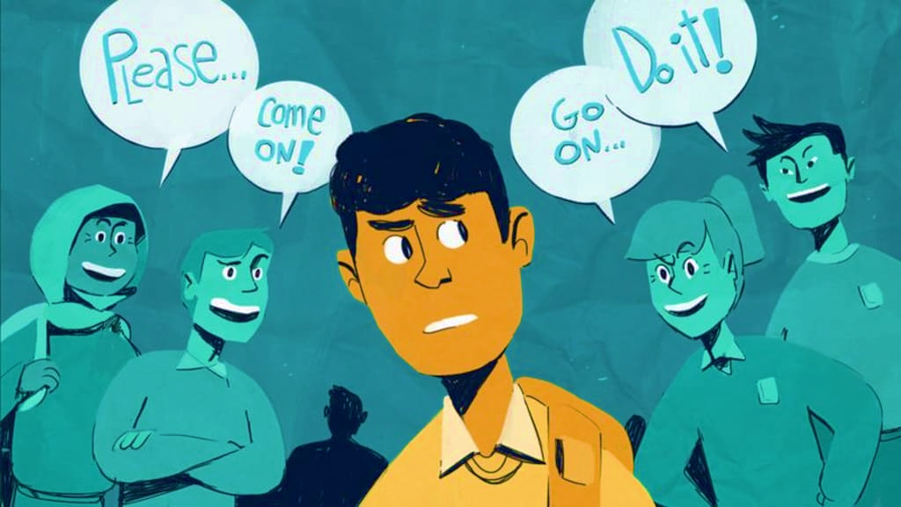
WARM-UP
Let‘s Quiz!
What do you know about Peer Pressure

Slide 5


1. A friend encourages you to try out for the basketball team.
This is which type of pressure?
Positive peer pressure
A
Negative peer pressure
B

Slide 6
2. What qualities can help a person to resist negative peer pressure?
Speed and Coordination
A
A nice Smile
B
Self-Confidence & Assertiveness
C
Nice Hair
D

Slide 7
3. When you are under pressure you should...
Stay Calm & Be Confident
A
Leave the situation if your friend persists
B
Make Eye-Contact & Repeat "NO"!
C
All of the above
D

Slide 8
4. Which is NOT an effective way to handle peer pressure?
Avoid or leave the unsafe situation
A
Give reasons for your refusal
B
Talk to an adult you trust
C
Give in and join in the same unsafe activity
D

Slide 9
5. What is ‘guilt’?
Telling a person something nice about himself/herself
A
Making someone feel bad if they do not do something
B

Slide 10
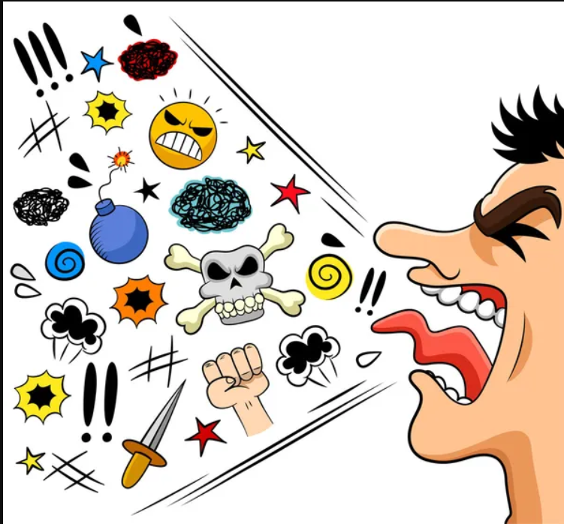

PRE-LISTENING
Offensive (adj)
/əˈfen.sɪv/
causing someone to feel upset and angry, often because of being rude

Slide 11
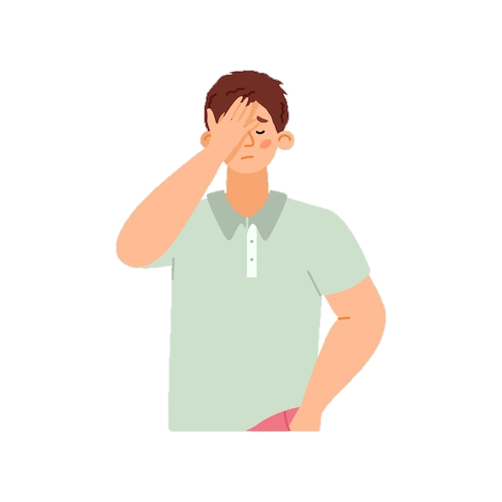
PRE-LISTENING
Ashamed (adj)
/əˈʃeɪmd/
feeling guilty or embarrassed about something you have done or about a quality in your character

Slide 12
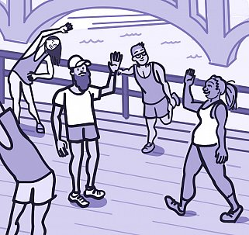
PRE-LISTENING
Physical (adj)
/ˈfɪz.ɪ.kəl/
relating to things you can see or touch, or relating to the laws of nature

Slide 13
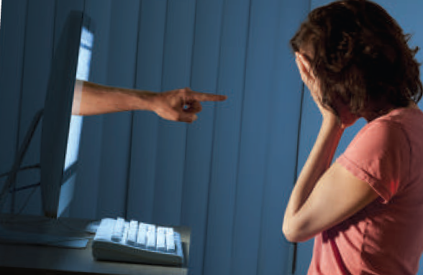
PRE-LISTENING
Cyberbullying (n)
/ˈsaɪ.bəˌbʊl.i.ɪŋ/
the activity of using the internet to harm or frighten another person, especially by sending them unpleasant messages

Slide 14
PRE-LISTENING
Form | Pronunciation | Meaning
1. Offensive (adj) | /əˈfen.sɪv/ | causing someone to feel upset and angry, often because of being rude
2. Ashamed (adj) | /əˈʃeɪmd/ | feeling guilty or embarrassed about something you have done or about a quality in your character
3. Physical (adj) | /ˈfɪz.ɪ.kəl/ | relating to things you can see or touch, or relating to the laws of nature
4. Cyberbullying (n) | /ˈsaɪ.bəˌbʊl.i.ɪŋ/ | the activity of using the internet to harm or frighten another person, especially by sending them unpleasant messages

Slide 15
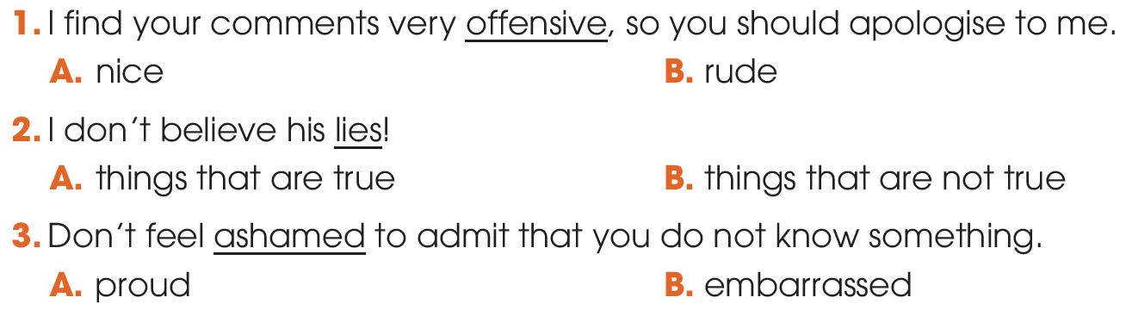
PRE-LISTENING
1
Choose the word or phrase with the closest meaning to the underlined one.

Slide 16

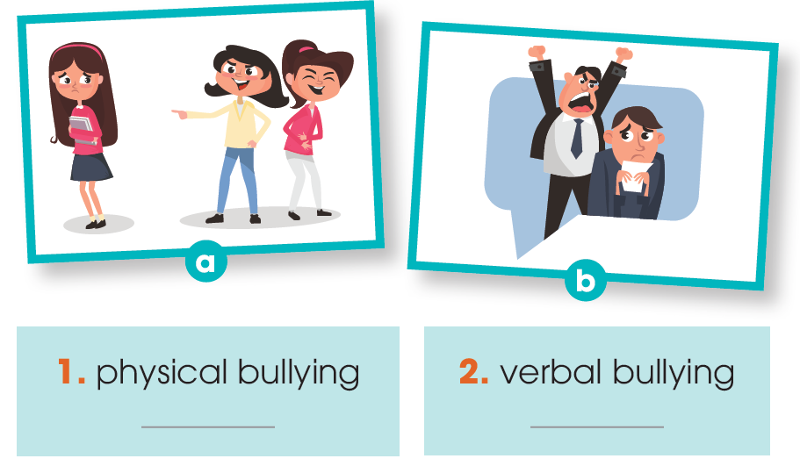
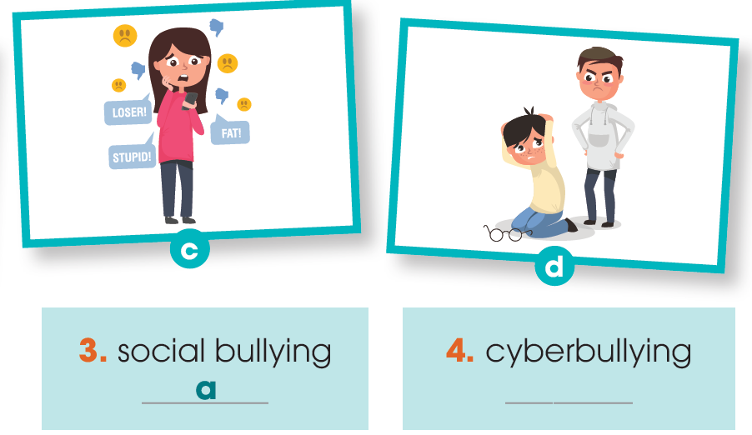
WHILE-LISTENING
2
Listen to a conversation between two students and match the pictures with the type of bullying.
d
b
c

Slide 17

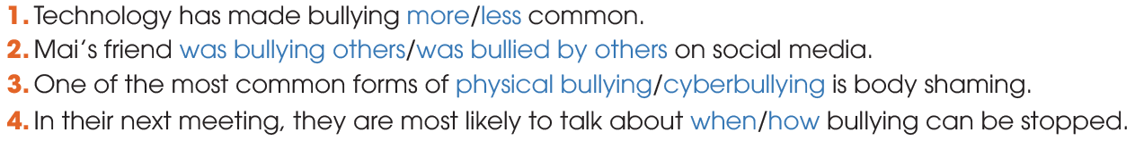
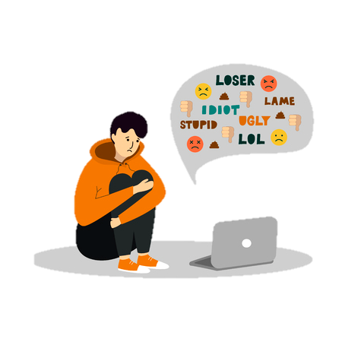
WHILE-LISTENING
3
Listen again. Circle the correct answers.

Slide 18
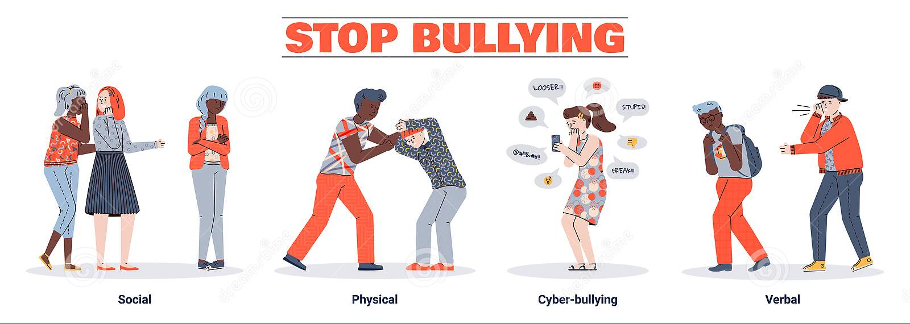
POST-LISTENING
4
Work in groups and answer the questions.
What types of bullying have you experienced or seen happening to people around you?

Slide 19
CONSOLIDATION
1
Wrap-up
What have you learnt today?
New Vocabulary
Listen for specific information in a conversation about types of bullying, and make predictions.

Slide 20
CONSOLIDATION
2
Homework
Do exercises in the workbook.
Prepare for Lesson 6 - Unit 9.

Slide 21

Website: hoclieu.vn
Fanpage: facebook.com/sachmem.vn/

