Slide 1
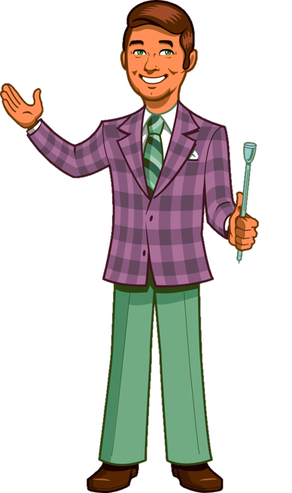
INSERT PLAYER
NAMES HERE
ABOUT GAME
PLAY GAME

Slide 2
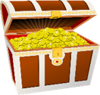
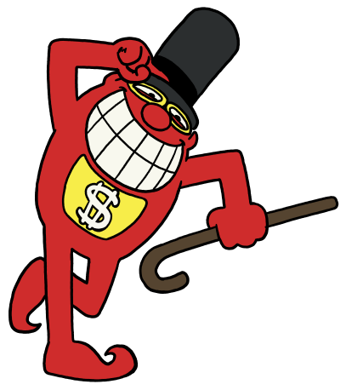
Board
Cash
Whammy
Pass
GO BACK
TWO
SPACES
MOVE
ONE
SPACE
PLAYER 1
$5000
+
ONE SPIN
$1000
+
ONE SPIN
$3000
+
ONE SPIN
 CYCLE
$500
+
ONE SPIN
 GAMING
CONSOLE
$4000
+
ONE SPIN
$1500
$750
$1000
$750
$0
$1000
$500
$250
EARNED
PRIZE VALUE
NO MORE SPINS
ADD SPINS OR
SELECT NEW PLAYER
PASSED
$1000
+
ONE SPIN
$750
+
ONE SPIN
$500

DESIGNER
SUNGLASSES
$750
$500
PLAYER 2
 BEDROOM
$1000
+
ONE SPIN
$750
+
ONE SPIN
$750
+
ONE SPIN
$750
+
ONE SPIN
$0
+ SPIN
EARNED
PRESS YOUR LUCK
  
PASSED
$750
+
ONE SPIN
 COMPUTER
$1000
$500
⧫ MAKE A MOVE
PASS SPINS 
PLAYER 3
$500
+
ONE SPIN
BIG BUCKS
$750
+
ONE SPIN
✪ CAMERA
 SNOWBOARD
⇧ TRIP
$1500
$0
$750
$1000
$1250
$2000
$1500
$500
$1000
$2500
EARNED
PASSED

Slide 3
ABOUT THE GAME
Quick Stats:
1 host
1 PPT operator
3 Players
54 total squares
9 whammies
Objective
Players answer questions to earn spins which are used to win cash and prizes on the big board. The player with the most prizes at the end of the game wins.
Questions
The host will ask up to 5 questions per round. The first player to buzz in answers without any choices. The other players have a chance to answer the same question with multiple choices, including the first player’s answer. If the first player is correct, they get 3 spins. Correct answers for everyone else get 1 spin.
Big Board
Player with the least spins goes first.
Player continues spinning until:
- Player is out of earned spins
- Player passed remaining spins
- Player has received 4 whammies
Next player with the least amount of spins goes next same as first player.
Passed spins automatically go the player with the highest score.
Any player that received passed spins must use all of them before using or passing their earned spins.
If a player lands on a whammy with passed spins, passed spins move over to the earned spins.
HOW TO USE
BACK
Credits:
Design & Layout, Programing – Mike Rusnak from rusnakcreative.com
Sound effects, logo, and theme are property of NBC
This is an unofficial Press Your Luck template.
This work is licensed under a Creative Commons Attribution-NonCommercial-ShareAlike 4.0 International License.

Slide 4
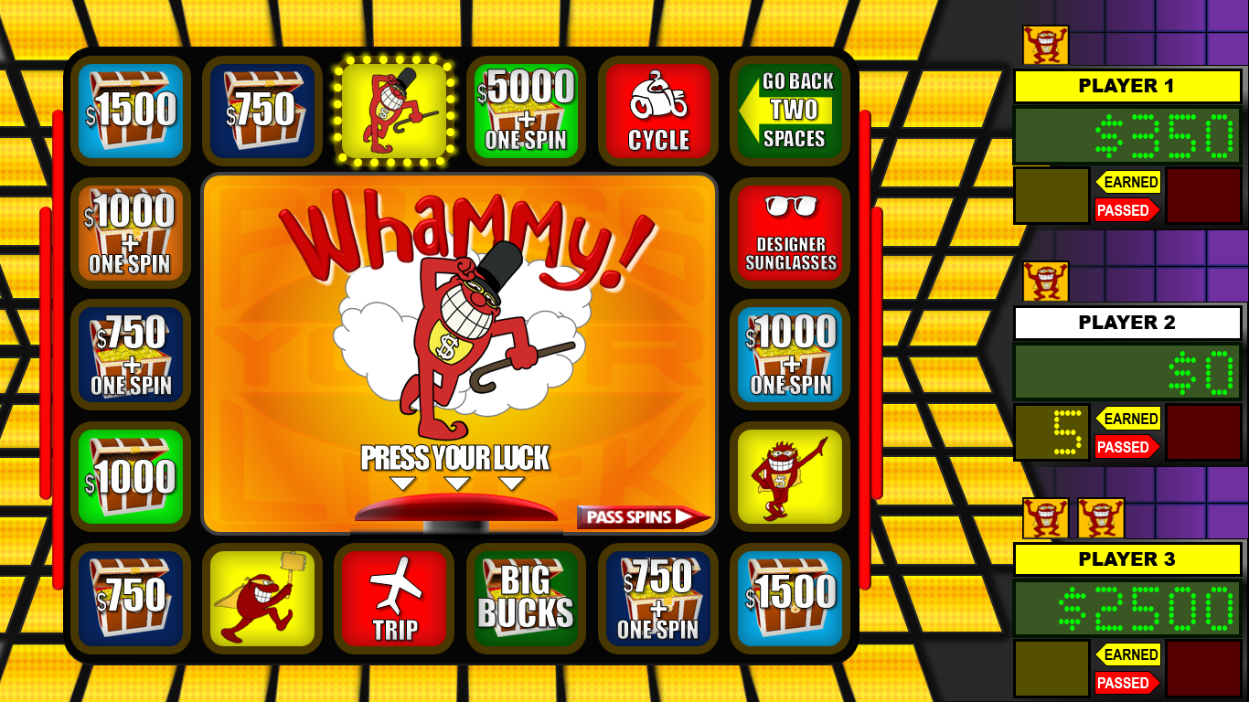
Big Board Button
Click to start/stop the Big Board from cycling.
Start and stop the board first before selecting first player!
HOW TO USE
Whammy
When player has 4 whammies, they lose.
Prize Score
Player’s total prizes won as cash value.
Player Name
Click this to select active player.
ABOUT GAME
Earned Spins
Click this to add a spin to the earned column.
BACK
Move Button
This green button will appear when you land on a space that requires you to move to another space.
Passed Spins Button
Click this button to pass unused spins to another player with the highest score.
Passed Spins
Other players may pass their unused spins, and they go here. Player must use up spins in this column.

Slide 5
SƯU TẦM: ĐOÀN VĂN DOANH, NAM TRỰC, NAM ĐỊNH
LINK NHÓM DÀNH CHO GV BỘ MÔN VẬT LÝ TRAO ĐỔI TÀI LIỆU VÀ CHUYÊN MÔN CT 2018
https://www.facebook.com/groups/299257004355186

