Slide 1

UNIT 2: ENTERTAINMENT & LEISURE
Lesson 1.1 – Vocabulary & Reading
Page 12

Slide 2



Lesson .
LESSSON OUTLINE
Consolidation

Slide 3

By the end of this lesson,
students will be able to:
- use vocabulary to talk about leisure activities.
- read for a gist and specific information.
- write about what they like and don’t like to do in their free time.

Slide 4
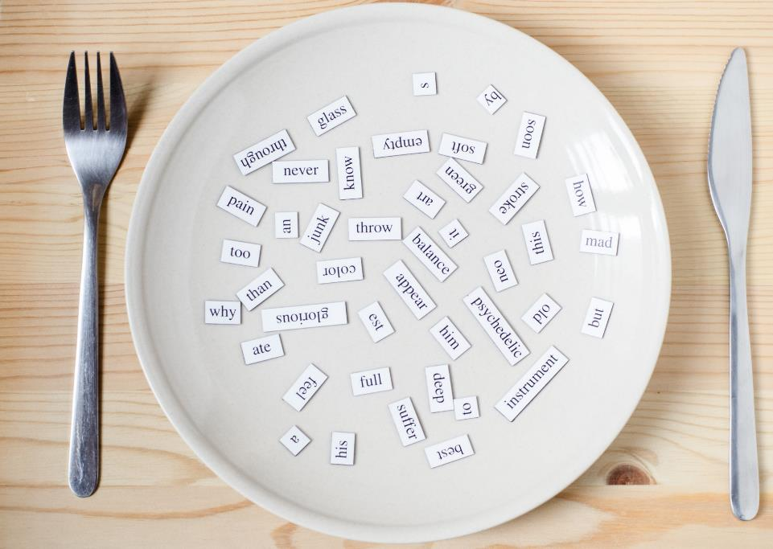
New words
do karate
go for a bike ride
go canoeing
do crossword puzzles
play role-playing games
go running
do aerobics
hang out with friends

Slide 5



Slide 6

Work in pairs.
What do you do on the weekends?
Do you have a lot of free time?

Slide 7



Slide 8


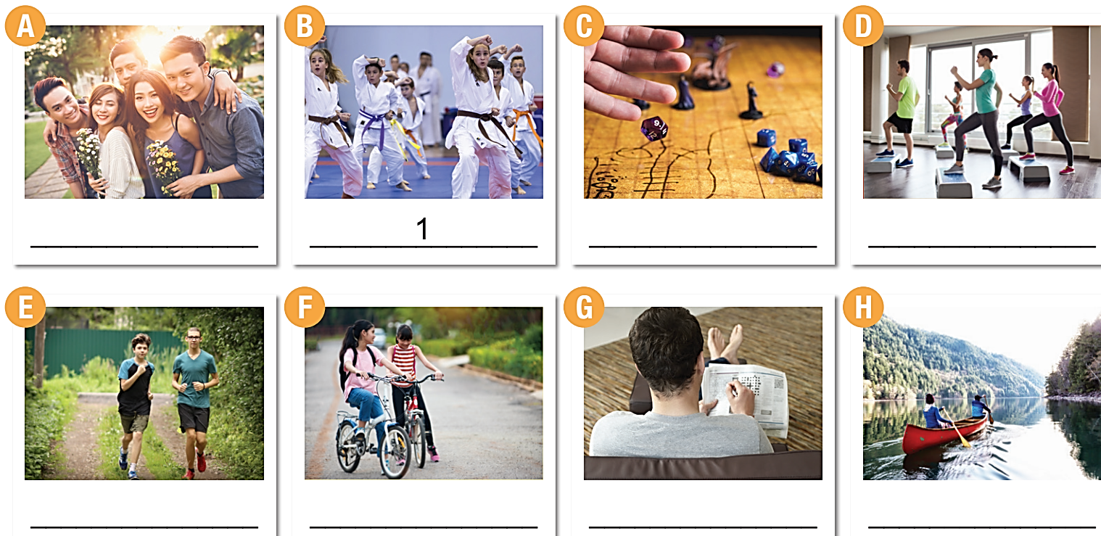

1. do karate 3. go for a bike ride 5. go canoeing 7. do crossword puzzles
2. play role-playing games 4. go running 6. do aerobics 8. hang out with friends
8
1
2
6
4
3
7
5

Slide 9
Listen and repeat.
do karate (v phr) / duː kəˈrɑːti / tập võ karate

play role-playing games (v phr)/ pleɪ ˈroʊl pleɪɪŋ ɡeɪmz / chơi trò chơi nhập vai

go for a bike ride (v phr) / goʊ fɔːr ə baɪk raid / chạy xe đạp

go running (v phr) / goʊ ˈrʌnɪŋ/ chạy bộ

go canoeing (v phr) / goʊ kəˈnuːɪŋ / chèo xuồng

do aerobics (v phr) / duː eˈroʊbɪks / tập thể dục nhịp điệu

do crossword puzzles (v phr) / duː ˈkrɔːswɜːrd ˈpʌzlz / chơi ô chữ

hang out with friends (v phr) / hæŋ aʊt wɪð frendz / đi chơi với bạn


Slide 10
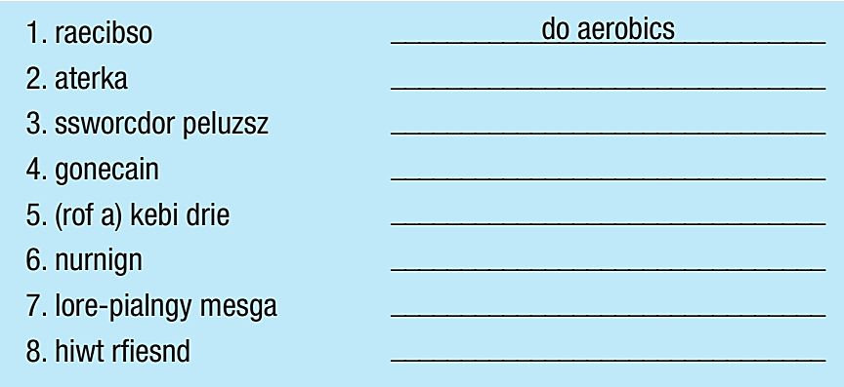
Extra Practice, WB page 8.
do karate
do crossword puzzles
go canoeing
go for a bike ride
go running
play role-playing games
hang out with friends

Slide 11
Extra Practice, WB page 8.
aerobics
1. My brother started doing ____________ last week. He likes the music and the fast movements.
2. I used to hang out _____________ every weekend when we lived near a park. We had picnics and chatted for hours.
3. Katie started doing ____________ when she was eight. Doing martial arts helps her become stronger and more confident.
4. The first thing my dad does when he gets the newspaper is solving the ____________.
5. _____________________ can be difficult for new players. You have to use your imagination, and it isn't easy to come up with a good story right away.
6. My mom and I sometimes go ____________ on the weekends at a lake. The water is beautiful.
7. My soccer coach wants me to go ____________ every day. He says it will make my legs and heart stronger.
8. I like to go ______________ on the weekends. My dad bought me a new bike, so I can ride it to school, too.
with friends
karate
crossword puzzles
Role-playing games
canoeing
running
for a bike ride

Slide 12


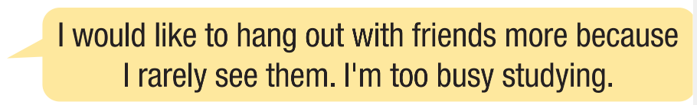

Slide 13



Slide 14
Pre- reading
What is the title of the passage?
→ Over to you
What are the highlighted words in the passage?
→ leisure, clue
Listen and repeat
leisure (n) / ˈliːʒər / thời gian rảnh
clue (n) / kluː / manh mối

Slide 15




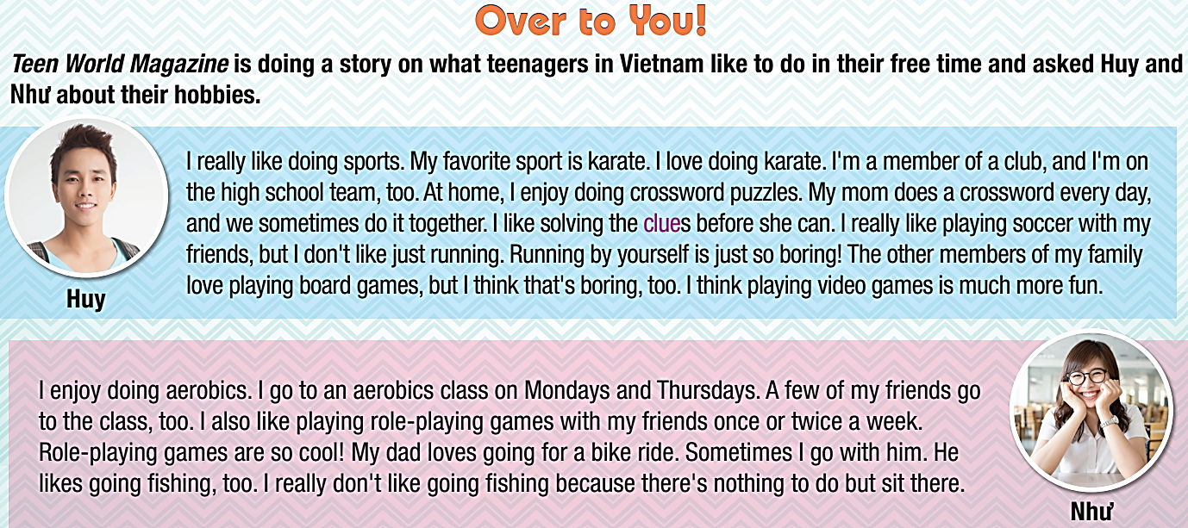
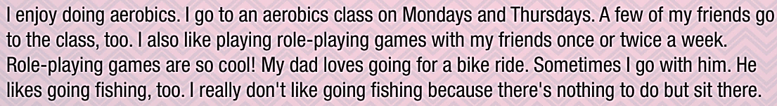

While- reading
✓
_____________________________

Slide 16
While- reading
b. Now, read and answer the questions.
1. What sport does Huy do on a team?
2. What activities does Huy say are boring?
3. What activities does Như do twice a week?
4. What activity does Như do with her dad?

Slide 17

1. What sport does Huy do on a team? ____________________
2. What activities does Huy say are boring? ________________
karate
running and playing board games
I really like doing sports. My favorite sport is karate. I love doing karate. I'm a member of a club, and I'm on the high school team, too. At home, I enjoy doing crossword puzzles. My mom does a crossword every day, and we sometimes do it together. I like solving the clues before she can. I really like playing soccer with my friends, but I don't like just
running. Running by yourself is just so boring! The other members
of my family love playing board games, but I think that's boring,
too. I think playing video games is much more fun.

Slide 18

3. What activities does Như do twice a week? __________________
4. What activity does Như do with her dad? ___________________
playing role-playing games
and going to an aerobics class
going for a bike ride
I enjoy doing aerobics. I go to an aerobics class on Mondays and Thursdays. A few of my friends go to the class, too. I also like
playing role-playing games with my friends once or twice a week.
Role-playing games are so cool! My dad loves going for a bike ride. Sometimes I go with him. He likes going fishing, too. I really
don't like going fishing because there's nothing to do but sit
there.

Slide 19

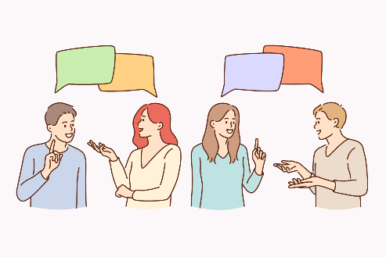
Post- reading
c. In pairs:
Do you prefer playing games and doing puzzles at home, or going outside to play sports? Why?

Slide 20

Consolidation

Slide 21
Writing
Write to Teen World Magazine about what you like and don’t like to do in your free time.

Slide 22
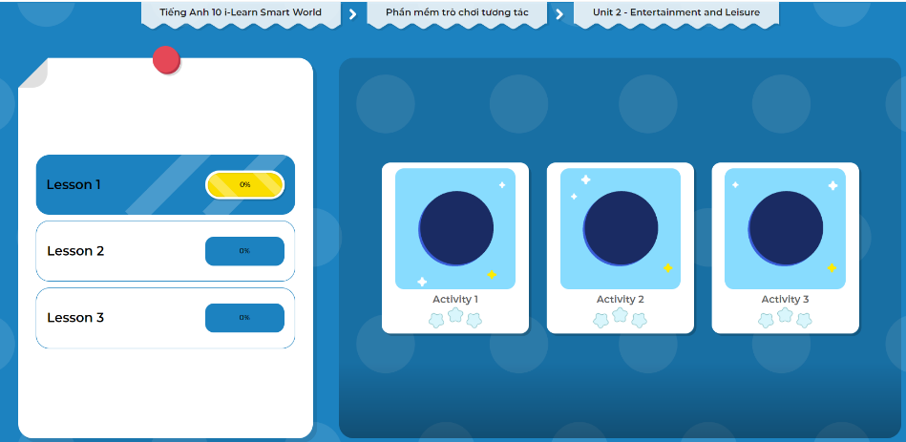
LET’S PLAY!
Click here to play the games.

Slide 23
Today’s lesson
Wrap-up
Vocabulary: about leisure activities.
Reading: for a gist and specific information.
Speaking: about leisure activities.

Slide 24
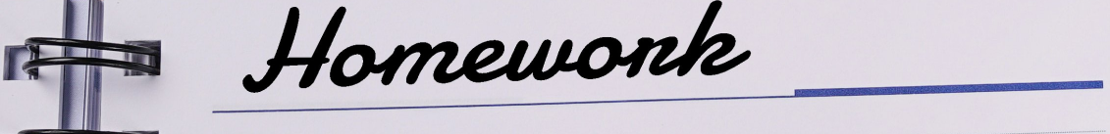
Finish the Reading exercise on pages 8 & 9, WB.
Do the exercises in Tiếng Anh 10 i-Learn Smart World Notebook on page 8.
Prepare the next lesson on page 13, SB.
Play the consolidation games in Tiếng Anh 10 i-Learn Smart World DHA App on www.eduhome.com.vn

Slide 25

Have a nice day!

