Slide 1

Unit 8: The World around Us
Lesson 3.1: Vocabulary & Listening
Page 68

Slide 2
Lesson Outline
Warm-up
Vocabulary
Pre-Writing: Listening
Pre-Writing: Useful lang.
Consolidation
Wrap-up

Slide 3
Objectives
By the end of this lesson, students will be able to learn…
Vocabulary: highland, beach, mountain, waterfall, bay, forest, island
Structure: modals (should, can)
Listening: listen to people’s conversations about places to visit

Slide 4

WARM-UP

Slide 5
Game
What is the odd word?
bus car train March

Slide 6
Game
What is the odd word?
January December campsite March

Slide 7
Game
What is the odd word?
sleeping bag mountain flashlight batteries

Slide 8
Game
What is the odd word?
blanket sleeping bag pillow
toy

Slide 9
Game
What is the odd word?
hungry sleep cold thirsty

Slide 10
Game
What is the odd word?
rafting cave campsite canyon

Slide 11

New words
highland, beach, mountain, waterfall, bay, forest, island

Slide 12

Presentation

Slide 13

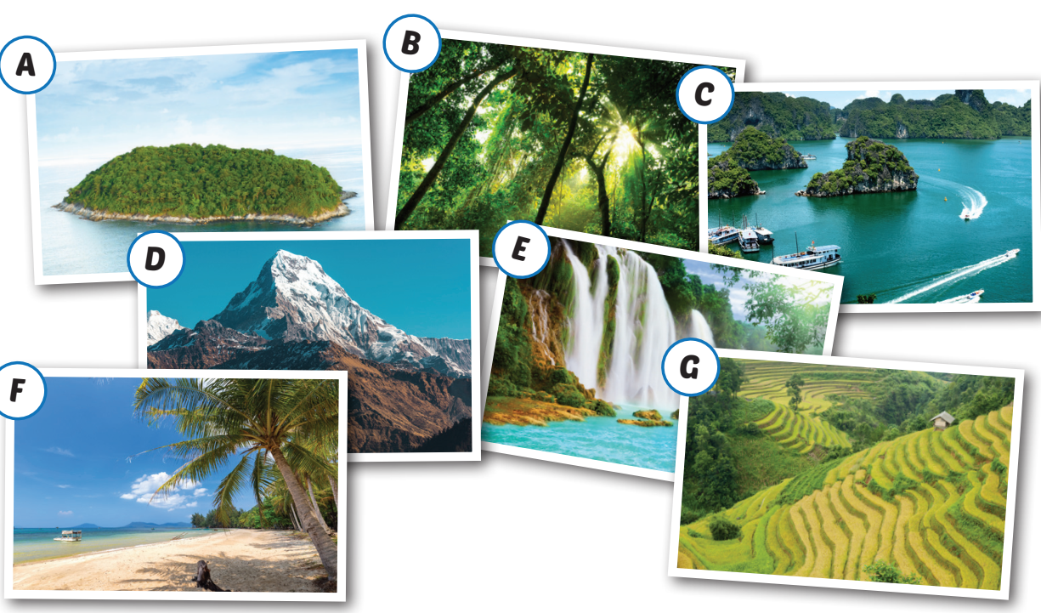
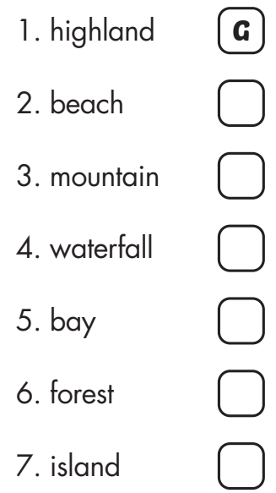
F
D
E
C
B
A

Slide 14

Click on each word and listen
1. highland (n) /ˈhaɪlənd/ cao nguyên
2. beach (n) /biːtʃ/ bãi biển
3. mountain (n) /ˈmaʊntn/ núi
4. waterfall (n) /ˈwɑːtərfɑːl/ thác nước
5. bay (n) /beɪ/ vịnh
6. forest (n) /ˈfɔːrɪst/ khu rừng
7. island (n) /ˈaɪlənd/ hòn đảo

Slide 15

Practice

Slide 16




Slide 17

You can go______________________________.

Slide 18
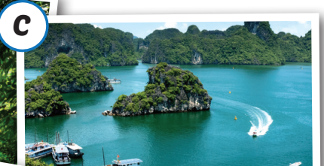
You can go______________________________.

Slide 19

You can go______________________________.

Slide 20

You can go______________________________.

Slide 21
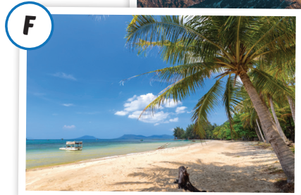
You can go______________________________.

Slide 22
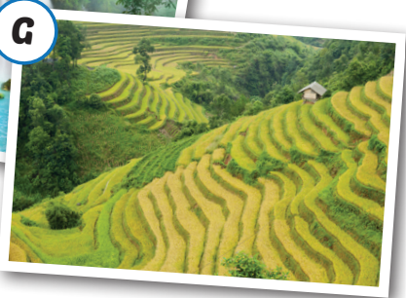
You can go______________________________.

Slide 23

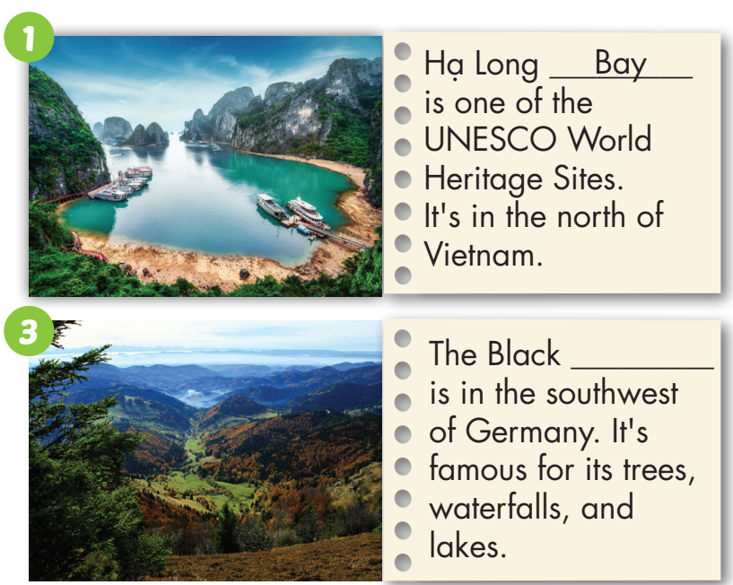
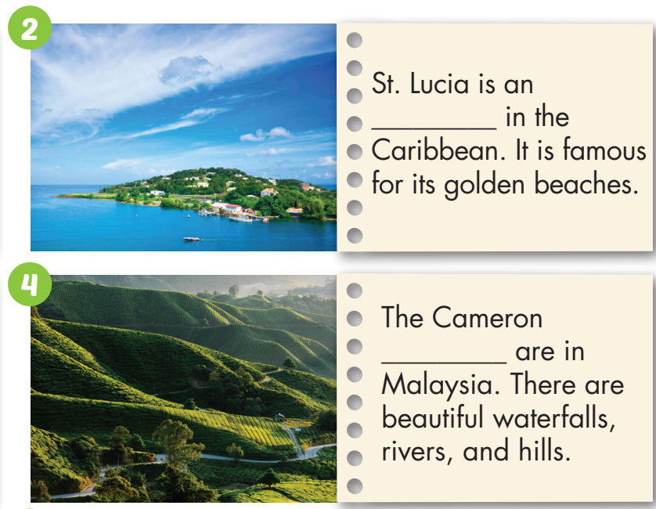
Look at the pictures and fill in the blanks using the words in the box.
island
forest
highlands

Slide 24
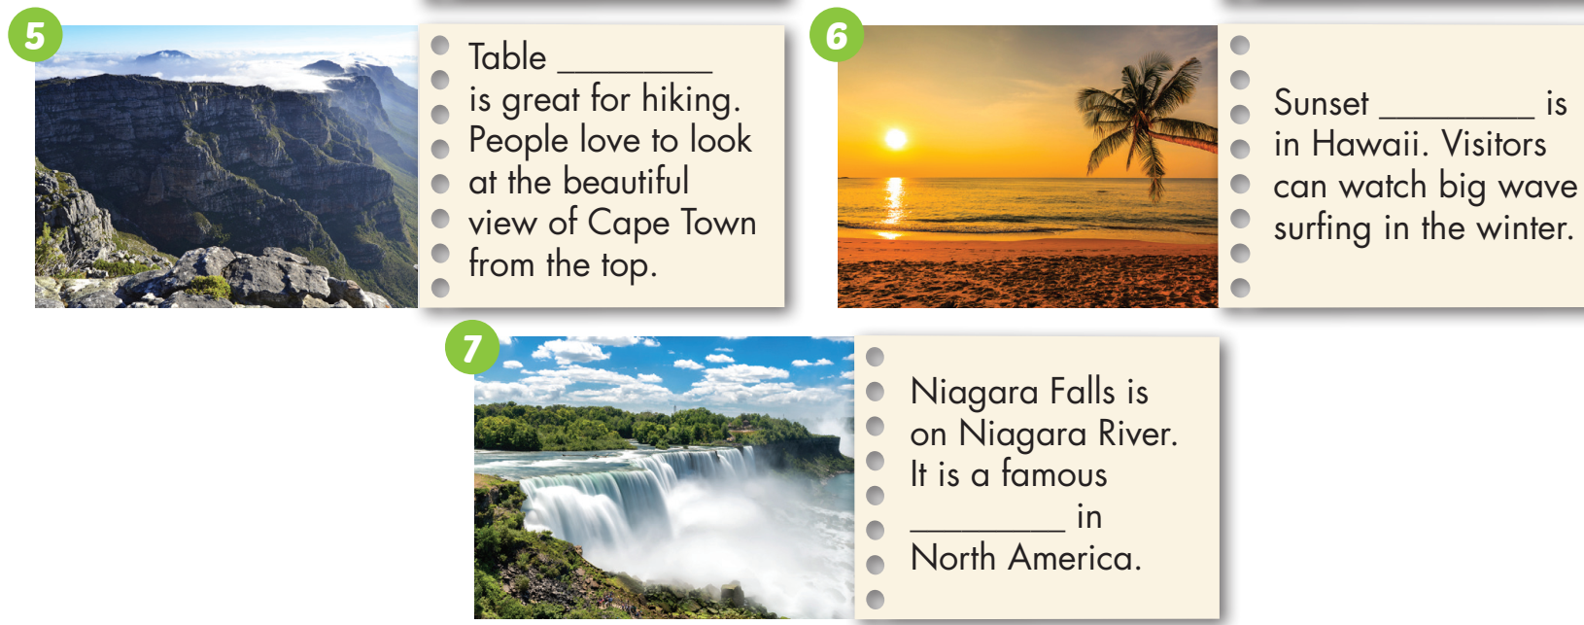
Look at the pictures and fill in the blanks using the words in the box.
mountain
beach
waterfall

Slide 25

Listening

Slide 26
Pre-Listening
Work in pairs and discuss the questions.
Do you want to visit any places in Vietnam and in the world? Why?

Slide 27




While-Listening
a. Listen to Tom talking about places to visit. These places are the best for people who like: doing sports/taking photos.
doing sports

Slide 28
b. Now, listen and number.
1. You can go there by train or bus.
2. You should go there between November and April.
3. You should go there between December and January.
4. You can go there by car or bus.
2
1
4
3

Slide 29
Script
Tom: Phú Quốc Island in Vietnam is great for diving. (1) You
should go there between November and April to miss the rainy season. A great place for surfing is the Bay of Fundy in
Canada. It has long beaches and big waves. (2) You can go there by train or bus. Mount Fuji is the highest mountain in Japan. It’s popular with hikers. (3) You can go there by car or bus. If you like skiing, you should go to the Black Forest in Germany. (4) You should go there between December and January for the snow.

Slide 30
Post-Listening
Work in pairs. Think about your trip and answer.
Where do you want to visit?
When do you want to visit?
How do you go there?

Slide 31


Where should I go for my vacation? What's the best way to get there? Should I go in September? | You should go to Phú Quốc Island. It's beautiful. You can go by boat or plane. No, you shouldn't go then because of the rain.

Slide 32
Where should I go for my vacation? What's the best way to get there? Should I go in __________? | You should go to __________________. You can go by ____ or ____. No, you shouldn't go then because of ___________.
Practice the conversation with your own ideas

Slide 33

CONSOLIDATION

Slide 34
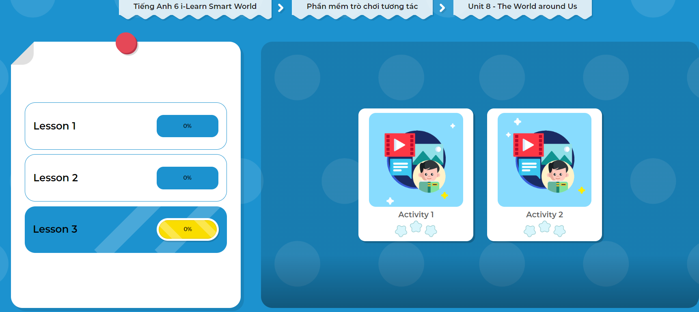
Extra Practice
DHA App
LET’S PLAY!
Click the picture below to play the games!

Slide 35

WRAP-UP

Slide 36
Today’s lesson
Vocabularies
highland, beach, mountain, waterfall, bay, forest, island
Grammar
Modals (should, can)
Listening
Listen to people’s conversations about places to visit

Slide 37
Homework
Learn by hearts vocabularies and make sentences using them.
Do the exercises on page 48 WB.
Do the exercises in Tiếng Anh 6 i-Learn Smart World Notebook on page 50.
Prepare the next lesson (page 69 - SB).
Play the consolidation games in Tiếng Anh 6 i-Learn Smart World DHA App on www.eduhome.com.vn

Slide 38

Lesson 3
Stay positive and have a nice day!

