Slide 2
FUTURE CAREER CHOICES
UNIT 9
CAREER PATHS
LESSON 3
READING

Slide 3
LESSON 3
READING
WARM-UP
Game: Feed the Monkey
Task 1: Discuss the following questions
PRE- READING
Task 2: Circle the words or phrases with
the closest meaning.
Task 3: Match each section with a heading
Task 4: Choose the correct answer.
WHILE- READING
Task 5: Discussion
POST- READING
CONSOLIDATION
Wrap-up
Homework

Slide 4
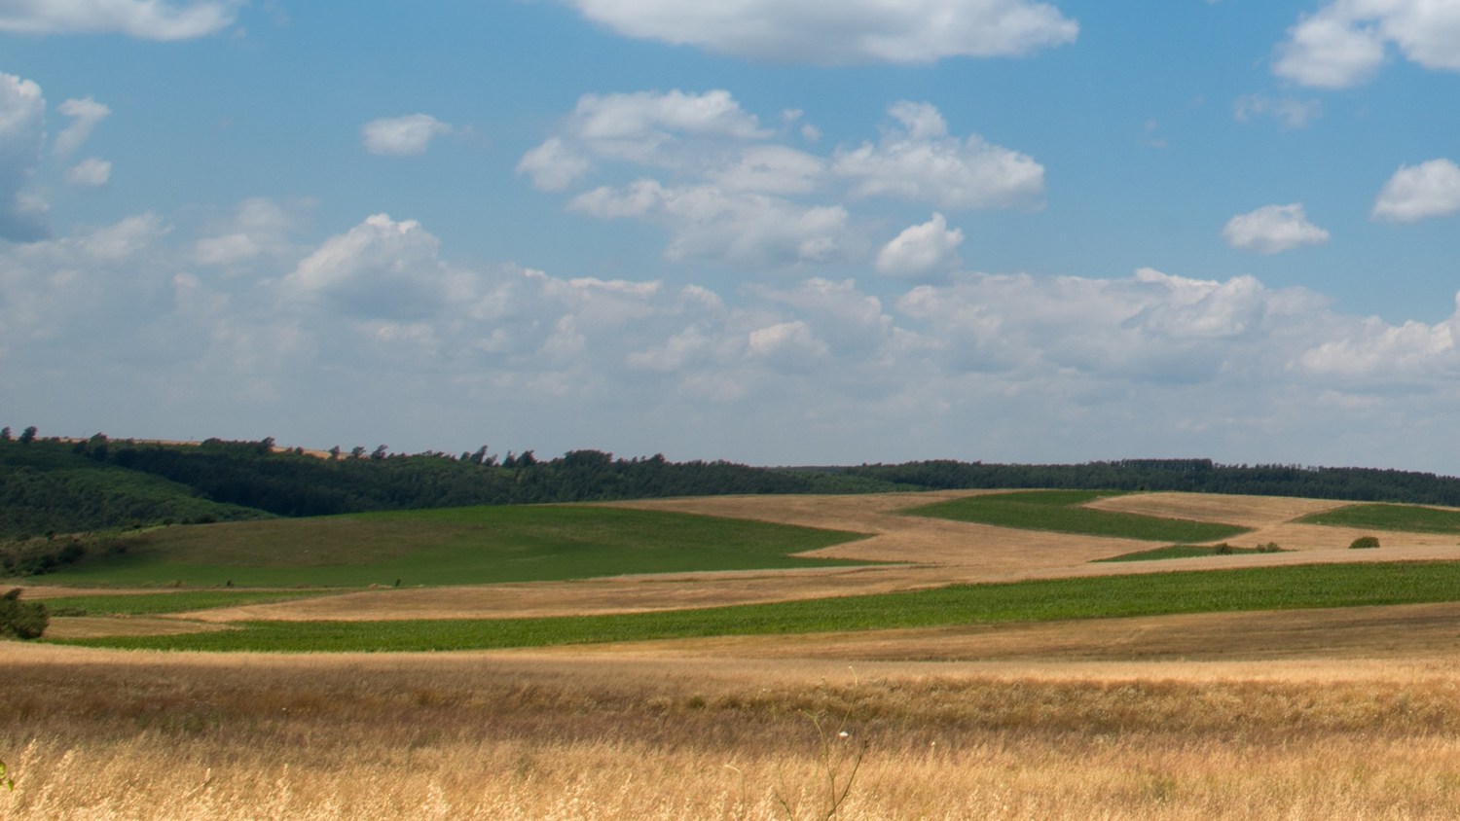


FEED THE MONKEY
WARM-UP
INSTRUCTIONS
Divide the class into 2 teams.
Each team picks an apple to choose the question.
The team look at the description and guess the job.
Each correct answer is 1 point for the team.
GOOD LUCK!
PLAY

Slide 5
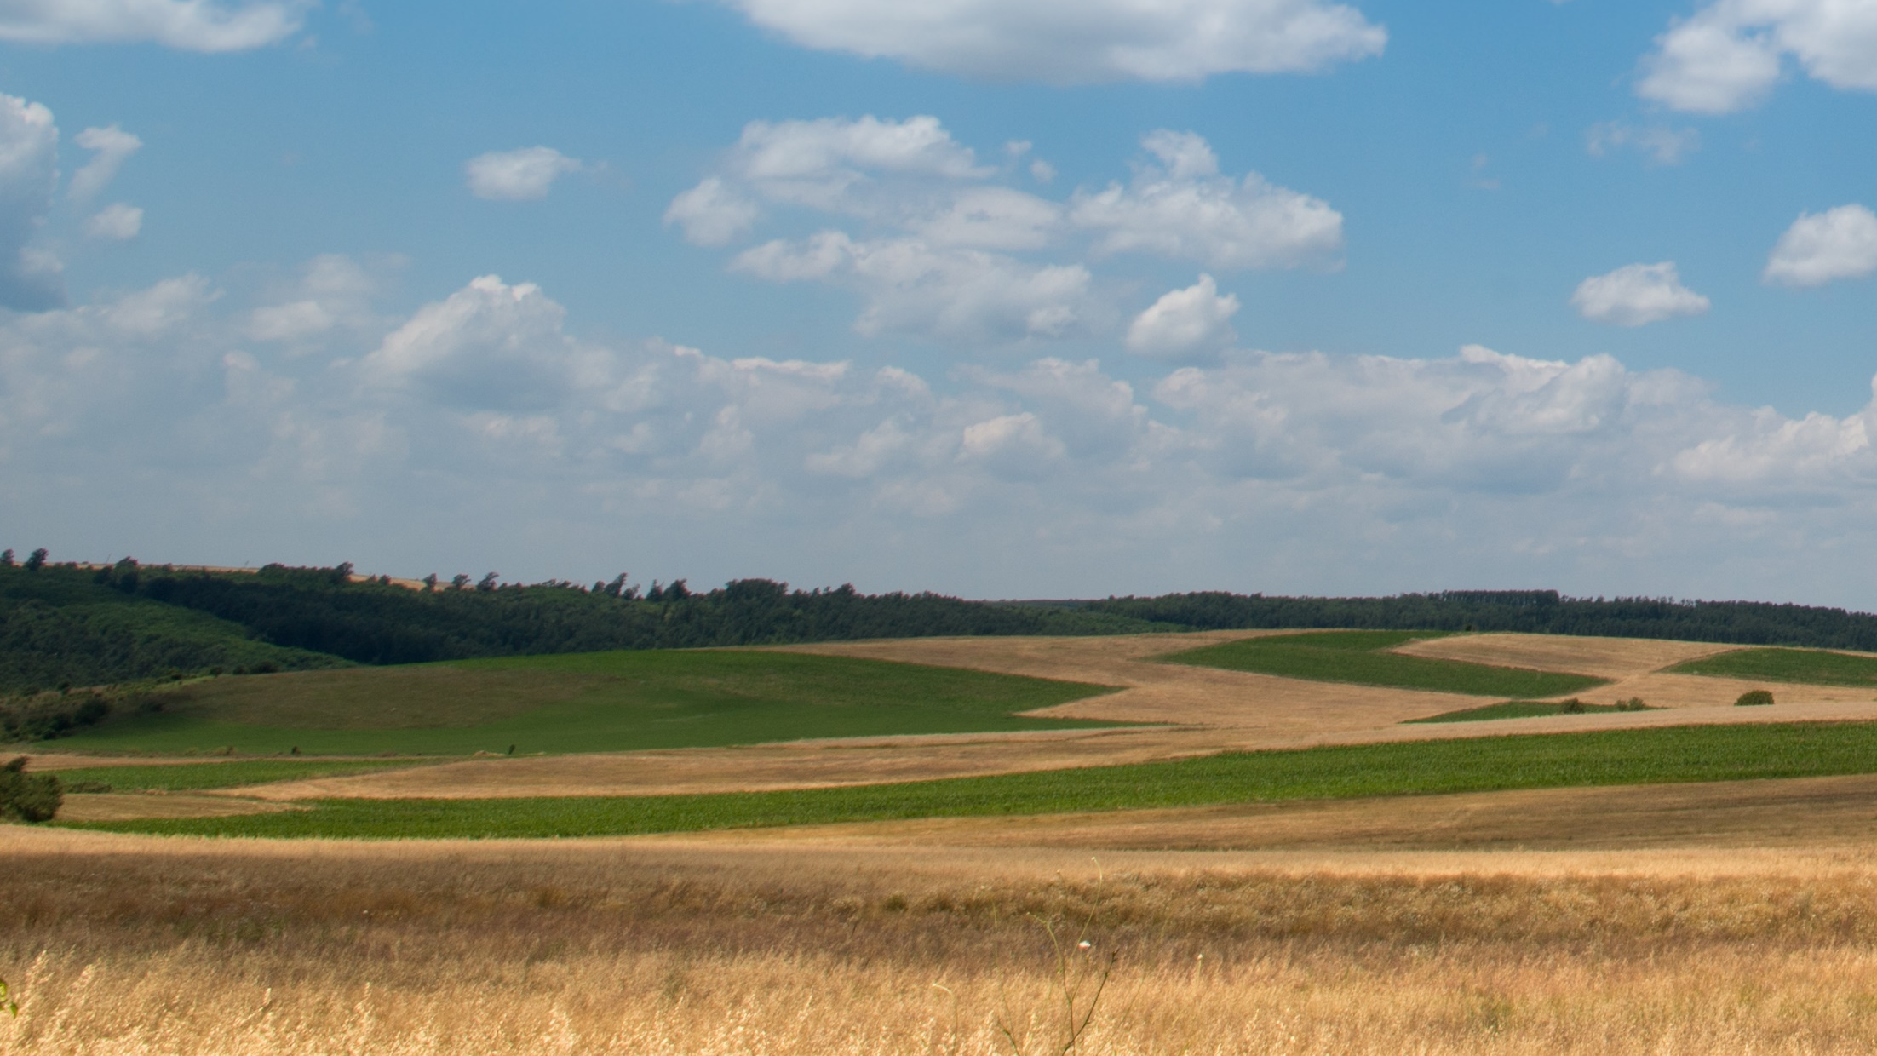





FINISH

Slide 6
a person whose job is to work in a garden
Hint: g_____
gardener
GO BACK

Slide 7
a person whose job involves travelling and working in a spacecraft
Hint: a_____
astronaut
GO BACK

Slide 8
a person whose job is cutting up and selling meat in a shop or killing animals for this
Hint: b______
butcher
GO BACK

Slide 9
a person whose job is to decide how things such as clothes, furniture, tools, etc. will look or work by making drawings, plans or patterns
Hint: d_________
designer
GO BACK

Slide 10
a man who stays at home to cook, clean, take care of the children, etc. while his wife, husband or partner goes out to work
Hint: h______ h_______
house husband
GO BACK

Slide 11
a person whose job is to collect and write news stories for newspapers, magazines, radio, television or online news sites
Hint: j_________
journalist
GO BACK

Slide 12
a person who is in charge of or works in a library
Hint: L________
librarian
GO BACK

Slide 13
a person who provides voices for films, television shows, video games, etc.
Hint: V_____ A______
voice actor
GO BACK

Slide 14
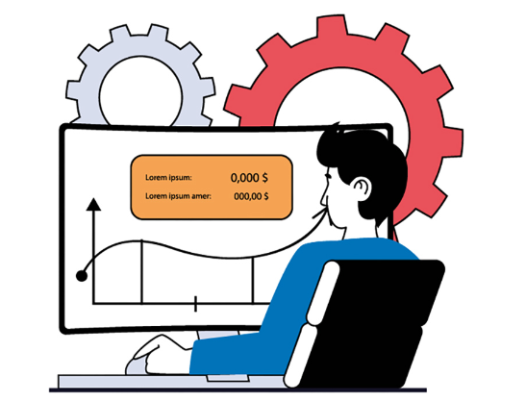

VOCABULARY
passionate (adj)
/ˈpæʃənət/
showing or caused by strong feelings or a strong belief.

Slide 15

VOCABULARY
specialty (n)
/ˈspeʃəlti/
an area of work or study that somebody gives most of their attention to and knows a lot about

Slide 16

VOCABULARY
take into account
/teɪk ɪntə əˈkaʊnt/
to consider or remember something when judging a situation

Slide 17

VOCABULARY
obsolete (adj)
/ˈɒbsəliːt/
no longer produced or used;
out of date

Slide 18
VOCABULARY
Form | Pronunciation | Meaning | Vietnamese equivalent
1. passionate (adj) | /ˈpæʃənət/ | showing or caused by strong feelings or a strong belief | Say đắm
2. specialty (n) | /ˈspeʃəlti/ | an area of work or study that somebody gives most of their attention to and knows a lot about | Chuyên môn

Slide 19
VOCABULARY
Form | Pronunciation | Meaning | Vietnamese equivalent
3. take into account | /teɪk ɪntə əˈkaʊnt/ | to consider or remember something when judging a situation | Tính đến
4. obsolete (adj) | /ˈɒbsəliːt/ | no longer produced or used; out of date | Lỗi thời

Slide 20

PRE-READING
1
Work in pairs. Discuss the following questions.
1. What are your career plans?
2. What do you need to do to prepare your future career?

Slide 21


PRE- READING
1
Work in pairs. Discuss the following questions.
1. What are your career plans?
2. What do you need to do to prepare your future career?
My plan is to become an English teacher after finishing high school. I need to improve my English skills and have a teaching certificate. How about you?

Slide 22


WHILE- READING
2
Read the article.
Circle the words or phrases with the closest meaning to the highlighted words or phrase

Slide 23
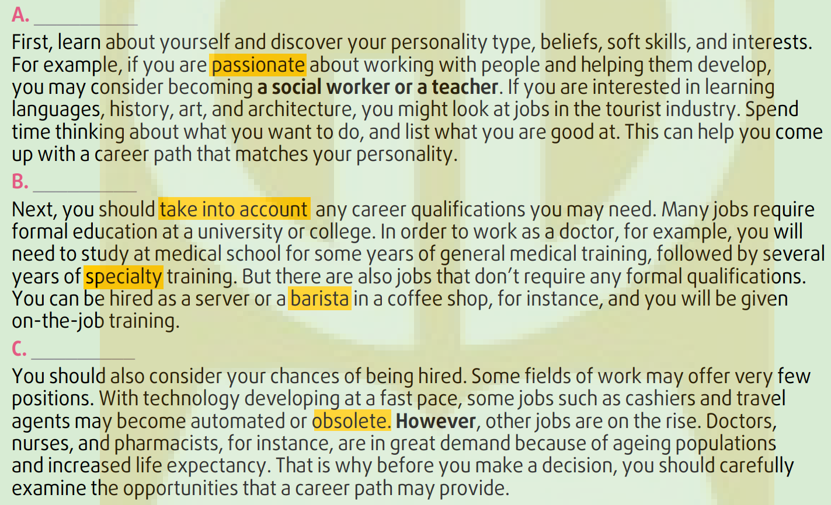
WHILE- READING
1. PASSIONATE
A. having strong feelings of enthusiasm for something
B. showing happiness and excitement about something

Slide 24
WHILE- READING
2. take into account
A. describe
B. consider

Slide 25
WHILE- READING
3. SPECIALTY
A. the subject of study that someone knows a lot about
B. the typical food that a restaurant is famous for

Slide 26
WHILE- READING
4. BARISTA
A. an owner of a coffee shop
B. a person who serves in a coffee shop

Slide 27
WHILE- READING
5. OBSOLETE
A. updated
B. out of date

Slide 28
WHILE- READING
3
Read the article again. Match each section (a–C) with a heading (1–4). There is one extra heading.
1. Think about employment opportunities
2. Ask the career experts for advice
3. Follow your passion and interests
4. Understand education requirements

Slide 29
WHILE- READING
3
4
1

Slide 30
WHILE- READING
4
Read the article again and choose the correct answer A, B, or C.
1. How is the article organised?
A. Using a ‛cause and effect’ text
structure.
B. Discussing similarities and differences.
C. Sorting information into themes and
categories.

Slide 31
WHILE- READING
4
Read the article again and choose the correct answer A, B, or C.
2. Why does the writer mention ‛a social
worker or a teacher’ in Section A?
A. To illustrate jobs related to working with and helping people.
B. To prove that it will be easy to get
these jobs in the future.
C. To show that more and more people want to work as social workers and teachers.

Slide 32
WHILE- READING
4
Read the article again and choose the correct answer A, B, or C.
3. Why does the writer include the server and barista jobs in Section B?
A. To compare these jobs with the jobs that need formal training.
B. To give an example of jobs that don’t require formal training.
C. To give additional examples of jobs that need formal training.

Slide 33
WHILE- READING
4
Read the article again and choose the correct answer A, B, or C.
4. The author uses ‛However’ in Section C in order to _________.
A. explain why the jobs will become obsolete
B. show the consequences of increased life expectancy
C. introduce jobs that are in demand

Slide 34

POST- READING
5
Work in pairs. discuss the following questions.
What kind of job do you prefer: a job that requires formal education or a job that does not? Why?

Slide 35
POST- READING
5
Work in pairs. discuss the following questions.
*Suggested answers:
I prefer a job that requires formal education because I believe that the formal education will provide me with not only the technical knowledge but also soft skills that help me get better prepared for the world of work.

Slide 36

CONSOLIDATION
1
Wrap-up
What have you learnt today?
Some lexical items about career path
New vocabulary words
Three-word phrasal verbs

Slide 37
CONSOLIDATION
2
Homework
Learn by heart new Vocabulary.
Do exercises in the workbook.
Prepare for Lesson 4 - Unit 9.

Slide 38
Website: hoclieu.vn
Fanpage: facebook.com/www.tienganhglobalsuccess.vn

