Slide 1

Unit 4: All things high-tech
Lesson 4b: Grammar
Page 66

Slide 2
Lesson Outline
Warm-up
Grammar
Consolidation
Wrap-up

Slide 3
Objectives
By the end of this lesson, students will be able to…
- use modals correctly.

Slide 4

WARM-UP

Slide 5

Work in pairs.
MATCHING
Match the verbs in column A with correct uses in column B
A | B
1. repair | a. planes
2. fly | b. photos
3. take | c. buildings
4. design | d. software

Slide 6

It’s time to learn …

Slide 7

Presentation

Slide 8
Examples
1. Can I go out?
2. You mustn’t touch the exhibits.
3. You have to be here on time.
4. You should drink more water.

Slide 9
Lead in
1. What are can, mustn’t, have to, should in those sentences ?
Modals.
2. What do we use modals for?
→T o give permission (can), prohibition (mustn’t), obligation, necessity/lack of necessity (have to), advice/recommendation (should).

Slide 10
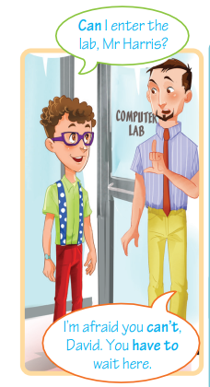

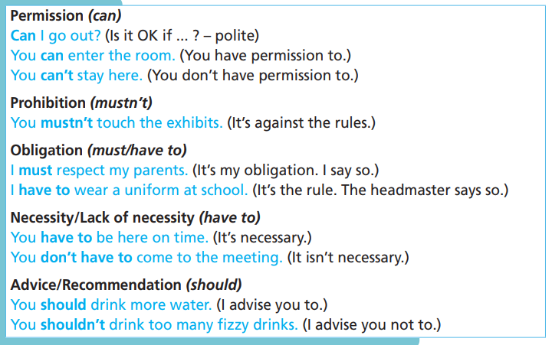

Slide 11

Practice

Slide 12
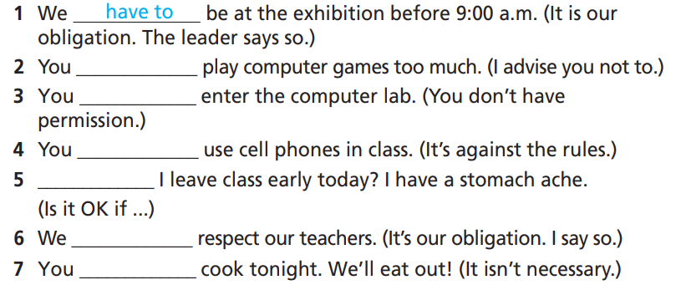
Practice
1 Fill in each gap with the correct modal verb.
How many sentences are there?
→ There are 7.
What are you going to do?
Fill in each gap with the correct modal verb.

Slide 13
Practice
1 Fill in each gap with the correct modal verb.
1. We _________ be at the exhibition before 9:00 a.m. (It is our
obligation. The leader says so.)
2. You _____________ play computer games too much. (I advise you not to.)
3. You _____________ enter the computer lab. (You don’t have
permission.)
4. You _____________ use cell phones in class. (It’s against the rules.)
have to
shouldn’t
can’t
mustn’t

Slide 14
Practice
Fill in each gap with the correct modal verb.
5. _____________ I leave class early today? I have a stomach ache. (Is it OK if ...)
6. We _____________ respect our teachers. (It’s our obligation. I say so.)
7. You _____________ cook tonight. We’ll eat out! (It isn’t necessary.)
Can
must
don’t have to

Slide 15
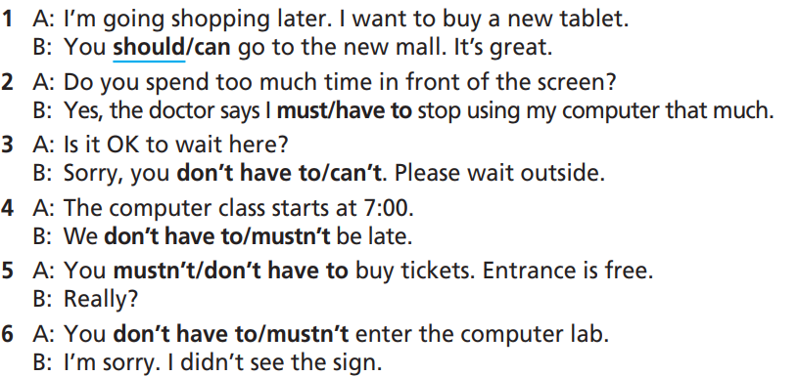
Practice
2 Choose the correct option.
How many sentences are there?
→ There are 6.
What will you do?
Choose the correct option.

Slide 16
Practice
2 Choose the correct option.
1. A: I’m going shopping later. I want to buy a new tablet.
B: You should/can go to the new mall. It’s great.
2. A: Do you spend too much time in front of the screen?
B: Yes, the doctor says I must/have to stop using my computer that much.
3. A: Is it OK to wait here?
B: Sorry, you don’t have to/can’t. Please wait outside.

Slide 17
Practice
2 Choose the correct option.
4. A: The computer class starts at 7:00.
B: We don’t have to/mustn’t be late.
5. A: You mustn’t/don’t have to buy tickets. Entrance is free.
B: Really?
6. A: You don’t have to/mustn’t enter the computer lab.
B: I’m sorry. I didn’t see the sign.

Slide 18
Extra Practice
WB, page 33
Choose the correct option.
1. Can/Must I use your tablet to check my emails?
2 Do I have to/must back up all my flies right now?
3. Computer games are fun, but you shouldn’t/mustn’t play too much.
4. You should/shouldn’t study hard for the exam.
5. I can/must go out tonight if I finish my homework.

Slide 19
Extra Practice
WB, page 33
Choose the correct option.
6. I must/can remember to video call my aunt tonight.
7. Doug can/has to repair your drone for you.
8. You have to/should pay fees to use this app.
9. You mustn’t/couldn’t share your password with anyone.
10. They have games consoles for gamers at the contest. You don’t have to/mustn’t bring yours.

Slide 20
Extra Practice
Grammar bank, page 71
Choose the correct option.
1. You mustn’t/don’t have to cook dinner tonight. Carmen did it for you.
2. Must/Can I use your drone for a while?
3. I don’t have/mustn’t to bring lunch box. I have lunch at the school canteen.
4. You shouldn’t/should go now. It's late.

Slide 21
Extra Practice
Grammar bank, page 71
Choose the correct option.
5. I have to/can take care of my sister when Mom is working.
6. Students mustn’t/don’t have to drink or eat in class.
7. You shouldn’t/mustn’t go out. It is raining heavily.
8. You can’t/don’t have to take part in the party if you don’t wear black clothes.

Slide 22

Production

Slide 23

Tell your partner five things he/ she should/ shouldn’t do.
Suggested answer
1. You should study hard.
2. You should brush your teeth at least twice a day.
3. You shoudn’t talk while the teacher is explaining the lesson.
4. You shouldn’t play too much video games.
5. You should recycle things.

Slide 24

CONSOLIDATION

Slide 25

Work in pairs.
Now, practice the conversation with your partner.
1. A: I’m going shopping later. I want to buy a new tablet.
B: You should go to the new mall. It’s great.
2. A: Do you spend too much time in front of the screen?
B: Yes, the doctor says I have to stop using my computer that much.
3. A: Is it OK to wait here?
B: Sorry, you can’t. Please wait outside.

Slide 26

Work in pairs.
Now, practice the conversation with your partner.
4. A: The computer class starts at 7:00.
B: We mustn’t be late.
5. A: You don’t have to buy tickets. Entrance is free.
B: Really?
6. A: You mustn’t enter the computer lab.
B: I’m sorry. I didn’t see the sign.

Slide 27

WRAP-UP

Slide 28
Today’s lesson
Grammar: use modals correctly.
Speaking: give advice.

Slide 29
Homework
Practise the structure and make sentences using them.
Do the exercises in TA 7 Right on WB (page 33).
Prepare the next lesson (page 67 SB).
Complete the grammar notes in TA 7 Right on Notebook (page 30).

Slide 30

Enjoy your day!

