Slide 1
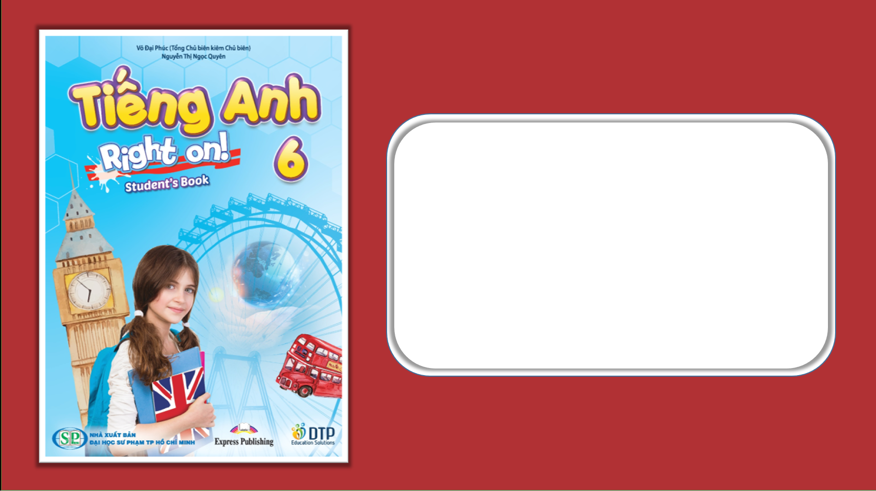
Unit 1: Home and Places
Lesson 1: Progress Check 2
Page 35

Slide 2
Lesson Outline
Warm-up
Reading
Listening
Writing
Consolidation
Wrap-up

Slide 3
Objectives
By the end of this lesson, students will be able to…
Improve listening and reading skills
Write about their neighbourhood
Practise test-taking skills

Slide 4

WARM-UP

Slide 5
Choose the word whose main stress is placed differently from that of the others.
1 A. suburb B. police C. yellow D. station
/ˈsʌbɜːb/
/pəˈliːs/
/ˈjeləʊ/
/ˈsteɪʃən/
2 A. parrot B. rabbit C. guitar D. office
/ˈpærət/
/ˈræbɪt/
/ɡɪˈtɑː/
/ˈɒfɪs/
3 A. museum B. furniture C. stadium D. bicycle
/mjuːˈziəm/
/ˈfɜːnɪtʃə/
/ˈsteɪdiəm/
/ˈbaɪsɪkəl/

Slide 6
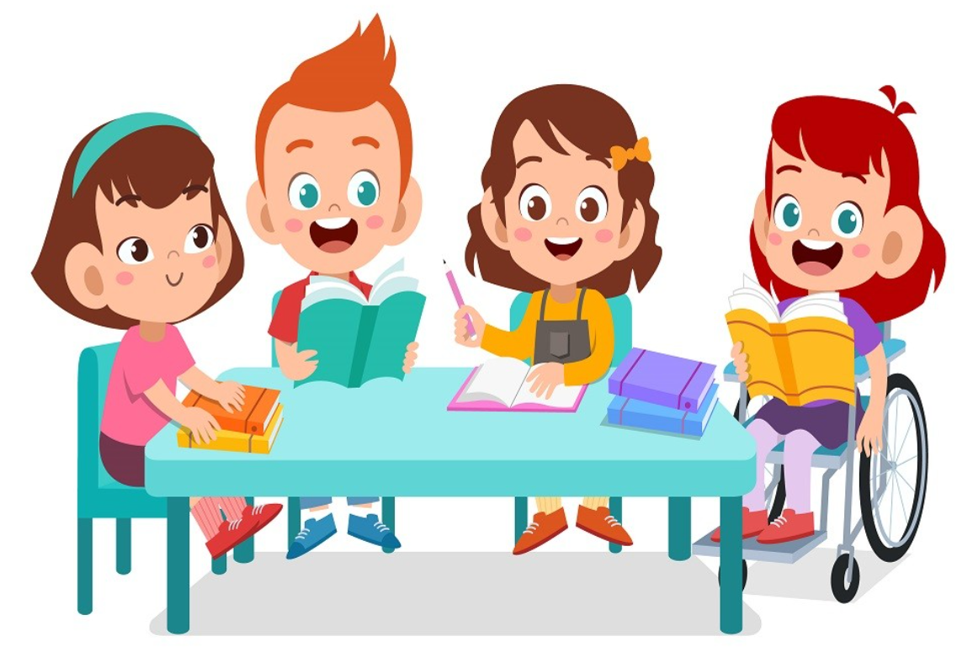
It’s time to learn …

Slide 7
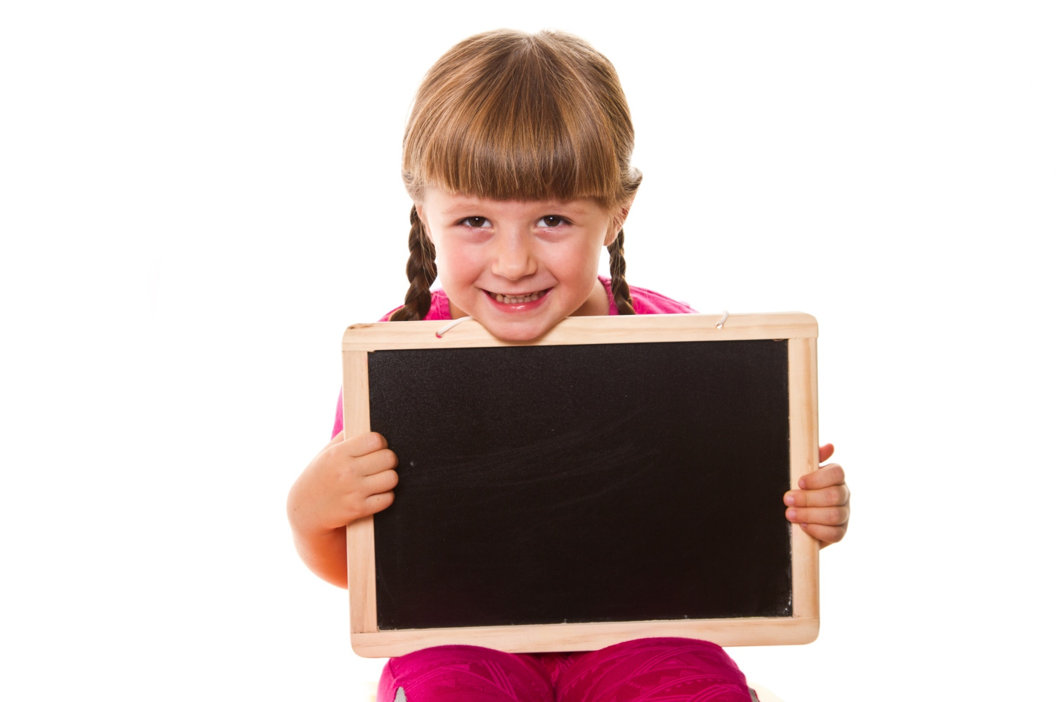
Reading

Slide 8
8. Read the text and answer the questions in your notebook.
Independence Palace, or Reunification Palace, is a beautiful palace in Ho Chi Minh City. The palace has got five levels with over 100 rooms. There is one ground floor, three main floors and two mezzanines. There are tunnels, a war room, a card-playing room, a casino and a telecommunications centre. There is a heliport on the roof where helicopters can land. Outside, there are beautiful gardens. It is open every day from 7:30 a.m. until 4:00 p.m. The palace is close to Bến Thành Market. There, people can buy souvenirs and try amazing Vietnamese dishes.
1 Where is Independence Palace?
2 How many levels has it got?
3 What is there on the roof?
4 When is it open?

Slide 9
8. Read the text and answer the questions in your notebook.
Independence Palace, or Reunification Palace, is a beautiful palace in Ho Chi Minh City. The palace has got five levels with over 100 rooms. There is one ground floor, three main floors and two mezzanines. There are tunnels, a war room, a card-playing room, a casino and a telecommunications centre. There is a heliport on the roof where helicopters can land. Outside, there are beautiful gardens. It is open every day from 7:30 a.m. until 4:00 p.m. The palace is close to Bến Thành Market. There, people can buy souvenirs and try amazing Vietnamese dishes.
1 Where is Independence Palace?
2 How many levels has it got?
It is in Ho Chi Minh City.
It has got five levels.

Slide 10
8. Read the text and answer the questions in your notebook.
Independence Palace, or Reunification Palace, is a beautiful palace in Ho Chi Minh City. The palace has got five levels with over 100 rooms. There is one ground floor, three main floors and two mezzanines. There are tunnels, a war room, a card-playing room, a casino and a telecommunications centre. There is a heliport on the roof where helicopters can land. Outside, there are beautiful gardens. It is open every day from 7:30 a.m. until 4:00 p.m. The palace is close to Bến Thành Market. There, people can buy souvenirs and try amazing Vietnamese dishes.
3 What is there on the roof?
4 When is it open?
There is a heliport on the roof.
It is open every day from 7:30 a.m. until 4:00 p.m.

Slide 11
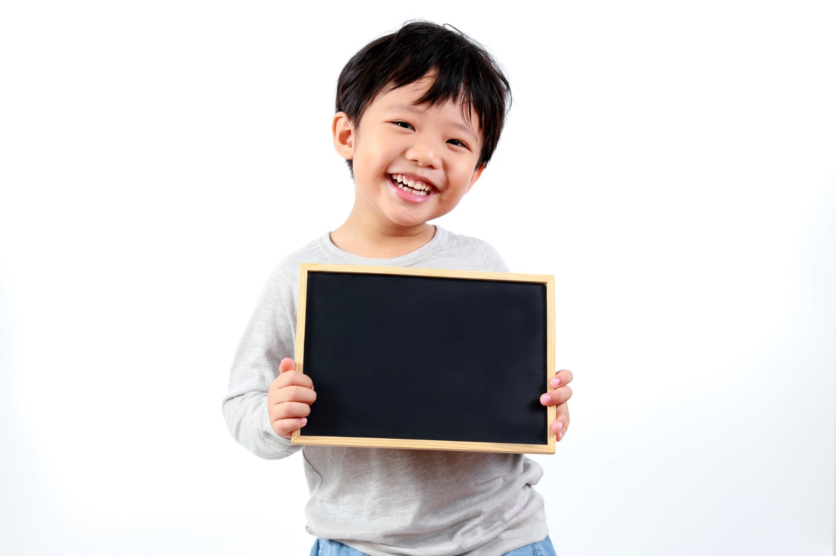
Listening

Slide 12

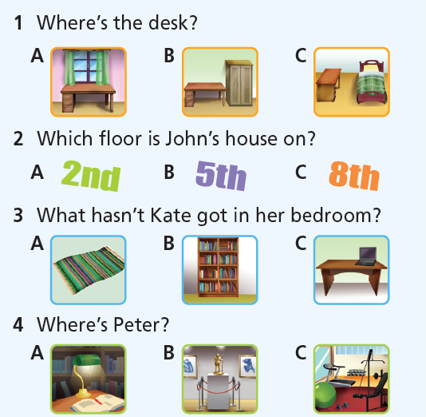
Listen and choose the correct answer (A, B or C).

Slide 13
Audio Scripts
1 Where’s the desk?
My bedroom is great! It has got a single bed, a big wardrobe and a window. Also, there is a desk so I can do my homework in the evenings. The wardrobe is next to my bed and the desk is in front of the window so I can look outside.

Slide 14
Audio Scripts
2 Which floor is John’s house on?
Hi, Emma! It’s John. Where are you? I can’t reach you on your mobile phone or on your home phone. Anyway, my birthday party is tomorrow evening. Please come! My house is at 2 Park Street, on the 8th floor. There is no lift on my floor, but you can go to the fifth floor and walk up to the 8th. See you there!

Slide 15
Audio Scripts
3 What hasn’t Kate got in her bedroom?
A: Hi, Kate! How is your new house?
B: Hi, Jill. It’s just great! It’s so big.
A: So, have you got your own room?
B: Yes, I have. It’s got a single bed and a thick carpet and a desk for my computer.
A: What about all your books?
B: They are in the bookcase in the living room, but that’s OK because I can read them on the sofa!

Slide 16
Audio Scripts
4 Where’s Peter?
A: Hi, Peter! Why are you here? Why aren’t you in the library? Haven’t you got an exam on Tuesday?
B: Hi, Sarah. No, that exam is on Friday. On Tuesday, we’ve got a class trip to a museum.
A: Oh! So that’s how you’ve got time to be in the gym!
B: That’s right!

Slide 17
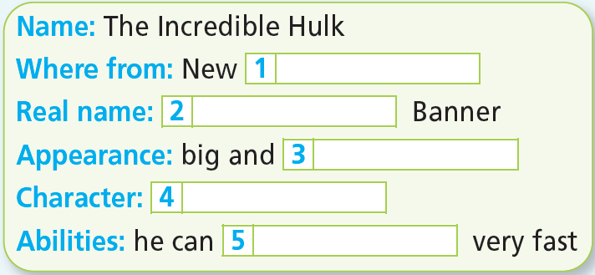
More Practice
WB p. 21
Listen and fill in the gaps.
York
Bruce
strong
clever
run

Slide 18
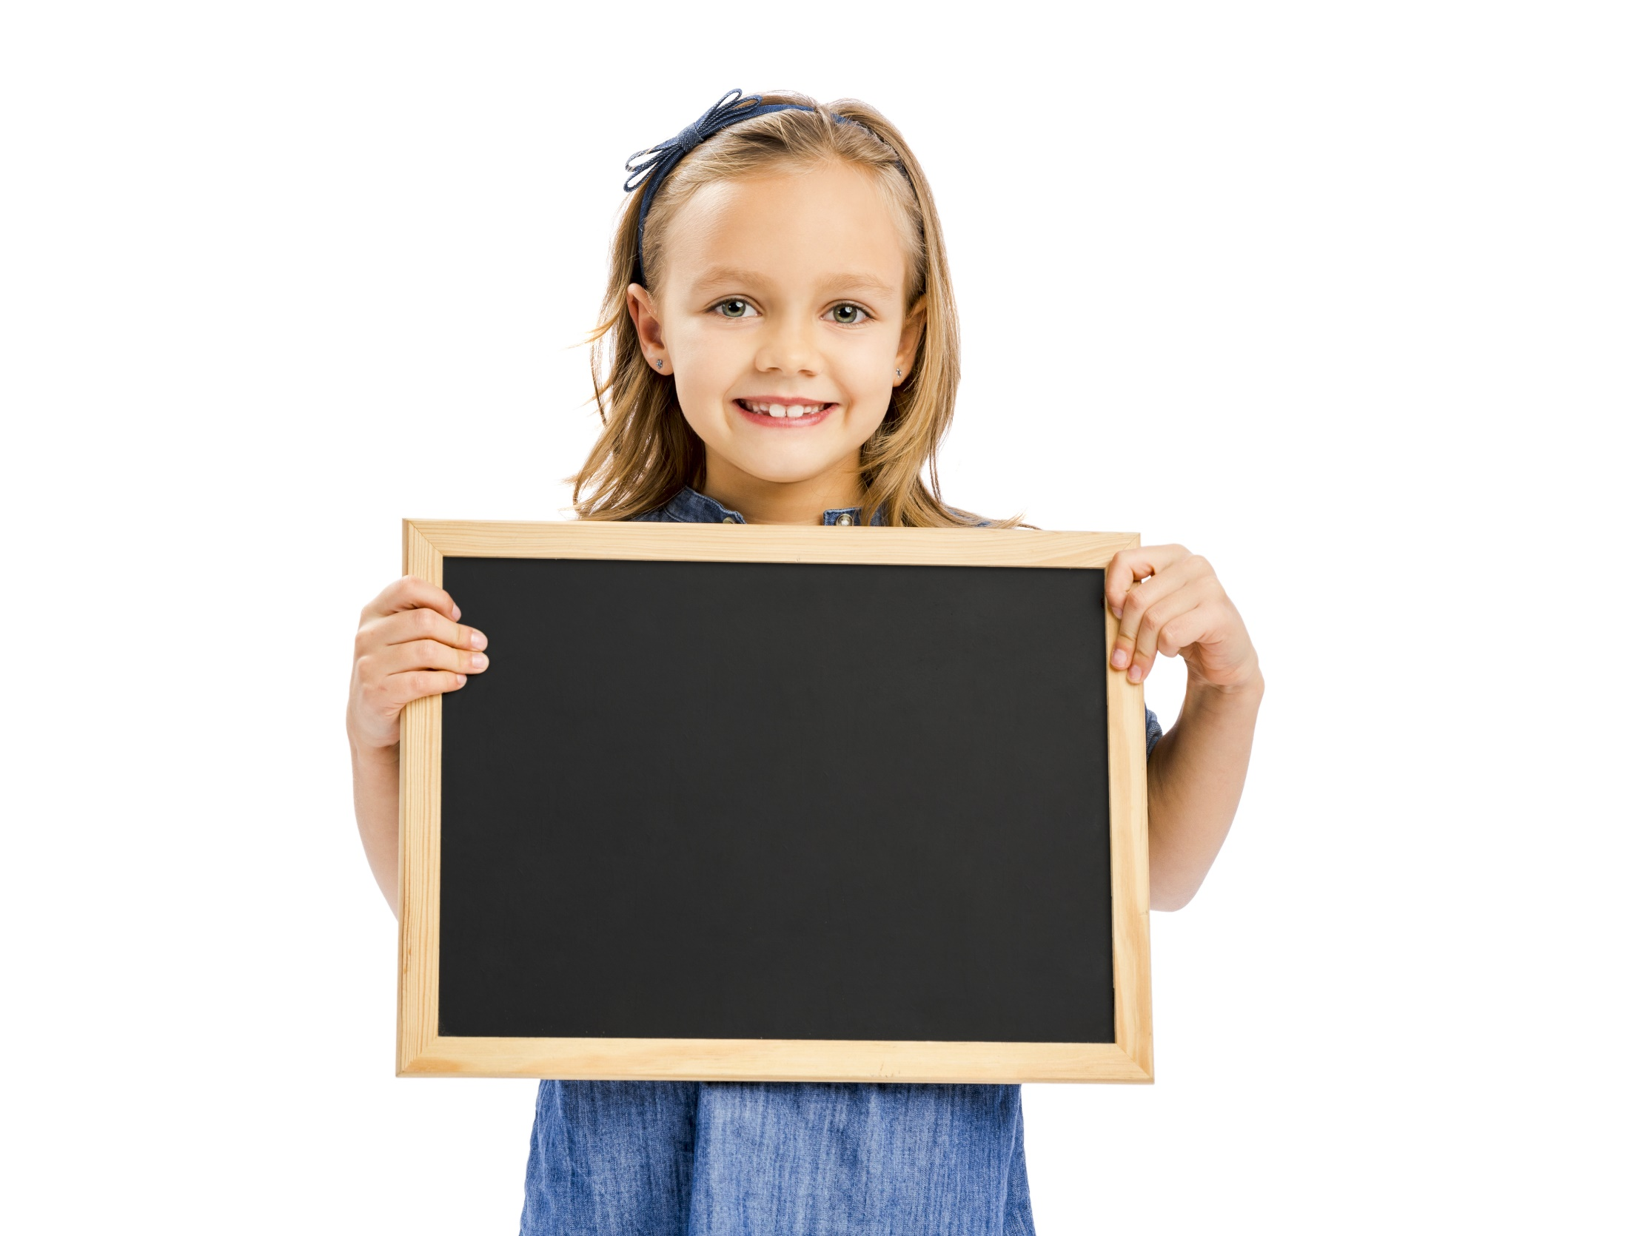
Writing

Slide 19
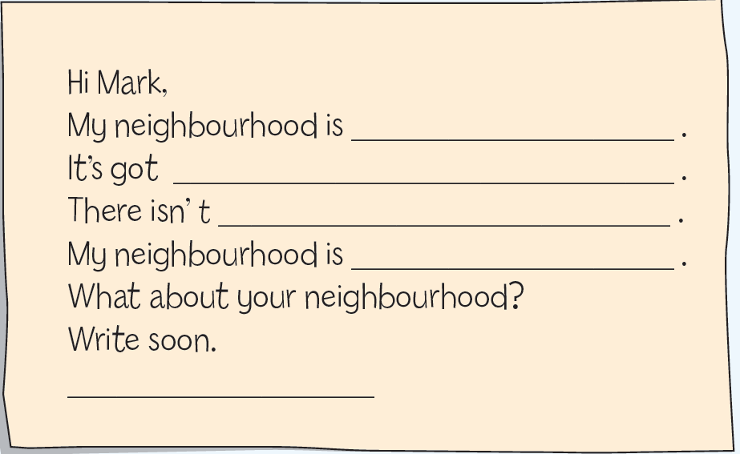
10. Complete a letter to Mark about your neighbourhood (about 50 words). Write about where it is, what there is/isn’t in it and how you like it.
Writing

Slide 20
More Practice
WB p. 21
★★★ Look at the notes and complete Jack’s email.
big, near park
outside: garden (✓), garage (✗)
inside:
downstairs – living room (✓), dining room (✗), kitchen (✓)
upstairs – bedroom (2), bathroom (2)
Jack’s room: big – bed (✓), wardrobe (✓), bookcase (✗), bedside cabinet (✗), desk (✓), posters (✓)

Slide 21
More Practice
WB p. 21
From: Jack
To: Mark
Subject: My new home!
Hi Mark,
How are you? I’m so happy with my new house! It’s in a quiet street near 1) ______________ . There is 2) __________________ outside. My house isn’t small. It’s 3) _________________ . Downstairs, there’s 4) ___________________ and 5) ___________________ . Upstairs, there are 6) ______________________ . My favourite room is my bedroom. It’s 7) _____________ . There’s 8) ___________________ in it. There isn’t 9) _________________ . There 10) _______________ of my favourite footballers on the walls.
I can’t wait for you to come and see me. How about this Saturday? Let me know.
Write back.
Jack

Slide 22
big, near park
outside: garden (✓), garage (✗)
inside:
downstairs – living room (✓), dining room (✗), kitchen (✓)
upstairs – bedroom (2), bathroom (2)
Jack’s room: big – bed (✓), wardrobe (✓), bookcase (✗), bedside cabinet (✗), desk (✓), posters (✓)
From: Jack
To: Mark
Subject: My new home!
Hi Mark,
How are you? I’m so happy with my new house! It’s in a quiet street near 1) ________. There is 2) _________ outside. My house isn’t small. It’s 3) ____. Downstairs there’s 4) ___________ and 5) ________. Upstairs there are 6) ____________________________. My favourite room is my bedroom. It’s 7) ____. There’s 8) ________________________ in it. There isn’t 9) ___________________________. There 10) ____________ of my favourite footballers on the walls.
I can’t wait for you to come and see me. How about this Saturday? Let me know.
Write back.
Jack
a park
a garden
big
a living room
a kitchen
two bedrooms and two bathrooms
big
a bed, a wardrobe and a desk
a bookcase or a bedside cabinet
are posters

Slide 23

CONSOLIDATION

Slide 24
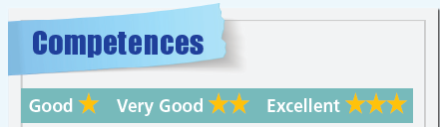
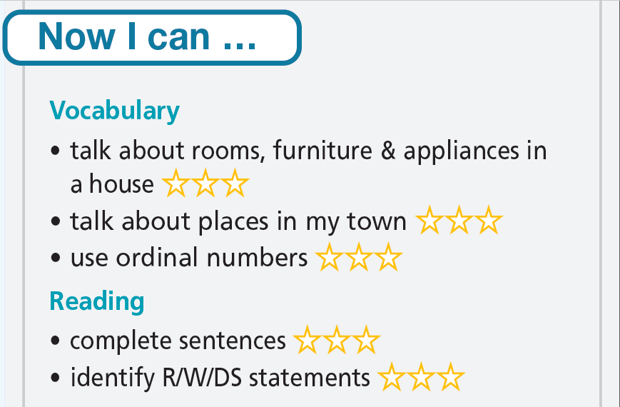
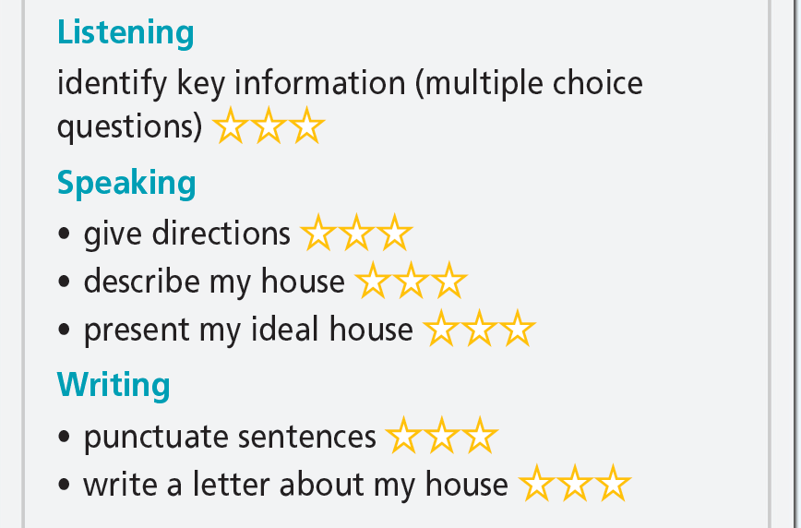

Slide 25

WRAP-UP

Slide 26
Today’s lesson
Skills:
Reading
Listening
Writing

Slide 27
Homework
Practise the vocabularies and grammar and make sentences using them.
Do the exercises in TA 6 Right on WB (p. 19).
Do Unit 1 Test 2 in Bài Tập Bổ Trợ TA 6 Right on (pp. 16-17).
Prepare the next lesson (p. 36 SB).

Slide 28
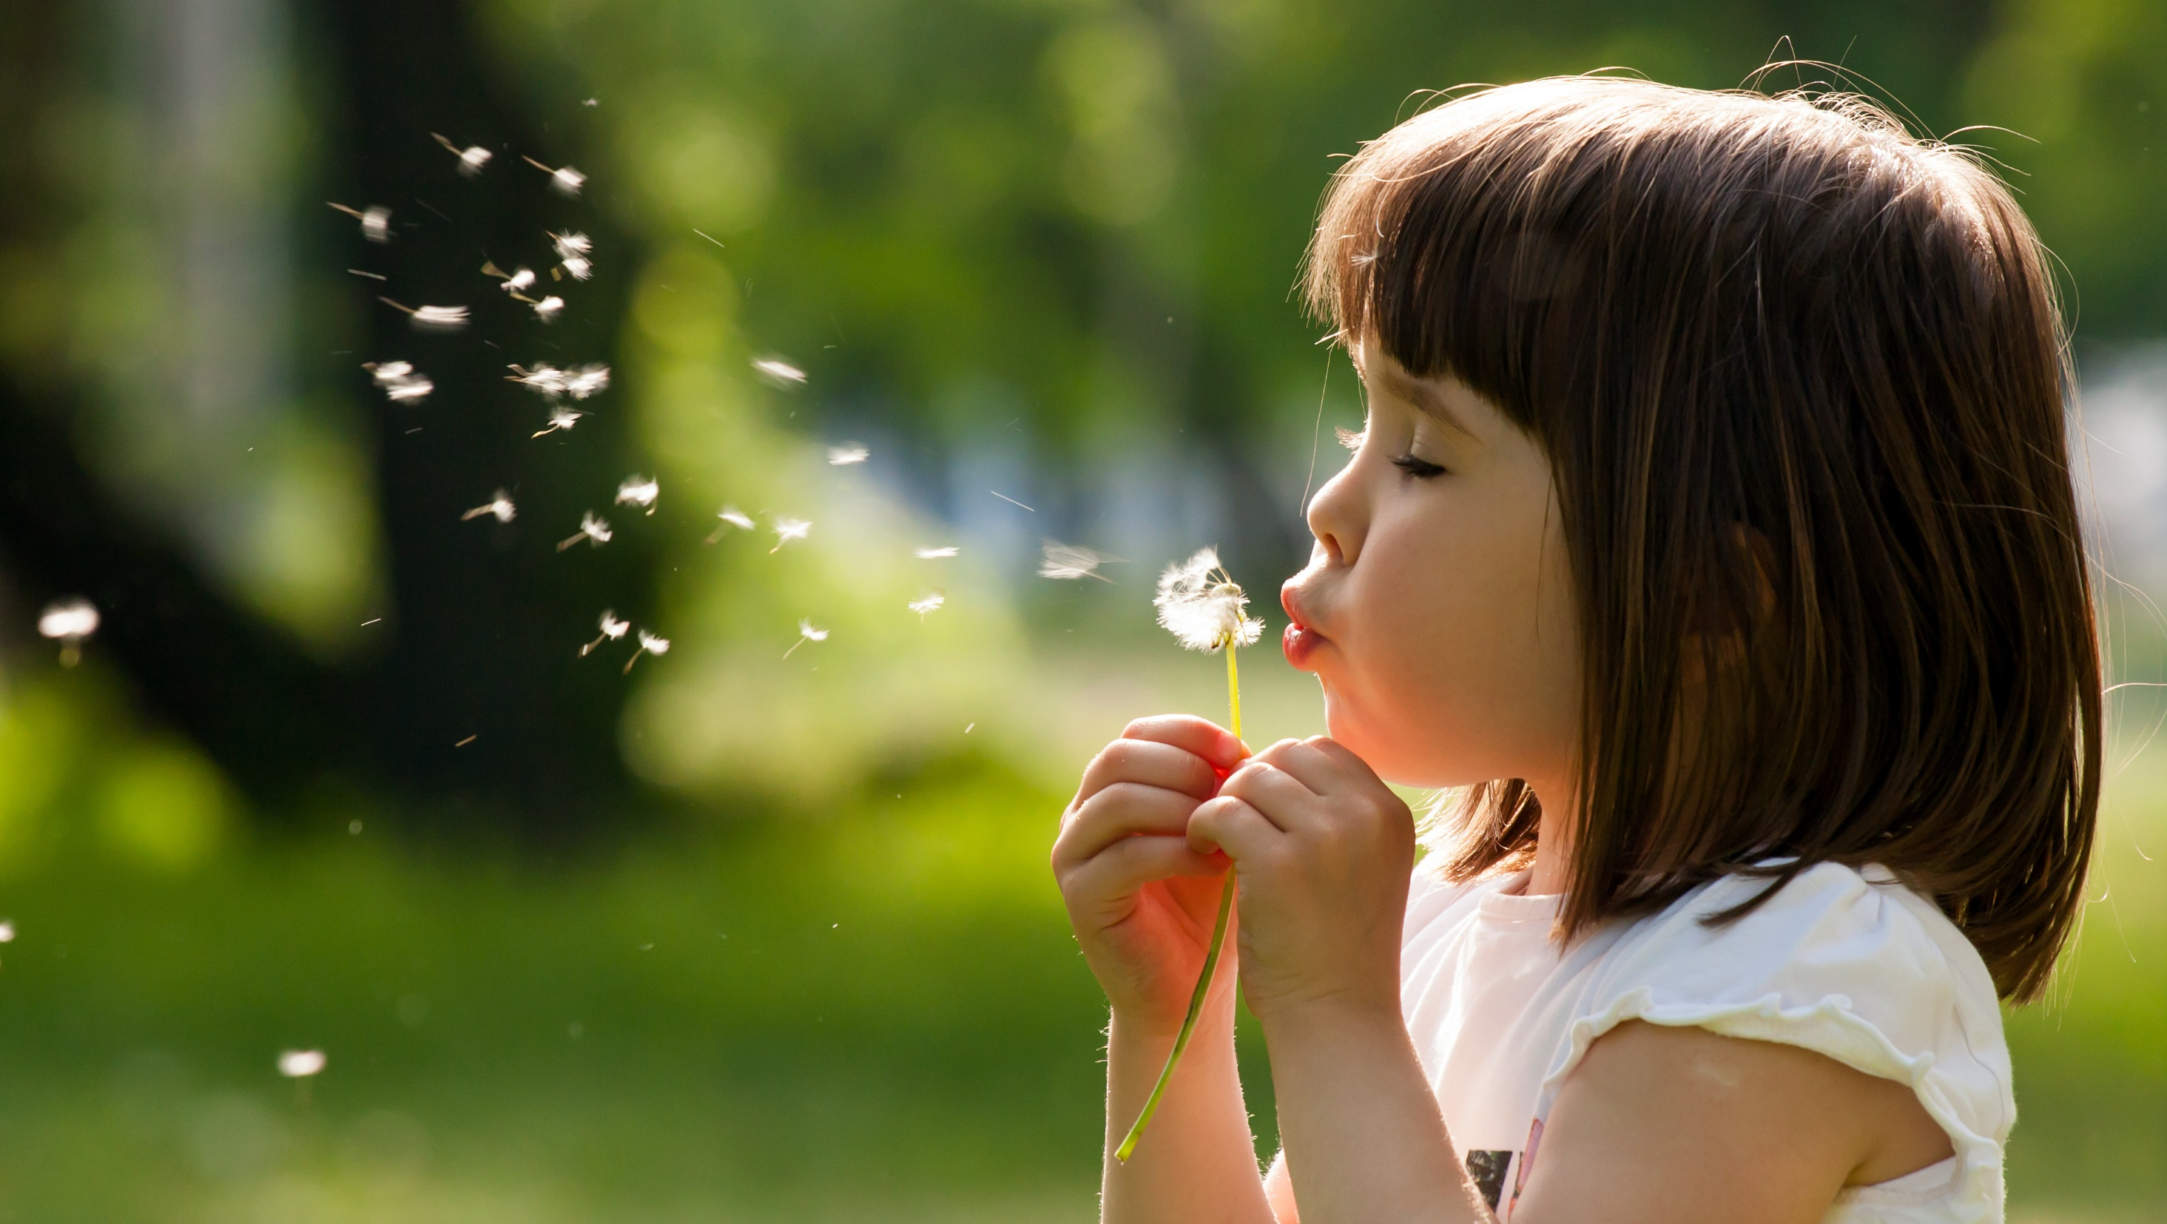
Enjoy your day!

