Slide 1

Unit 1: My friends
Lesson 1.3
Page 12

Slide 2
Lesson Outline
Warm-up
Speaking
Consolidation
Wrap-up

Slide 3
Objectives
By the end of this lesson, students will be able to ….
Vocabulary: Remember and use the Alphabet flexibly
Structure: use the structures below with confidence.
- My friend’s name is Alfie.
- How do you spell “Alfie”?
- A-L-F-I-E.

Slide 4

WARM UP

Slide 5
FASTEST PEN GAME
1. Alfie
2. blue and red.
3. It’s black and yellow
4. one black and yellow cat
5. three black and white dogs
Notes:
Divide students into 3-4 games, make lines.
Divide board into 3-4 parts for each teams.
Teacher say ONE WORD => each student in turn write ONE LETTER. The last student finishing the word have to SLAP THE BOARD AND SAY BINGO.
Levep up when teacher says A PHRASE (students write 1 WORD) => A SENTENCE. (students write 1 WORD)

Slide 6

It’s time to learn …

Slide 7
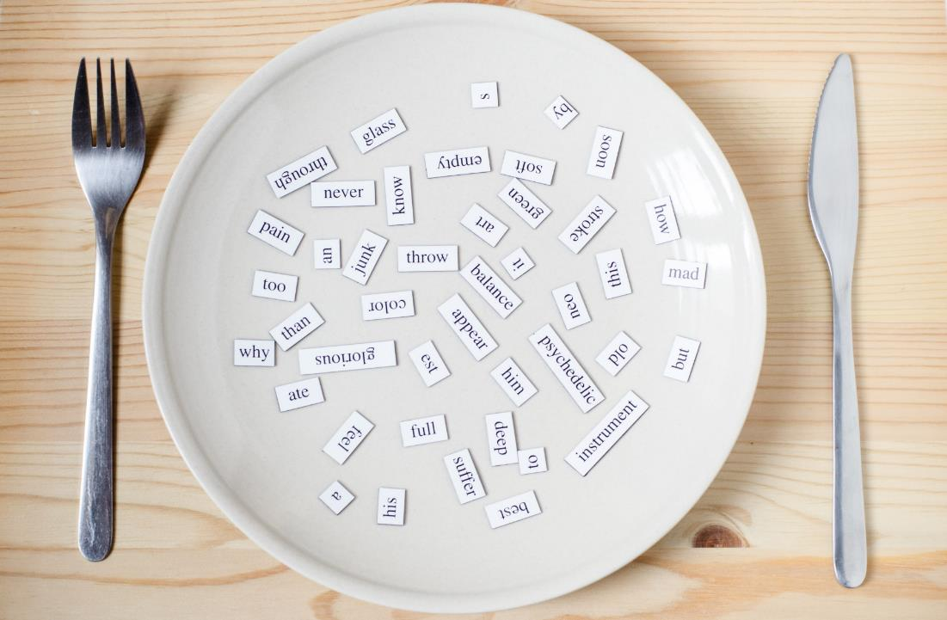
Speaking

Slide 8


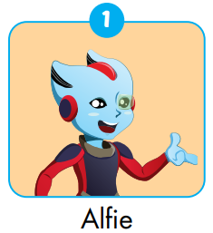
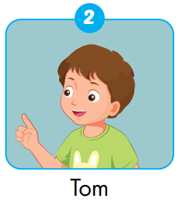
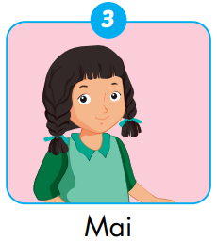
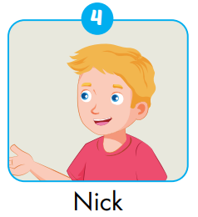
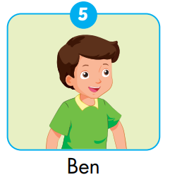
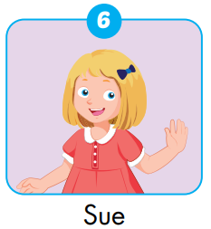
Notes:
Invite students to play roles.

Slide 9

Practice 1

Slide 10



How can you spell “Alfie”?
A-L-F-I-E.
30
20
40
10
ESTHER
50
80
ELLY
NOOB
KELVIN
ROSE
LISA
SARAH
TINA
ANNA
ROSY
SLENDERMAN
HUGO
JENNIE
NACY
MARIO
LUCY
IRONMAN
MARIA
PATT
LOUIS
60
70
SPIN
Notes:
-divide students into 2-3 teams.
In turn, ask and answer the name.
Click SPIN to spin the wheel. Click on the WHEEL TO STOP and get point.
(there are already 20 names in game)

Slide 11

Practice 2

Slide 12
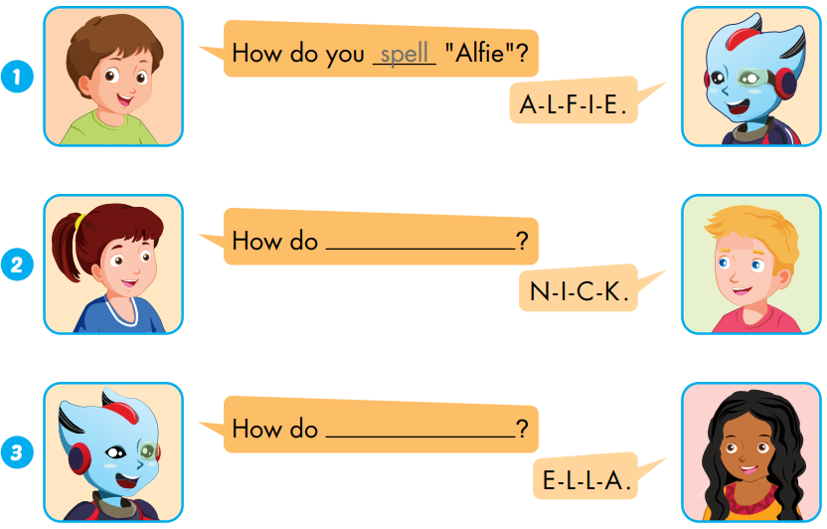

Extra 1 – WB P.9
...
spell
...
spell “Nick”
spell “Ella”
...

Slide 13
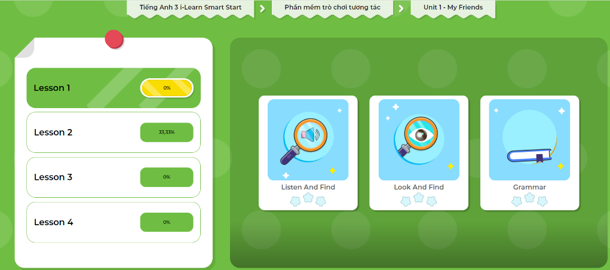
Extra-Act2. DHA app.
Click here to play the games

Slide 14
FREER PRACTICE

Slide 15
Act1.
NOOB
ALEX
ANNA
DYLAN
SIMON
Wheel of points
My friend’s name is Alfie.
It’s A-L-F-I-E.
SHARI
SARAH
ESTHER
IRON MAN
ROSE
ANNA
ELLY
PETER
KELVIN
Notes:
LOOK AT THE EXAMPLE
Divide students into 2 teams.
Tiktoktoe to find the winner. => say aloud.
Go the next slides to SPIN => GET POINT.

Slide 16
30
20
40
10
50
80
RETURN
60
70
SPIN
Notes:
Click spin the spin the wheel.
Click the wheel to stop.
Click return SYMBOL to comeback to game.

Slide 17

The result of the last survey:
No. | What’s your name? | How can your spell ...?
1. | Alfie | A-L-F-I-E
2. | Lucy | L-U-C-Y
3. | Sarah | S-A-R-A-H
4. | Hugo | H-U-G-O
5. | DYLAN | D-Y-L-A-N

Slide 18

Act2. Speaking
My friend’s name is Lucy.
It’s L-U-C-Y.
My friend’s name is Hugo.
It’s H-U-G-O.
My friend’s name is ... .
It’s ... .
...
Notes:
Based on the result of the last survey, make a small talk about friends’ name.

Slide 19

CONSOLIDATION

Slide 20

X
O
Notes:
There are three rounds.
Divide students into 2 groups. Tiktoktoe to find the winner.
The winner choose one letter and say aloud.
The first team HAVING 4 LETTERS IN A LINE/COLUMN/CROSS will be the winner.

Slide 21

How can you spell “Alfie”?
TOM | LUCY | LISA | HUGO
MATT | BEN | DAN | MAY
BILL | NICK | KIM | JILL
SUE | SAM | ALEX | PAT
A-L-F-I-E.
Notes:
There are three rounds.
Divide students into 2 groups. Tiktoktoe to find the winner.
The winner choose one letter and say aloud.
The first team HAVING 4 LETTERS IN A LINE/COLUMN/CROSS will be the winner.
(use the XO in slide to mark the moving)

Slide 22

WRAP-UP

Slide 23
Lesson 3
Today’s lesson
Vocabularies
The Alphabet
Structures/ Sentence patterns
My friend’s name is Alfie.
It’s A-L-F-I-E.

Slide 24
Lesson 3
Homework
Practice the vocabularies and structure; and make sentences using them.
Do the exercises in Tiếng Anh 3 i-Learn Smart Start WB (page 9)
Do the exercises in Tiếng Anh 3 i-Learn Smart Start Notebook (page 10)
Prepare the next lesson (page 13 SB)
Play games in Tiếng Anh 3 i-Learn Smart Start DHA App on www.eduhome.com.vn

Slide 25

Enjoy your day!

