Slide 2
Unit 3
GREEN LIVING
LESSON 6
WRITING
A problem-solving report on
green solutions

Slide 3
LESSON 3
READING
WARM-UP
Situation
Task 1: Complete the notes.
Task 2: Match the sections with the headings.
PRE-WRITING
WHILE-WRITING
Task 3: Write a problem-solving report.
POST-WRITING
Cross-check
CONSOLIDATION
Wrap-up
Homework

Slide 4
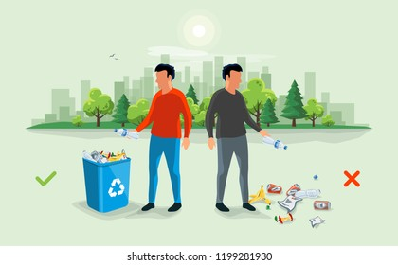
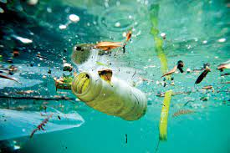
WARM-UP
What should you do when you see people throwing rubbish improperly?

Slide 5
PRE-WRITING
1
Complete the notes using the words in the box.
Problems & consequences | Green solutions
Many single-use plastic products are thrown in rubbish bins. They take many years to decompose in landfills. | Use them in arts and crafts projects (e.g. making plant pots) or (1) ________ them
People leave the lights on and the water running in restrooms. This is a waste of electricity and water. | Install (2) ________ lights and sensor taps that turn off when no one is around
Dry leaves are sometimes burnt in the schoolyard. This can cause air pollution and fires. | Create (3) _______________
Many parents drive their children to school and pick them up from school every day. This causes traffic jams, noise, and air pollution at the school gate. | Encourage more students to cycle or walk to school, or use (4) ______________ to go to school (e.g. free bus tickets, cycle-to-school programme)
compost piles
recycle
public transport
automatic

Slide 6
PRE-WRITING
2
Match the sections with the correct headings.
Introduction
A. _____________
This report describes the problem of single-use plastics in our school and suggests three main solutions to the problem.
B. _____________
Many students at our school buy bottled water or takeaway food. As a result, hundreds of water bottles and single-use plastic containers are thrown away every day. Besides, students often put containers with leftovers in them into the recycling bin, which can lead to contaminating the recyclable waste. This means our school produces a lot of plastic waste that goes to landfills and has a harmful effect on the environment.
Problems

Slide 7
PRE-WRITING
2
Match the sections with the correct headings.
Solutions
C. ___________
To solve this problem, we propose the following solutions. First, we suggest that the school should provide more recycling bins. Second, the Youth Union should hold regular sessions to teach students how to recycle properly. Third, we recommend that we make use of plastic waste in arts and crafts projects, for example, for making plant pots or bird feeders.
D. ___________
Reusing and recycling single-use plastics will lead to a greener school environment and help promote a green lifestyle among young people. Therefore, we recommend you put the suggested solutions into practice as soon as possible.
Conclusion

Slide 8
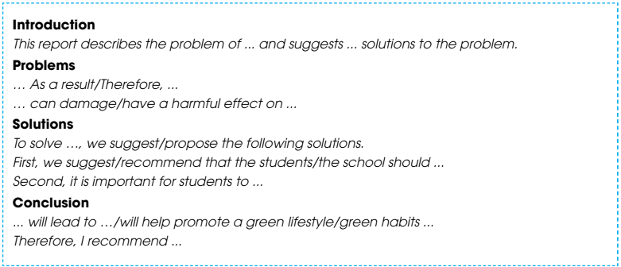
WHILE-WRITING
3
Choose one of the problems in Task 1, and write a problem-solving report.

Slide 9
POST-WRITING
Cross-check
Writing rubric
1. Organization: …/10
2. Legibility: …/10
3. Ideas: …/10
4. Word choice: …/10
5. Grammar usage and mechanics: …/10
TOTAL: …/50

Slide 10
CONSOLIDATION
1
Wrap-up
What have you learnt today?
Practising to write a problem-solving report

Slide 11
CONSOLIDATION
2
Homework
Do exercises in the workbook.
Rewrite the paragraph in the notebooks.

Slide 12
Website: hoclieu.vn
Fanpage: facebook.com/www.tienganhglobalsuccess.vn

