Slide 1



Unit 3: On Screen
Lesson 3E: Word Skills

Slide 2
01
Discussion
02
03
What does privacy mean to you and why do you think it’s important?
04
05
?
06

Slide 3
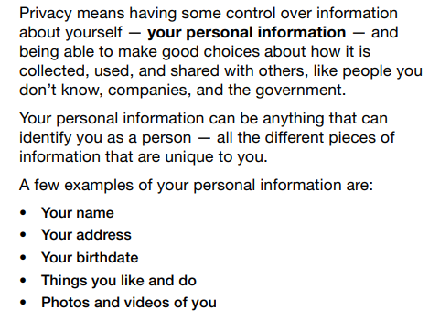
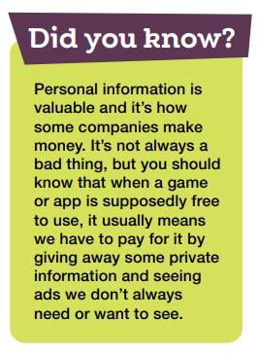
PRIVACY
01
02
03
04
05
06

Slide 4




They are warning people not to download or copy films, music, etc. illegally.
www.phuongnam.edu.vn

Slide 5



www.phuongnam.edu.vn

Slide 6
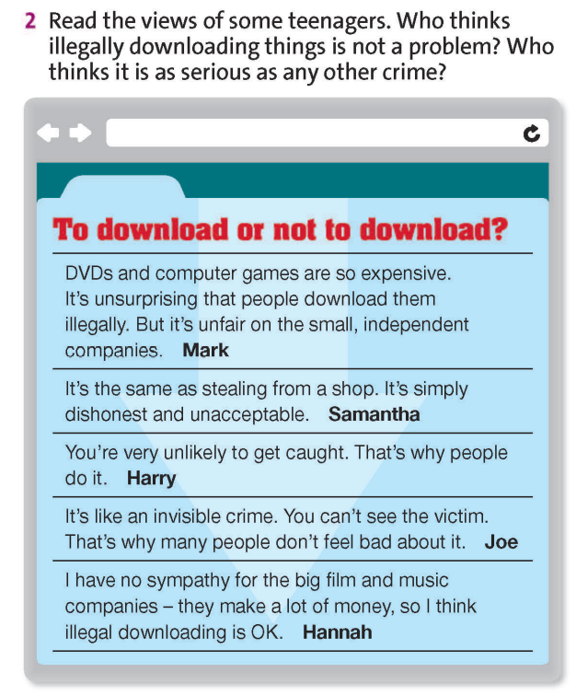
As serious as other crimes
Not a problem
www.phuongnam.edu.vn

Slide 7
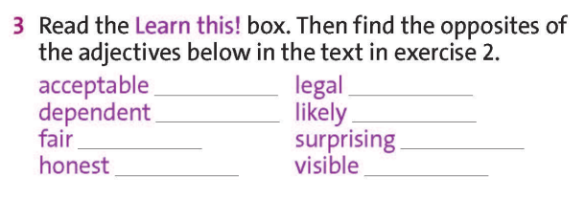
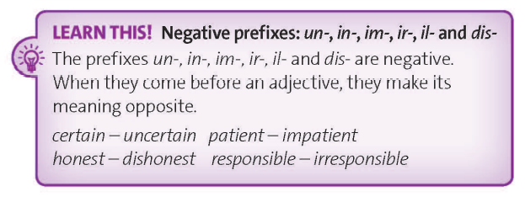
www.phuongnam.edu.vn

Slide 8
unacceptable
illegal
independent
unlikely
unfair
unsurprising
dishonest
invisible
www.phuongnam.edu.vn

Slide 9
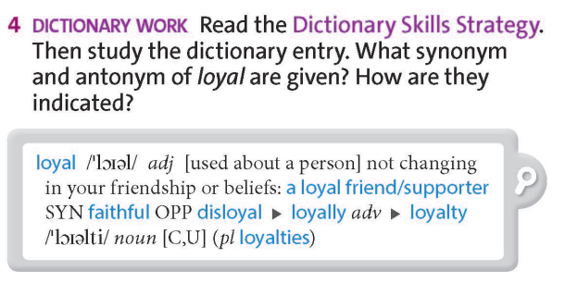
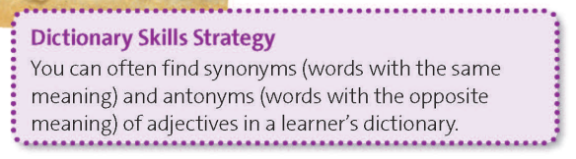
www.phuongnam.edu.vn

Slide 10
synonym faithful; SYN
antonym disloyal; OPP
www.phuongnam.edu.vn

Slide 11
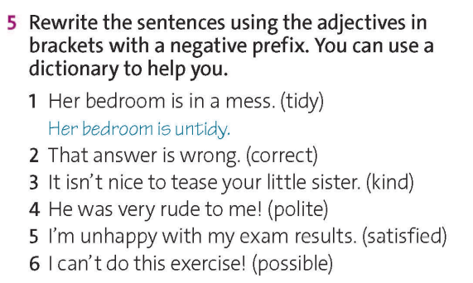
2. That answer is incorrect.
5. I’m dissatisfied with my exam result.
3. It is unkind to tease your little sister.
6. It is impossible to do this exercise!
4. He was very impolite to me!
www.phuongnam.edu.vn

Slide 12
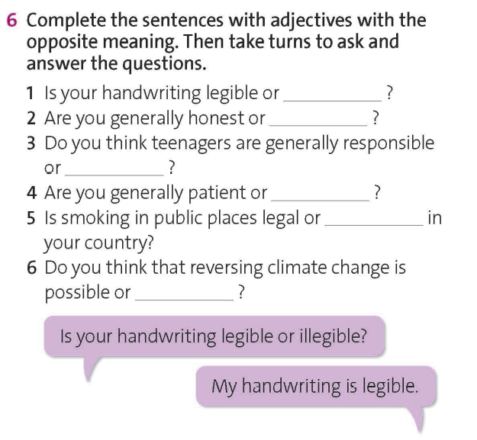
illegible
dishonest
irresponsible
impatient
illegible
impossible
www.phuongnam.edu.vn

Slide 13
illegible
dishonest
irresponsible
impatient
illegible
impossible
Example
www.phuongnam.edu.vn

Slide 14
01
Homework
02
03
1. Finish all the tasks
2. Prepare U3-F (P.40)
04
?
05
06

Slide 15

www.phuongnam.edu.vn

Slide 16



Thank you!
CTCP ĐẦU TƯ VÀ PHÁT TRIỂN GIÁO DỤC PHƯƠNG NAM

