Slide 1


Slide 2


Unit
7
ENVIRONMENTAL PROTECTION
LESSON 1: GETTING STARTED
At the Go Green Club
1

Slide 3
LESSON 1: GETTING STARTED
WARM-UP
Asking questions
PRESENTATION
Vocabulary
Task 1: Listen and read.
Task 2: Read the conversation again and match the two halves in the two columns.
Task 3: Complete each sentence with one word or phrase from the box.
Task 4: Write a phrase from the box under each picture.
PRACTICE
FUTHER PRACTICE
Task 5: Environment Quiz.
CONSOLIDATION
Wrap-up
Homework

Slide 4
WARM-UP
Answer the question:
WHAT ARE
THE ENVIROMENTAL ISSUES IN OUR CITY?
ENVIROMENTAL PROTECTION

Slide 5
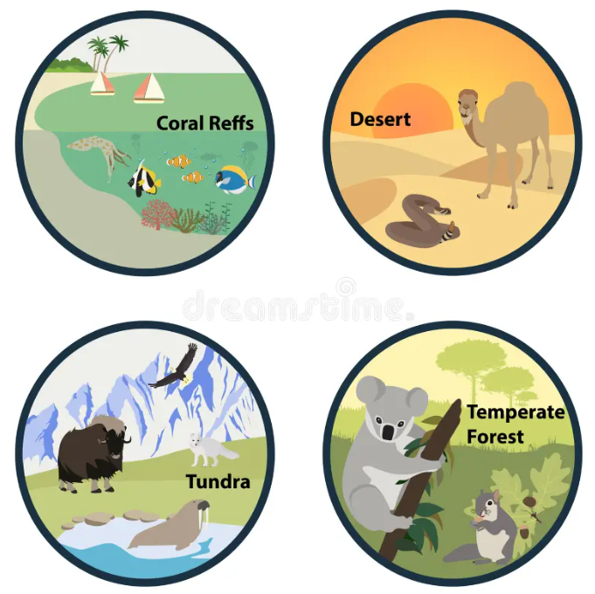


PRESENTATION
habitat (n)
/ˈhæbɪtæt/
môi trường sống

Slide 6
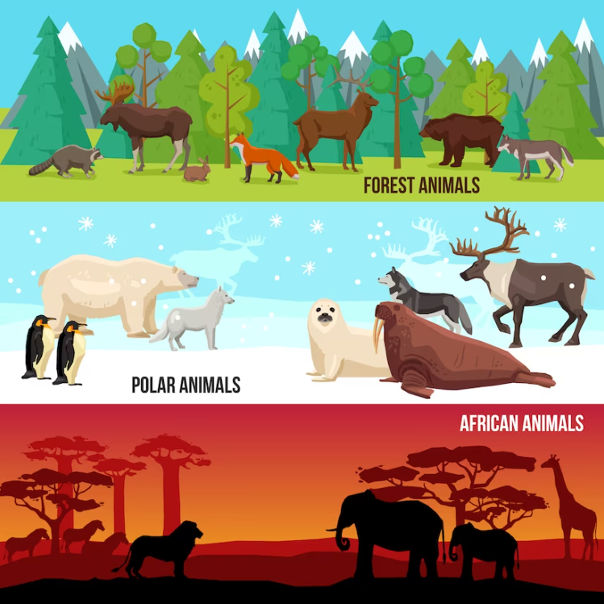
PRESENTATION
endangered species (n)
/ɪnˈdeɪndʒəd ˈspiːʃiːz/
động vật sách đỏ

Slide 7
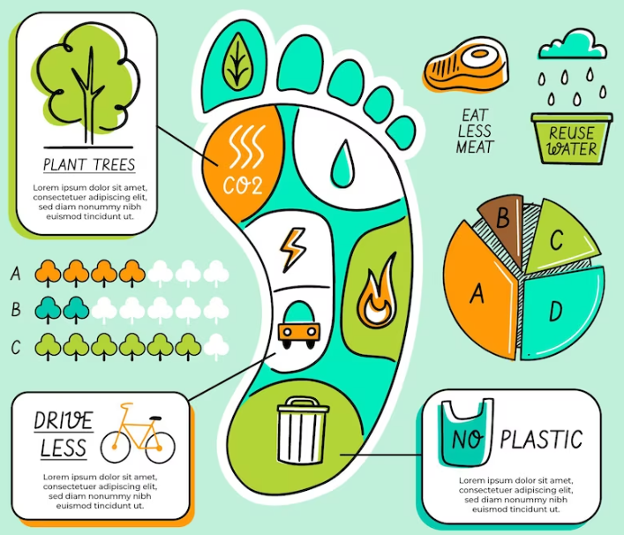

PRESENTATION
carbon footprint (n)
/ˌkɑːbən ˈfʊtprɪnt/
dấu chân cac-bon

Slide 8

PRESENTATION
release (v)
/rɪˈliːs/
thải ra

Slide 9

PRESENTATION
single-use (adj)
/ˌsɪŋɡl ˈjuːs/
dùng một lần

Slide 10
PRESENTATION
New words | Pronunciation | Meaning
1. habitat (n) | /ˈhæbɪtæt/ | môi trường sống
2. endangered species (n) | /ɪnˈdeɪndʒəd ˈspiːʃiːz/ | động vật sách đỏ
3. carbon footprint (n) | /ˌkɑːbən ˈfʊtprɪnt/ | dấu chân cac-bon
4. release (v) | /rɪˈliːs/ | thải ra
5. single-use (adj) | /ˌsɪŋɡl ˈjuːs/ | dùng một lần

Slide 11
PRACTICE
1
Listen and read.
Club leader: Hello. Welcome back. Today we’re discussing environmental problems and environmental protection. What are our serious environmental problems now?
Nam: Pollution and habitat loss, I think.
Ann: I agree. The air and water quality are getting worse and worse.
Club leader: Any others?
Ann: Yes, I can think of some like global warming, endangered species loss, …
Nam: So what should we do to help protect our environment?
Club leader: We can reduce our carbon footprint even in our homes.
Ann: What do you mean by ‘carbon footprint’?
Club leader: It’s the amount of carbon dioxide we release into the environment.
Ann: I see. So we can do things like turning off devices when we’re not using them.
Club leader: Right … And there is much more we can do, like practising the 3Rs.
Nam: We can plant more trees in our neighbourhood too.
Ann: And try to avoid using single-use products, like plastic bags, and stop littering.
Club leader: Yeah. And we can volunteer at some local environment programmes to save endangered species.

Slide 12
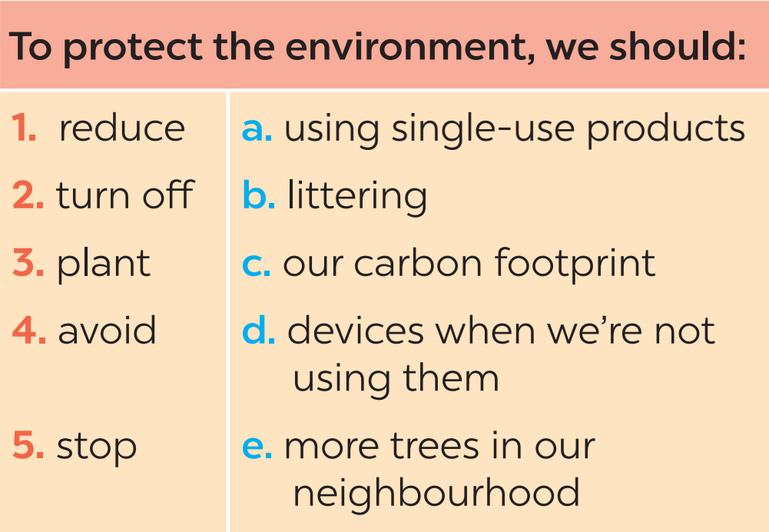
PRACTICE
2
Read the conversation again and match the two halves in the two columns.

Slide 13
PRACTICE
3
Complete each sentence with one word or phrase from the box.
reduce single-use pollution carbon footprint environment programme
Pollution
1. ________ is a serious problem everywhere.
2. We should avoid dumping waste into lakes and rivers to _______ water pollution.
3. We shouldn’t throw away _________ products but recycle them.
4. ______________ is the amount of carbon dioxide we release into the environment.
5. We hope a lot more people join our ______________________.
reduce
single-use
Carbon footprint
environment programme

Slide 14
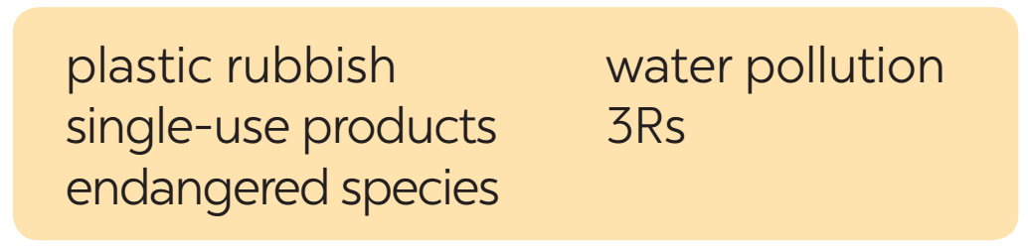

PRACTICE
4
Write a phrase from the box under each picture.
1. ____________
2. ____________
3Rs
water pollution

Slide 15

PRACTICE
4
Write a phrase from the box under each picture.
3. _______________
4. ____________
endangered species
plastic rubbish

Slide 16
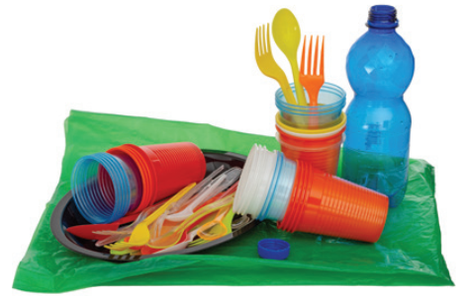
PRACTICE
4
Write a phrase from the box under each picture.
5. _______________
single-use products

Slide 17
FURTHER PRACTICE
5
Environment Quiz
1. Which of the following is the greenest form of transport?
A. Motobike B. Bus C. Bicycle
2. Which of the following is a renewable source?
A. Coal B. Oil C. Wind
3. What causes the most pollution?
A. Factories B. Animals C. Hospitals

Slide 18
FURTHER PRACTICE
5
Environment Quiz
4. The surroundings in which we live are our ______.
A. habitat B. place C. environment
5. Which of these will reduce your carbon footprint?
A. Cutting down a lot of trees.
B. Recycling paper products.
C. Leaving the TV on all night.

Slide 19

CONSOLIDATION
1
Wrap-up
What have we learnt in this lesson?
identify the topic of the unit
use lexical items related to environment protections
identify the language features that are covered in the unit

Slide 20

CONSOLIDATION
2
Homework
- Do exercises in the workbook.
- Start preparing for the Project of the unit.

Slide 21

Website: hoclieu.vn
Fanpage: facebook.com/www.tienganhglobalsuccess.vn/

