Slide 2
DISCUSSION ON DIFFERENT CAREERS
UNIT 9
CAREER PATHS
LESSON 4
SPEAKING

Slide 3
LESSON 4
SPEAKING
WARM-UP
Warm-up: Quiz
CONTROLLED PRACTICE
Vocabulary
Task 1: Work in pairs
LESS-CONTROLLED PRACTICE
Task 2: Discuss and complete information
FREE PRACTICE
Task 3: Report your group's answers
CONSOLIDATION
Wrap-up
Homework

Slide 4
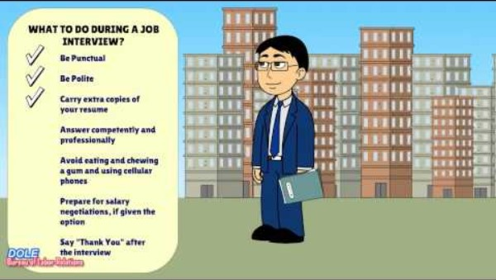
WARM-UP
Notes:
https://www.youtube.com/watch?v=ep-w4mzXMa0&t=3s

Slide 5

1. What is the recommended time to arrive for a job interview?
5 minutes early
15 minutes early
On time
30 minutes early

Slide 6
2. How should you dress for a job interview?
Casual attire
Business casual
Formal wear
Professional and conservative

Slide 7
3. What should you do if you don't understand a question during the interview?
Make up an answer
Change the topic
Politely ask for clarification
Pretend you heard and answer vaguely

Slide 8
4. How should you respond to salary negotiation?
Avoid discussing salary
Express disinterest in negotiation
Accept the first offer without discussion
Be prepared to negotiate based on research

Slide 9
5. What is the recommended etiquette regarding cell phones during an interview?
Turn it off
Keep it visible for emergencies
Put it on silent mode
Answer calls discreetly

Slide 10
6. How should you conclude the interview?
Thank the interviewer and express interest
Ask for feedback
Leave without saying anything
Hand over additional resumes

Slide 11
7. Where can you find information about a company before an interview?
Social media
Company website
News articles
All of the above

Slide 12
8. What is the appropriate length for answers during an interview?
Very short
2-3 sentences
As long as necessary
5-10 minutes

Slide 13
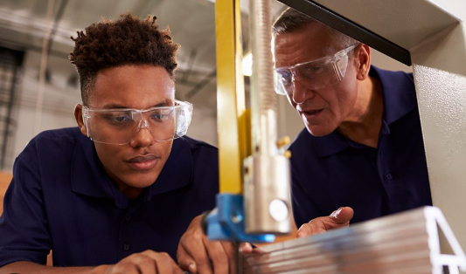

VOCABULARY
apprenticeship (n)
/əˈpren.tɪs.ʃɪp/
a period of time working as an apprentice

Slide 14

VOCABULARY
diploma
/dɪˈpləʊ.mə/
a document given by a college or university to show that you have passed a particular exam or finished your studies

Slide 15

VOCABULARY
architecture
/ˈɑː.kɪ.tek.tʃər/
the art and practice of designing and making buildings

Slide 16

VOCABULARY
combine
/kəmˈbaɪn/
to (cause to) exist together, or join together to make a single thing or group

Slide 17
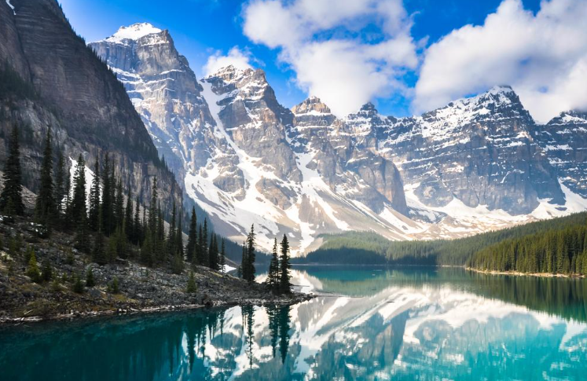
VOCABULARY
natural sites (n)
/ˈnætʃ.ər.əl/ /saɪt/
areas or locations in nature that have distinctive features, ecological significance, or aesthetic value.

Slide 18
VOCABULARY
Form | Pronunciation | Meaning | Vietnamese equivalent
1. apprenticeship | /əˈpren.tɪs.ʃɪp/ | a period of time working as an apprentice | tập nghề
2. diploma | /dɪˈpləʊ.mə/ | a document given by a college or university to show that you have passed a particular exam or finished your studies | bằng cấp
3. architecture | /ˈɑː.kɪ.tek.tʃər/ | the art and practice of designing and making buildings | ngành kiến ​​​​trúc

Slide 19
VOCABULARY
Form | Pronunciation | Meaning | Vietnamese equivalent
4.combine | /kəmˈbaɪn/ | to (cause to) exist together, or join together to make a single thing or group | kết hợp
5. natural sites | /ˈnætʃ.ər.əl/ /saɪt/ | areas or locations in nature that have distinctive features, ecological significance, or aesthetic value. | khu bảo tồn thiên nhiên

Slide 20
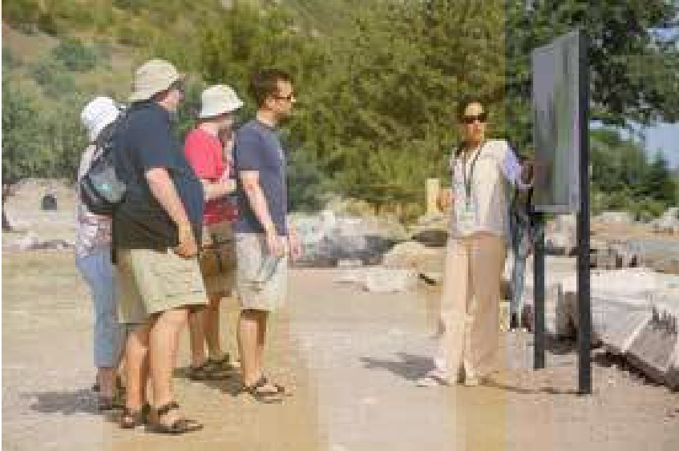
CONTROLLED PRACTICE
1
Work in pairs. Use the given ideas to complete the information about the job of a tour guide.
A. attend part-time courses or complete an apprenticeship
B. may only be employed in the high season
C. be patient, confident, and able to deal with stressful situations
D. good communication skills

Slide 21
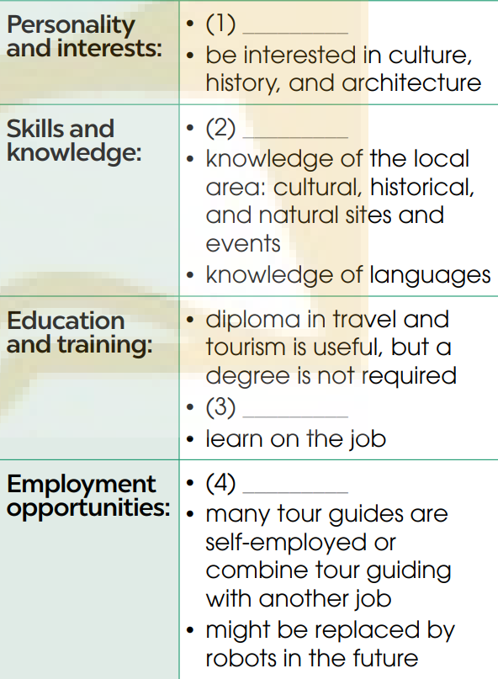
CONTROLLED PRACTICE
C
D
A. attend part-time courses or complete an apprenticeship
B. may only be employed in the high season
C. be patient, confident, and able to deal with stressful situations
D. good communication skills
A
B

Slide 22
LESS-CONTROLLED PRACTICE
2
Work in groups. Choose one of these jobs. Discuss and complete information about the job you choose.
To become a teacher of English/police officer/doctor, you need to consider:
*Example:
A: Let’s talk about the job of a doctor. What do you think we need to consider before we pursue this career?
B: Well, I think a doctor’s personality is very important. You must be very kind and care for patients. You must have a passion for helping people.
C: …

Slide 23
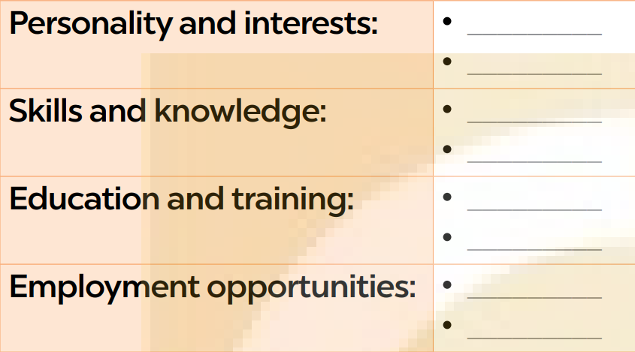
LESS-CONTROLLED PRACTICE
2
Work in groups. Choose one of these jobs. Discuss and complete information about the job you choose.

Slide 24
LESS-CONTROLLED PRACTICE
Personality and interests: | be very kind and care for patients have a passion for helping people be interested in health, causes of diseases, and medical science
Skills and knowledge: | soft skills such as good communication, decision-making, time-management and teamwork skills technical skills and medical knowledge to assess patient’s condition, prescribe medication, offer treatments, etc.
Education and training: | study at medical school to get a medical degree complete general medical training where you combine work experience with on-the-job training usually at a hospital complete specialty training in a specialist area of medicine or in general practice
Employment opportunity: | many varied opportunities and different career options there will always be demand for doctors may have a poor work-life balance

Slide 25

FREE PRACTICE
3
Work in groups. Compare the job in 1 with your chosen job in 2. Discuss the similarities and differences and decide which job you prefer and why. Report your group's answers to the class

Slide 26
FREE PRACTICE
*Suggested answer:
Our group discussed the jobs of a tour guide and a doctor. Although they are very different jobs, we found some similarities between the two. Both tour guides and doctors must be kind and patient. They also must be able to deal with stressful situations. Soft skills such as communication, decision-making, time management, and teamwork skills are important for both professions.
However, the technical skills required for a tour guide and a doctor are very different. For example, tour guides must have knowledge of the local area, and cultural, historical and natural sites and events, and knowledge of languages. Doctors need medical knowledge to assess patients, and treat them. It is a lot easier to become a tour guide as you don’t need formal education or training at university.

Slide 27
FREE PRACTICE
However, to qualify as a doctor, you must not only go to medical school, but complete another 10 years of on-the-job training.
While tour guides have limited job opportunities and many are out of work in the low season, doctors are in high demand. The job of a doctor will never become automated or obsolete, but tour guides might be replaced by robots in the future.
Two people in our group prefer the job of a tour guide because they always enjoy learning about history, art and culture. They find the job of a tour guide more interesting and less challenging than the job of a doctor. They believe they’ll have a better life-work balance. The other two people prefer the job of a doctor. They think the job of a tour guide is only in demand in the high season and doesn’t pay well. On the other hand, doctors have varied job opportunities and different career options.

Slide 28
01
Wrap up
CONSOLIDATION
*What have you learnt today?
Discuss the skills and experience needed for Career path
New Vocabulary about Career.

Slide 29
Home Work
CONSOLIDATION
02
Do exercises in the workbook.
Learn new words by heart.
Prepare Lesson 5 – Unit 9.

Slide 30
Website: hoclieu.vn
Fanpage: facebook.com/www.tienganhglobalsuccess.vn

