Slide 1
Unit 3:
Protecting the Environment
Lesson 2.3: Pronun. & Speaking
Pages 30 & 31

Slide 2
Lesson Outline
Warm-up
Pronunciation
Speaking
Consolidation
Wrap-up

Slide 3
By the end of this lesson, students will be able to…
practice word stress for two-syllable verbs.
practice giving advice about how to reduce pollution, using conjunctions to make compound and complex sentences.

Slide 4
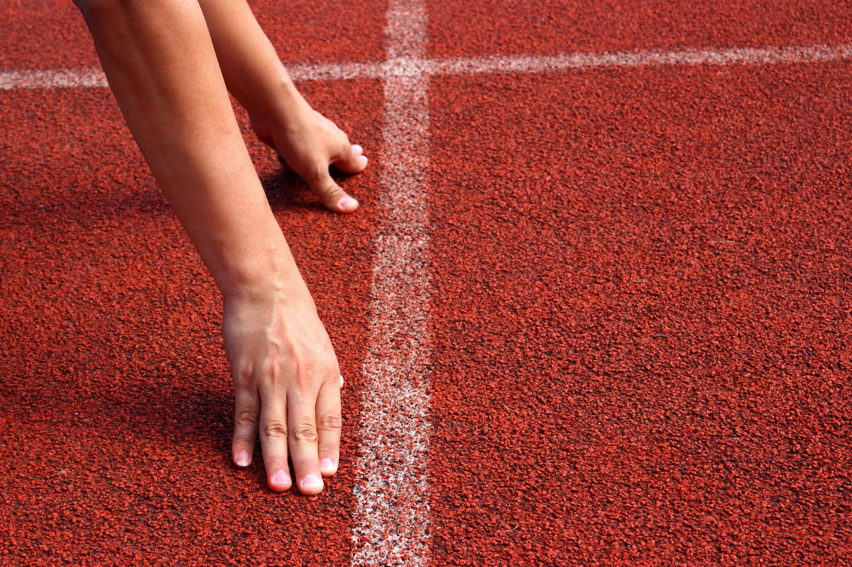
WARM UP

Slide 5
Choose the word whose underlined part is pronounced differently from that of the others.
A. cycling B. knitting C. practice D. recipe
/ ˈsaɪklɪŋ / /ˈnɪtɪŋ / /ˈpræktɪs / /ˈresəpi /
2. A. shuttlecock B. lung C. nature D. umbrella
/ ˈʃʌtəlkɒk / /lʌŋ / /ˈneɪtʃər / /ʌmˈbrelə /
3. A. protect B. stock C. conditioner D. provide
/ˈ prəˈtekt / /stock / /kənˈdɪʃənər / / prəˈvaɪd /

Slide 6
Choose the words whose main stress is placed differently from the others.
A. hometown B. candy C. vehicle D. disease
/ ˈhəʊmtaʊn / / ˈkændi / / ˈvɪəkəl / / dɪˈziːz /
2. A. entertainment B. development C. environment D. improvement
/entəˈteɪnmənt / / dɪˈveləpmənt / / ɪnˈvaɪrənmənt / /ɪmˈpruːvmənt /
3. A. damage B. prevent C. poison D. mention
/ˈdæmɪdʒ / / prɪˈvent / /ˈpɔɪzən/ /ˈmenʃən /

Slide 7
Pronunciation

Slide 9
b. Listen to the words and focus on the underlined letters.
reuse (v)
/ˌriːˈjuːz/
collect (v)
/ kəˈlekt /
reduce (v)
/ rɪˈdʒuːs /

Slide 10
c. Listen and cross out the one with wrong stress.
damage repair affect pollute
/ ˈdæmɪdʒ /
/ rɪˈpeər /
/ əˈfekt /
/ pəˈluːt /
d. Read the words with the correct stress to a partner.

Slide 11
d. Read the words with the correct stress to a partner.
reuse collect reduce
/ˌriːˈjuːz/
/ rɪˈdʒuːs /
/ kəˈlekt /
damage repair affect pollute
/ ˈdæmɪdʒ /
/ rɪˈpeər /
/ əˈfekt /
/ pəˈluːt /

Slide 12
Practice

Slide 13
a. Take turns asking and answering about the different effects of pollution. Use “if” or “unless”
1. Practice in pairs.
2. Review the use of First Conditional.

Slide 14
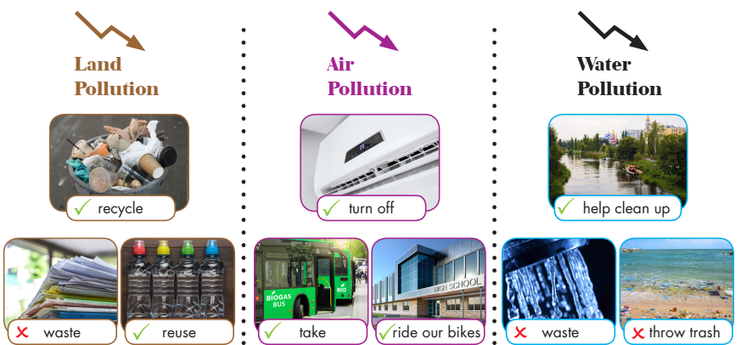

Slide 15
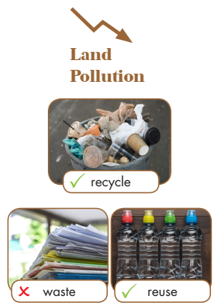
What should we do to reduce land pollution?
We should recycle trash so we can reduce land pollution.
What else?
We shouldn’t waste paper and we should recycle trash.

Slide 16
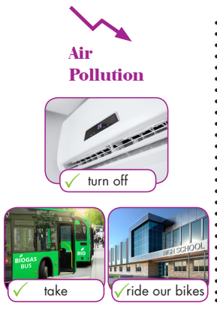
What should we do to reduce air pollution?
We should turn off the air conditioner when we leave the room.
Anything else?
We should ride our bikes and we should take the bus to school.

Slide 17
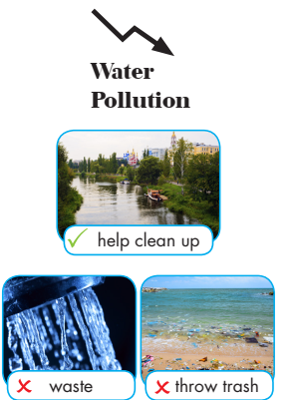
What should we do to reduce water pollution?
We should help clean up the river.
What else?
We shouldn’t waste water and we shouldn’t throw trash on the beach.

Slide 18
Production

Slide 19
Task a
Making a poster.
Work in pairs
Discuss ways to reduce pollution and their purpose. Then, choose a title and at least five solutions and write them on the poster.

Slide 20
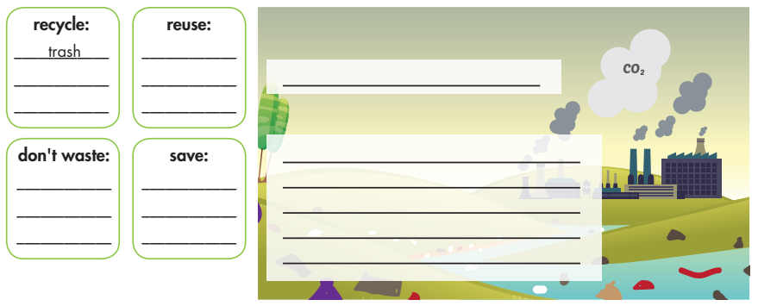
Task a

Slide 21
Task b
Making a poster.
Present your ideas to each other.

Slide 22
CONSOLIDATION

Slide 23
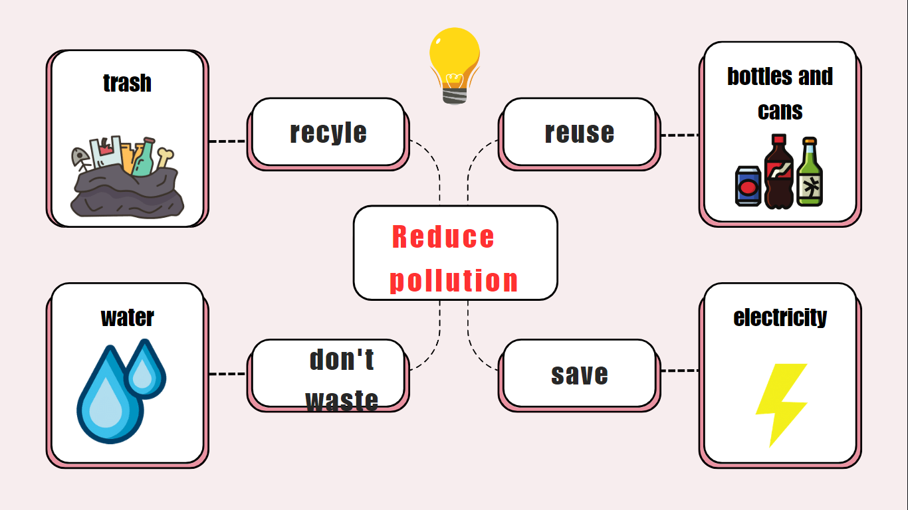
Finish making your own poster.
Example

Slide 24
WRAP-UP

Slide 25
Today’s lesson
Pronunciation
Stress the second syllable for most two-syllable verbs.
Speaking
Discuss ways to reduce pollution with encouraging the speaker to continue.

Slide 26
Homework
Practice pronouncing the word stress.
Do the writing exercise on page 17 WB
Do the exercises in TA 8 i-Learn Smart World Notebook, page 27
Prepare the next lesson (pages 32 & 33 SB)
Play the consolidation games on www.eduhome.com.vn

Slide 27
Lesson 3
Stay positive and have a nice day!

