Slide 1

Unit 2: Fit for life
Progress Check (Cont.)
Page 43

Slide 2
Lesson Outline
Warm-up
Reading
Listening.
Writing
Consolidation
Wrap-up

Slide 3
Objectives
By the end of this lesson, students will be able to…
- practise test-taking skills (Reading, Listening, Writing).

Slide 4

WARM-UP

Slide 5
Choose the word whose underlined part is pronounced differently from that of the others.
1. A. fat B. art C. mat D. pad
2. A. steak B. meat C. team D. seat
3. A. rushed B. watched C. played D. parked
/fæt/
/ɑːt/
/mæt/
/pæd/
/steɪk/
/miːt/
/ti:m/
/si:t/
/rʌʃt/
/wɒtʃt/
/pleɪd/
/pɑːkt/

Slide 6
Choose the word whose main stress is placed differently from that of the others.
1. A. famous B. special C. stressful D. polite
2. A. martial B. lesson C. advice D. jogging
3. A. snorkelling B. protection C. rollerblades D. badminton
/ˈfeɪməs/
/ˈspeʃəl/
/ˈstresfəl/
/pəˈlaɪt/
/ˈmɑːʃəl/
/ˈlesən/
/ədˈvaɪs/
/ˈdʒɒɡɪŋ/
/ˈsnɔːkəlɪŋ/
/prəˈtekʃən/
/ˈrəʊləbleɪdz/
/ˈbædmɪntən/

Slide 7

It’s time to learn …

Slide 8
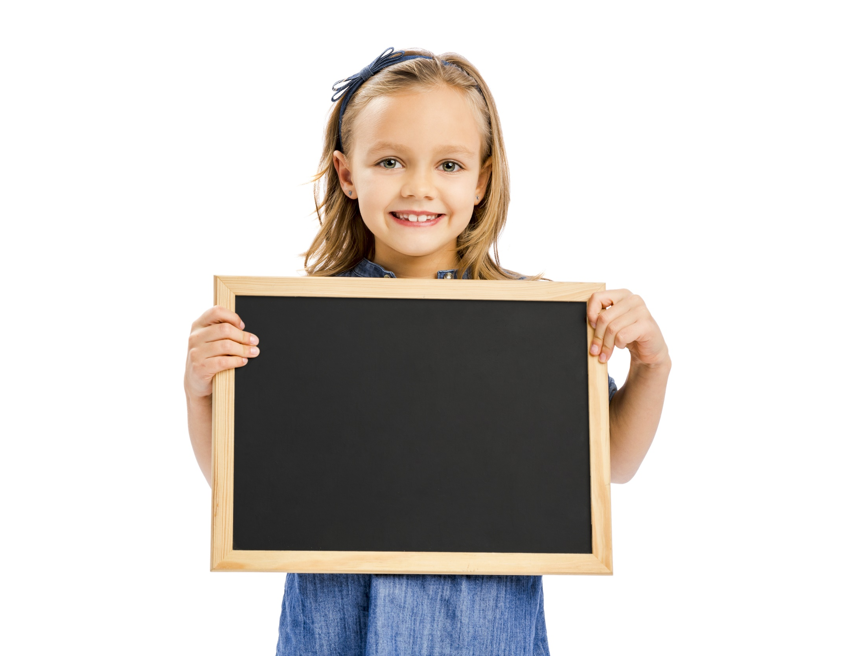
Reading

Slide 9
7. Read the text and decide if the statements are R (right) or W (wrong).
A Glass of Water, please.
Hi, I’m Alex. I used to drink lots of fizzy drinks like cola and soda, but last year I changed my habit. I started drinking lots of water because it is important to our bodies.
Our bodies are about 60% water. That means we have more water than bone. When we exercise, our bodies lose up to 10% of their water. We need to drink more to replace that water and perform well. Drinking water also helps our brain work better. Also, our skin looks brighter and our body temperature stays the same even on a hot day, all because of the water inside us.
So how much water should we drink? Most experts suggest around eight glasses a day. Other drinks such as tea, milk and fresh fruit juice are OK too. What about you? Do you drink enough water?
1 Alex started drinking fizzy drinks last year. ◻
2 Our bodies have more bone than water. ◻
3 We lose a lot of our water when we exercise. ◻
4 Our skin doesn’t change when we drink water. ◻
5 Experts think eight glasses of water per day is too much. ◻

Slide 10
7. Read the text and decide if the statements are R (right) or W (wrong).
A Glass of Water, please.
Hi, I’m Alex. I used to drink lots of fizzy drinks like cola and soda, but last year I changed my habit. I started drinking lots of water because it is important to our bodies.
Our bodies are about 60% water. That means we have more water than bone. When we exercise, our bodies lose up to 10% of their water. We need to drink more to replace that water and perform well. Drinking water also helps our brain work better. Also, our skin looks brighter and our body temperature stays the same even on a hot day, all because of the water inside us.
So how much water should we drink? Most experts suggest around eight glasses a day. Other drinks such as tea, milk and fresh fruit juice are OK too. What about you? Do you drink enough water?
W (wrong)
1 Alex started drinking fizzy drinks last year.
2 Our bodies have more bone than water.
3 We lose a lot of our water when we exercise.
4 Our skin doesn’t change when we drink water.
5 Experts think eight glasses of water per day is too much.
W (wrong)
R (right)
W (wrong)
W (wrong)

Slide 11
More Practice
Read the text again and circle the correct answer:
1. Alex often drank lots of ___________ .
A. cola and soda B. tea C. milk D. water and juice
2. Our bodies are about ____________ .
A. 40% water B. 80% water C. 60% water D. 10% water
3. Water is ____________ to our bodies.
A. harmful B. fresh C. interesting D. important
4. What should we do to replace the lost water?
A. do exercise B. drink beer C. eat meat D. drink water
5. Drinking water also helps our brain ____________ .
A. become lazy B. work better C. look brighter D. work worse

Slide 12
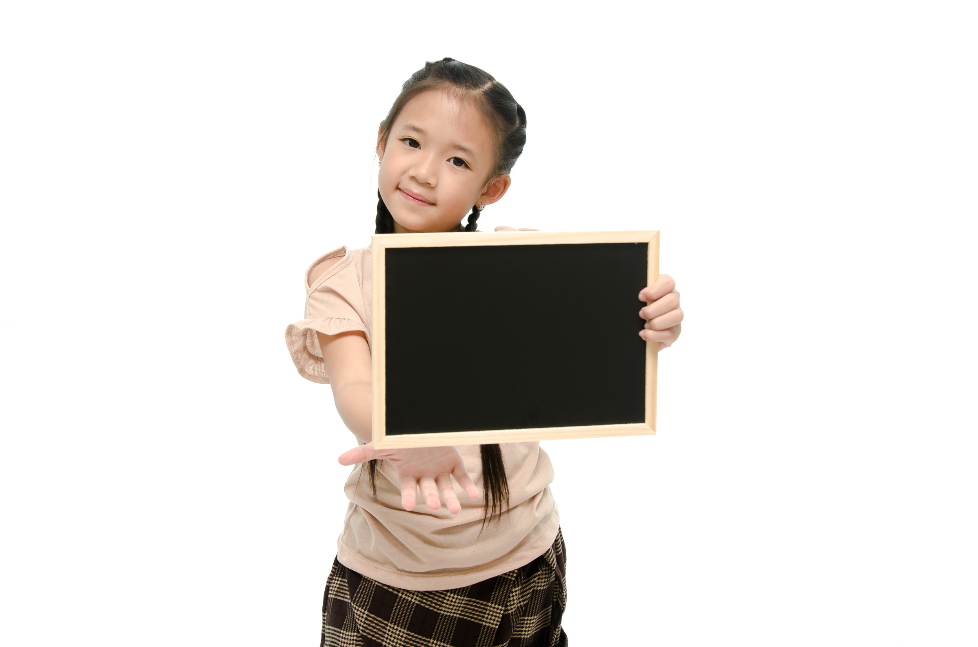
Listening

Slide 13


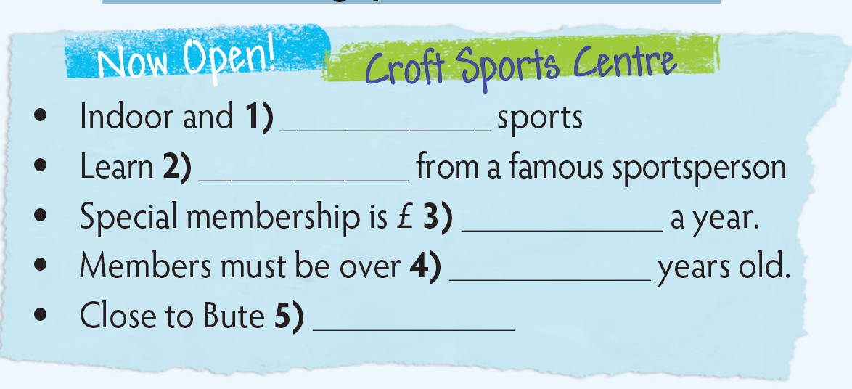
8. Listen to a radio advertisement and fill in the gaps (1-5) in the advert.
outdoor
kickboxing
200
16/sixteen
Forest

Slide 14
Audio Scripts
Hello. I’m Gary Haven, the manager of Croft Sports Centre and I want to invite all the listeners to come along and try all the sports we have. We offer a variety of indoor and outdoor sports. We also offer kickboxing lessons from a famous champion! The cost depends on the sport, ranging from 5 to 25 pounds per day, but we also offer a special yearly membership that covers all sports for just 200 pounds. A lot of the sports here are not for young children, so members must be at least 16. However, we have a play park for children up to 12. You can find us just outside of town near Bute Forest. For more information, check ghaven@croftsportscentre.com.

Slide 15
More Practice
WB p. 25
5 ★★ Listen to an advert and complete the leaflet.
Bluebird Snack Bar
Open 7:00 a.m. to 1) ______ p.m.
We serve traditional English food!
Breakfast:
2) _______, bread, orange juice or 3) ______ OR a cooked breakfast (weekends only).
Lunch:
Ploughman’s lunch of 4) ________, cold meat and salad OR a wide range of sandwiches and 5) ________.
Dinner:
6) ________ or beef with vegetables.
3.00
Cereal
tea
cheese
fruit
Chicken

Slide 16
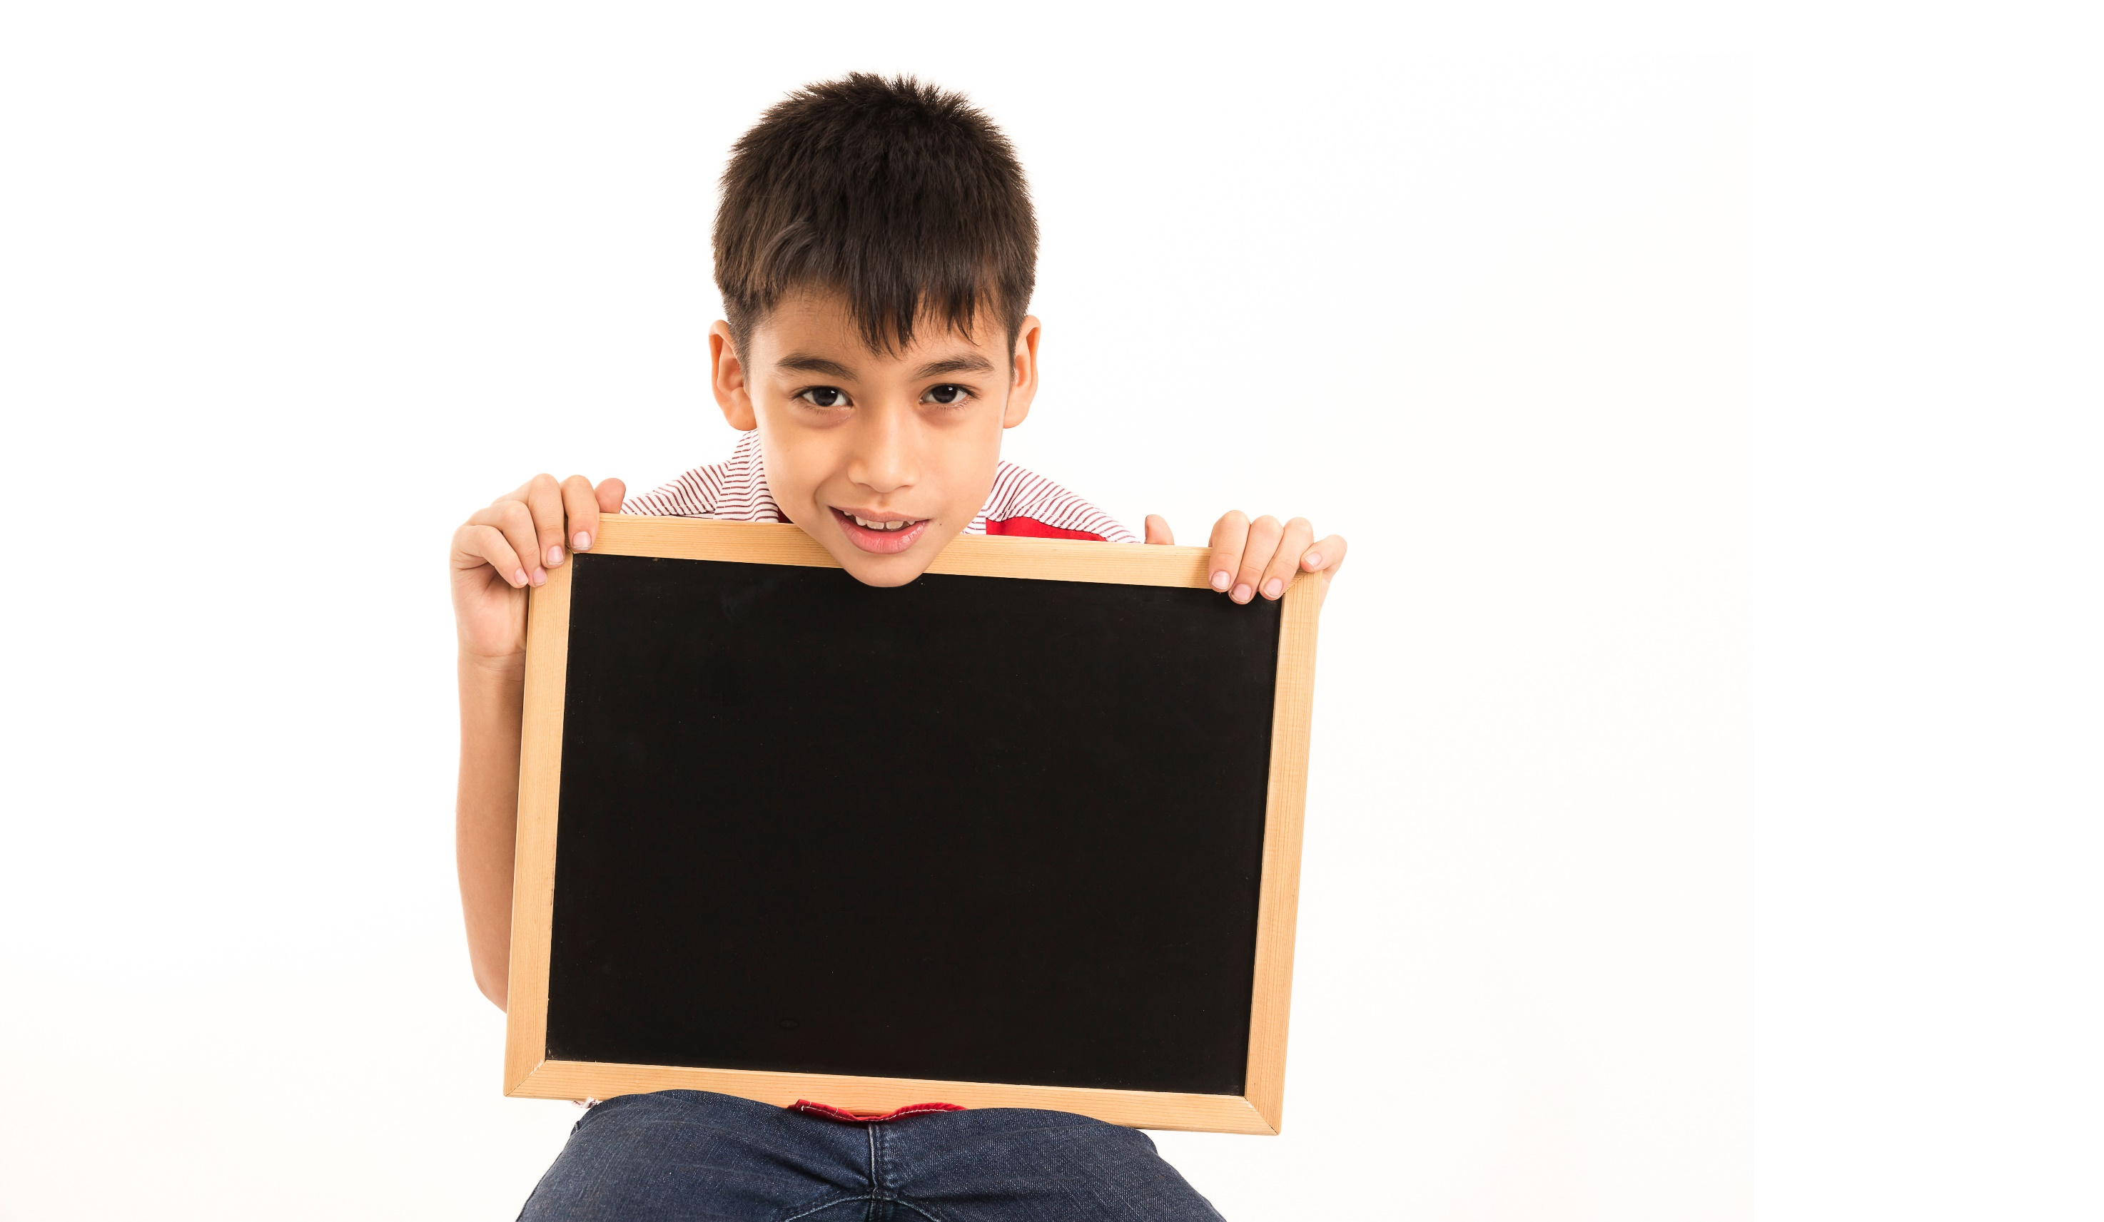
Writing

Slide 17

9. You attended a special sports event at your school. Write a paragraph describing it (about 60-80 words). Include its name, the place, the date and the activities.

Slide 18
Peer-correction
Criteria | Yes | No
Opening
Body (name, place, date, activities)
Ending
Grammar mistakes | Underline
Spelling mistakes | Circle

Slide 19
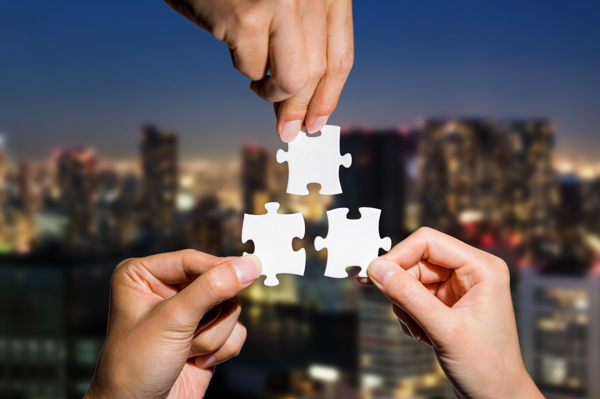
CONSOLIDATION

Slide 20
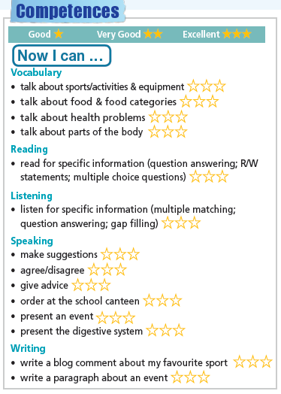
Colour the number of stars if you are good or very good or excellent at what you have learnt in Unit 2.

Slide 21

WRAP-UP

Slide 22
Today’s lesson
Skills:
Reading: the importance of water
Listening: a radio advertisement
Writing: a sports event

Slide 23
Homework
Review the vocabularies and grammar and make sentences using them.
Do exercises in workbook on pages 24 & 25.
Prepare the next lesson (page 44 SB)
Do Unit 2 Test 2 in Bài Tập Bổ Trợ TA 7 Right on (pp. 24 & 25)

Slide 24

Lesson 3
Stay positive and have a nice day!

