Slide 1
English 8
PERIOD 34: REVISION OF UNITS 3,4
Welcome to our class

Slide 2
Warm up.
A. Vocabulary.

Slide 3
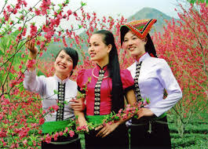
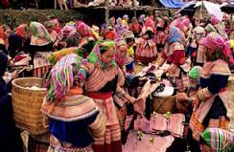
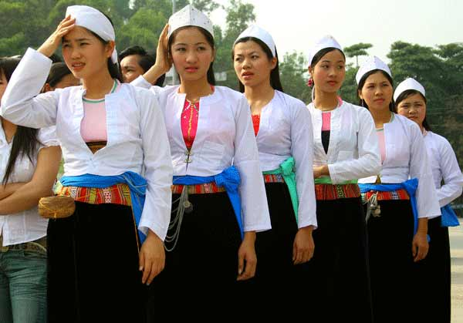
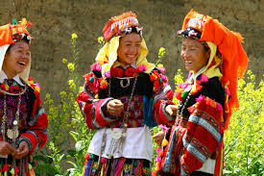
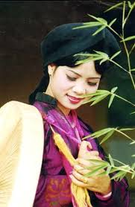
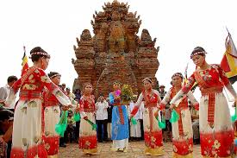
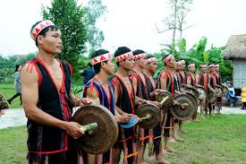
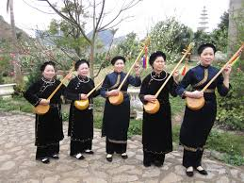
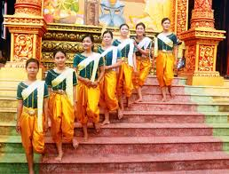
a.Matching
The Kinh The Ede The Khmer The red Yao The Tay
The Thai The Cham The H’Mong The Muong
1
2
3
The Thai
The H’Mong
The Muong
4
5
6
The red Yao
The King
The Cham
7
8
9
The Ede
The Tay
The Khmer

Slide 4
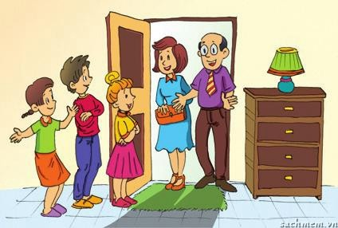
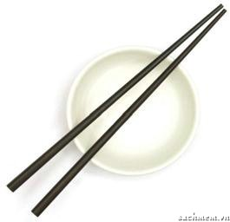
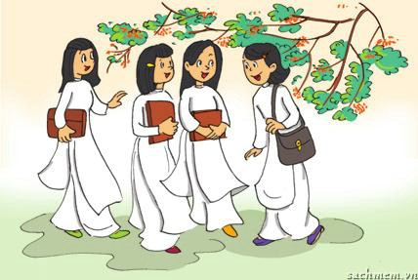
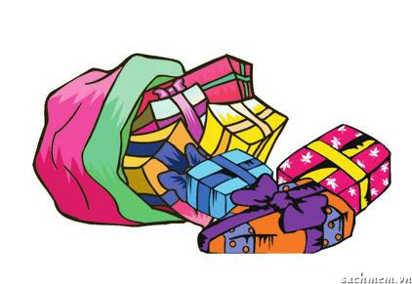
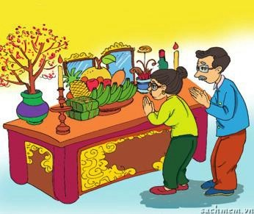
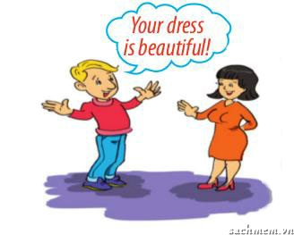
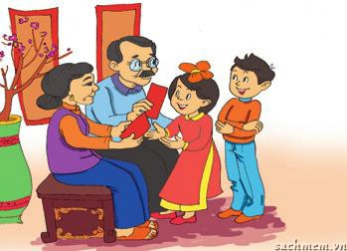
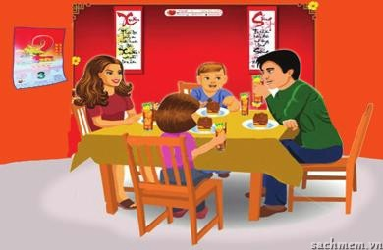
b. Match the pictures with the customs and traditions in the box
1. | smiling to accept a compliment
2. | worshipping ancestors
3. | wrapping gifts in colourful paper
4. | having lunch together on the second day of Tet
5. | placing the chopsticks on top of the rice bowl when finishing a meal
6. | children in the family standing in a row to greet guests
7. | wearing ao dai on special occasions
8. | giving children lucky money at Tet
C
g.
c.
C / T
a.
e.
f.
C
h.
T
b.
f.
C
e.
C
c.
a.
g.
T
b.
d.
d.
C/T
h.

Slide 5
B. LANGUAGE FOCUS
I. Choose the best answer.
1. You should ________ information about a custom or tradition.
A. finds B. find C. finding
2. A custom is something that has become an ____________ way of doing things.
A. to be accept B. to accept C. accepted
3. In the UK, there are lots of customs for table manners. For example, We ____________ use a knife and fork at dinner.
A. have to B. are having C. has to
4.In Viet Nam, you____________ use only the first name to address people older than you.
A. should B. must C. shouldn’t
5. At the Mid-Autumn Festival, kids can sing, dance, and enjoy moon-cakes ; ____________, every child likes it very much.
A. Therefore B. Moreover C. Because .

Slide 6
6. In 2010, Ha Noi____________ its 1000th anniversary.
A. celebrated B. commemorated C. worshipped
7. Tet is an occasion for family____________ in Viet Nam.
A. visitings B. Meeting C. reunions
8. ____________ spring comes, many Vietnamese villages prepare for a new festival season.
While B. When C. Nevertheless
9. Choose the word that has a different stressed syllable from that of the others
Cutlery B. accept C. social
10.Choose the underlined word or phrase (marked A,B or D) in each sentence that needs correcting
Which colour is the Cham’s clothing?
A B C

Slide 7
B. LANGUAGE FOCUS
II. Use the correct form of the verbs to complete the sentences.
be
1. My mother always tells me that I have to ____________ home by 9 p.m. (be)
2. When I came, the whole family ___________ dinner around a big dining table. (have)
3. Children should__________ things from adults with both hands. (take)
4. In Australia, you mustn’t ___________ on a person’s accent. (comment)
was having
take
comment

Slide 8
C. READING
I.Fill in the gaps with the words provided.
served
Celebrate
Traditional
Therefore
world
In Tet is the biggest festival in Vietnam. To (1) ……………..Tet, Vietnamese people make many tasty (2)……..……….foods. The most important food includes Chung cakes, sausages, boiled chicken, spring rolls, and sticky rice. Chung cake is made of sticky rice, pork, green beans, and other spices, wrapped in green leaves; (3)…….….., this cake needs a lot of preparation . This cake can be kept for a long time, even though the weather is often humid during Tet. Other significant foods that cannot be missed to worship the ancestors are sausages, spring rolls, and sticky rice. Because ausages are difficult to make, people often buy them from famous suppliers.However, sticky rice and spring rolls are easier to prepare and must be (4)………..immediately after they are cooked, so they are often made at home

Slide 9
C. READING
.
II. Read the paragraph
1. True / False
2. Answer the questions.
→ Practice at home

Slide 10
D. WRITING
* Rewrite these sentences with the cues given or directed in the brackets.
What is the waterwheel used for ?
The waterwheel is used to get water to the fields. ( make the question with underlined part).
→
2. The communal house (nha rong) is. ( make the question with the answer).
→
3. You / should / respect / old people . ( complete sentence)
→
Which is the biggest house in this village ?
You should respect old people.

Slide 11
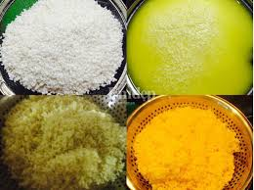
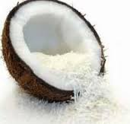
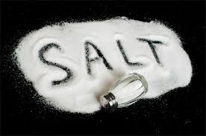
Writing
How to make yellow sticky rice
D. WRITING
4. Read the notes on how to make yellow sticky rice
Ingredients:
-Sticky rice : 500g
Turmeric : three sbsp extra
shredded coconut : one cup
Salt : ¼ tsp
Notes:
Soak sticky rice – water-five hours +
rinse rice –drain
Mix well w/ turmeric extract , wait- 10 mins
4. Add coconut + salt – mix well
5. Steam – 30mins – check cooked
6. Serve

Slide 12
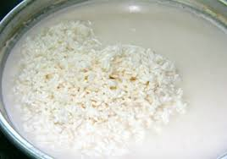
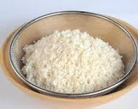
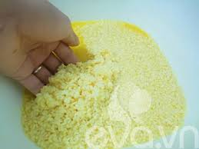
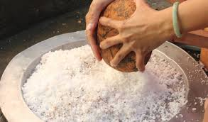
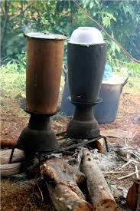
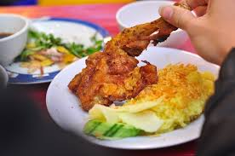
First , then , next , after that , finally , remember ……
1. This delicious dish is very easy to make . First , you need to soak the sticky rice in water for at least five hours ……………
1. rinse rice –drain /well .
+
2. Then rinse (vo) the rice and drain (làm khô) it well .
3. Next , add the turmeric and mix it well . Then wait for 10 minutes.
+
2. Add/ turmeric / mix/well . Wait /10 minutes
+
4. After that add the coconut and salt . Remember to mix it well
3. Add coconut + salt – mix well
5. Finally ,steam the rice for about 30 minutes. Check that it is fully cooked .
4. Steam / rice/ 30minutes . check that it/ fully cooked
6. You can serve this dish with chicken .
Remember to serve it hot.
5. you/ serve /dish /chicken .

Slide 13
E. AT HOME
Review all the vocabularies and structures.
Write a short paragraph about how to make yellow sticky rice
Be ready for TEST 2.

Slide 14
Notes:
14

