Slide 1

Unit 7: Toys
Lesson 3.3
Page 104

Slide 2
Lesson Outline
Warm-up
Practice
Speaking
Consolidation
Wrap-up

Slide 3
Objectives
By the end of this lesson, students will be able to…
Vocabulary: Practice the vocabularies learnt earlier in the lesson.
Structure: Practice structures:
Put the ball on the chair.

Slide 4

WARM UP

Slide 5







Put
the ball
?
the bed.
THANK YOU!
under
robot
NEXT
Click on the right option

Slide 6

Put
?
in the
wardrobe
THANK YOU!
doll
the doll
NEXT
Click on the right option

Slide 7
Click on the right option
Put the
car
on
?
THANK YOU!
table
the table
NEXT

Slide 8
?
the train
in the
toy box.
THANK YOU!
Put
Show
NEXT
Click on the right option

Slide 9
Put
the doll
?
box.
THANK YOU!
on
in the
NEXT
Click on the right option

Slide 10

It’s time to learn …

Slide 11

Pre-Speaking
Listen and write
______ _______ _______ ______ _______ bed.
Put the ball on the bed.
Notes:
Click textbox: pre-speaking to hear the sound

Slide 12
Pre-Speaking
Listen and write
______ the _______ ______ _______ _________.
Put the doll under the table.
Notes:
Click textbox: pre-speaking to hear the sound

Slide 13
Pre-Speaking
Listen and write
______ ______ teddy bear ______ _______ _________.
Put the teddy bear in the wardrobe.
Notes:
Click textbox: pre-speaking to hear the sound

Slide 14
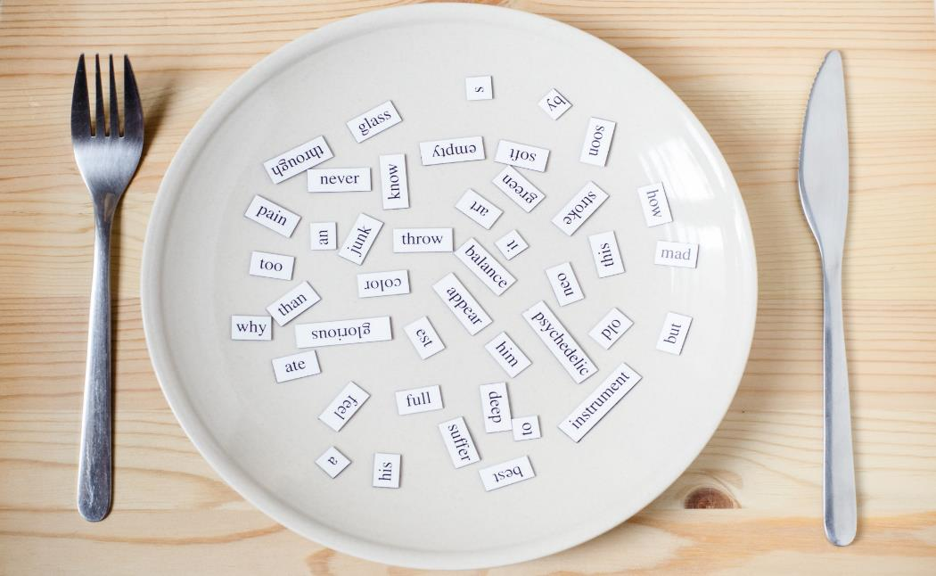
Structures
Put the ball on the chair.

Slide 15

While-Speaking
Practice

Slide 16



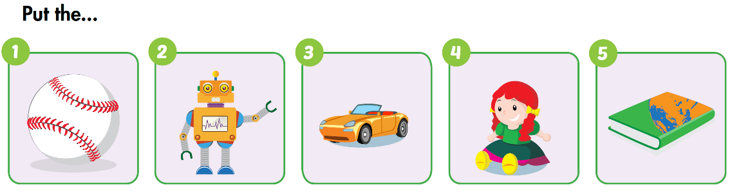
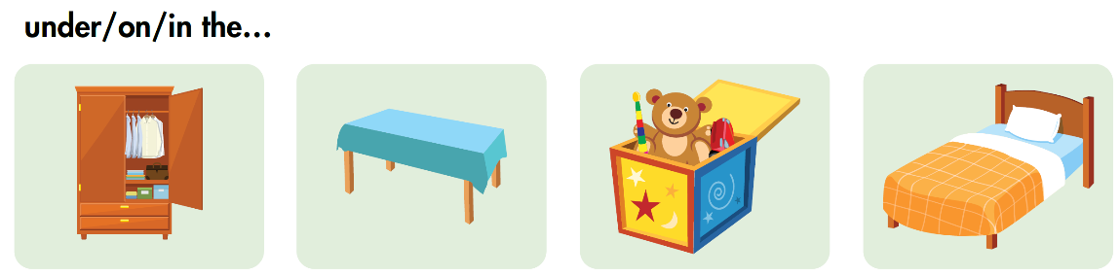

Slide 17
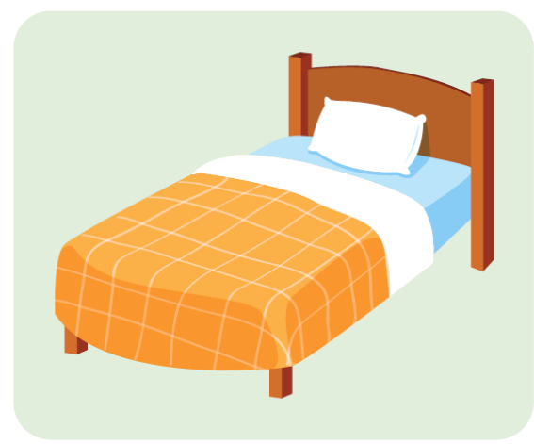

Put the ball under the bed.

Slide 18

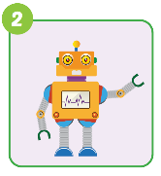
Put the robot in the toy box.

Slide 19
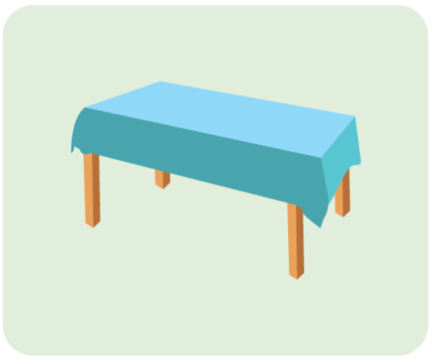
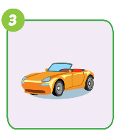
Put the car on the table.

Slide 20
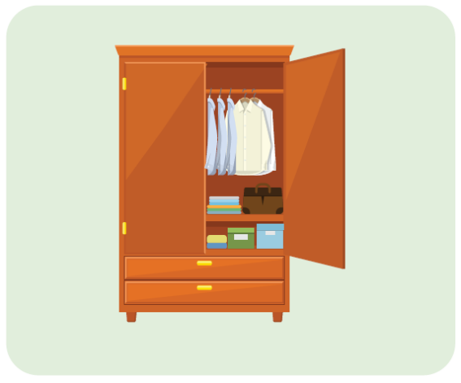
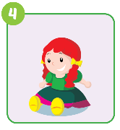
Put the doll in the wardrobe.

Slide 21

Put the book on the table.

Slide 22

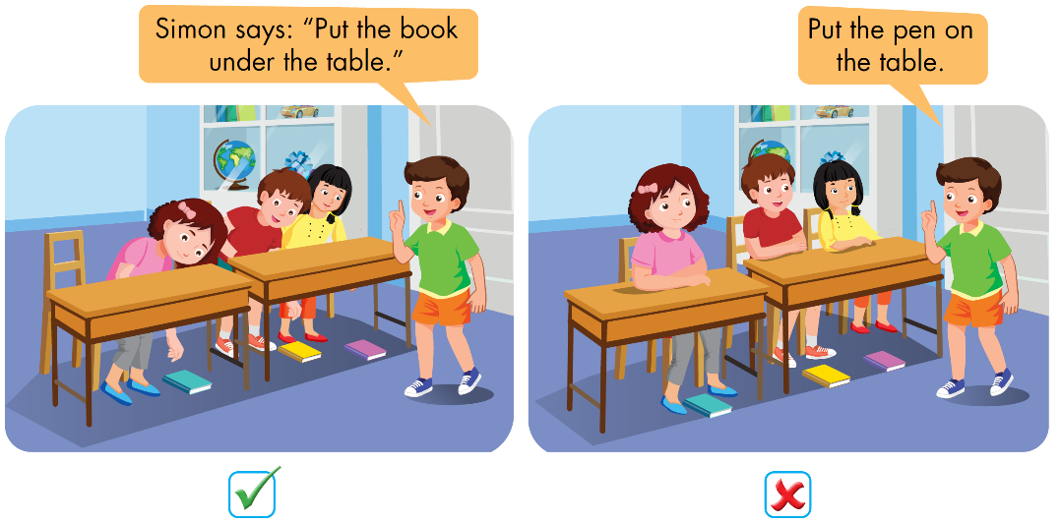
Post speaking

Slide 23










Listen and choose
A
C
B

Slide 24


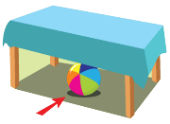
Listen and choose
A
C
B

Slide 25
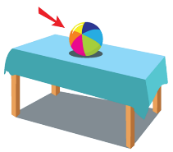

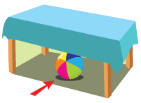
Listen and choose
A
B
B

Slide 26

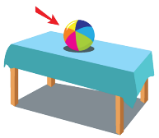

Listen and choose
A
B
B

Slide 27

CONSOLIDATION

Slide 28
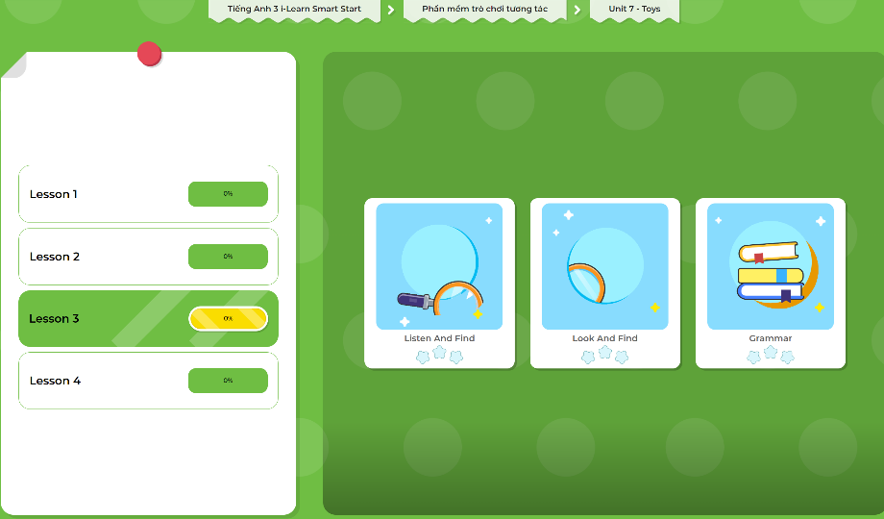
Extra Practice
DHA App
LET’S PLAY!
Click here to play the games

Slide 29

WRAP-UP

Slide 30
Today’s lesson
Structures/ Sentence patterns
Put the ball on the chair.

Slide 31
Homework
Practice the vocabularies and structure; and make sentences using them.
Do the exercises in Tiếng Anh 3 i-Learn Smart Start WB (page 73)
Do the exercises in Tiếng Anh 3 i-Learn Smart Start Notebook (page 48)
Prepare the next lesson (page 105 SB)
Play the consolidation games in Tiếng Anh 3 i-Learn Smart Start DHA App on www.eduhome.com.vn

Slide 32

Enjoy your day!

