Slide 1


Slide 2
Unit
8
BECOMING INDEPENDENT
Unit
FAMILY LIFE
LESSON 3
READING
How to become independent

Slide 3
LESSON 3
READING
WARM-UP
Guessing
PRE-READING
Leading
Task 2. Read the article. Match the paragraphs with their headings.
Task 3. Match the highlighted phrase with the heading.
Task 4. Complete the diagrams with information from the text.
WHILE-READING
POST-READING
Discussion
Wrap-up
Homework
CONSOLIDATION

Slide 4
WARM-UP
GUESSING
Work in groups.
Use body language to explain the words.
If you get the correct answer ➔ 1 point.
- If the answer is wrong or you don’t have the answer ➔ the chance is for other groups.
The group with more correct answers will be the winner.

Slide 5
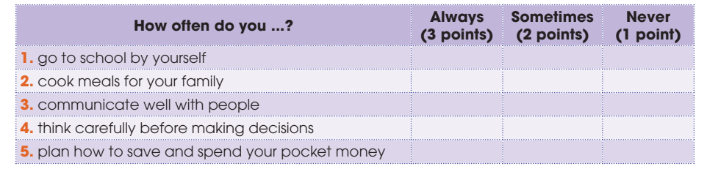
PRE-READING
1
Tick the appropriate box to see how independent you are. Add up your points. If your total score is nine or above, you are independent. Compare with a partner.

Slide 6
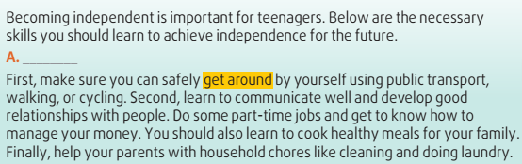
WHILE-READING
2
Read the text. Match the paragraphs (A-C) with their headings (1-5).
5

Slide 7
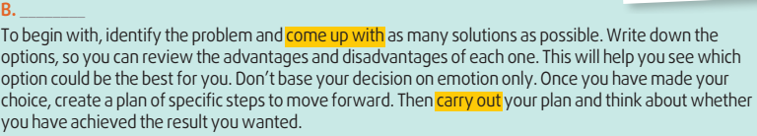
WHILE-READING
2
Read the text. Match the paragraphs (A-C) with their headings (1-5).
4

Slide 8
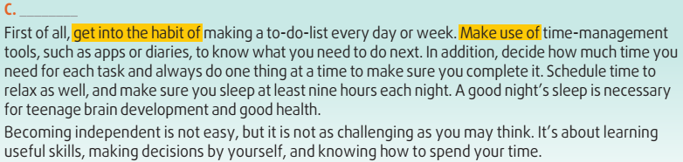
WHILE-READING
2
Read the text. Match the paragraphs (A-C) with their headings (1-5).
3

Slide 9
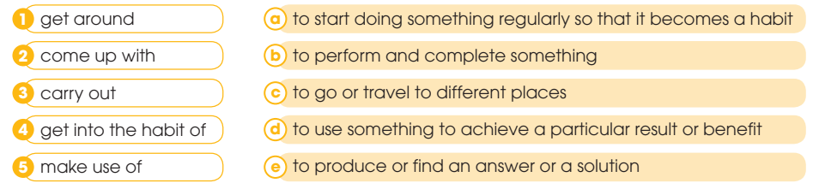
WHILE-READING
3
Read the text again and match the highlighted phrases in the text with their meanings.
1. c 2. e 3. b 4. a 5. d

Slide 10
WHILE-READING
4
Complete the diagrams with information from the text.
Decision-making skills
Identify the problem
Think of (1) ______________
Review pros and cons
Pick the (2) ______________
Create and carry out your plan
many solutions
best option

Slide 11
WHILE-READING
4
Complete the diagrams with information from the text.
Time-management skills
Make (3) ______________
Use time-management tools
Do one thing at a time
Schedule time to relax
Have a good (4) ______________
a to-do-list
night’s sleep

Slide 12


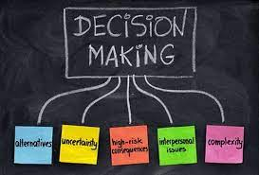
POST-READING
5
Discussion
Which of the skills mentioned in the text do you have?
What other skills do you think teenagers need to become independent?

Slide 13
CONSOLIDATION
1
Wrap-up
What have you learnt today?
Some skills to become independent
Reading for main ideas and specific information

Slide 14
CONSOLIDATION
2
Homework
Do exercises in the workbook.
Prepare for Lesson 4 - Unit 8.

Slide 15

Website: hoclieu.vn
Fanpage: facebook.com/www.tienganhglobalsuccess.vn

