Slide 1

Unit 2: Family
Lesson 1.3
Page 26

Slide 2
Lesson Outline
Warm-up
Practice
Speaking
Consolidation
Wrap-up

Slide 3
Objectives
By the end of this lesson, students will be able to introduce their family members, using ….
Vocabulary:
father, mother, brother, sister
Structures:
This is my father.
Hello, Lucy. I’m Alfie.
Hello, Alfie.

Slide 4

WARM UP

Slide 5
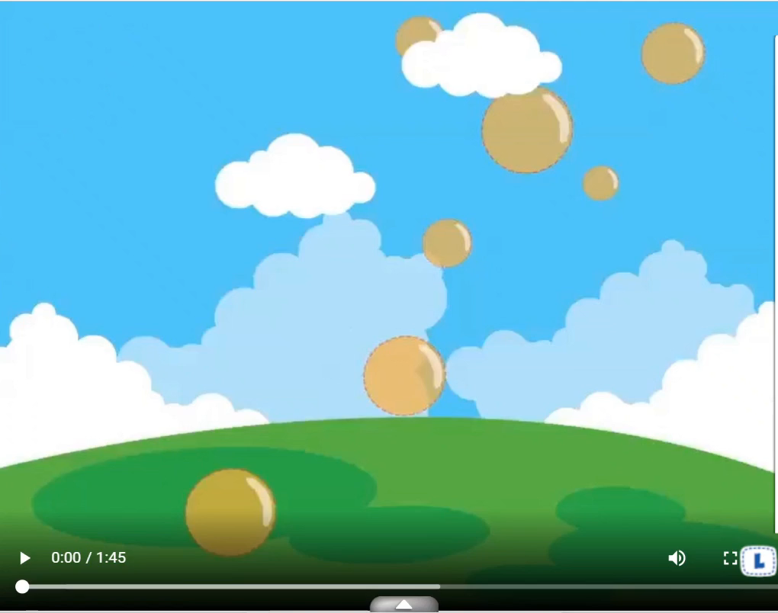

Slide 6




Look at the numbers and say the family members.
1
3
Well done!
1
4
1
2
1
2
3
1
2
2
3
2
2
3
4
1
2
4
3
2
1
3
4
4
1
4
1
2
4
Notes:
Have students review the family members vocabulary.
Ask them to identify the words and numbers on the pictures.
Let them say the vocabulary first.
Correct their pronunciation if needed.
Ask the class to look at the number in each box and say a family member word.

Slide 7

It’s time to learn …

Slide 8

Practice

Slide 9

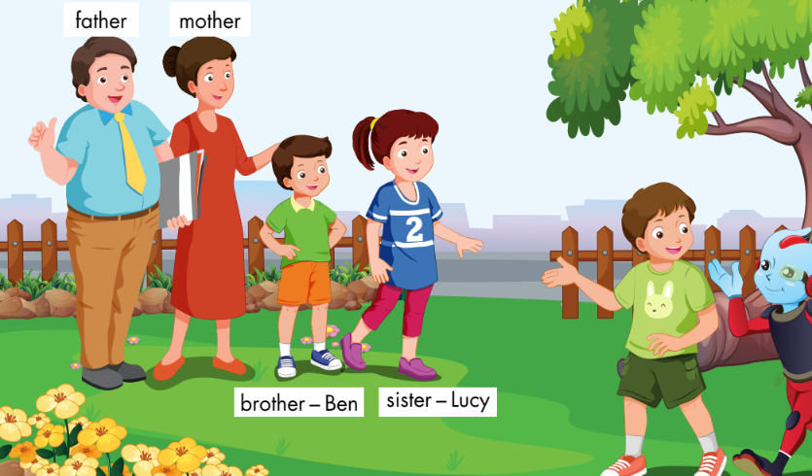
E
1. Point and say.
Notes:
Have the class look at the picture.
Ask them what they can see in the picture.
Ask them to point to the picture and say the family words and spell the names.
Remind them of the key structure: “This is my…” to introduce family members.
1. Point and say.
Divide the class into two pairs.
Demonstrate the activity using the speech bubbles.
Have the student A point to a person in the picture, have the student B introduce.
Swap roles and repeat.
Afterwards, have some pairs demonstrate the activity in front of the class.

Slide 10

Speaking

Slide 11
E
2. Role-play.
Example:
Tina: This is my brother, Ben.
Mark: Hello, Ben. I’m Mark.
Ben: Hello, Mark.
Notes:
2. Role-play.
Divide the class into groups of three.
Demonstrate the activity using the example.
Ask them to role-play the activity.
Swap roles and repeat.
Afterwards, have some pairs demonstrate the activity in front of the class.

Slide 12
Practice

Slide 13
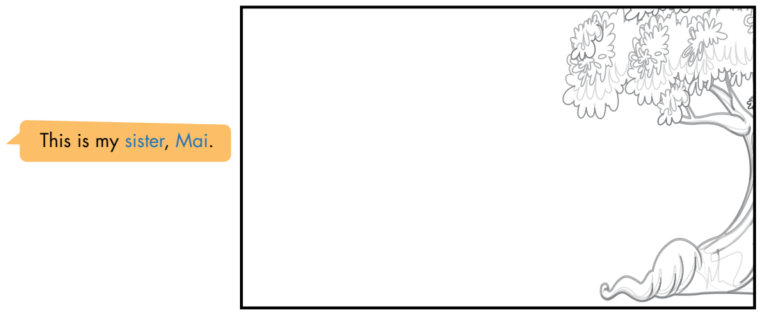
F
1. Draw your family. Point and say.
Notes:
F. 1. Draw your family. Point and say.
Have the students look at the picture of the garden and draw their family.
Divide the class into pairs.
Have the student A point and say about their family.
Swap roles and repeat.
Afterwards, have some students demonstrate the activity in front of the class.

Slide 14
Speaking

Slide 15
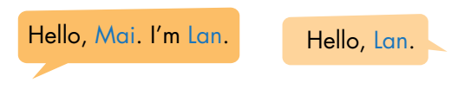
F
2. Role-play.
Example:
Lily: This is my sister, Mary.
Sam: Hello, Mary. I’m Sam.
Mary: Hello, Sam.
Notes:
2. Role-play.
Divide the class into groups of three.
Demonstrate the activity using the example.
Ask them to role-play the activity.
Swap roles and repeat.
Afterwards, have some pairs demonstrate the activity in front of the class.

Slide 16

CONSOLIDATION

Slide 17
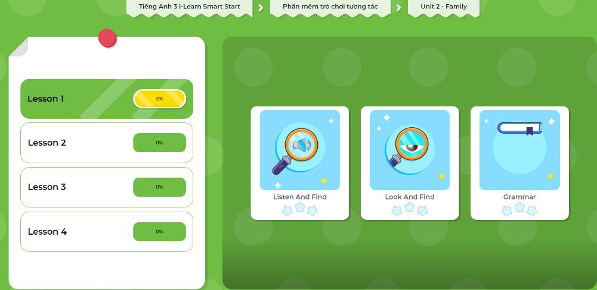
LET’S PLAY!
Click here to play the games!

Slide 18




Look and say.
This is my… .
Notes:
Look and say.
Demonstrate the activity in front of the class.
Ask the class to look at the flashcards.
Have them use the structure: “This is my… .” to introduce family members.
Help them with their pronunciation and grammar (if any).

Slide 19

WRAP-UP

Slide 20
Today’s lesson
Vocabularies
father
mother
brother
sister
Structures/ Sentence patterns
This is my father.
Hello, Lucy. I’m Alfie.
Hello, Alfie.

Slide 21
Homework
Practice the vocabularies and structures; and make sentences using them.
Do the exercises in Tiếng Anh 3 i-Learn Smart Start Notebook on page 16.
Prepare the next lesson: Unit 2 – Lesson 2 – Page 27.
Play the consolidation games in Tiếng Anh 3 i-Learn Smart Start DHA App on www.eduhome.com.vn

Slide 22

Enjoy your day!

