Slide 1


Slide 2
UNIT
3
CITIES OF THE FUTURE
Unit
FAMILY LIFE
LESSON 5
LISTENING
Living in a smart city

Slide 3
LESSON 5
LISTENING
WARM-UP
Kim’s game
PRE-LISTENING
Task 1. Match the words and phrase with their meanings.
Task 2. Listen and choose the correct answer.
Task 3. Listen and complete the table.
WHILE-LISTENING
POST-LISTENING
Task 4. Discuss the questions.
CONSOLIDATION
Wrap-up
Homework

Slide 4
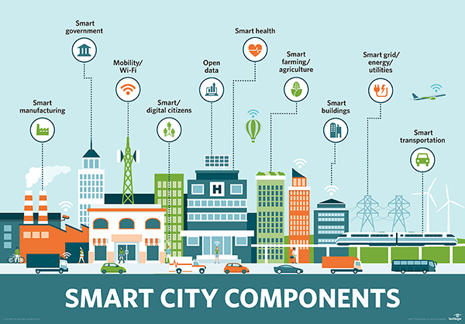
WARM-UP

Slide 5
PRE-LISTENING
1
Match the words and phrase with their meanings.
interact
privacy
sense of community
neighbourhood
an area of a town
the feeling of belonging to a group
to talk or do things with other people
the state of being alone and not watched or interrupted by other people

Slide 6


PRE-LISTENING
interact
/ˌɪn.təˈrækt/

Slide 7
PRE-LISTENING
privacy (n)
/ˈprɪvəsi, ˈpraɪ-/
Eg: With seven people squashed in one house, you don't get much privacy.

Slide 8


PRE-LISTENING
sense of community (n)
/sens əv kəˈmjuː.nə.ti/

Slide 9
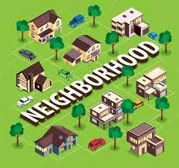
PRE-LISTENING
neighbourhood (n)
/ˈneɪbəhud/

Slide 10
PRE-LISTENING
1
Match the words and phrase with their meanings.
interact
privacy
sense of community
neighbourhood
an area of a town
the feeling of belonging to a group
to talk or do things with other people
the state of being alone and not watched or interrupted by other people

Slide 11
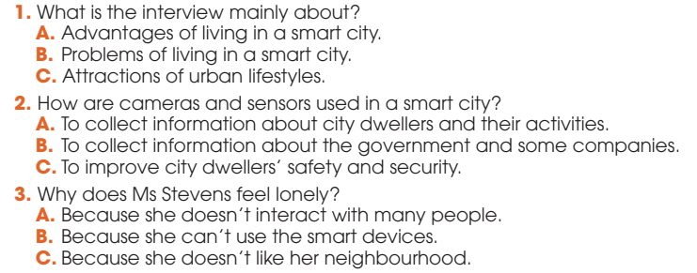
WHILE-LISTENING
2
Listen to an interview and choose the correct answers A, B, or C.

Slide 12
WHILE-LISTENING
3
Listen to the interview again and complete the table.
Situations | Problems
There are cameras and sensors everywhere. | City dwellers may lose their (1) ______________ in public areas.
People use (2) ________________ to help them with household chores. | It is not easy for some people to get familiar with and use the smart devices.
Some city dwellers (3) _________ with each other face to face less. | There is no (4) ___________________ in the neighbourhood.
right to privacy
smart technologies
interact
sense of community

Slide 13


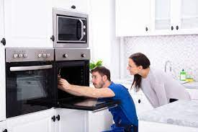
POST-LISTENING
5
Work in groups. Discuss the following questions.
Do you agree with Ms Stevens? Which of the disadvantages she mentions do you think is the most serious? Why?

Slide 14
CONSOLIDATION
1
Wrap-up
What have you learnt today?
Words and phrases related to living in a smart city
Listening for main ideas and specific information

Slide 15
CONSOLIDATION
2
Homework
Do exercises in the workbook.
Prepare for Lesson 6 - Unit 3.

Slide 16

Website: hoclieu.vn
Fanpage: facebook.com/www.tienganhglobalsuccess.vn

