Slide 1

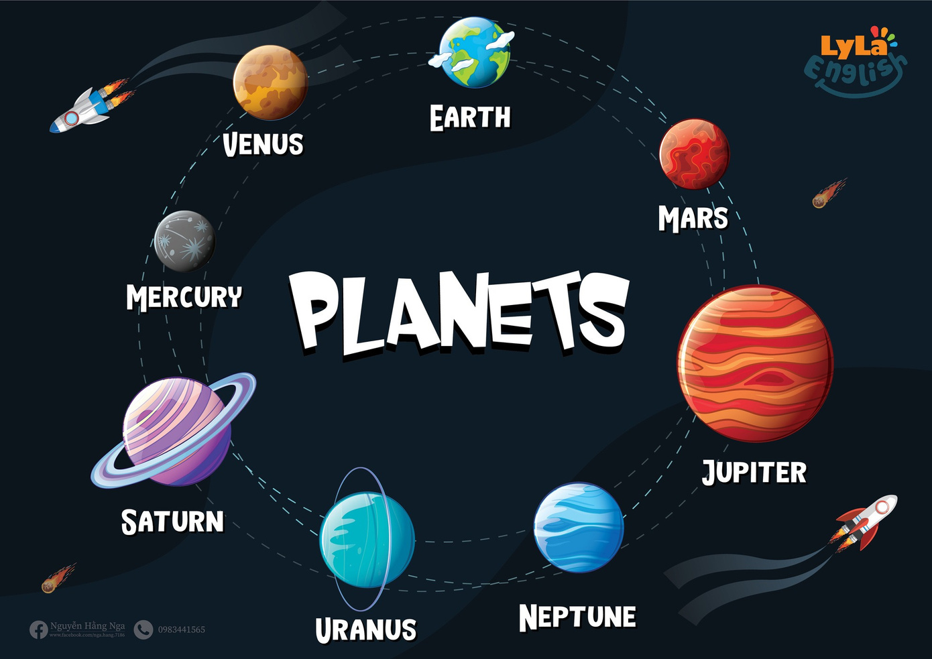


Slide 2

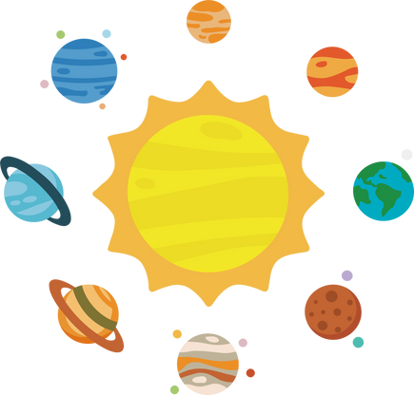
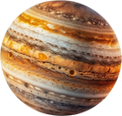
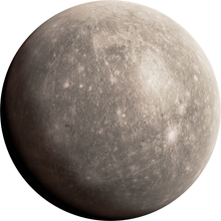
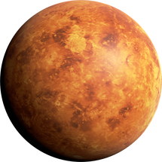
I. QUESTION
1.How many planets are there in the solar system?
- There are .. planets
2. What is the biggest planet in the solar system?
- It’s ...
3. What is the smallest planet in the solar system?
- It’s ...
4. What is the hottest planet in the solar system?
- It’s ...

Slide 3
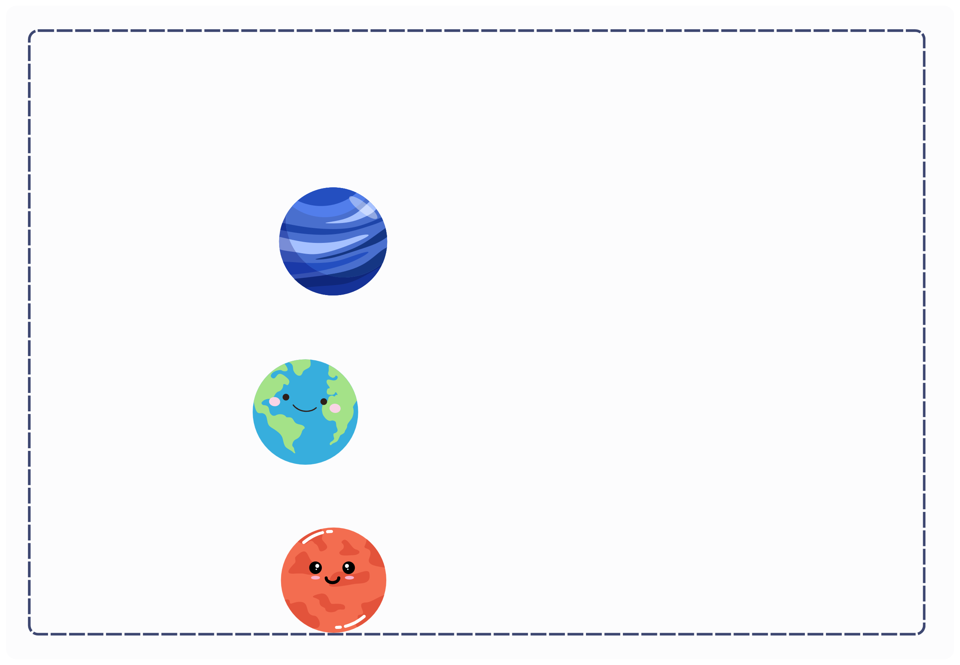
I. QUESTION
5. What is the farthest planet in the solar system? - It’s ...
6. What planet are we living on? - It’s ...
7. What is called red planet in the solar system? - It’s ...

Slide 4
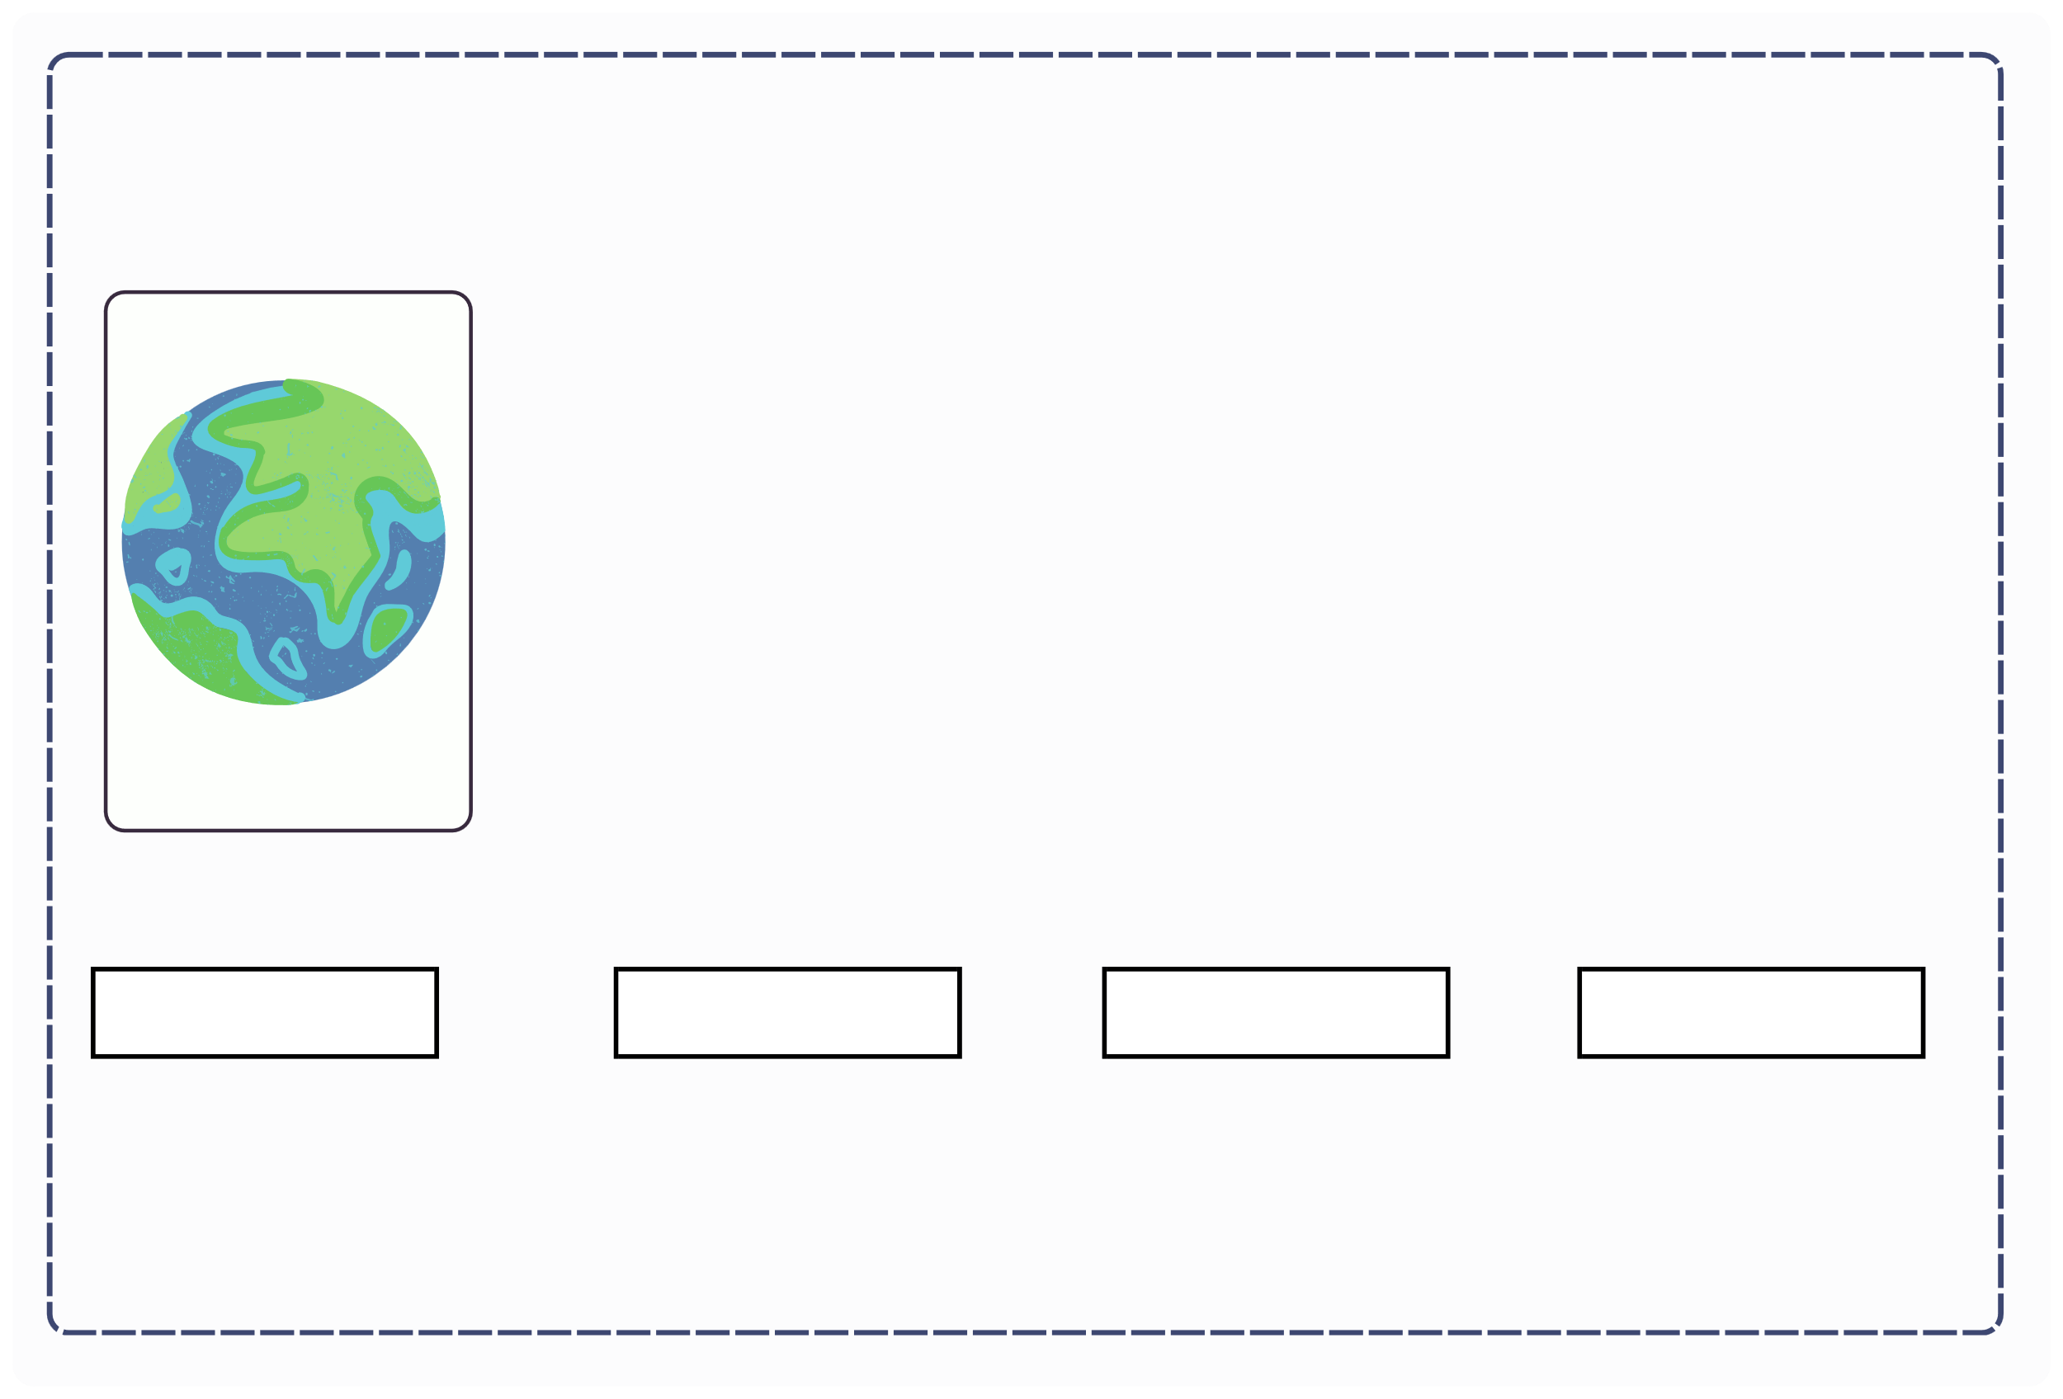
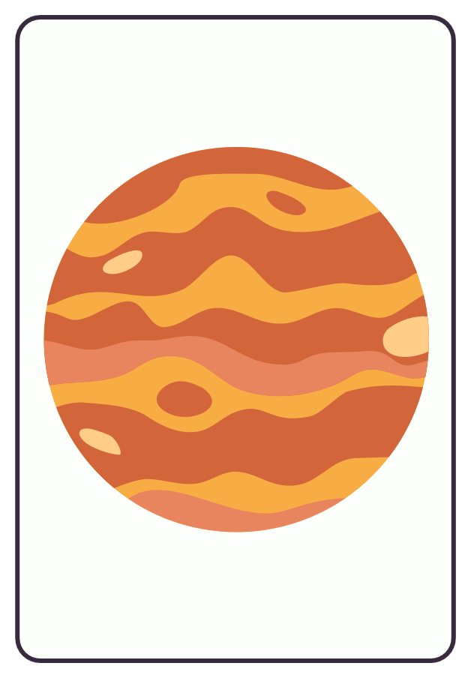

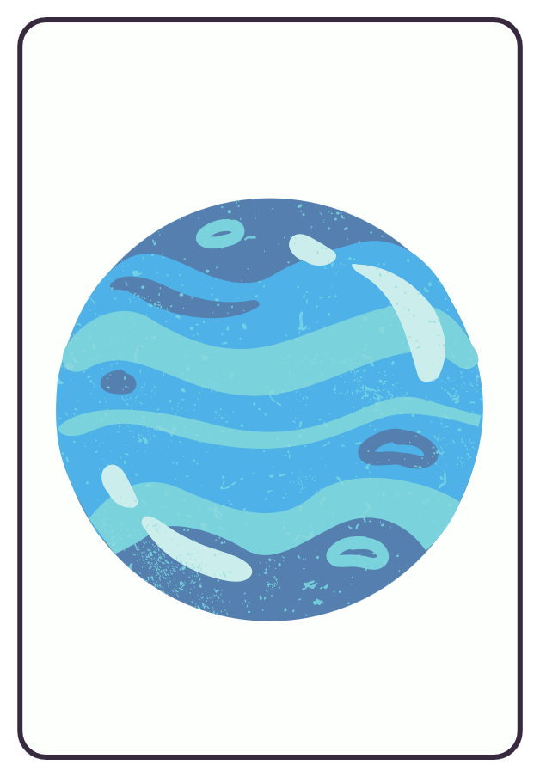
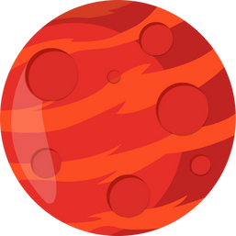
II. VOCABULARY
Earth
Mars
Jupiter
Neptune

Slide 5
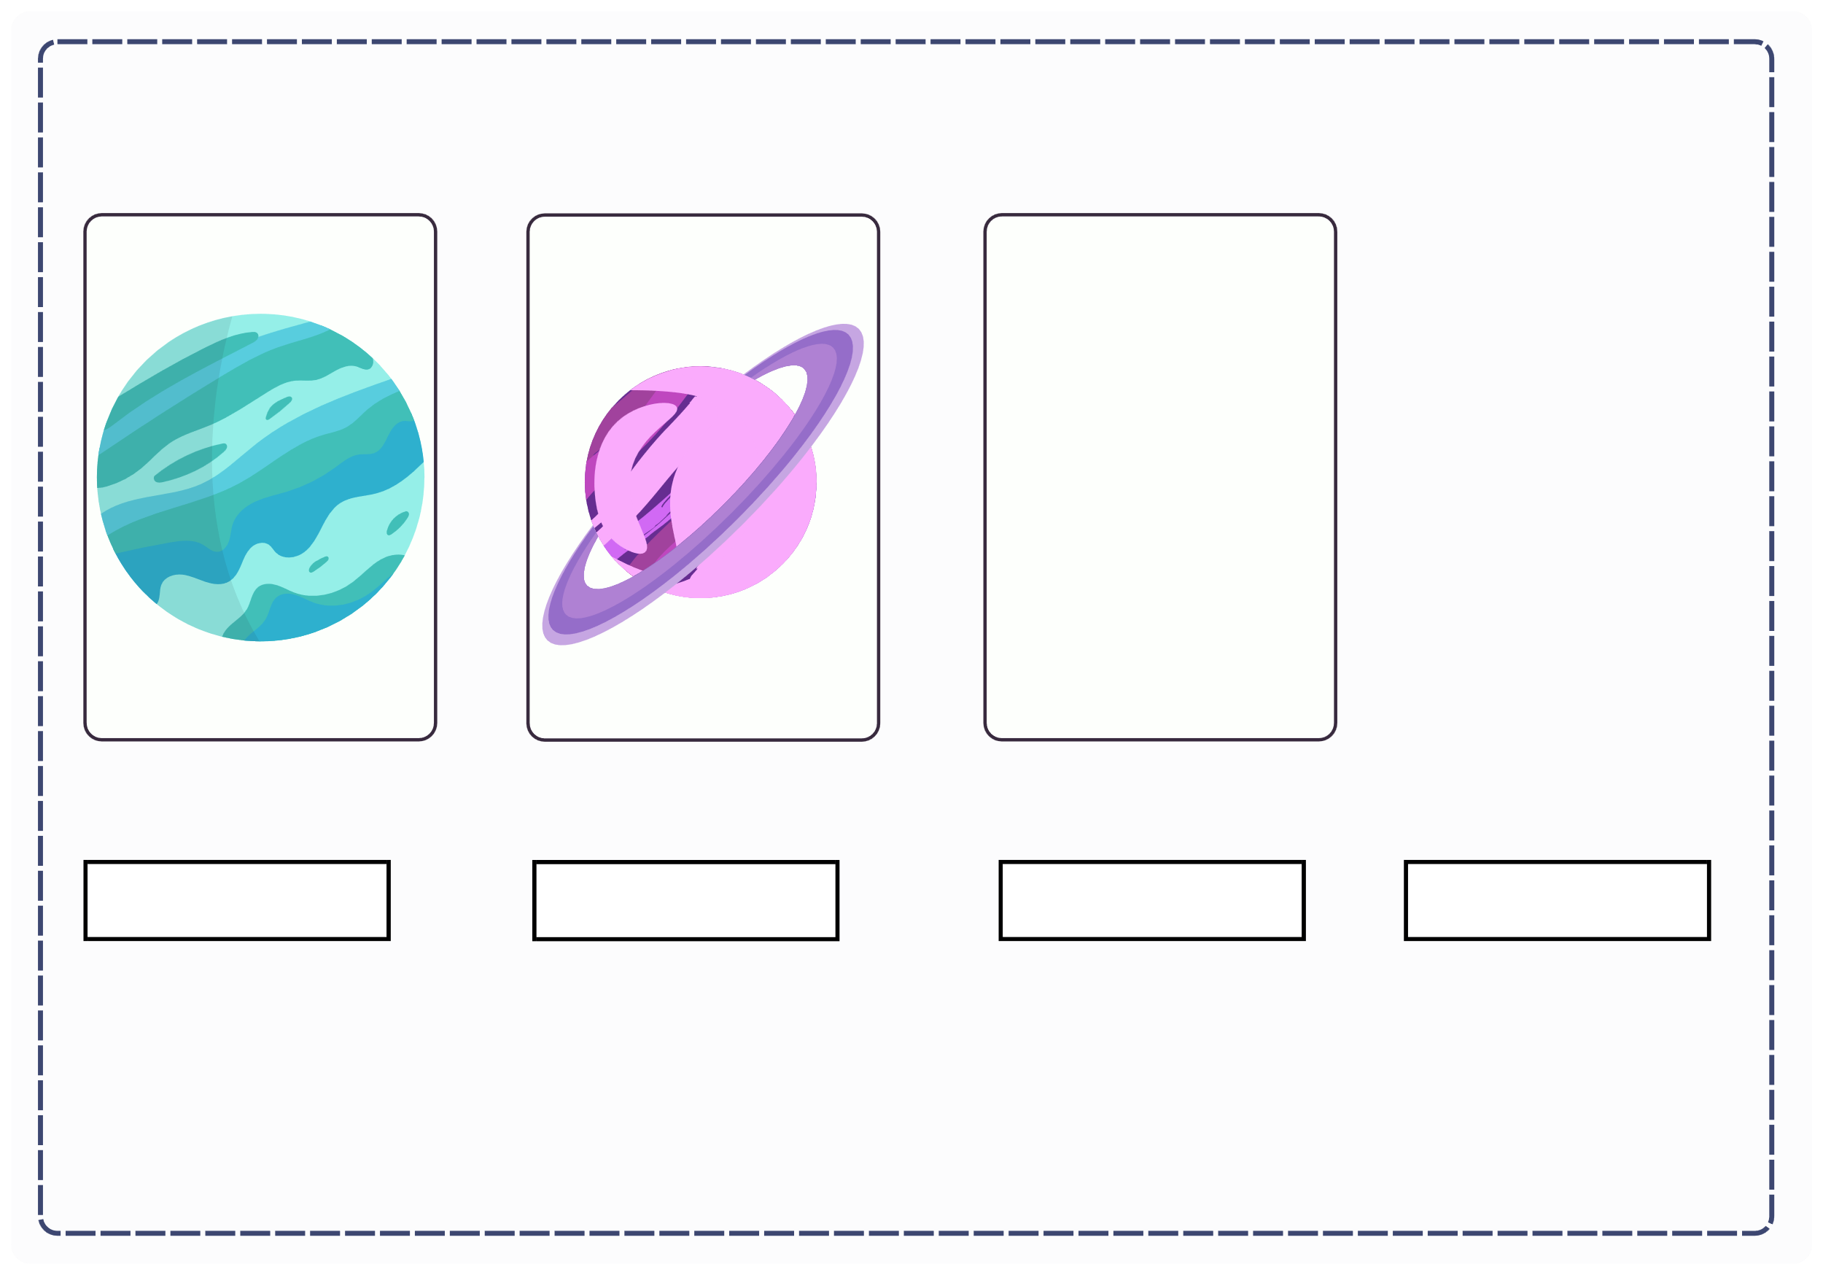
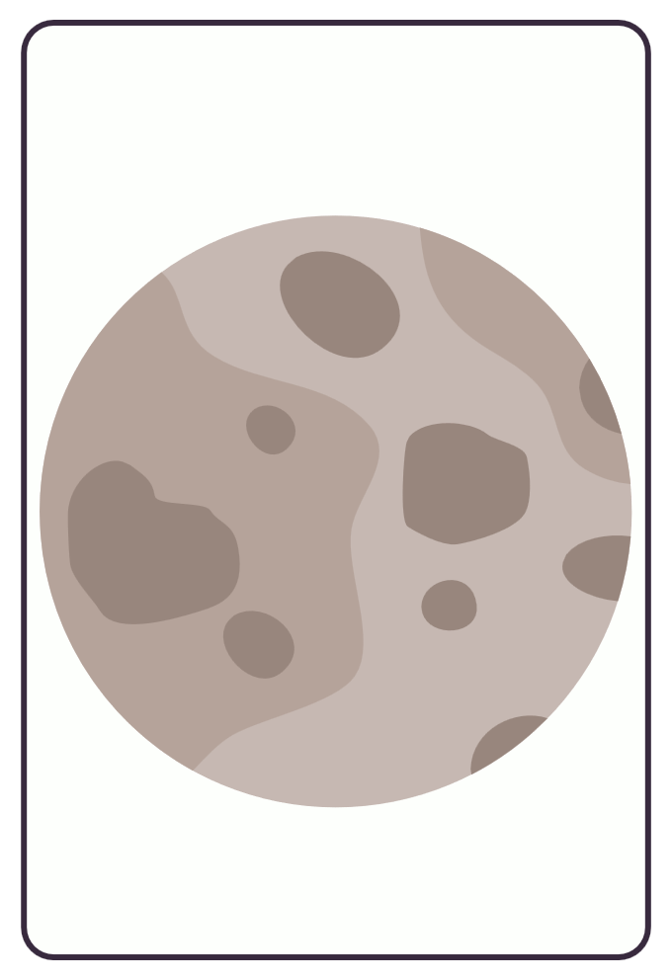
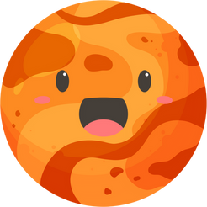
II. VOCABULARY
Uranus
Saturn
Mercury
Venus

Slide 6

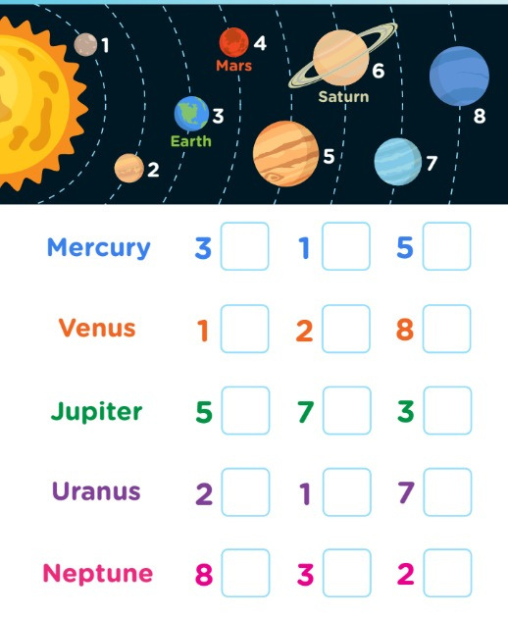
III. EXERCISES:
1.Tick the correct planet:
Mercury Venus Jupiter Uranus
Neptune
3 1 5
2
8
1 2
7 1
3
5 8
3
7
2

Slide 7
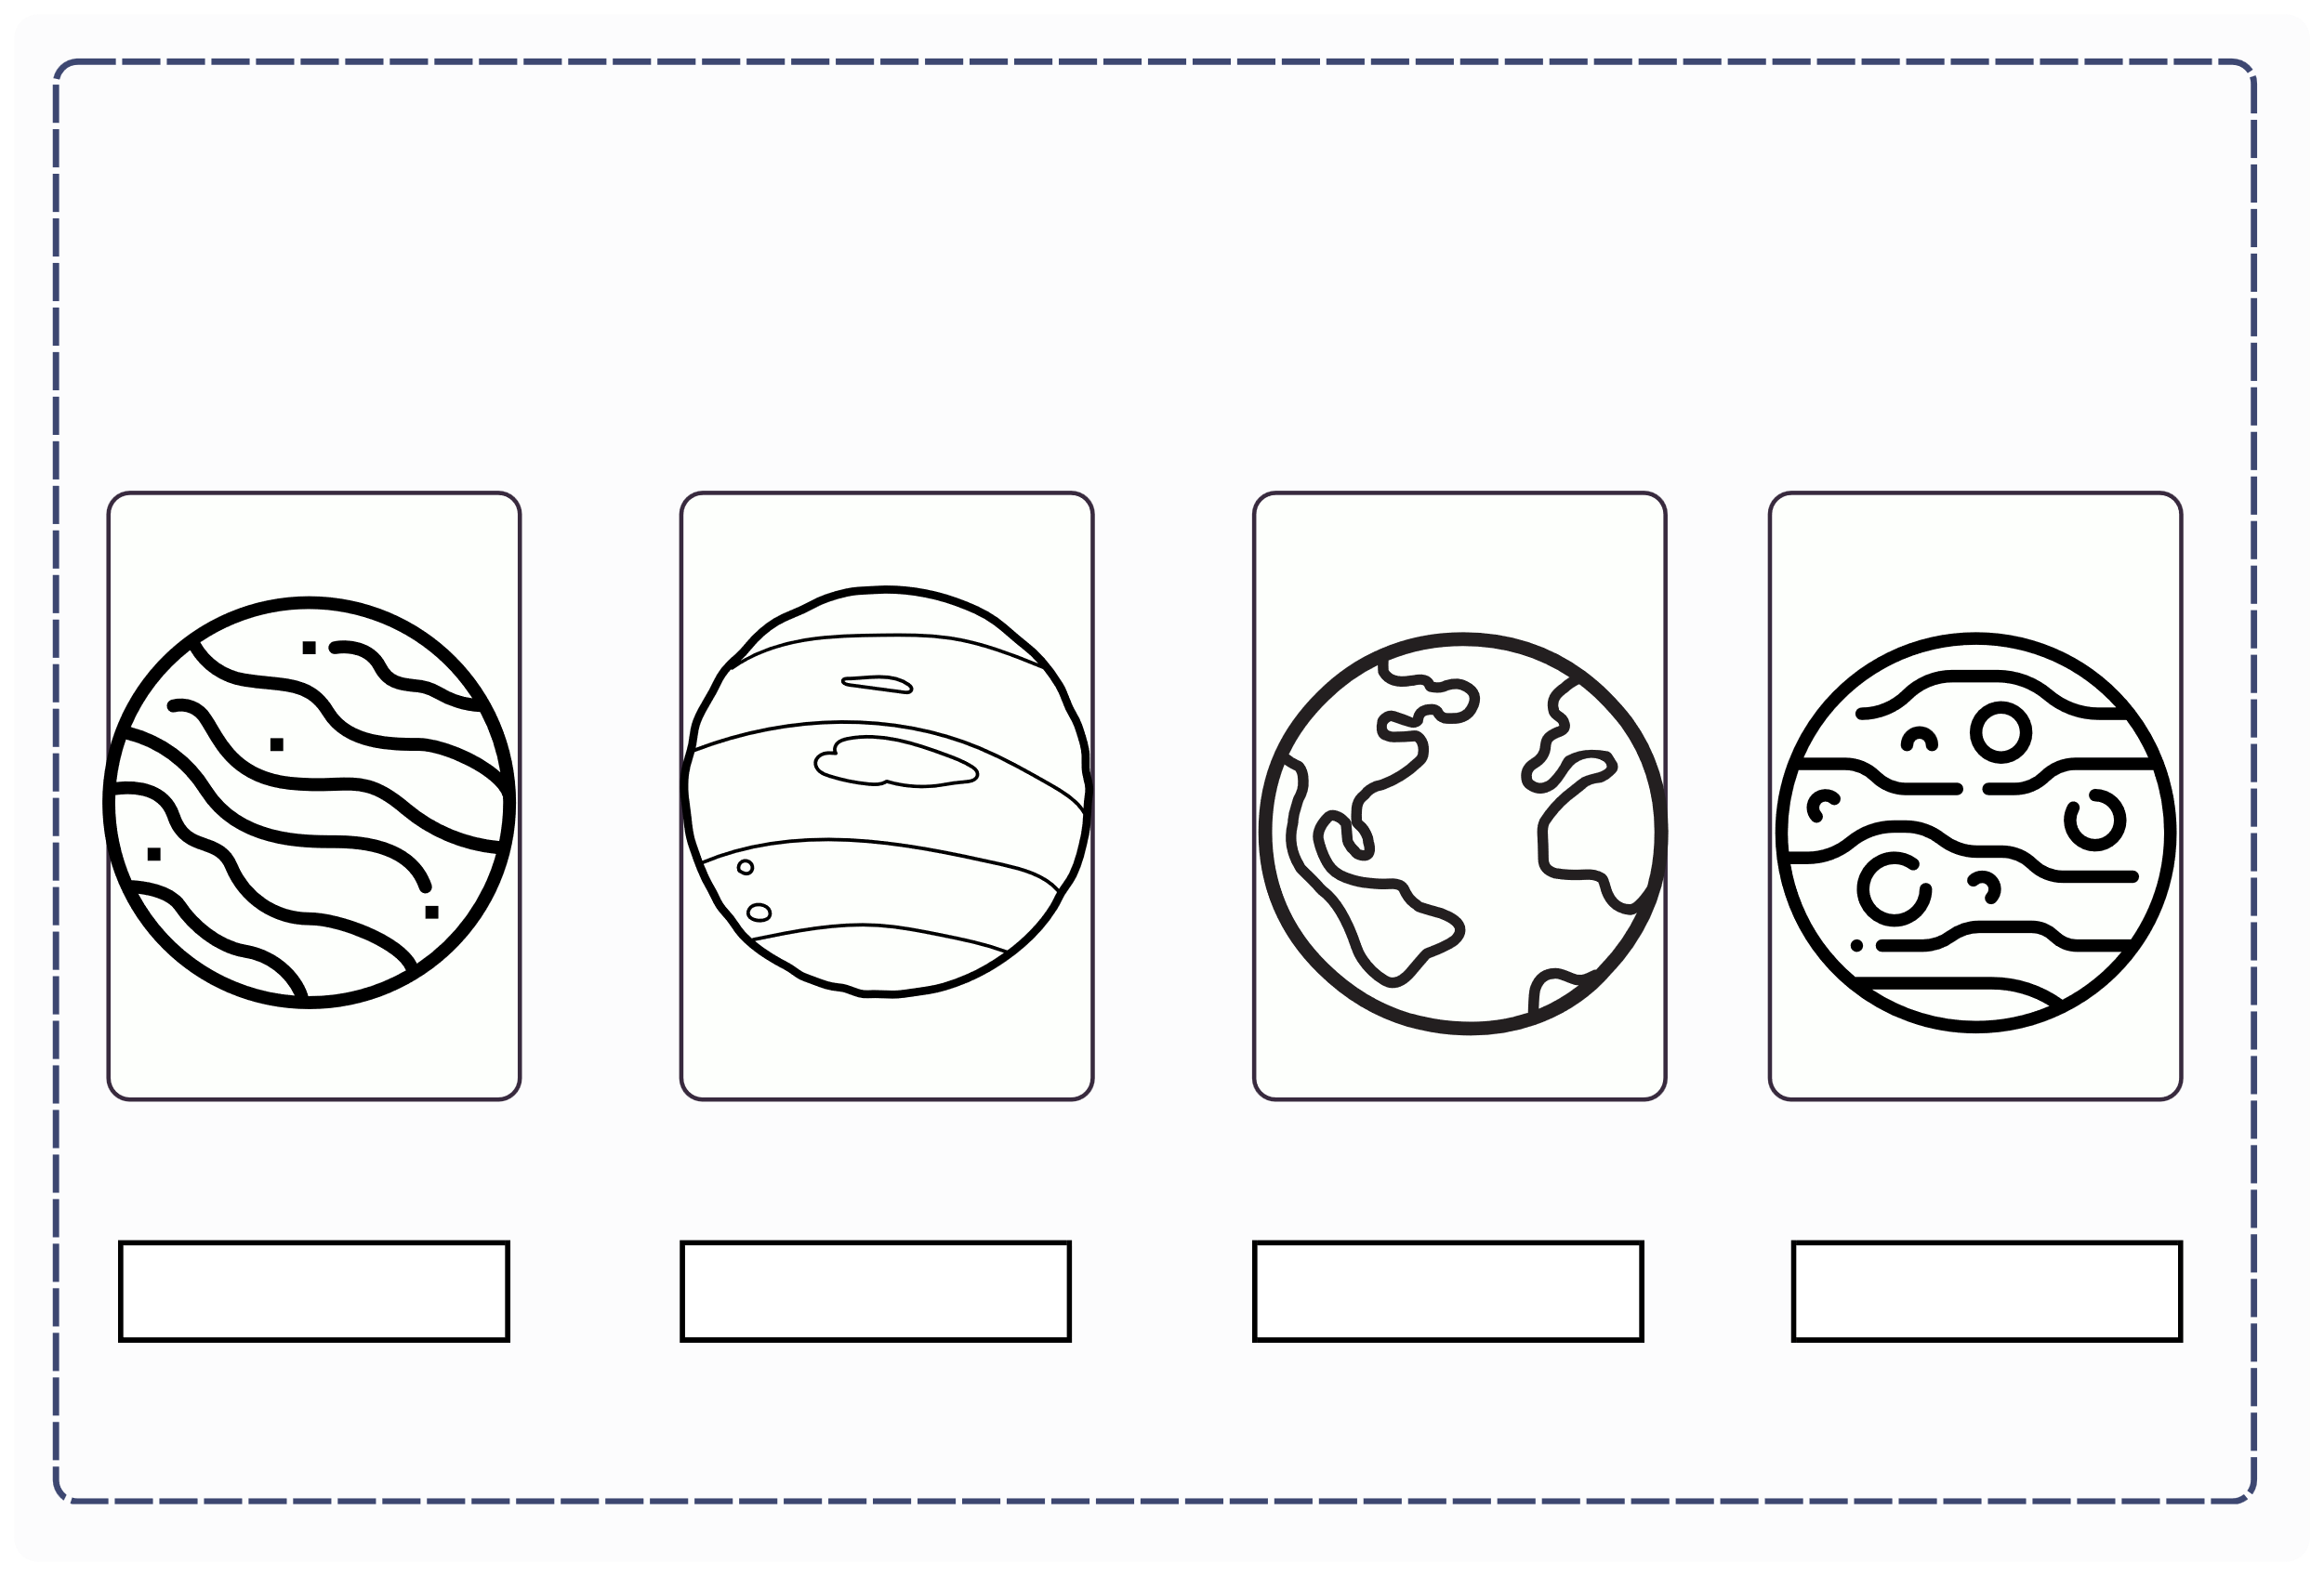
III. EXERCISES:
2. Read and color planets:
Mars
Neptune
Earth
Jupiter

Slide 8
III. EXERCISES:
3.Trace the words:
Uranus Mars
Neptune
Venus
Mercury
Saturn

Slide 9
III. EXERCISES:
4. Fill the missing words:
1.E_ _ _ _
5. U_ _ _ _ _
2. M_ _ _
6. S_ _ _ _ _
3. J_ _ _ _ _
7. M_ _ _ _ _ _
4. N_ _ _ _ _ _
8. V_ _ _ _

Slide 10
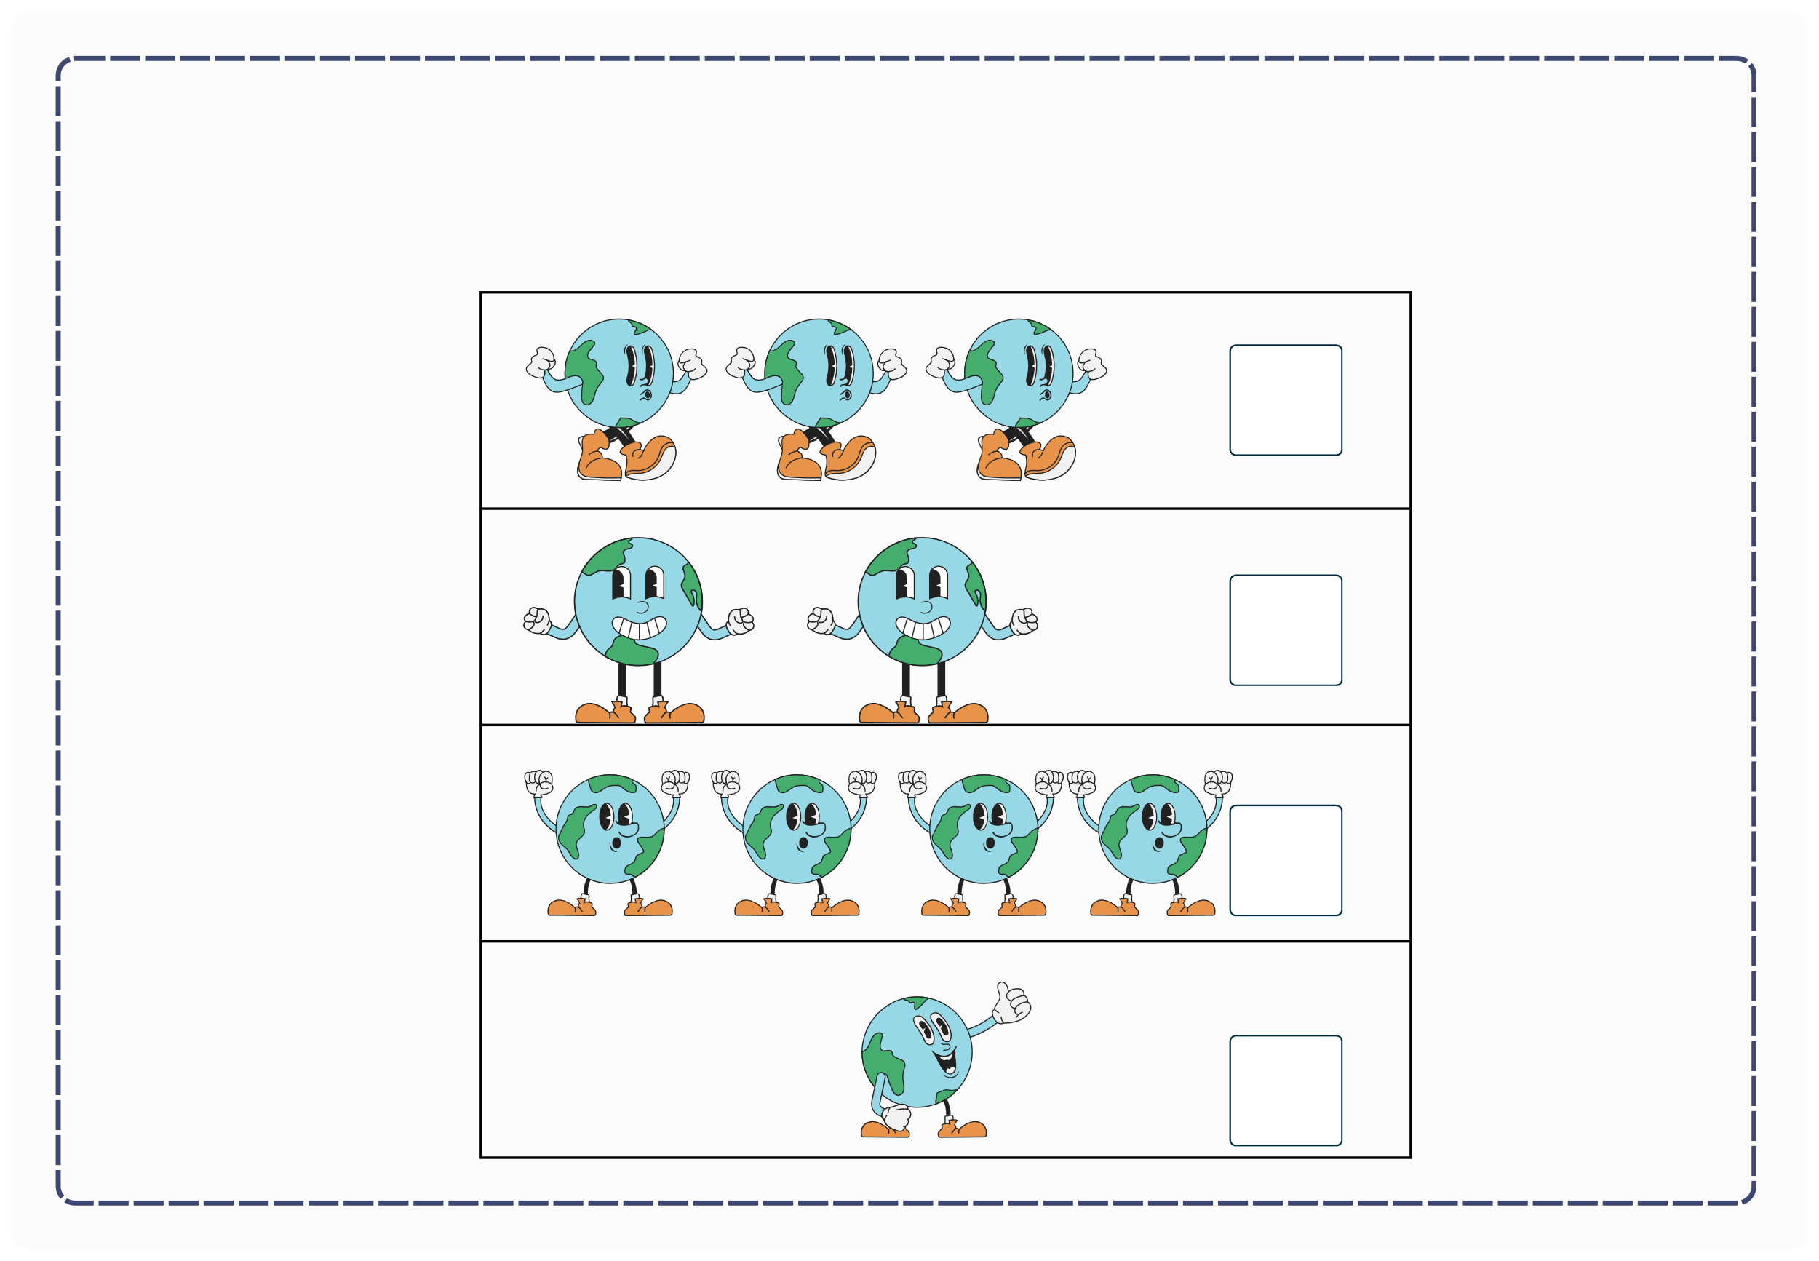
III. EXERCISES:
5. Count the Earth:

Slide 11
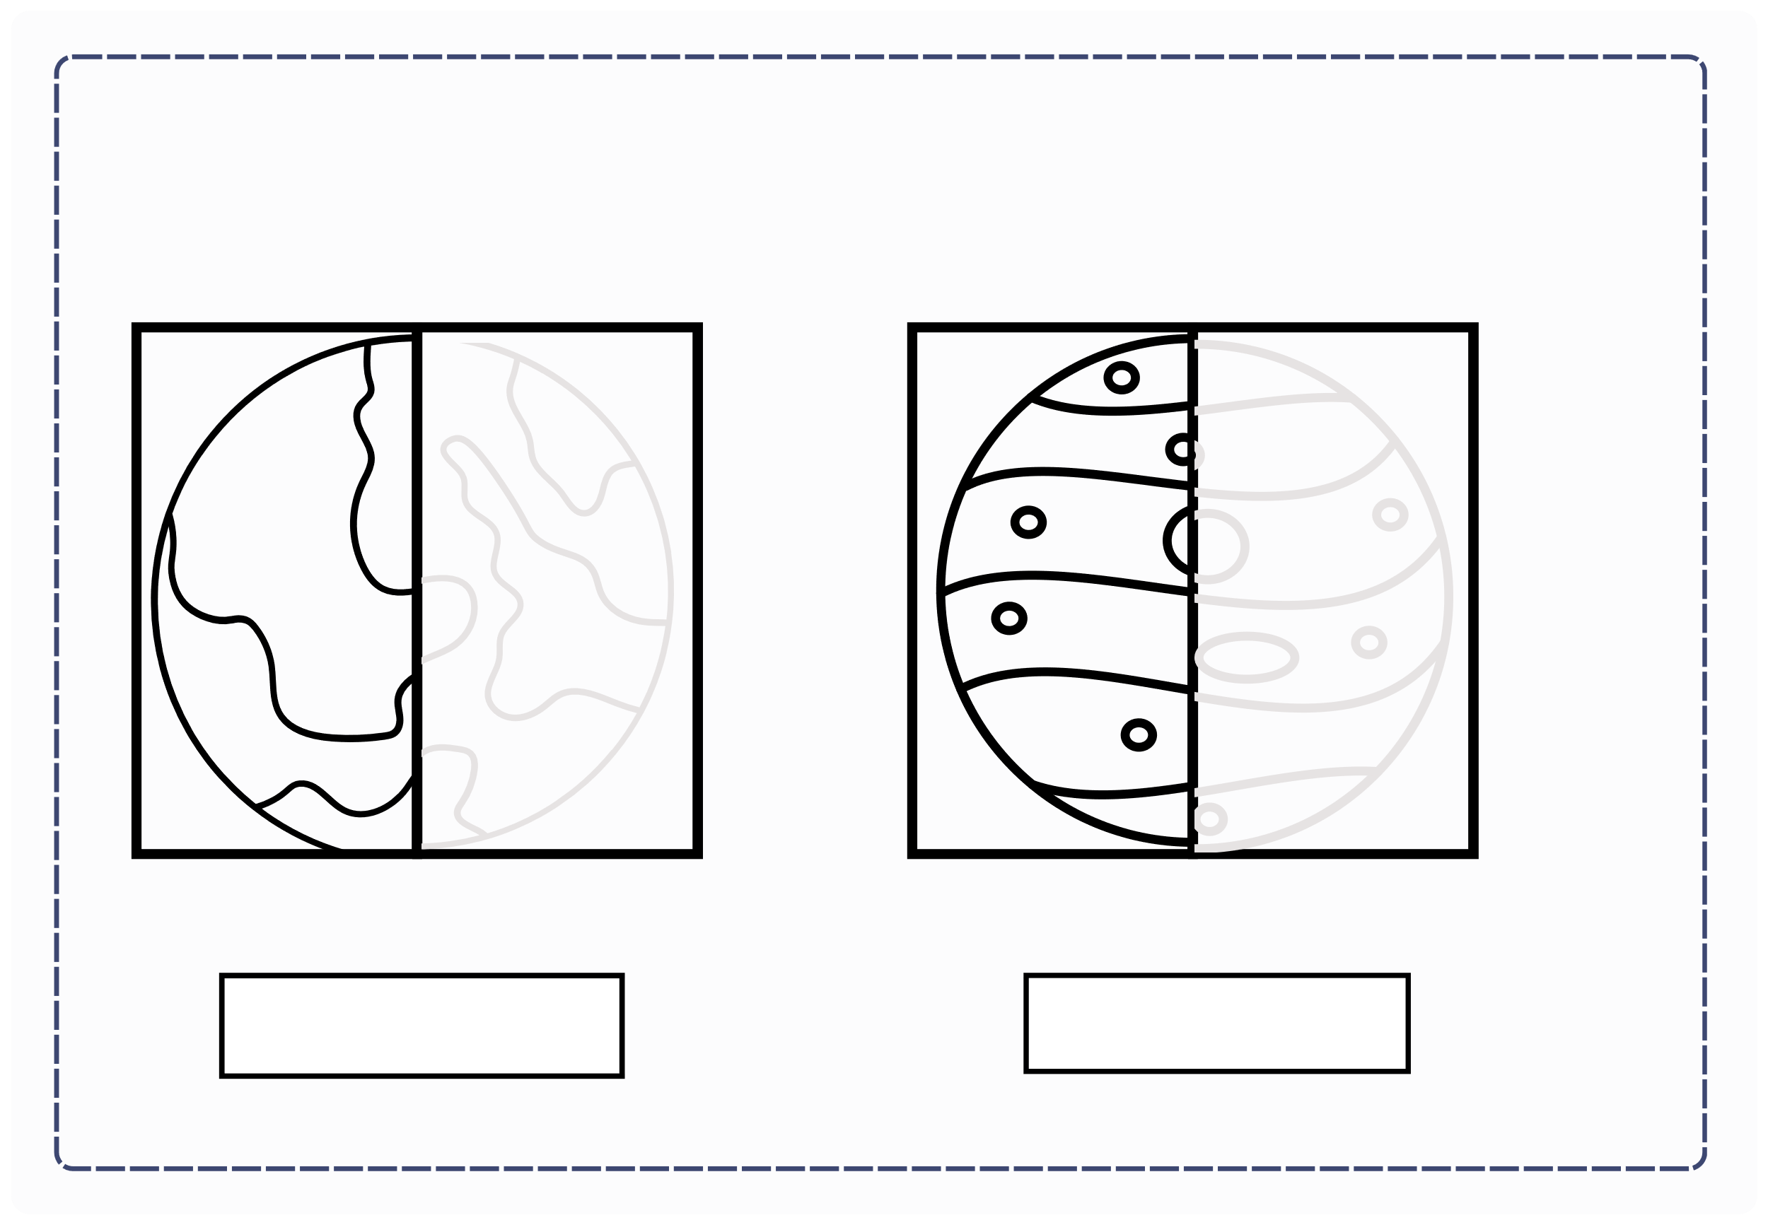
III. EXERCISES:
6. Draw the other halves, color the pictures:
Earth
Mercury

Slide 12
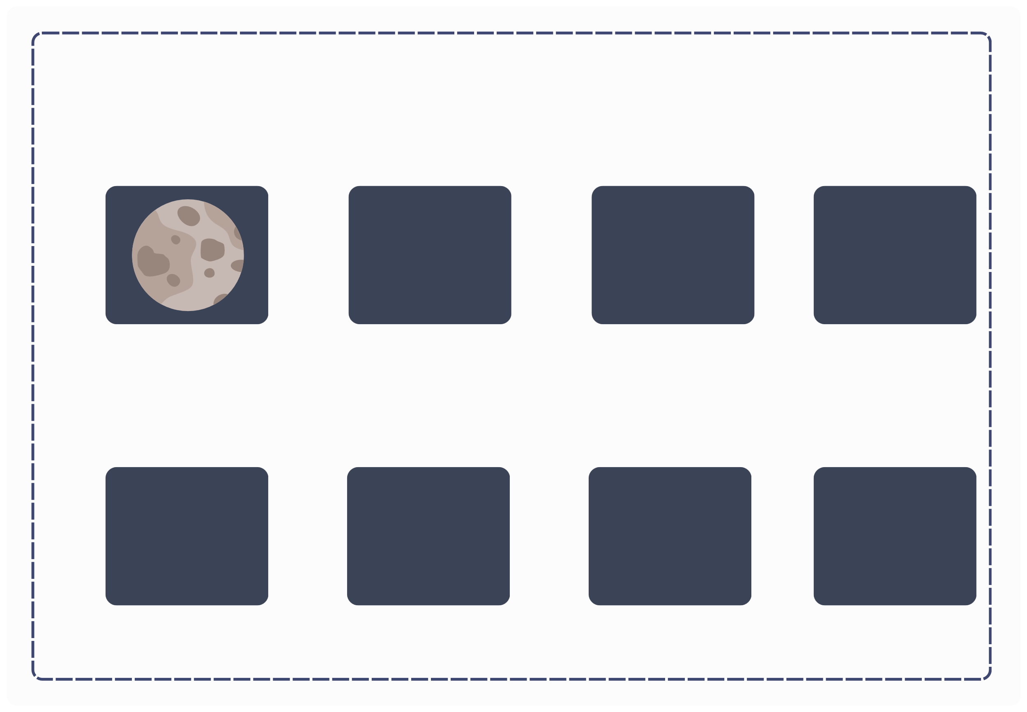
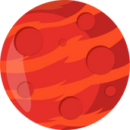
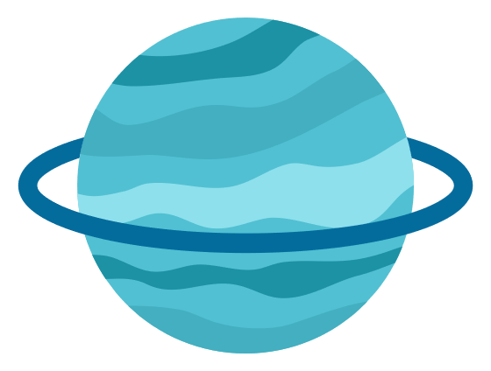
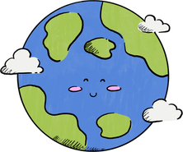
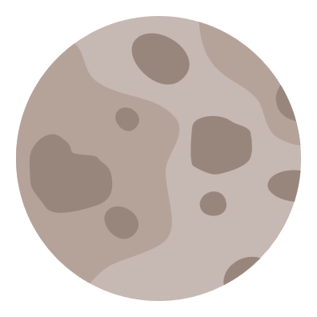
III. EXERCISES:
7. Find and line the similar picture:

Slide 13
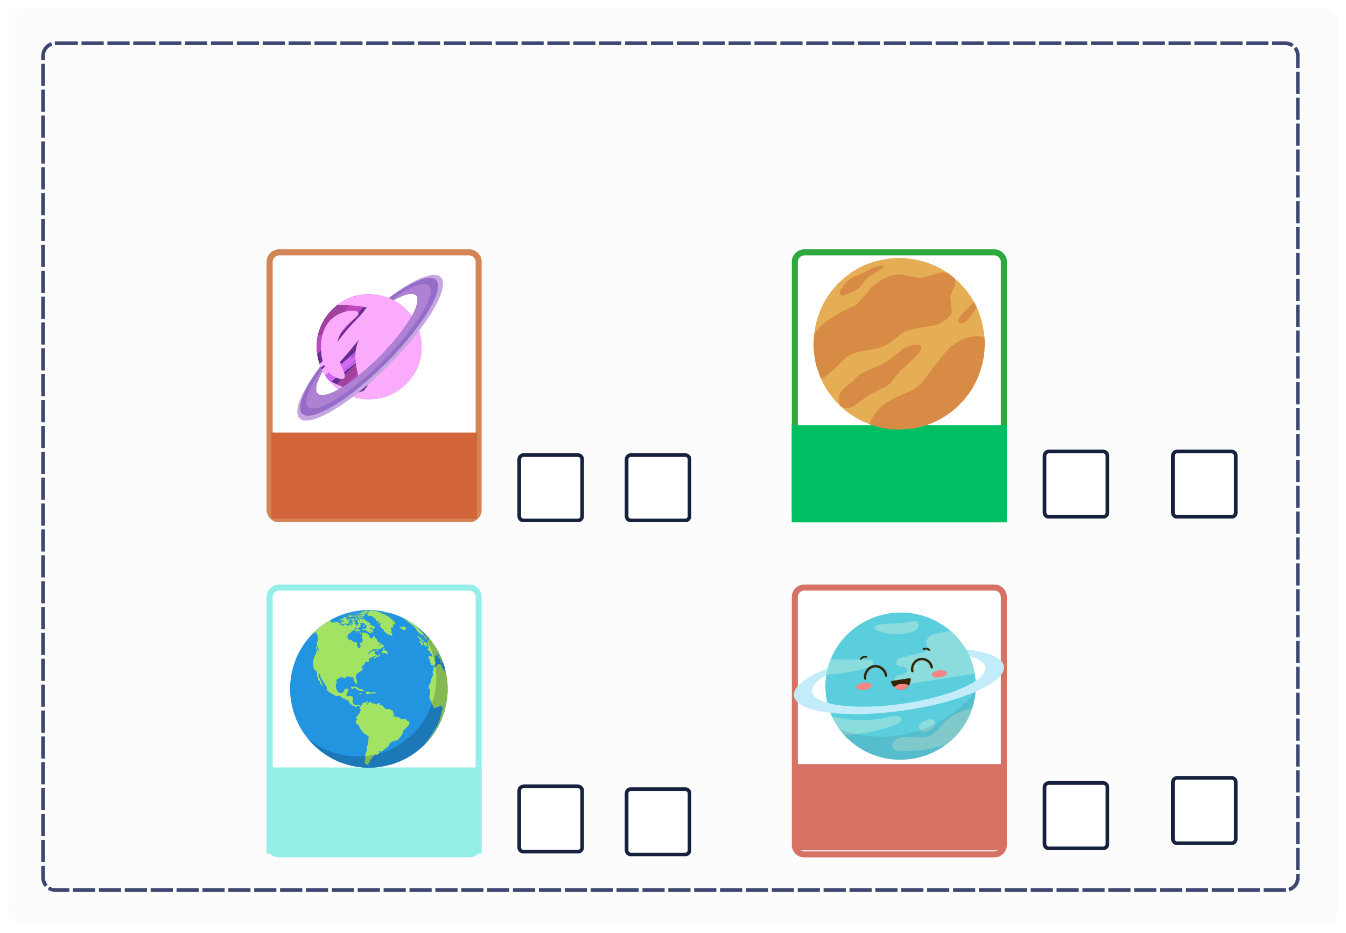
III. EXERCISES:
8. True or False?
venus
saturn
earth
uranus

