Slide 1


Slide 2




Unit
10
ENERGY SOURCES
LESSON 6: SKILLS 2

Slide 3

OBJECTIVES
By the end of the lesson, students will be able to:
+ Listening: listen for main ideas and specific information about the topic how to save energy at home
+ Writing: write a paragraph of about 70 words about how you save energy at home

Slide 4
LESSON 6: SKILLS 2
WARM-UP
Pass the chalk
Task 1: Work in pairs. Answer the questions.
Task 2: Listen and circle the phrases you hear.
Task 3: Listen again and tick T (True) or F (False).
Task 4: Discuss: What is the most effective way to save energy?
LISTENING
Task 5: Work in pairs. Read some ways to save energy at home. Choose three ways and write them in your notebook.
Task 6: Write a paragraph of about 70 words about how to save energy at home
WRITING
CONSOLIDATION
Wrap-up
Homework

Slide 5

LESSON 6: SKILLS 2
WARM-UP
Pass the chalk
Aims of the stage:
To activate students’ prior knowledge and vocabulary related to the lesson

Slide 6
WARM-UP
HOW TO SAVE ENERGY?
TEAM A
TEAM B

Slide 7

LESSON 6: SKILLS 2
WARM-UP
Pass the chalk
Task 1: Work in pairs. Answer the questions.
Task 2: Listen and circle the phrases you hear.
Task 3: Listen again and tick T (True) or F (False).
Task 4: Discuss: What is the most effective way to save energy?
LISTENING
Aims of the stage:
To help Ss brainstorm the topic and prepare for the listening text

Slide 8
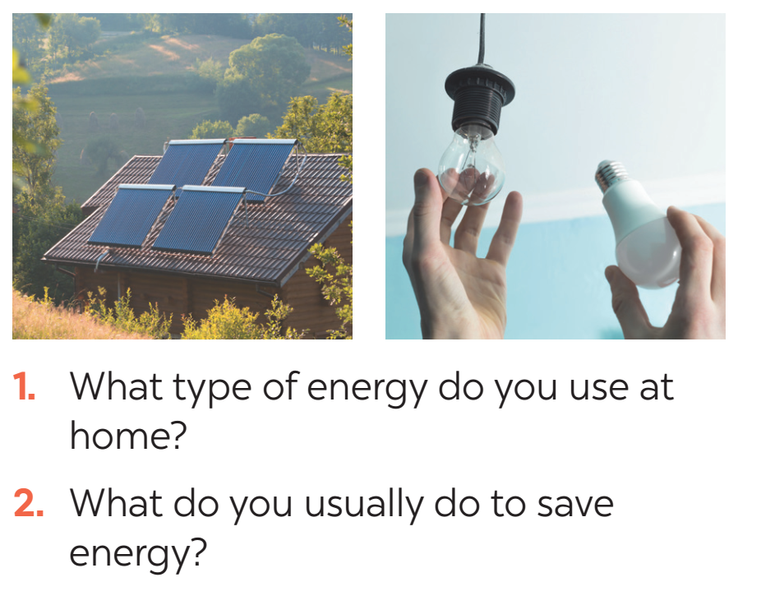

LISTENING
1
Work in pairs. Answer the questions.

Slide 9

LISTENING
2
Mr Lam is discussing with his students about how to save energy at home. Listen and circle the phrases you hear.
1. save energy
2. turn oﬀ the lights
3. save money
4. use low energy light bulbs
5. produce electricity
6. use solar panels

Slide 10

LISTENING
3
Listen again and tick T (True) or F (False) for each sentence.
 | T | F
1. Mr Lam says we use energy for cooking, heating and lighting.
2. Linh always turns oﬀ the lights when going out.
3. Linh turns oﬀ electrical appliances when not using them.
4. Minh uses low energy light bulbs at his house.
5. Minh uses solar energy to cook meals.

Slide 11

LISTENING
4
Discuss: What is the most effective way to save energy?
E.g. The most effective way to save energy is only reading and writing in daylight.

Slide 12
LESSON 6: SKILLS 2
WARM-UP
Pass the chalk
Task 1: Work in pairs. Answer the questions.
Task 2: Listen and circle the phrases you hear.
Task 3: Listen again and tick T (True) or F (False).
Task 4: Discuss: What is the most effective way to save energy?
LISTENING
Task 5: Work in pairs. Read some ways to save energy at home. Choose three ways and write them in your notebook.
Task 6: Write a paragraph of about 70 words about how to save energy at home
WRITING

Slide 13
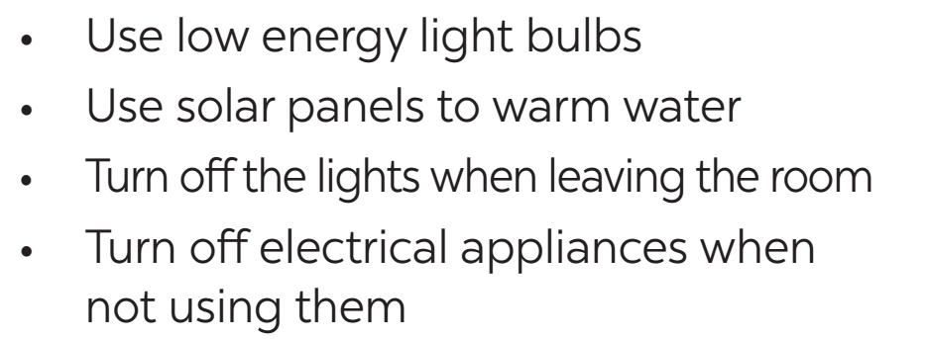

WRITING
5
Work in pairs. Read some ways to save energy at home. Choose three ways and write them in your notebook.

Slide 14
WRITING
6
Write a paragraph of about 70 words about how you save energy at home.
Example:
We use a lot of energy at home and it costs us a lot. To save energy, we should try making more use of natural light instead of keeping the lights unnecessarily in the morning and afternoons. Moreover, we should unplug your electrical gadgets when not in use. These devices consume at least 10% of electricity even when inactive. Therefore, unplug them to save electricity. Most importantly, installing solar panels can help you excessively. They are very economical and help in saving a lot of energy. This can help in getting cheap electricity and protect the environment.

Slide 15

WRITING
PEER CHECK AND CROSS CHECK
Students can:
go and see other’s work
give comments to each other

Slide 16
LESSON 6: SKILLS 2
WARM-UP
Pass the chalk
Task 1: Work in pairs. Answer the questions.
Task 2: Listen and circle the phrases you hear.
Task 3: Listen again and tick T (True) or F (False).
Task 4: Discuss: What is the most effective way to save energy?
LISTENING
Task 5: Work in pairs. Read some ways to save energy at home. Choose three ways and write them in your notebook.
Task 6: Write a paragraph of about 70 words about how to save energy at home
WRITING
CONSOLIDATION
Wrap-up
Homework

Slide 17

CONSOLIDATION
1
WRAP-UP
In this lesson, we have learnt to:
- use the lexical items related to the topic Energy sources
- listen for main ideas and specific information about the topic how to save energy at home.
- write a paragraph of about 70 words about how you save energy at home.

Slide 18

CONSOLIDATION
2
HOMEWORK
Prepare for the next lesson: Looking back & Project
Rewrite the passage on the notebook.
Do exercise in the workbook.

Slide 19

Website: hoclieu.vn
Fanpage: facebook.com/www.tienganhglobalsuccess.vn/

