Slide 1
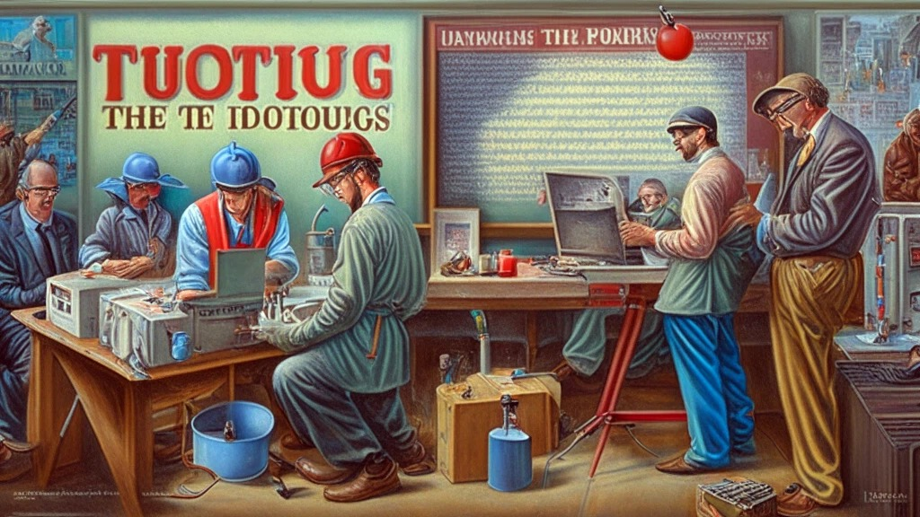

Slide 2



Unit
12
CAREER CHOICES
LESSON 3: A CLOSER LOOK 2

Slide 3

OBJECTIVES
By the end of the lesson, students will be able to:
Use adverbial clauses of result, reasons, and concession.

Slide 4
LESSON 3: A CLOSER LOOK 2
LESSON 1: GETTING STARTED
WARM-UP
Option 1: Think
Option 2: Conjunction Catch
Grammar Explanation
Task 1: Choose the correct word to complete each sentence.
Grammar Explanation
Task 2: Complete the sentences with so or such
Task 3: Join the sentences, using the given word in brackets
PRESENTATION
PRACTICE
Task 4: Rewrite each sentence. Use the given word in brackets.
Task 5: Complete the sentences with your own ideas. Then exchange them with a partner.
PRODUCTION
CONSOLIDATION
Wrap-up
Homework

Slide 5
WARM-UP
OPTION 1
- Look at the sentence:
Although
________ the sun was shining, it was very cold.
- Complete the sentence with one of the following words: “Although, Because, So.”
- We use “although” when we want to express a contrast between two clauses.

Slide 6
WARM-UP
OPTION 2
Conjunction Catch

Slide 7
WARM-UP
OPTION 2
- There are slips of paper with individual conjunctions for each adverb clause type (although, so, because)
- Teacher throws the slips of paper around the class while students stand and move around.
HOW TO PLAY
- When a student catches a slip, they must immediately shout out a sentence that uses the conjunction correctly as part of an adverb clause.

Slide 8
WARM-UP
OPTION 2
LET’S PLAY

Slide 9

PRESENTATION
An adverbial clause of concession expresses contrast. It is introduced with a subordinate conjunction. The most common conjunctions are though and although. Though and although can be placed at the beginning or in the middle of the sentence.
Examples:
- Although many of us were not present, the meeting was conducted as scheduled.
- The room is nice, though small

Slide 10
PRESENTATION
1
Choose the correct word to complete each sentence.
1. Although / But footballers are well-paid, they have short careers.
2. She still applied for the job so / though she had almost no chance to get it.
3. Although / However she went to the cinema early, she couldn’t buy the ticket.
4. She has to do repetitive tasks in her job, although / but she still likes it.
5. Though / But Mike felt tired, he managed to finish his homework.

Slide 11
PRESENTATION
An adverbial clause of result shows the result of an action or event. It is often introduced with so / such … that … We use so + adj + that and such (+ a / an) + adj + noun + that.
Example:
The box was so heavy that the worker couldn’t lift it up.
She is such a skilful tailor that all theladies in the neighbourhood like the clothes she makes.

Slide 12
PRESENTATION
– An adverbial clause of reason explains the reason why an action is done or an event happens. It is often introduced with because and since. Since is often placed at the beginning of a sentence. Because can be placed at the beginning or in the middle of the sentence.
Example:
James wants to become a tour guide because he loves travelling. / Because he loves travelling, James wants to become a tour guide.
Since she was late, she couldn’t join the career orientation session.

Slide 13
PRACTICE
2
Complete the sentences with so or such.
so
1. The factory was ______ far from his home that he couldn’t go there to work.
2. Katie was ______ a lazy worker that no manager wanted to hire her.
such
3. They are ______ creative designers that everyone admires them.
such
4. Can you speak louder? You voice is ______soft that I can’t hear you.
so
such
5. He is ______ a handsome man that many people think he could be an actor.

Slide 14
PRACTICE
3
Join the sentences, using the given word in brackets.
1. Jenny didn’t attend the job fair. She was ill. (because)
Jenny didn’t attend the job fair because she was ill. /
Because she was ill, Jenny didn’t attend the job fair.
___________________________________________________.
2. Henry is excellent at maths. Everyone thinks he will become a mathematician. (since)
Since Henry is excellent in maths, everyone thinks he will become a mathematician.
___________________________________________________.

Slide 15
PRACTICE
3
Join the sentences, using the given word in brackets.
3. Mai practised speaking English a lot. She wanted to get a high score on the speaking test. (because)
___________________________________________________.
Mai practised speaking English a lot because she wanted to get a high score on the speaking test. / Because she wanted to get a high score on the speaking test, Mai practised speaking English a lot.
4. Ms Nga is away this week. We’ll put off the next class meeting. (since)
___________________________________________________.
Since Ms Nga is away this week, we’ll put off the next class meeting.

Slide 16
PRACTICE
3
Join the sentences, using the given word in brackets.
5. I couldn’t go to the office on time. There was a traffic jam. (because)
___________________________________________________.
I couldn’t get to the office on time because there was a traffic jam. / Because there was a traffic jam, I couldn’t get to the office on time

Slide 17
LESSON 3: A CLOSER LOOK 2
LESSON 1: GETTING STARTED
WARM-UP
Option 1: Think
Option 2: Conjunction Catch
Grammar Explanation
Task 1: Choose the correct word to complete each sentence.
Grammar Explanation
Task 2: Complete the sentences with so or such
Task 3: Join the sentences, using the given word in brackets
PRESENTATION
PRACTICE
Task 4: Rewrite each sentence. Use the given word in brackets.

Slide 18
PRACTICE
4
Rewrite each sentence. Use the given word in brackets.
1. I forgot to bring money, so I couldn’t buy the career guidebook. (because)
1. The guide said to them: “Is it your first time here?”
I couldn’t _____________________________________________
_____________________________________________________.
buy the career guidebook because I forgot to bring money./Because I forgot to bring money, I couldn’t buy the career guidebook.
______________________________________________________________________________________________________.
2. Olivia asked the guide: “Do the people live on fishing?”
2. My navigation skill is very bad. I could never work as a taxi driver. (so)
______________________________________________________________________________________________________.
I’m __________________________________________________
_____________________________________________________.
so bad at navigation that I could never work as a taxi driver.

Slide 19
PRACTICE
4
Rewrite each sentence. Use the given word in brackets.
3. Sally couldn’t use the computer. There was a power cut. (since)
1. The guide said to them: “Is it your first time here?”
there was a power cut, Sally couldn’t use the computer.
Since ________________________________________________
_____________________________________________________.
______________________________________________________________________________________________________.
2. Olivia asked the guide: “Do the people live on fishing?”
4. She had a university degree, but she couldn’t find a good job. (although)
she had a university degree, she couldn’t find a good job. /She couldn’t find a good job although she had a university degree.
Although____________________________________________
____________________________________________________.
______________________________________________________________________________________________________.

Slide 20
PRACTICE
4
Rewrite each sentence. Use the given word in brackets.
5. The florist was very skilful. Her flower shop attracted many customers. (such)
1. The guide said to them: “Is it your first time here?”
______________________________________________________________________________________________________.
such a skillful florist that her flower shop attracted many customers.
She was _____________________________________________
_____________________________________________________.
2. Olivia asked the guide: “Do the people live on fishing?”
______________________________________________________________________________________________________.

Slide 21
LESSON 3: A CLOSER LOOK 2
LESSON 1: GETTING STARTED
WARM-UP
Option 1: Think
Option 2: Conjunction Catch
Grammar Explanation
Task 1: Choose the correct word to complete each sentence.
Grammar Explanation
Task 2: Complete the sentences with so or such
Task 3: Join the sentences, using the given word in brackets
PRESENTATION
PRACTICE
Task 4: Rewrite each sentence. Use the given word in brackets.
Task 5: Complete the sentences with your own ideas. Then exchange them with a partner.
PRODUCTION

Slide 22
PRODUCTION
Work in two groups. Take turns to give and change the Yes/No questions into reported speech.
5
1. Although my sister is a fashion designer,_________________
- Work independently and prepare for your performance.
2. I want to become a pilot because,______________________
- Group A gives three Yes / No questions, and group B changes them into reported questions.
3. My father has such a hard job that______________________
- Then swap roles.
4. Since most vocational courses take a short time to finish,_____
5. The garment worker felt so bored that_____

Slide 23
PRODUCTION
Complete the sentences with your own ideas. Then exchange them with a partner.
5
1. Although my sister is a fashion designer, she often wears very simple clothes.
1. Although my sister is a fashion designer,_________________
2. I want to become a pilot because ______________________
2. I want to become a pilot because I like travelling in the sky.
3. My father has such a hard job that______________________
3. My father has such a hard job that he always feels exhausted when coming home.
4. Since most vocational courses take a short time to finish,_____
4. Since most vocational courses take a short time to finish, students can start working soon.
5. The garment worker felt so bored that_____
5. The garment worker felt so bored that she started to find another job.

Slide 24
PRODUCTION
Sample answers:
1. Although my sister is a fashion designer, she often wears very simple clothes.
1. Although my sister is a fashion designer,_________________
2. I want to become a pilot because I like travelling in the sky.
2. I want to become a pilot because ______________________
3. My father has such a hard job that he always feels exhausted when coming home.
3. My father has such a hard job that______________________
4. Since most vocational courses take a short time to finish,_____
4. Since most vocational courses take a short time to finish, students can start working soon.
5. The garment worker felt so bored that_____
5. The garment worker felt so bored that she started to find another job.

Slide 25
EXTRA ACTIVITY
- Work in groups A and B.
- Each person in Group A writes an adverbial clause (e.g. Although she wants to become a doctor)
- Each person in Group B writes a clause (e.g. I like travelling.) on their own piece of paper.
- Then, take out a paper from box A and a paper from box B, and read aloud the sentence made from the two clauses.

Slide 26
LESSON 3: A CLOSER LOOK 2
LESSON 1: GETTING STARTED
WARM-UP
Option 1: Think
Option 2: Conjunction Catch
Grammar Explanation
Task 1: Choose the correct word to complete each sentence.
Grammar Explanation
Task 2: Complete the sentences with so or such
Task 3: Join the sentences, using the given word in brackets
PRESENTATION
PRACTICE
Task 4: Rewrite each sentence. Use the given word in brackets.
Task 5: Complete the sentences with your own ideas. Then exchange them with a partner.
PRODUCTION
CONSOLIDATION
Wrap-up
Homework

Slide 27

CONSOLIDATION
1
Wrap-up
What have we learnt in this lesson?
Use adverbial clauses of result, reasons, and concession.

Slide 28

CONSOLIDATION
2
Homework
- Do exercises in the workbook.

Slide 29
Website: hoclieu.vn
Fanpage: facebook.com/www.tienganhglobalsuccess.vn/

