Slide 1

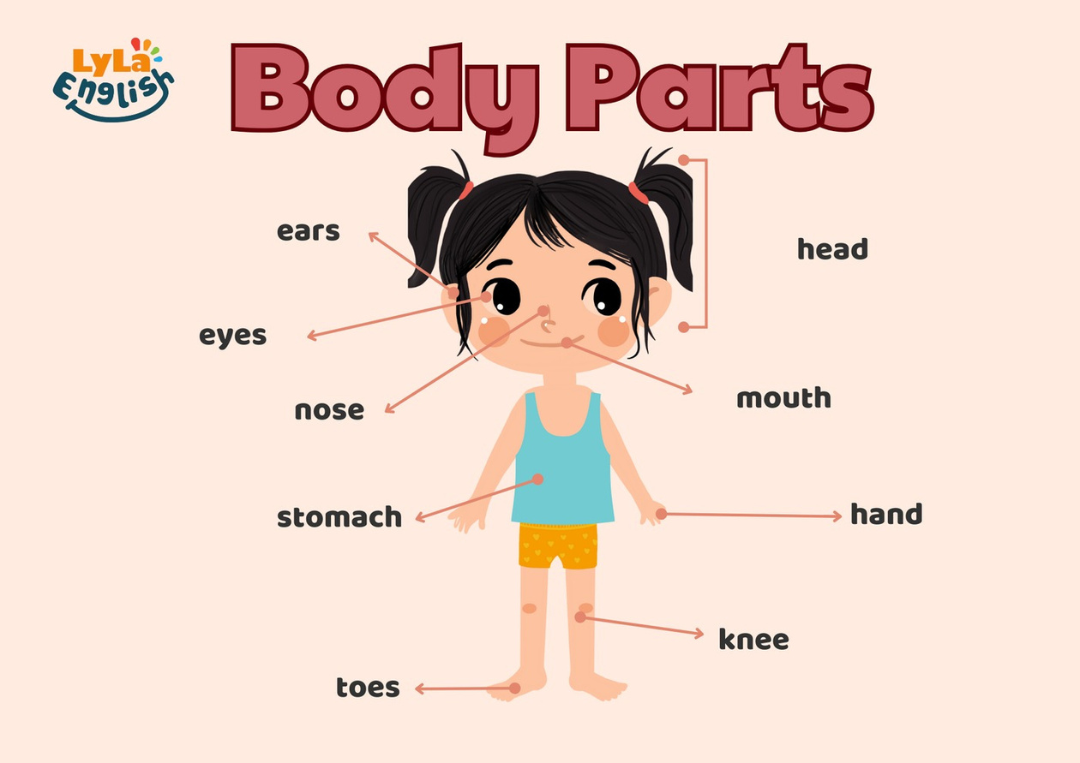
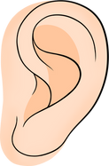


Slide 2
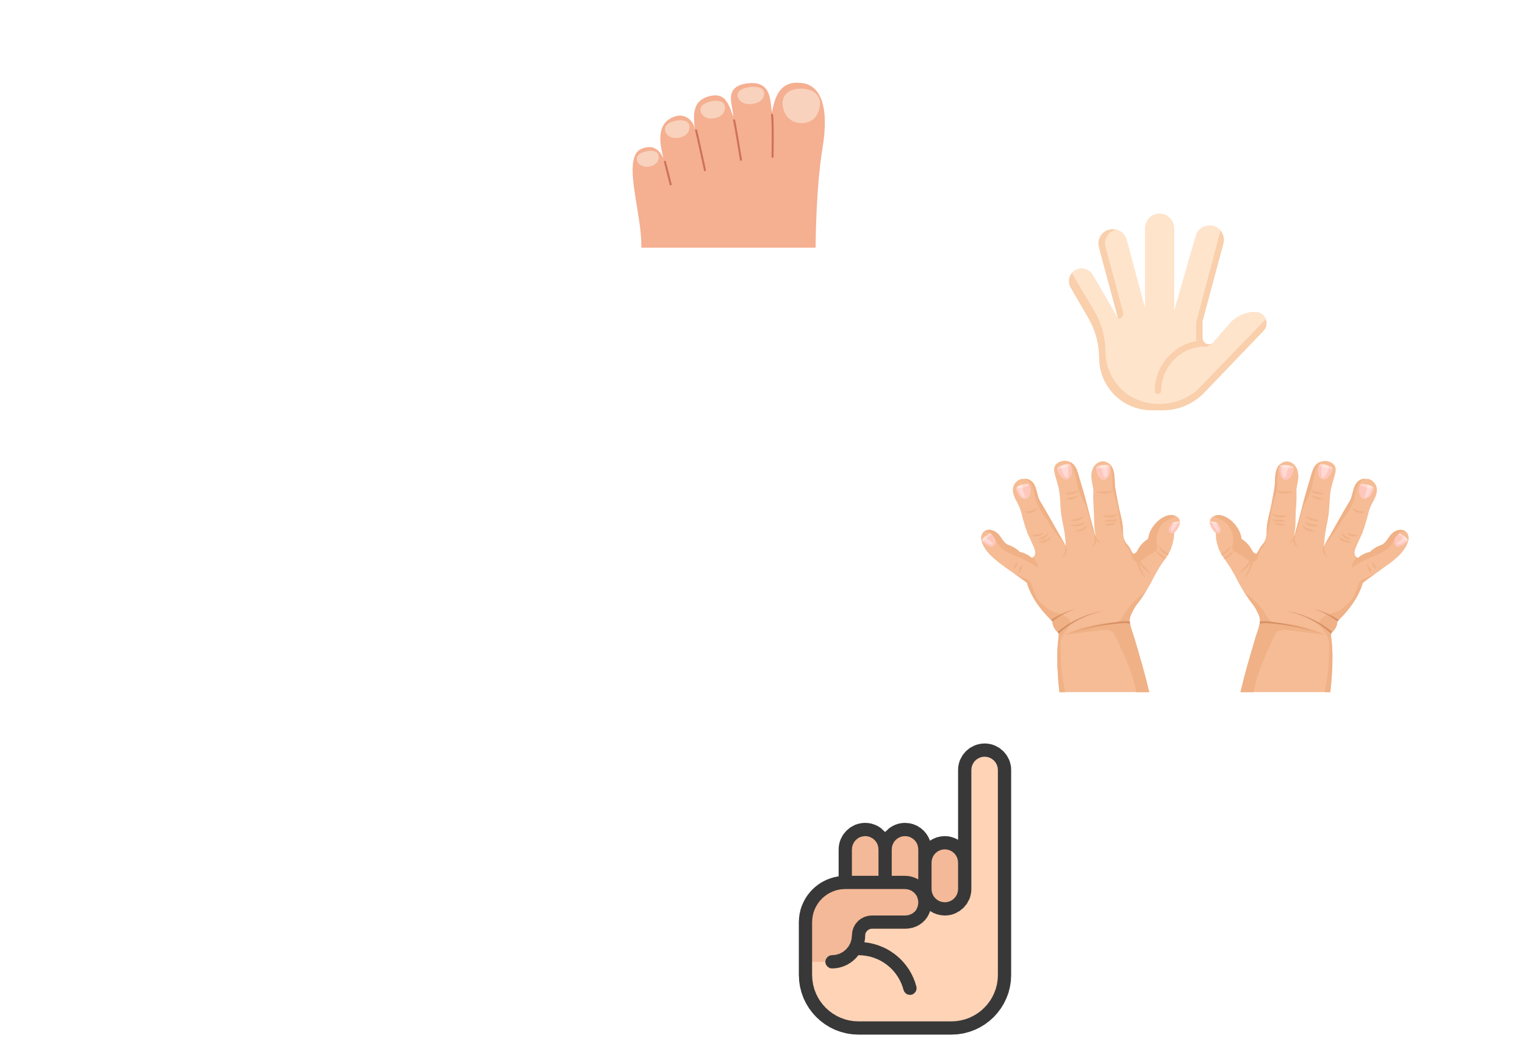
I. QUESTION
1. Show me your toes?
2. How many fingers are there in one hand?
There are ...fingers.
3. How many fingers are there in 2 hands?
There are ... fingers.
4. Where are your fingers?
5. Show me your 1 little finger?

Slide 3

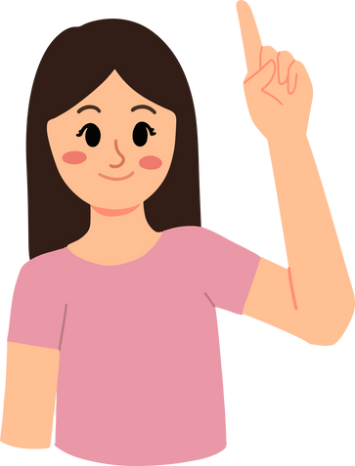
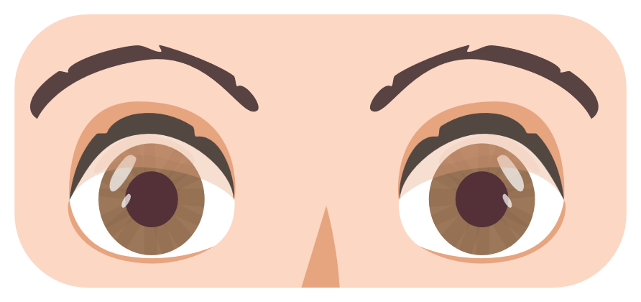
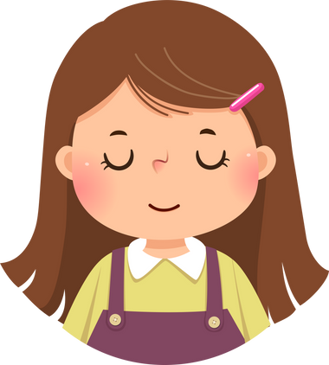
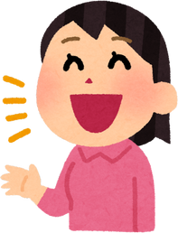
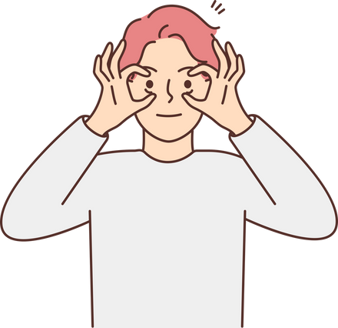
I. QUESTION
6. Point your finger up/ down?
7. Put it on your nose/ eyes/ mouth?
8. How many eyes do you have? There are ... eyes.
9. Close your eyes!/ open your eyes!/ Open your mouth!

Slide 4
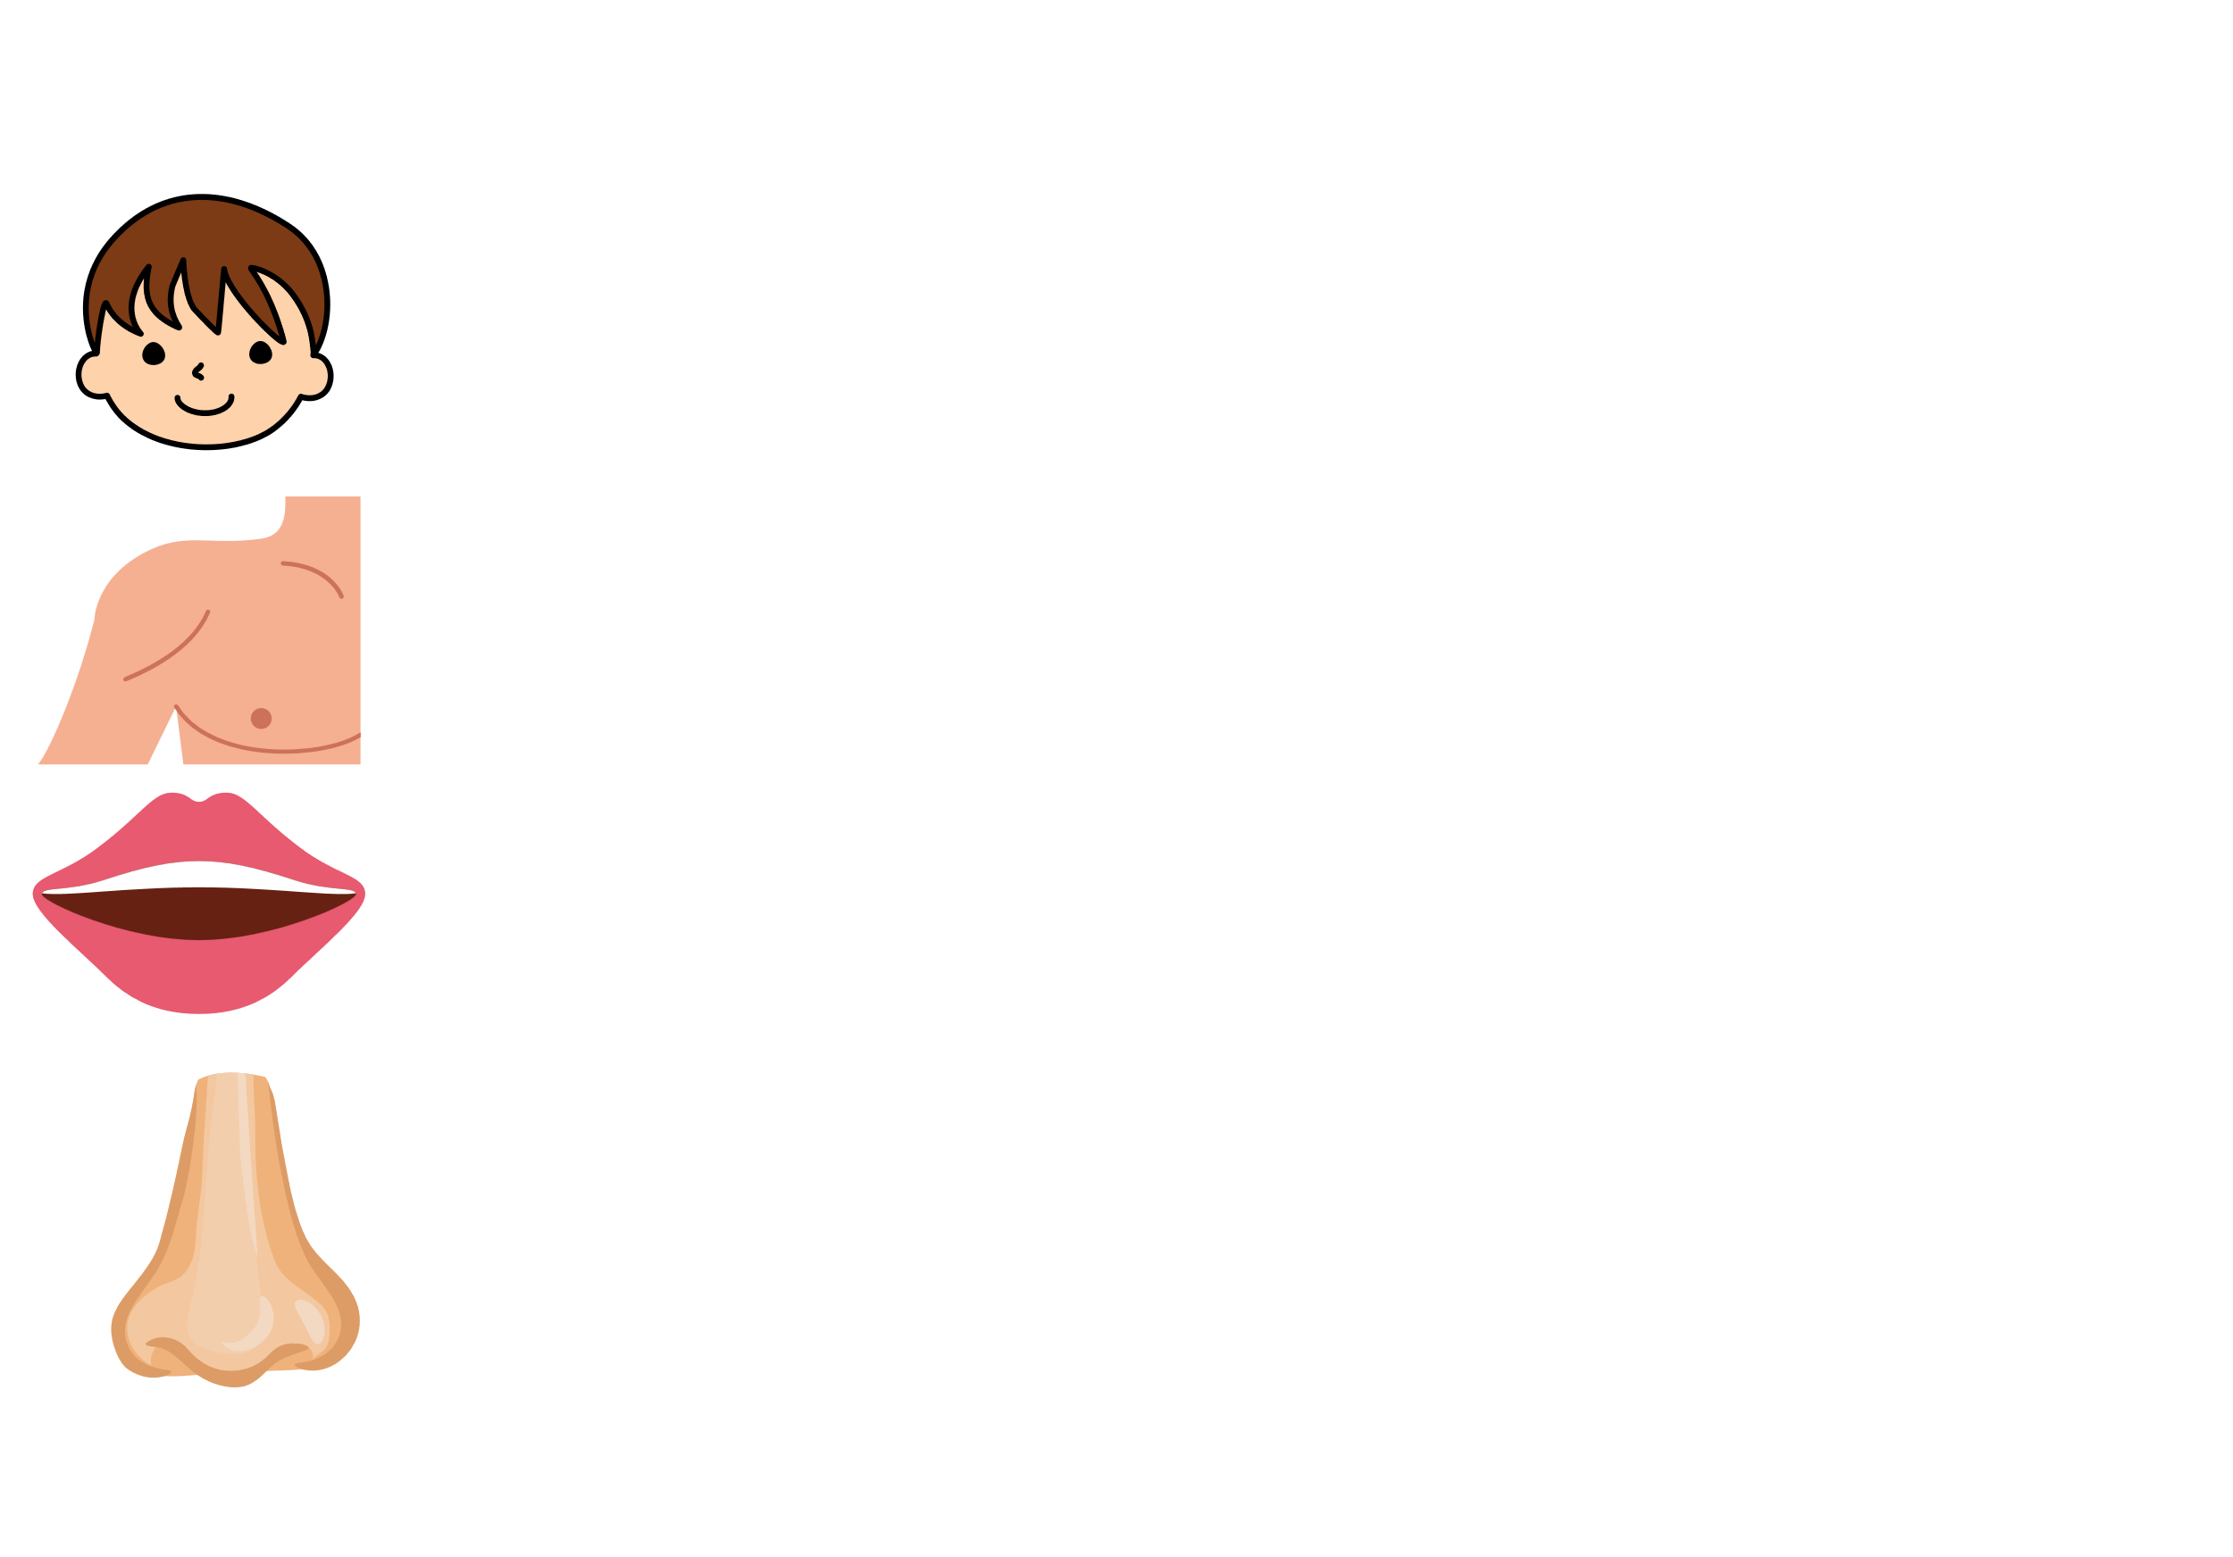
II. VOCABULARY
Head:...........................................................
Shoulder:.....................................................
Mouth:.........................................................
Nose:...........................................................

Slide 5
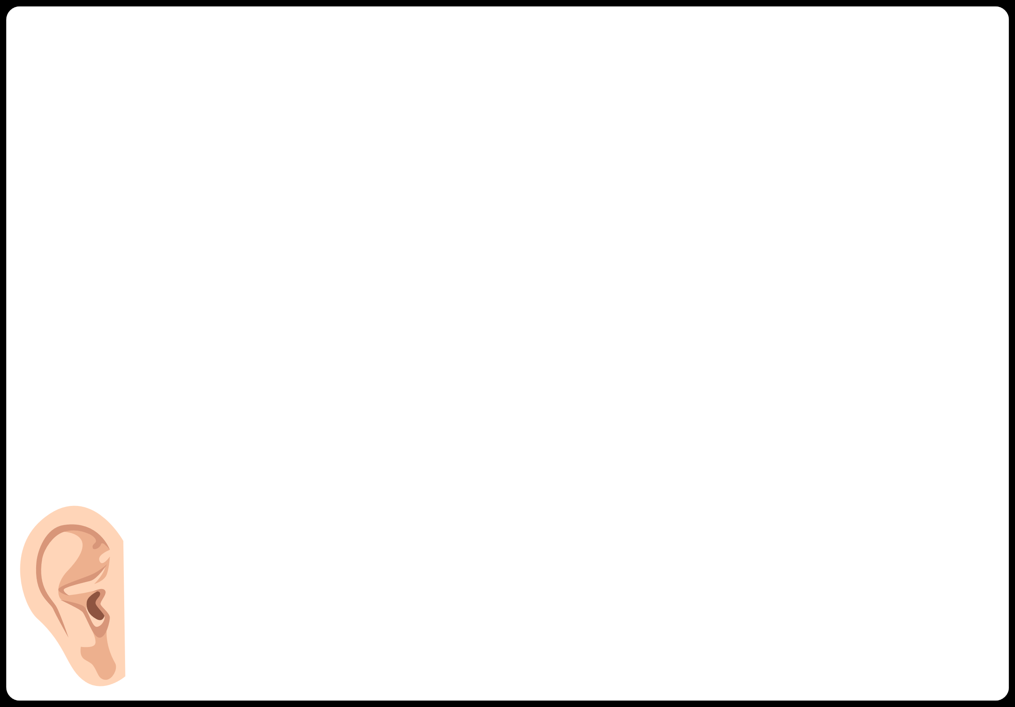
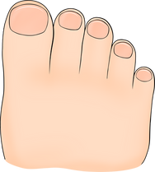
II. VOCABULARY
Knee:..........................................................
Toe:............................................................
Eyes:.............................................................
Ear::................................................................

Slide 6
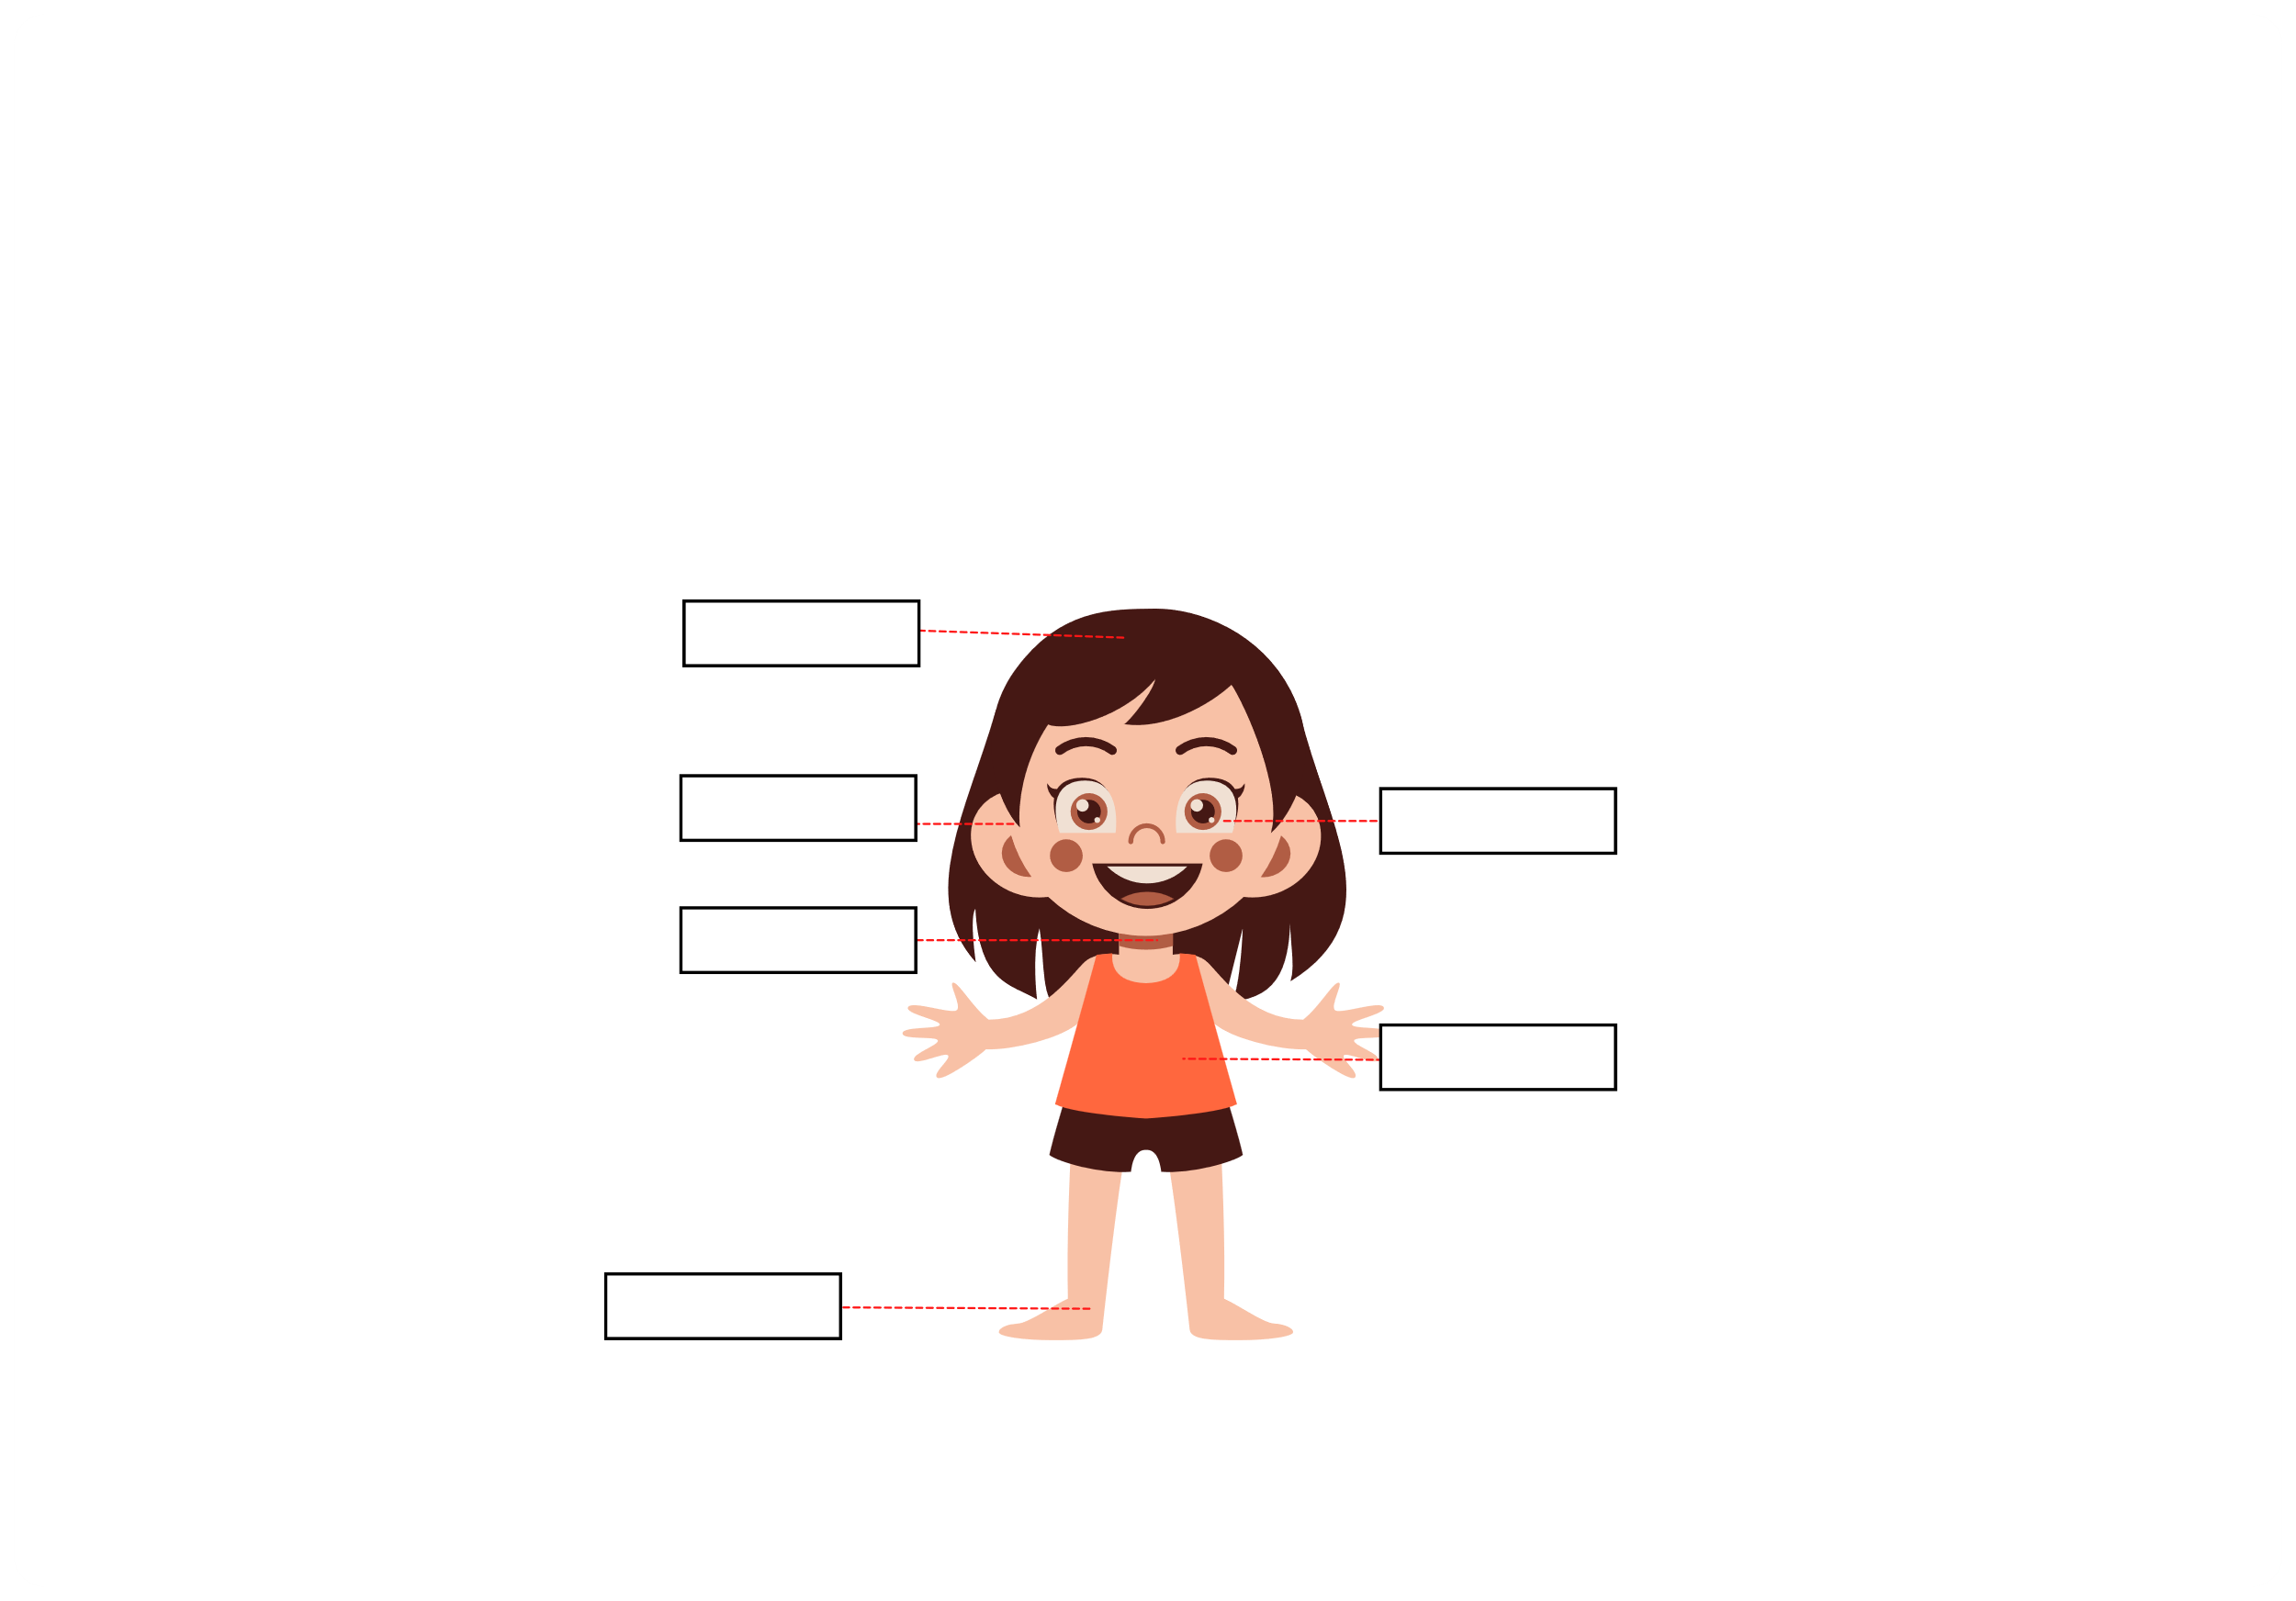
III. EXERCISES:
1.Choose the correct answer below. Write in the box:
knee
eye
neck
hair
stomach
ear

Slide 7
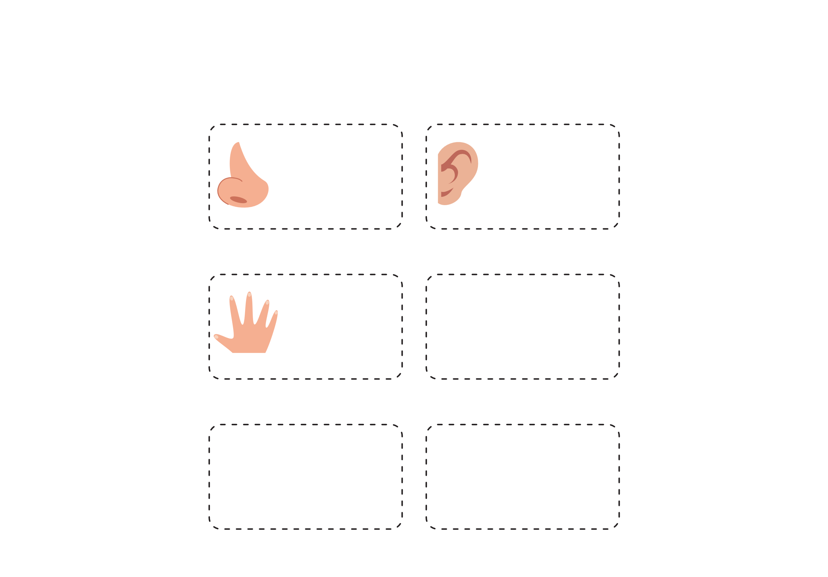

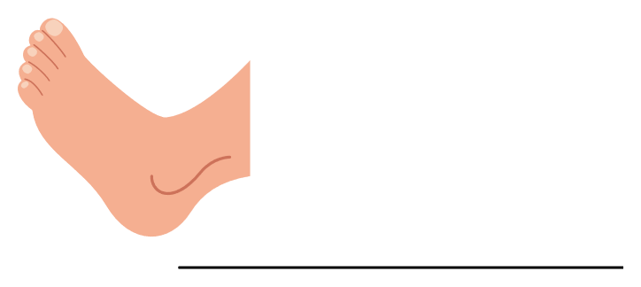
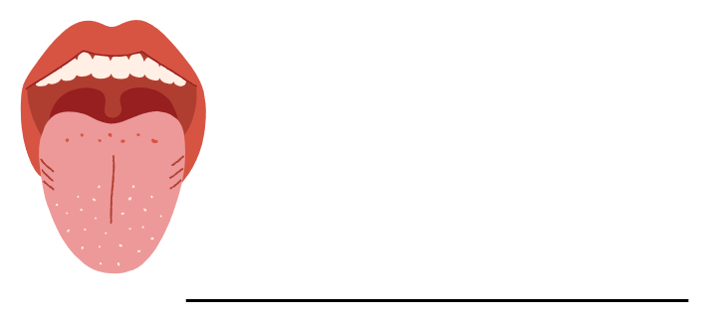
III. EXERCISES:
2. Unscramble the letters and write the name of the body part:
soen
are
nahn
yee
otof
uthom

Slide 8
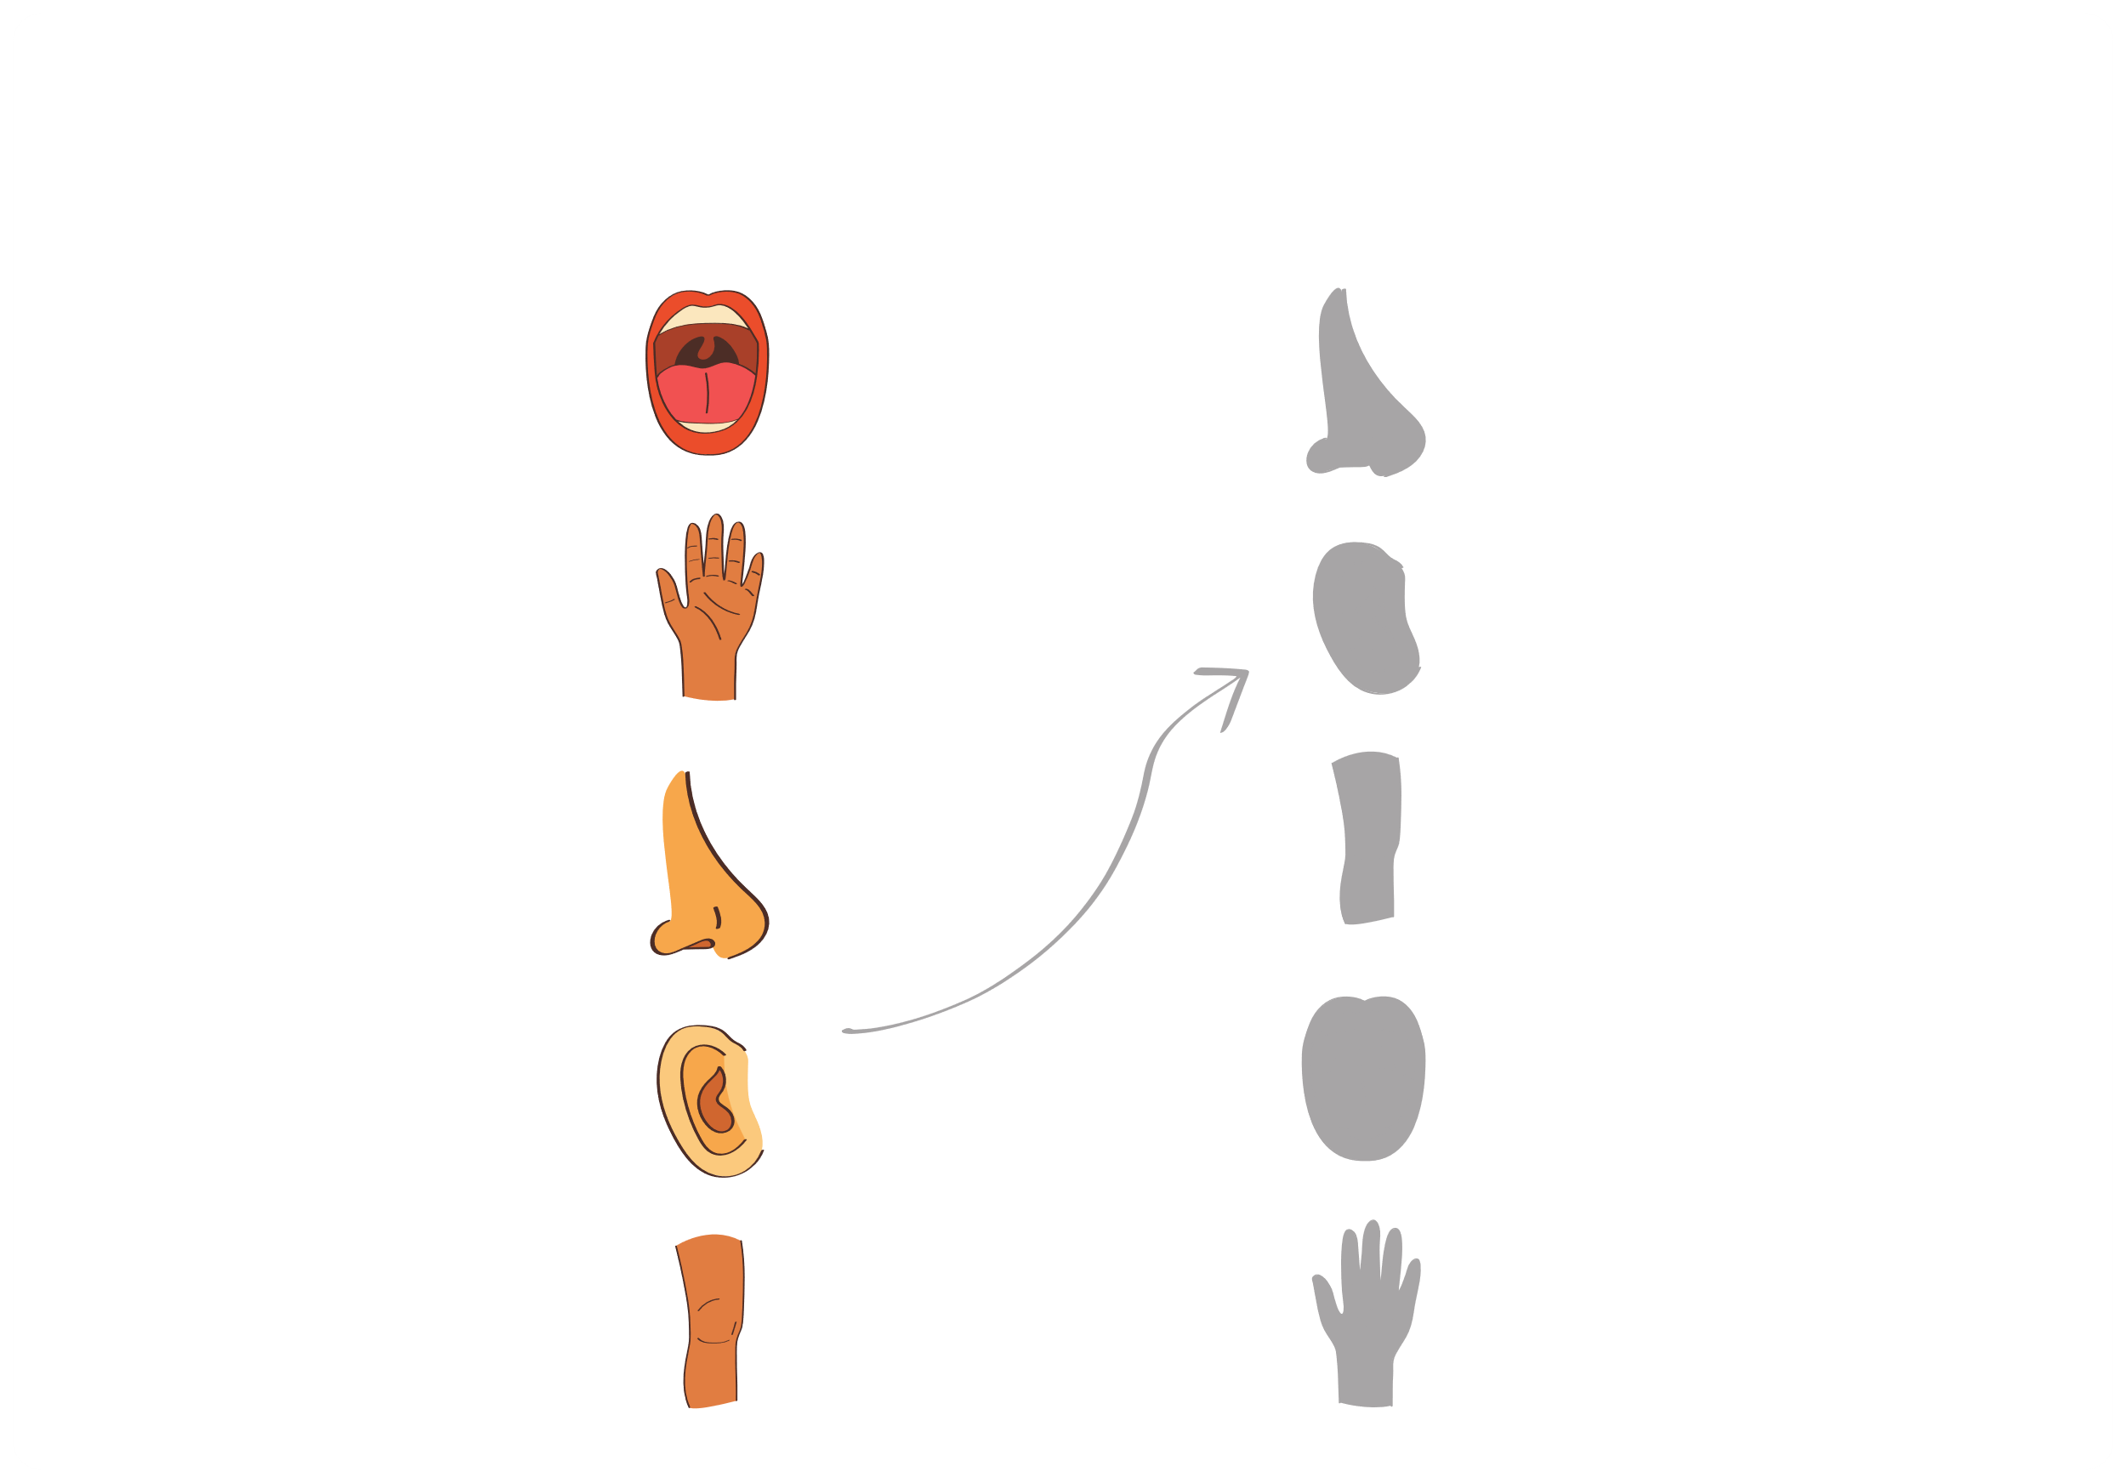
III. EXERCISES:
3. Draw a line between each body part element and it's shadow:

Slide 9

III. EXERCISES:
4. Find the following words:
K
U
A
F
F
A
R
M
S
F
B
Z
knee
C
L
P
O
I
E
L
T
H
C
T
V
nose
H
J
N
R
N
H
Q
E
O
F
O
I
toe
I
Z
O
E
G
A
A
E
U
O
N
T
N
L
S
H
E
N
C
T
L
O
G
O
shoulder
Q
E
E
E
R
D
I
H
D
T
U
E
finger
N
G
Q
A
R
H
K
N
E
E
E
S
M
X
V
D
V
C
R
Z
R
S
D
M

Slide 10
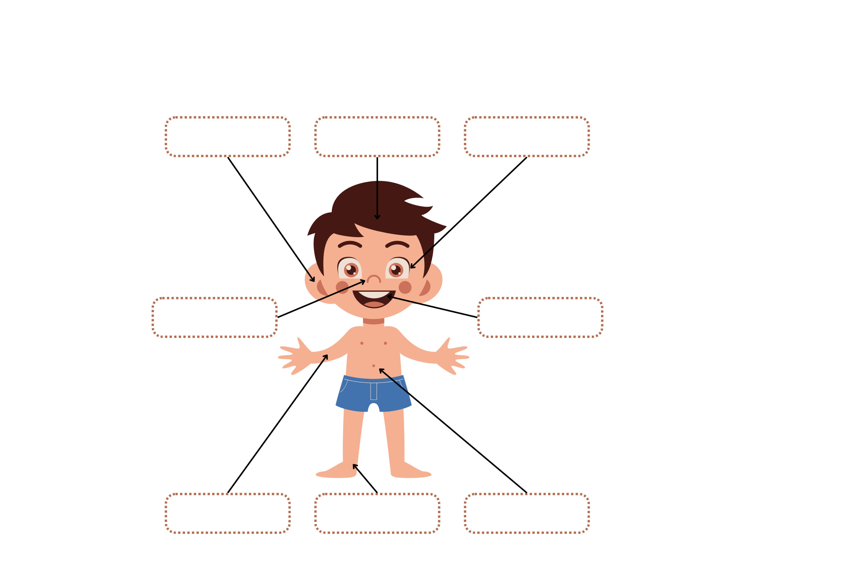
III. EXERCISES:
5. Fill the missing letter to complete the body parts name:
EA-
H_IR
EY_
N_SE
M_UTH
HA_D
F_OT
STO_ATCH

Slide 11
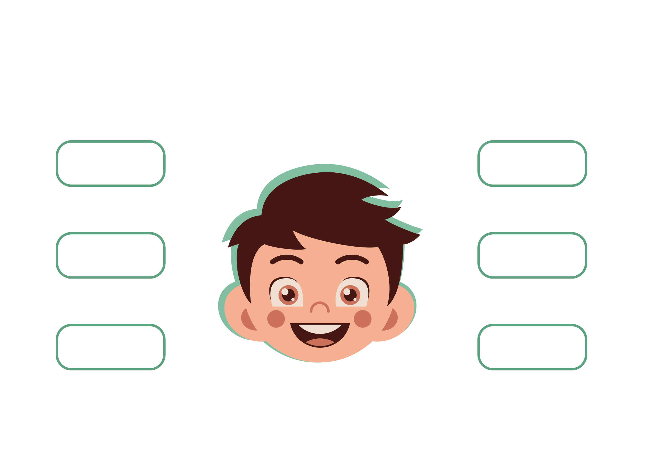
III. EXERCISES:
6. Match the words with the correct parts:
hair
nose
eyes
eyebrow
ears
mouth

Slide 12
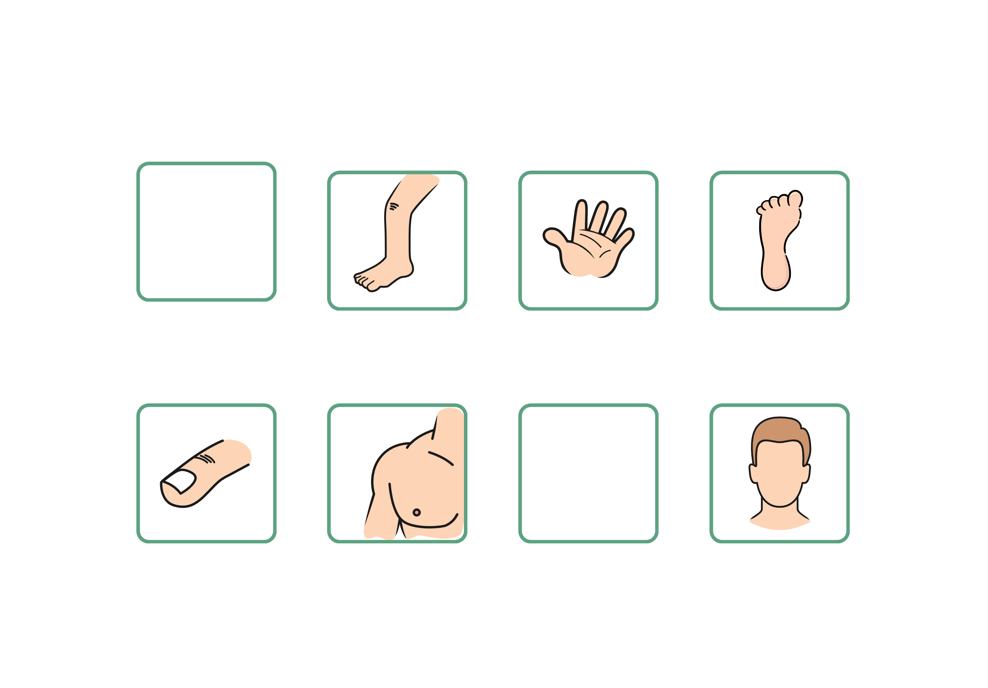
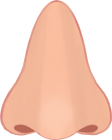
III. EXERCISES:
7. Trace the words:
Nose
Leg
Hand
Foot
Finger
Shoulder
Ear
Head

Slide 13
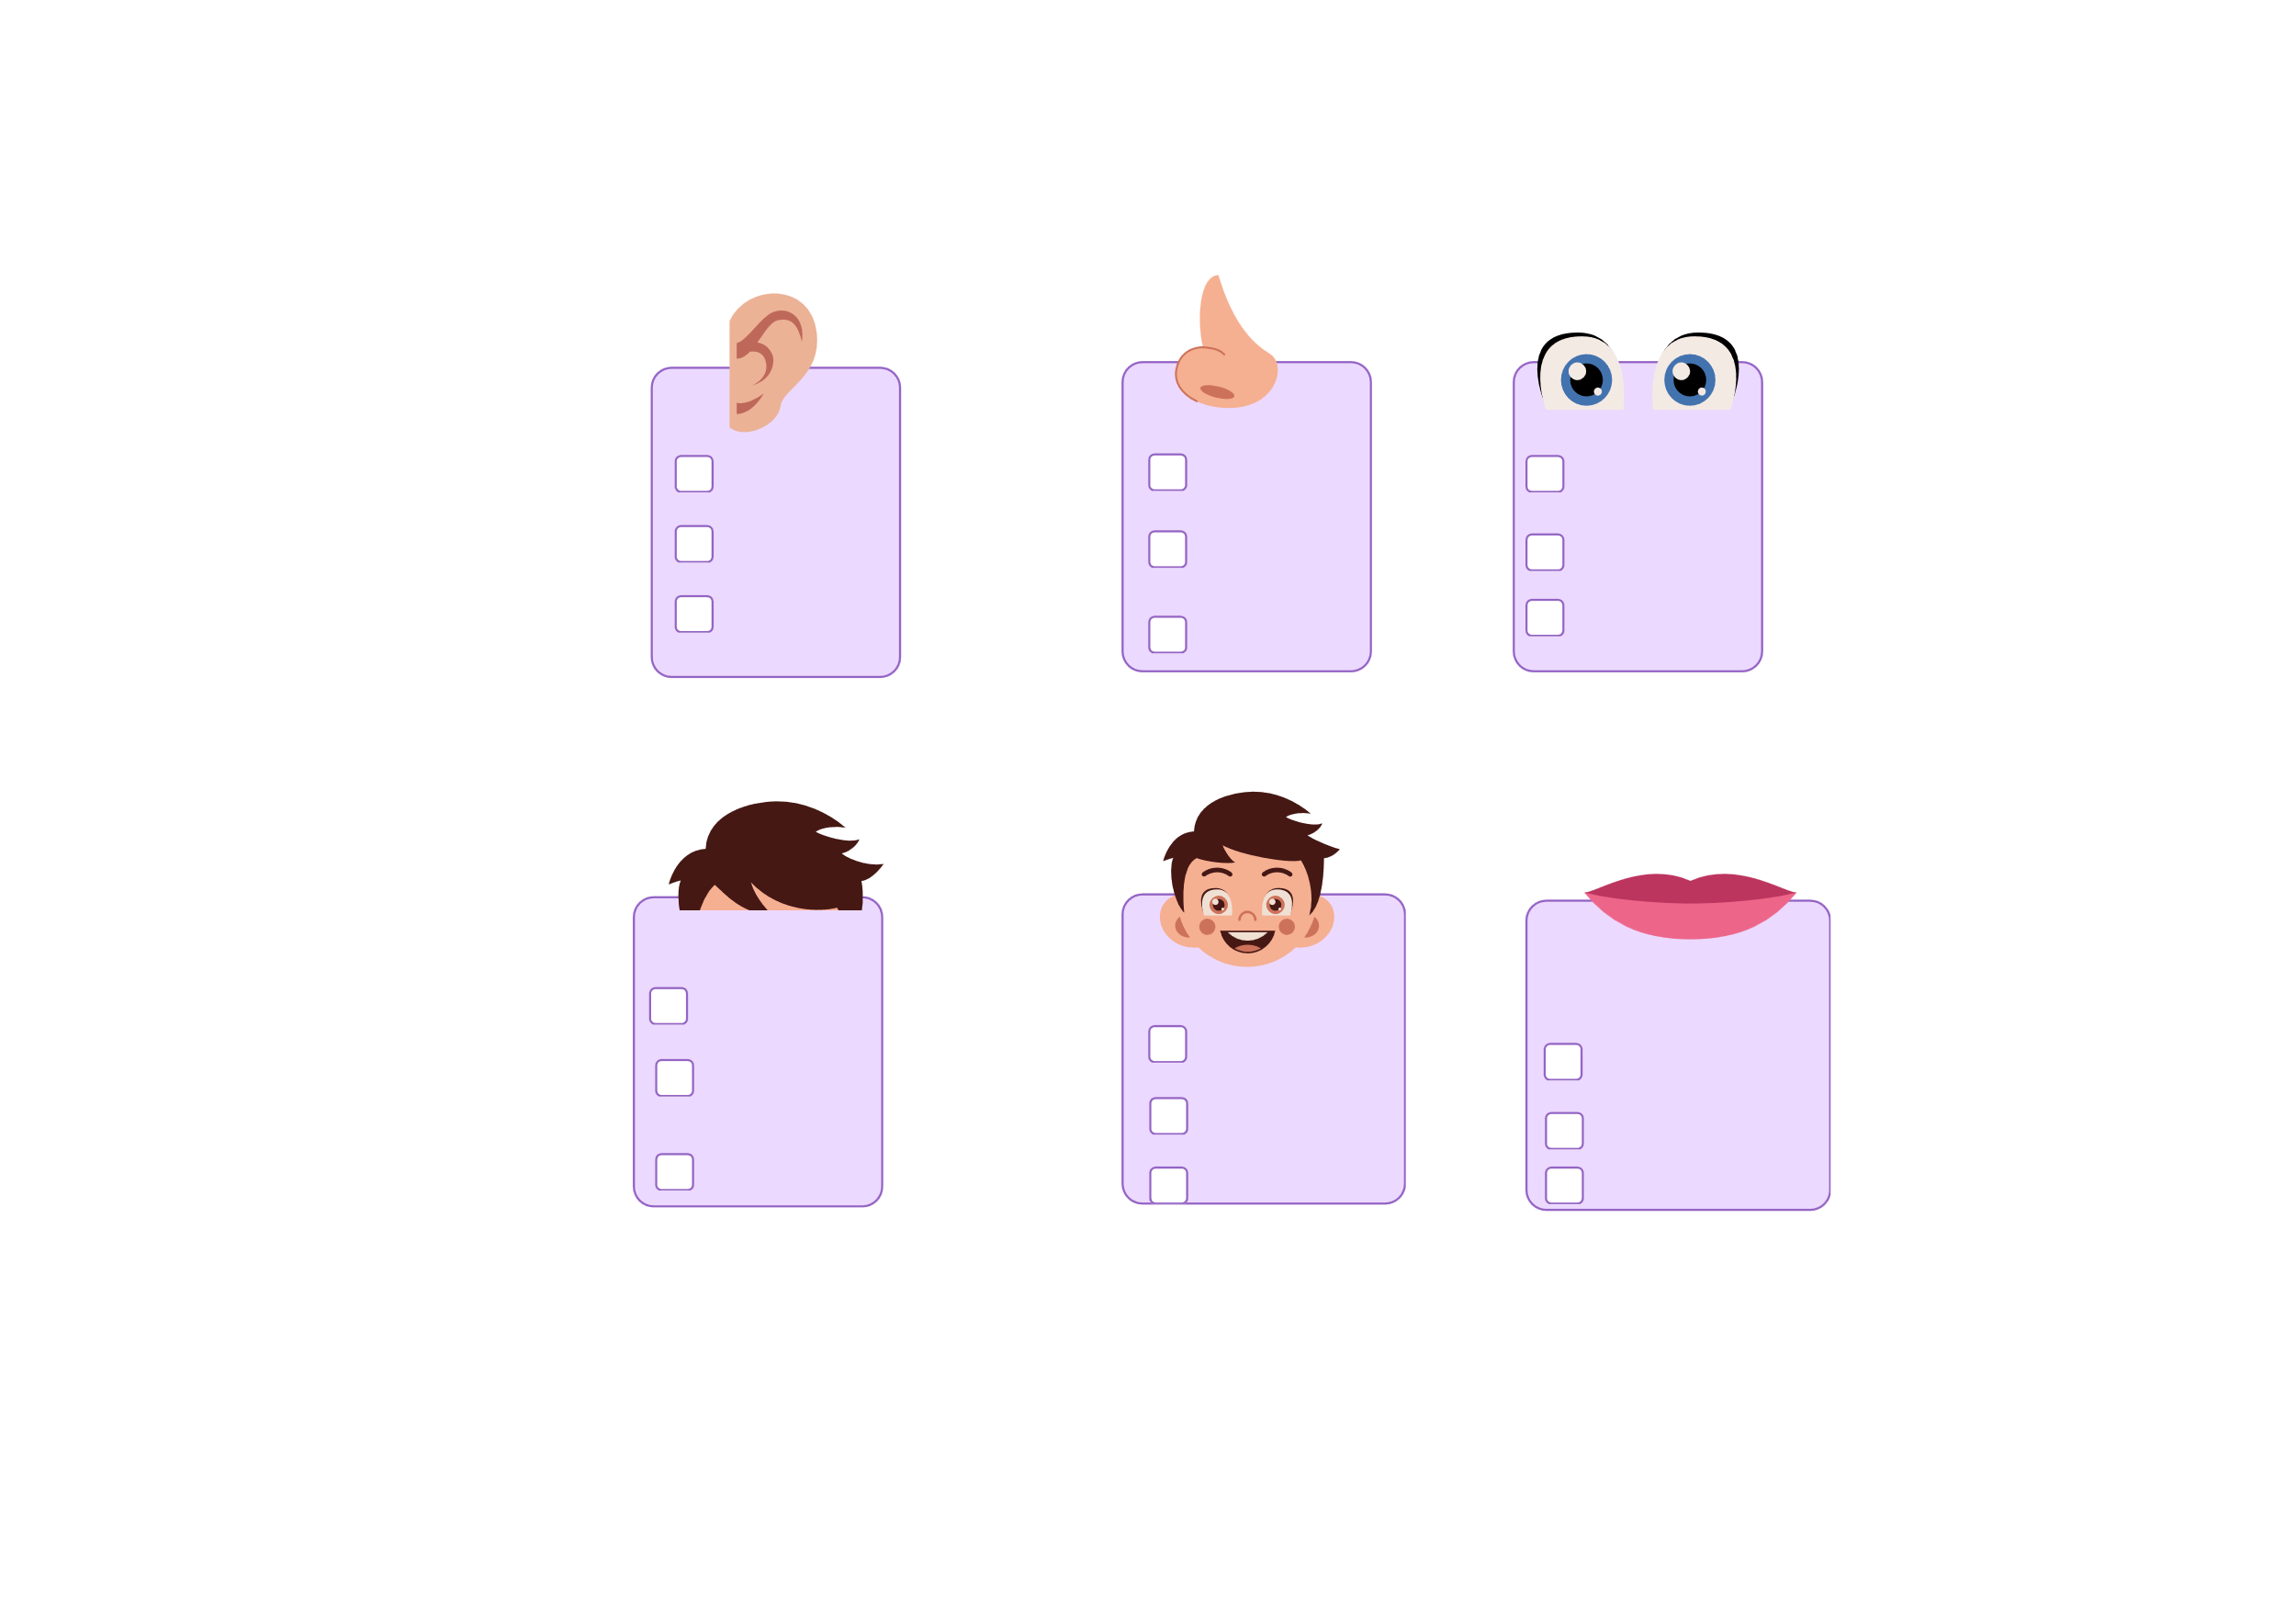
III. EXERCISES:
8. Look and tick the correct body part:
ear
eyes nose
teeth
mouth
hair
eyes
eyes
neck
hair mouth
chin
face teeth
tongue nose
mouth
mouth

