Slide 1

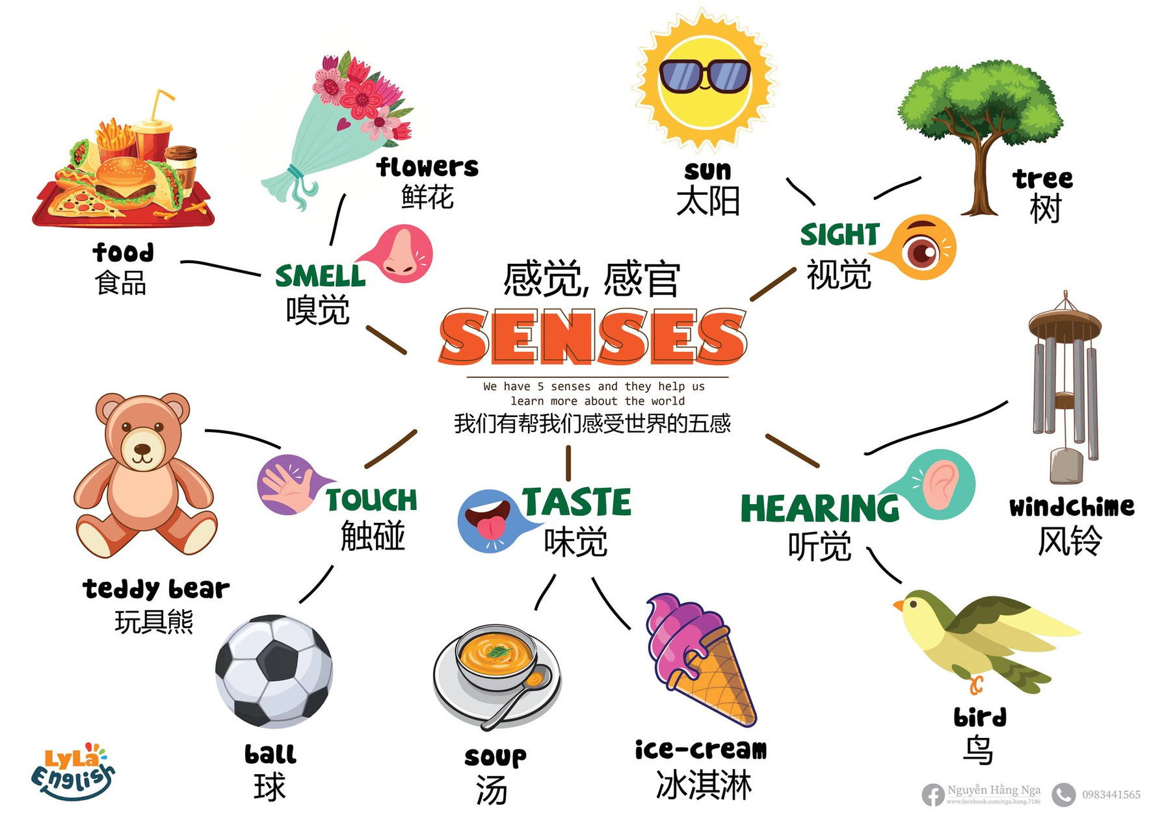


Slide 2



I. QUESTION
1.How many senses do you have?
I have ... senses.
2. What do you use to see/ hear/ taste/ smell?
I use ...
3. What can you see with your eyes?
I can see ...
4. What can you hear with your ears?
I can hear...

Slide 3





I. QUESTION
5. What can you taste with your tongue?
I can taste ...
6. What can you smell with your nose?
I can smell...
7. What can you touch with your hands?
I can touch...

Slide 4



II. VOCABULARY
sight:...........................................................
hearing:......................................................
taste:..........................................................
touch:.........................................................
smell:.........................................................

Slide 5





III. EXERCISES
1. Look and match:

Slide 6


III. EXERCISES
2. Trace and match:
sight taste
touch
hearing
smell

Slide 7













III. EXERCISE:
3. Choose the correct answer:
taste
hearing
sight
taste
smell sight
sight hearing
smell hearing
touch smell

Slide 8








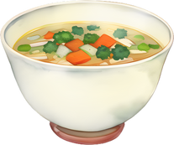
III. EXERCISES
4. Classify the following food:
hearing
taste
touch
sight

Slide 9




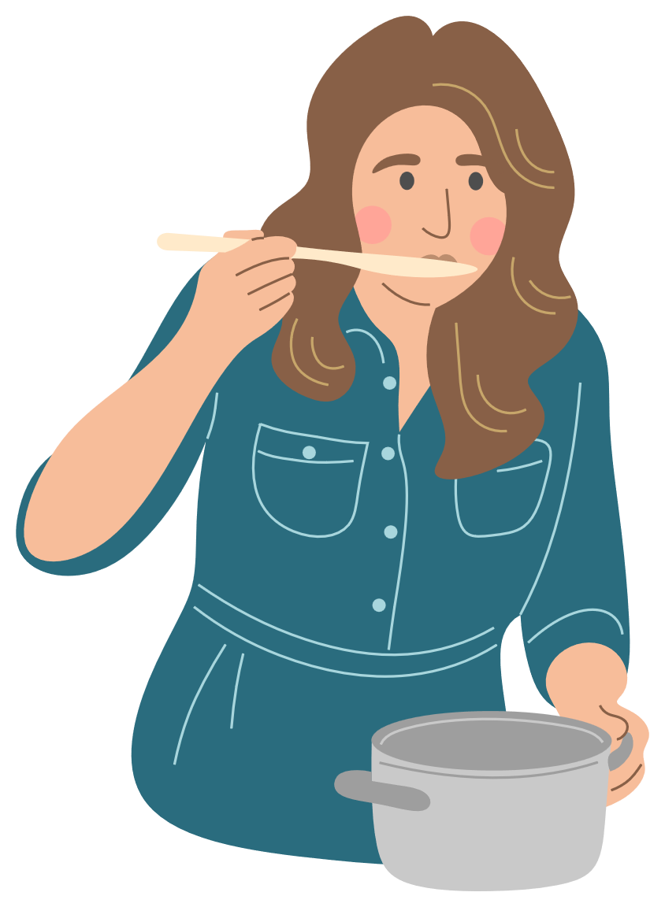
III. EXERCISES
5. Reorder the words:
s/l/l/m/e .....
t/u/o/h/c ...
h/a/e/r/g/n/i ...
t/s/a/e/t ...

Slide 10







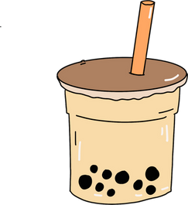
III. EXERCISES
6. Choose True or False:
taste
hearing
sight
touch
smell
taste

Slide 11





III. EXERCISE:
7. Color the TASTE sense:

Slide 12

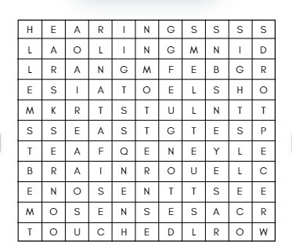
III. EXERCISES
8. Find the word:
touch
hearing
taste smell sight

