Slide 1



Unit 2: Adventure
Lesson 2H: Writing

Slide 2







I went to school.
I went to school.
Outdoor activities.
www.phuongnam.edu.vn

Slide 3


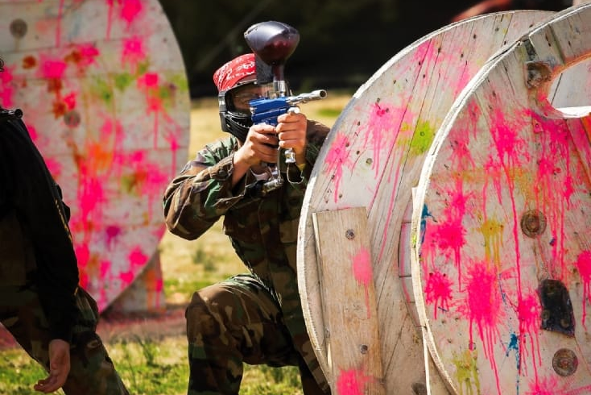

This is…
rock climbing
paintballing
jet-skiing

Slide 4
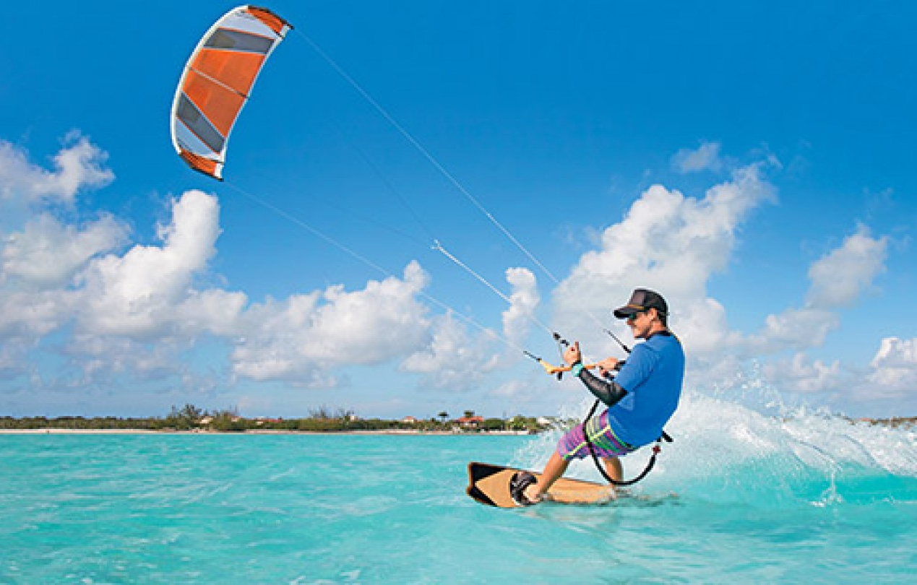
This is…
kayaking
jet-skiing
kite surfing

Slide 5
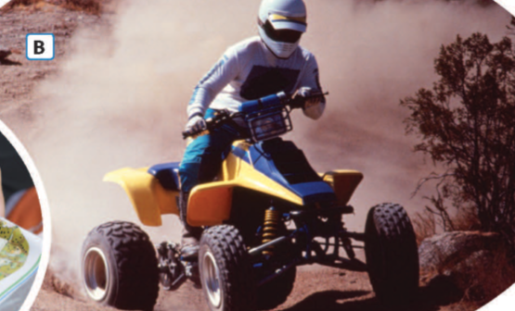
This is…
quad biking
mountain biking
abseiling

Slide 6
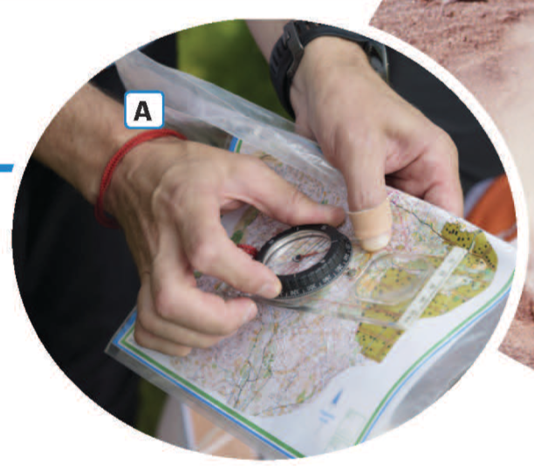
This is…
abseiling
orienteering
kayaking

Slide 7

Ex1. Describe photos A and B using structures and strategy in lesson 2G.
www.phuongnam.edu.vn

Slide 8
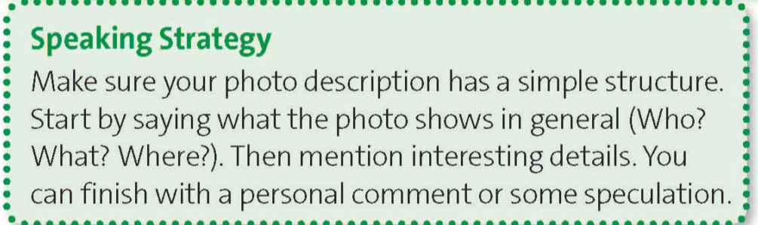

Structure reminder
www.phuongnam.edu.vn

Slide 9
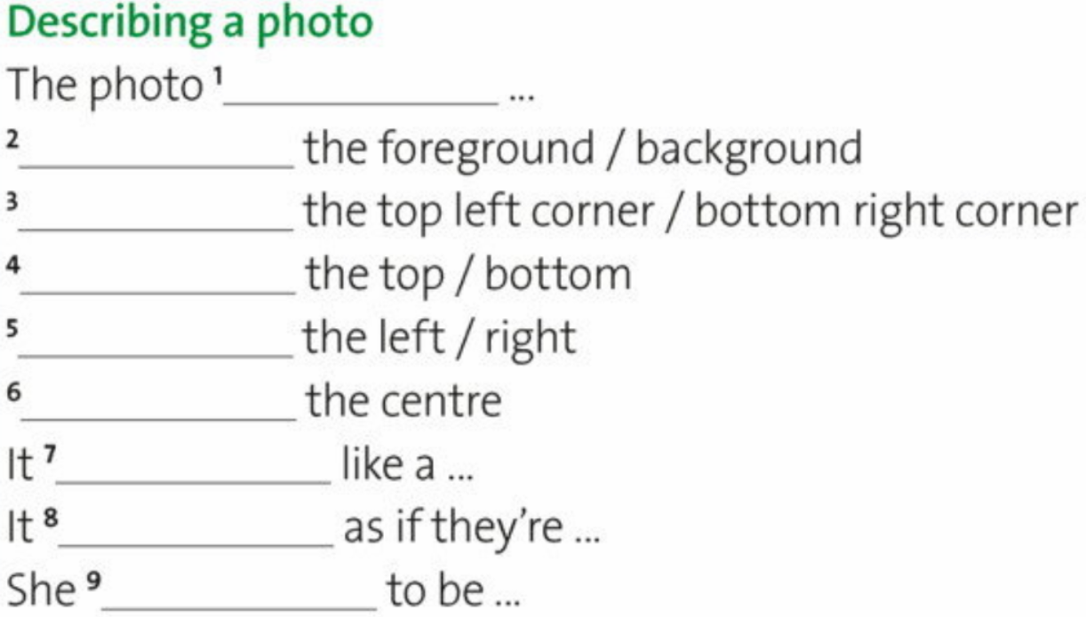
Structure reminder
shows
In
In
At
On
In
looks
looks/seems
seems
www.phuongnam.edu.vn

Slide 10
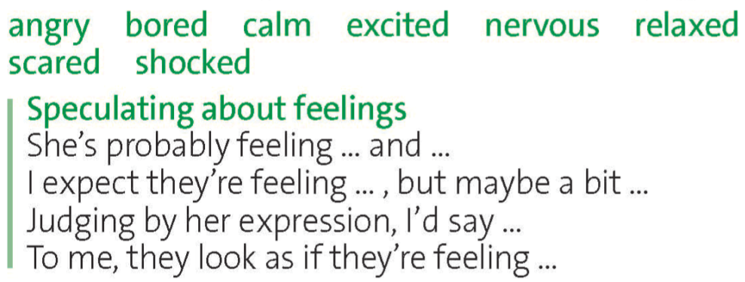
Structure reminder
www.phuongnam.edu.vn

Slide 11



UNIT 2:
ADVENTURE
www.phuongnam.edu.vn

Slide 12
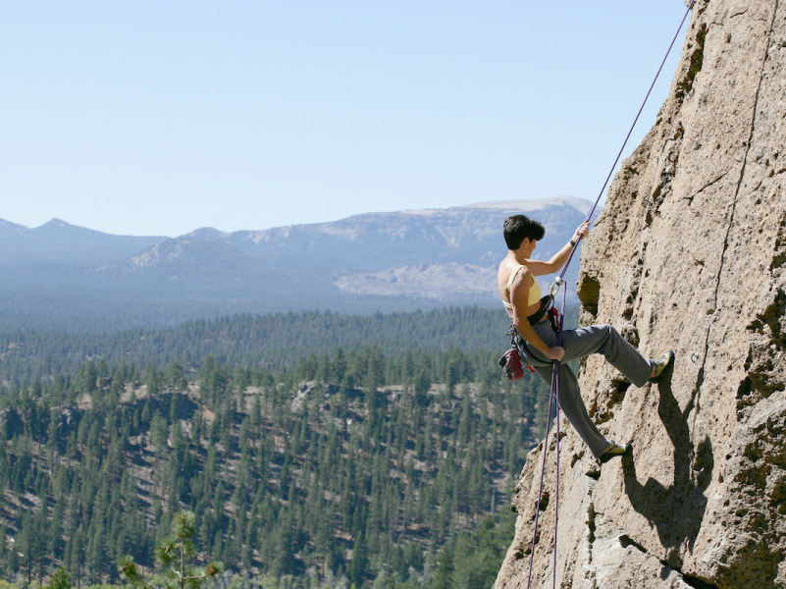
abseiling (n) /ˈæb.seɪ.lɪŋ/
the activity of going down a very steep slope while holding on to a rope that is fastened to the top of the slope
www.phuongnam.edu.vn

Slide 13
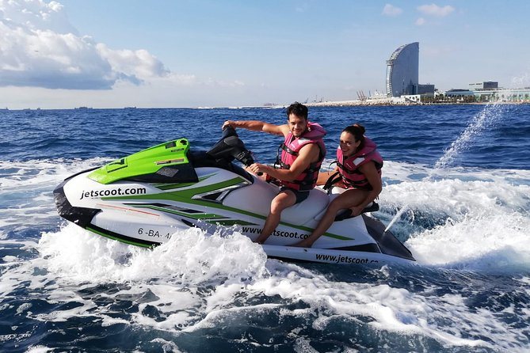
jet-skiing (n) /ˈdʒetˌskiː.ɪŋ/
the activity of using a Jet Ski to travel across water
www.phuongnam.edu.vn

Slide 14
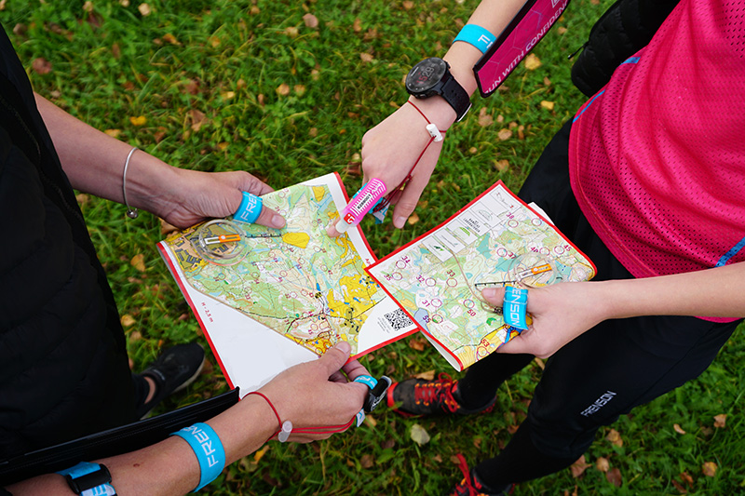
orienteering (n) /ˌɔː.ri.ənˈtɪə.rɪŋ/
an activity in which you have to find your way to somewhere on foot as quickly as possible by using a map and a compass
www.phuongnam.edu.vn

Slide 15
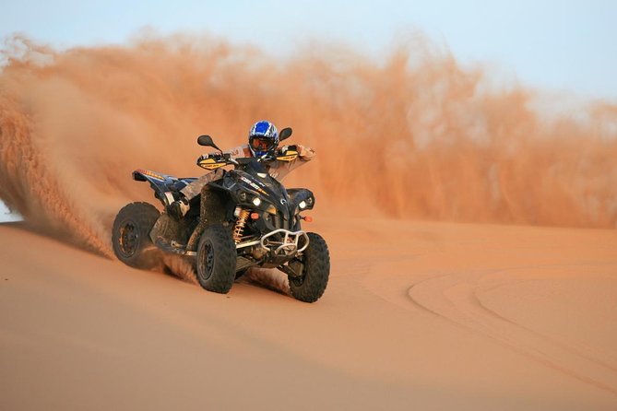
quad biking (n) /ˈkwɒd ˌbaɪkɪŋ/
the activity of using a Quad Bike for racing and traveling
www.phuongnam.edu.vn

Slide 16

Ex2. Which outdoor activities from the list would you like/dislike to do? Why/Why not?
www.phuongnam.edu.vn

Slide 17
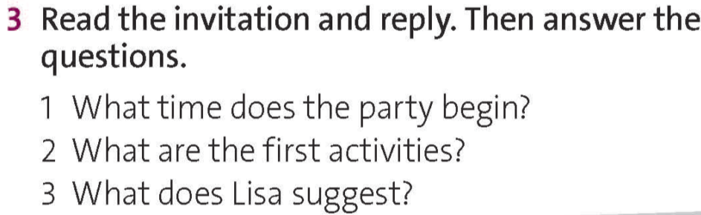
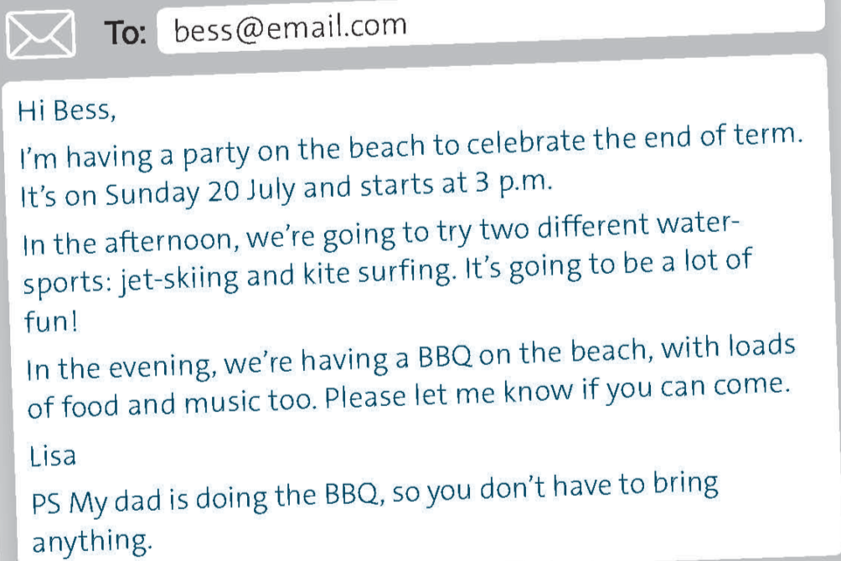
1. The party begins at 3 p.m.
www.phuongnam.edu.vn

Slide 18
2. The first activities are jet-skiing and kite surfing.
www.phuongnam.edu.vn

Slide 19
3. Lisa suggests that Bess doesn’t have to bring anything.
www.phuongnam.edu.vn

Slide 20
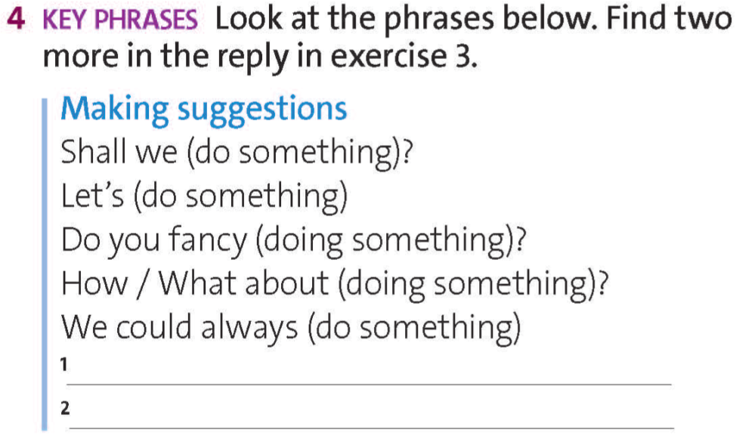
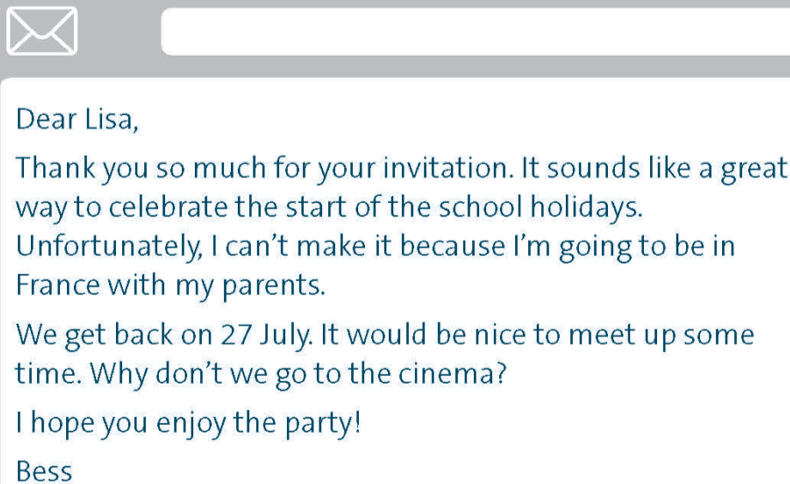
It would be nice to meet up some time.
Why don’t we go to the cinema?
www.phuongnam.edu.vn

Slide 21

www.phuongnam.edu.vn

Slide 22
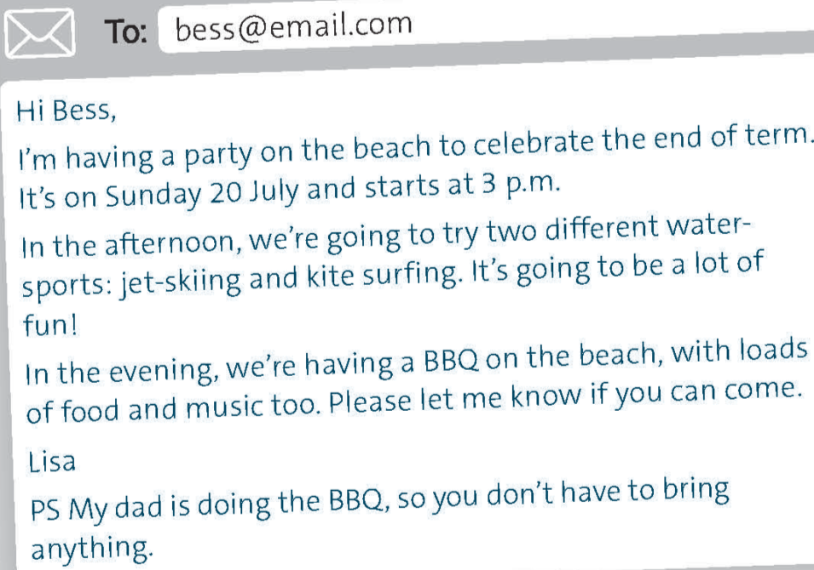
Ex 5. Find three abbreviations in the invitations in exercise 3. What do they mean? Do you know any other common abbreviations?
BBQ
etc.
e.g.
p.m.
PS
a.m.
Check all
www.phuongnam.edu.vn

Slide 23

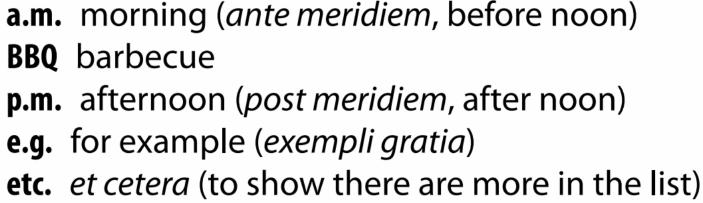

Ex 5. Find three abbreviations in the invitations in exercise 3. What do they mean? Do you know any other common abbreviations?
www.phuongnam.edu.vn

Slide 24
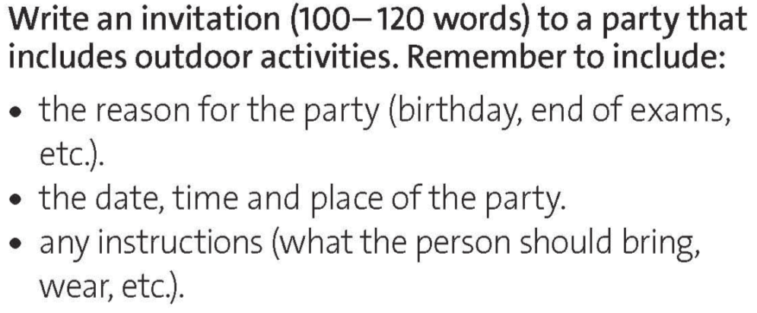
www.phuongnam.edu.vn

Slide 25
Ex6. Match the phrases on the left columns with the correct expressions on the right columns
For the party, you can just wear anything that you feel comfortable, no need you formal clothing. You can also bring your best friends Ned and MJ with you.
The reason of the party
The date, time, place for the party
When you get there, we’re going to try two different sports: paintballing and rock climbing. It’s going to be a lot of fun! I’m going to prepare a deluxe buffet by the riverside. The team members of the Avengers are going to be there too. Please let me know if you can come.
Tony Stark.
Any instructions
Schedule and outdoor activities
Hi Peter Parker,
I’m having a party on my private island to celebrate on your high school graduation. It’s on Monday 26 June and starts at 10 a.m.
Check all
www.phuongnam.edu.vn

Slide 26
Ex6. Rearrange the texts into the correct time order.
Hi Peter Parker,
I’m having a party on my private island to celebrate on your high school graduation. It’s on Monday 26 June and starts at 10 a.m.
For the party, you can just wear anything that you feel comfortable, no need you formal clothing. You can also bring your best friends Ned and MJ with you.
When you get there, we’re going to try two different sports: paintballing and rock climbing. It’s going to be a lot of fun! I’m going to prepare a deluxe buffet by the riverside. The team members of the Avengers are going to be there too. Please let me know if you can come.
Tony Stark.
For the party, you can just wear anything that you feel comfortable, no need you formal clothing. You can also bring your best friends Ned and MJ with you.
2
Hi Peter Parker,
I’m having a party on my private island to celebrate on your high school graduation. It’s on Monday 26 June and starts at 10 a.m.
1
When you get there, we’re going to try two different sports: paintballing and rock climbing. It’s going to be a lot of fun! I’m going to prepare a deluxe buffet by the riverside. The team members of the Avengers are going to be there too. Please let me know if you can come.
Tony Stark.
3
www.phuongnam.edu.vn

Slide 27
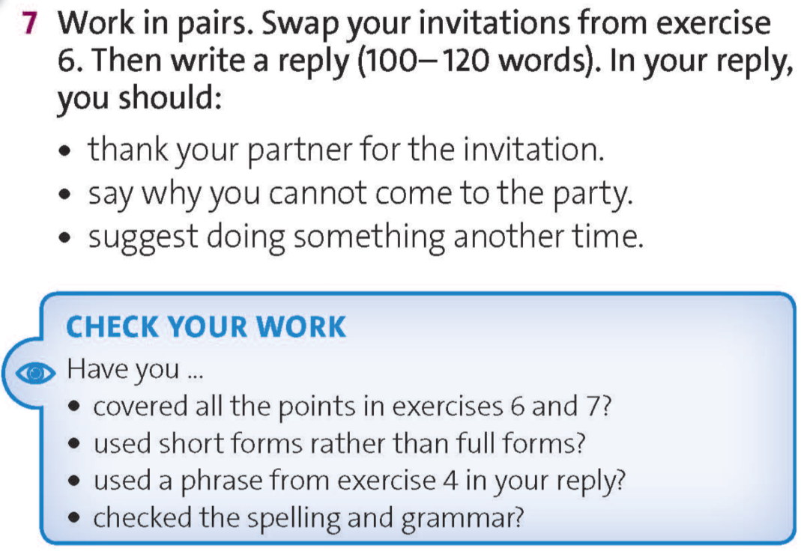
www.phuongnam.edu.vn

Slide 28



- Learn by heart all the new words
- Prepare for next lesson – Culture

Slide 29

www.phuongnam.edu.vn

Slide 30



Thank you!
CTCP ĐẦU TƯ VÀ PHÁT TRIỂN GIÁO DỤC PHƯƠNG NAM

