Slide 2

Unit 4
urbanization
READING
Urbanization
of
Ha Noi

Slide 3
LESSON 3
READING
WARM-UP
Game: Fishing
PRE- READING
Task 1: Discuss the questions.
Task 2: Discuss and follow the question
Task 3: Match the highlighted words with their meanings.
Task 4: Answer the question.
WHILE- READING
POST- READING
Task 5: Discussion
CONSOLIDATION
Wrap-up
Homework

Slide 4

WARM-UP
CATCH THE FISH!

Slide 5


WARM-UP
Students work in 2 groups.
There are several pictures and you need to choose the correct fish that the picture represents.
Raise your hands to get turns and choose the correct answer.

Slide 6

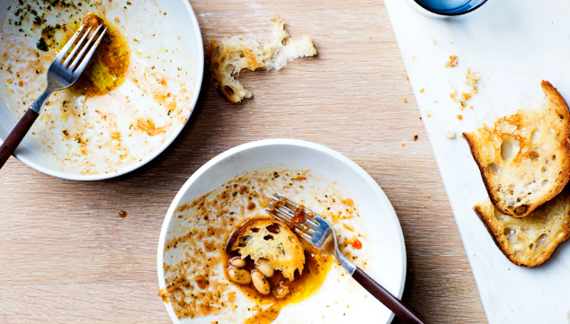





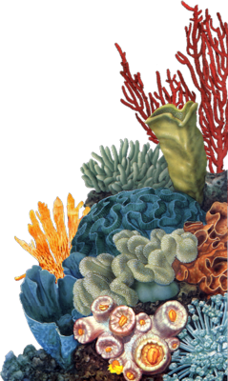






WARM-UP
leftover
leftover
contaminated
cardboard boxes
rinse out

Slide 7


WARM-UP
rinse out
cardboard boxes
contaminated
rinse out
leftover

Slide 8
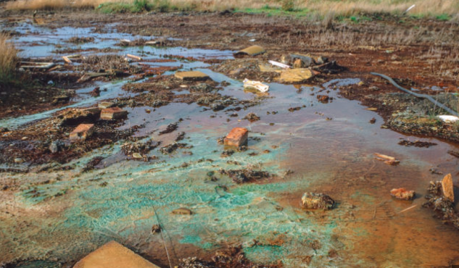
WARM-UP
contaminated
contaminated
cardboard boxes
leftover
rinse out

Slide 9

WARM-UP
cardboard boxes
rinse out
contaminated
leftover
cardboard boxes

Slide 10
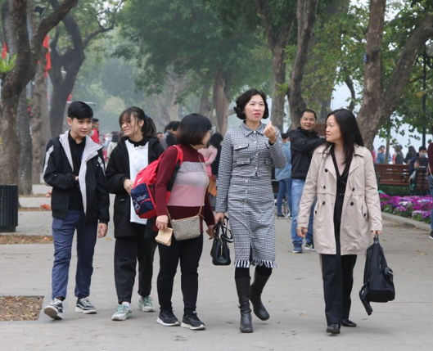

VOCABULARY
resident (n)
/ˈrez.ɪ.dənt/
a person who lives or has their home in a place

Slide 11
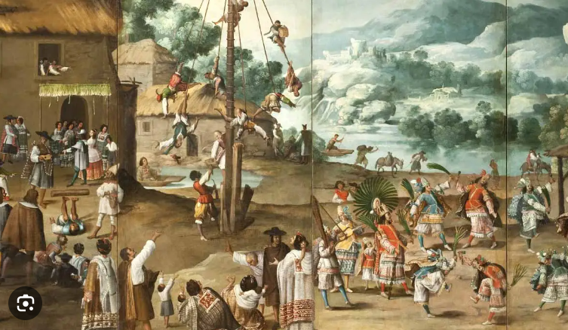
VOCABULARY
colonial (adj)
/kəˈləʊniəl/
relating to a colony or colonialism

Slide 12

VOCABULARY
gradually (adv)
/ˈɡrædʒ.u.ə.li/
slowly over a period of time or a distance

Slide 13

VOCABULARY
modernising (n)
/ˈmɒdərnaɪzɪŋ/
The act of adapting (something) to modern needs or habits, typically by installing modern equipment or adopting modern ideas or methods.

Slide 14

VOCABULARY
concern (n)
/kənˈsɜːn/
a worried or nervous feeling about something, or something that makes you feel worried

Slide 15
VOCABULARY
Form | Pronunciation | Meaning
1. resident (n) | /ˈrez.ɪ.dənt/ | a person who lives or has their home in a place
2. colonial (adj) | /kəˈləʊniəl/ | relating to a colony or colonialism
3. gradually (adv) | /ˈɡrædʒ.u.ə.li/ | slowly over a period of time or a distance
4. modernising (n) | /ˈmɒdərnaɪzɪŋ/ | adapt (something) to modern needs or habits, typically by installing modern equipment or adopting modern ideas or methods.
5. concern (n) | /kənˈsɜːn/ | a worried or nervous feeling about something, or something that makes you feel worried

Slide 16
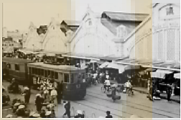
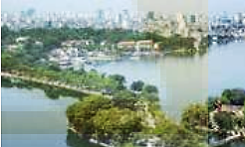
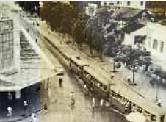
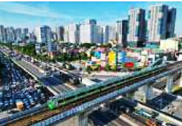
PRE- READING
11
Work in pairs. Look at the pictures in the article in 2 below. discuss the following questions.

Slide 17
PRE- READING
11
In the first and second pictures, I can see old streets of Ha Noi. There were only low-rise buildings, and people mainly got around on foot, trishaw, bicycle or tram.
In the third and fourth pictures, I can see a present-day Hanoi with many high-rise buildings. There are more modern vehicles such as cars and trains. Streets are very busy, too.

Slide 18
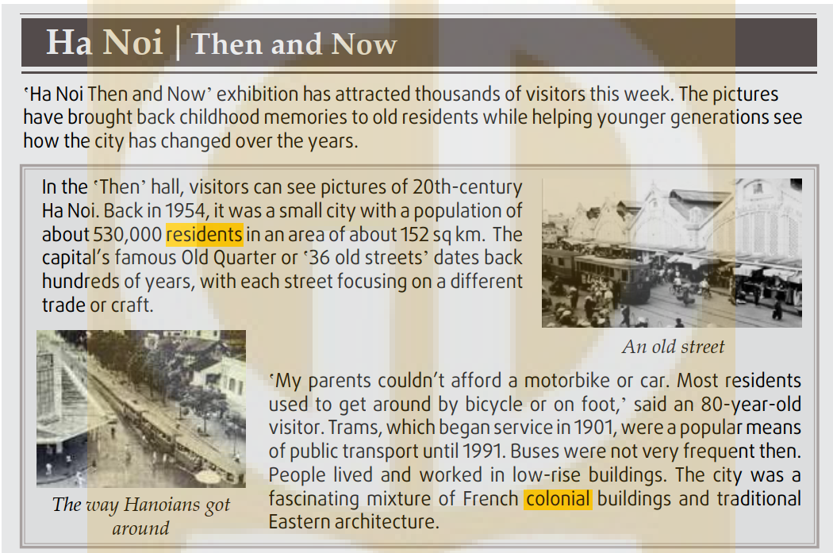
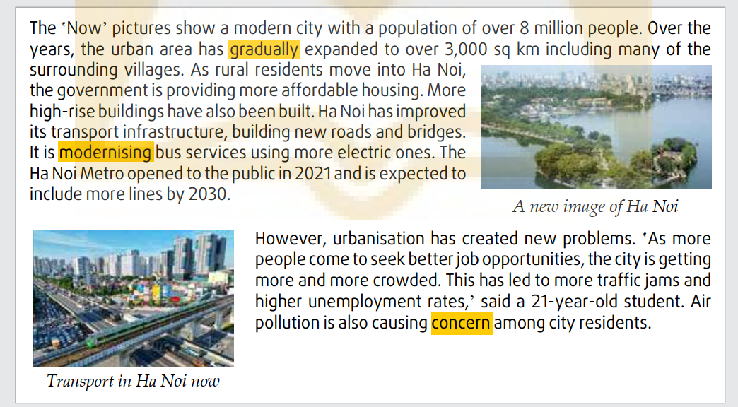
PRACTICE
2
Read the news items and choose the correct meanings of the highlighted words

Slide 19



PRACTICE
2
Read the news items and choose the correct meanings of the highlighted words
1. residents
A. people who live in a particular place
B. buildings in a particular place
2. colonial
A. connected with the native country
B. connected with a country that controls another country
3. gradually
A. slowly, over a period of time
B. quickly, over a short time

Slide 20




PRACTICE
2
Read the news items and choose the correct meanings of the highlighted words
4. modernising
A. making something attractive
B. making use of the latest technology, design, etc.
5. concern
A. a feeling of satisfaction
B. a feeling of worry about something important

Slide 21
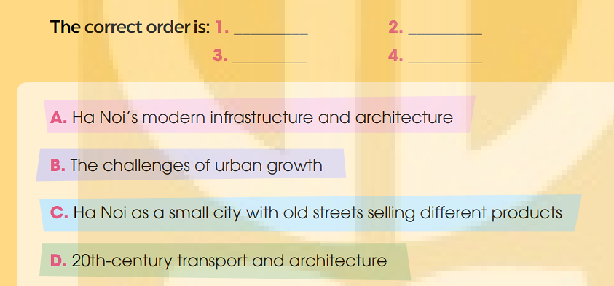
PRACTICE
3
Read the article again. Put the main ideas in the order they appear in the article.
C
D
A
B

Slide 22
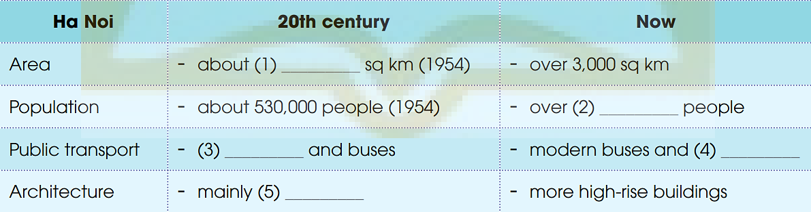
PRACTICE
4
Read the article again and complete the table using no more than THREE words and/or a number for each gap.
152
8 million
trams
metro/
trains
low-rise buildings

Slide 23
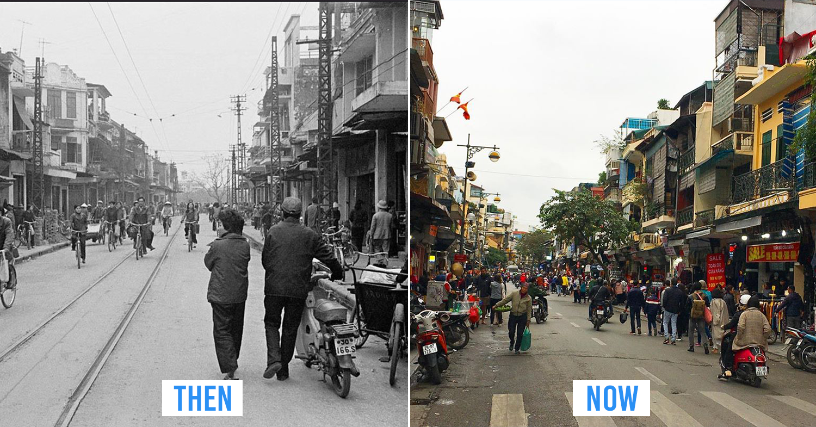
PRODUCTION
5
Work in pairs. discuss the following questions.

Slide 24


PRODUCTION
I prefer to live in Ha Noi at present because I like the modern facilities. Getting around in Ha Noi is very convenient nowadays.
I prefer to live in Ha Noi in the past. For me, Ha Noi in the past was more peaceful and quieter than Ha Noi at present. It was also safer to get around because people mainly went on foot or by bicycle.

Slide 25

CONSOLIDATION
1
Wrap-up
What have you learnt today?
Read for main ideas and specific information in news items about the Urbanisation of Ha Noi
New vocabulary words

Slide 26

CONSOLIDATION
2
Homework
Do exercises in the workbook.
Prepare for Lesson 4 - Unit 4.

Slide 27
Website: hoclieu.vn
Fanpage: facebook.com/www.tienganhglobalsuccess.vn

