Slide 1


Slide 2



Unit
3
COMMUNITY SERVICE
LESSON 6: SKILLS 2
Listening
  Tom and Linda’s community activities last summer.
Writing
  Write an email about your school activities last summer.

Slide 3

OBJECTIVES
By the end of the lesson, students will be able to:
listen for specific information about some community activities and their benefits;
write an email about the community activities you did last summer.

Slide 4
LESSON 6: SKILLS 2
WARM-UP
Chatting & Homework checking
Task 1: What community activities are the children doing in the pictures?
Task 2: Circle the correct answers.
Task 3: Listen again and fill in each blank with no more than two words.
LISTENING
Task 4: Read Tom’s email to Nam about his school activities last summer.
Task 5: Write an email of about 70 words to Tom about your school activities last summer.
WRITING
POST-LISTENING
& WRITING
Task 6: Class gallery
Wrap-up
Homework
CONSOLIDATION

Slide 5

LESSON 6: SKILLS 2
WARM-UP
Chatting & Homework checking
Aims of the stage:
to lead in the topic of the lesson: school community activities in summer

Slide 6
WARM-UP
Your plans for school activities next summer holiday?

Slide 7

LESSON 6: SKILLS 2
WARM-UP
Chatting & Homework checking
Task 1: What community activities are the children doing in the pictures?
Task 2: Circle the correct answers.
Task 3: Listen again and fill in each blank with no more than two words.
LISTENING
Aims of the stage:
To help students develop listening skills for specific information.

Slide 8
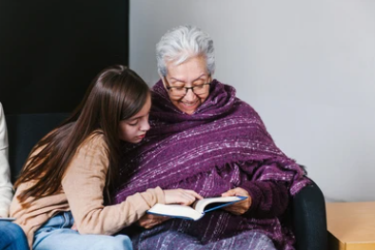
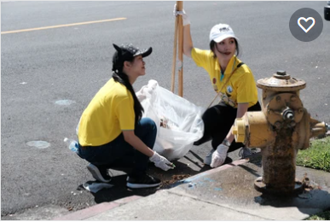
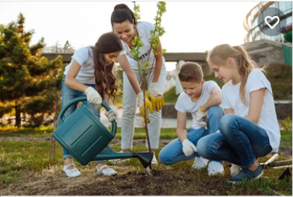
PRE-LISTENING
1
What community activities are the children doing in the pictures?
a
b
c
reading books to the elderly
picking up litter
planting trees

Slide 9

WHILE-LISTENING
2
Listen to Tom and Linda talking about their community activities last summer. Circle the correct answers.
1. Linda and her friends taught ______.
A. English and literature
B. maths and history
C. English and maths
2. Linda and her friends ______ the elderly.
A. talked to
B. cooked for
C. read books to
3. Tom and his friends picked up ______.
A. books and paper
B. bottles and books
C. paper and bottles
4. Tom and his friends ______.
A. grew some trees
B. tutored maths
C. cleaned schools

Slide 10
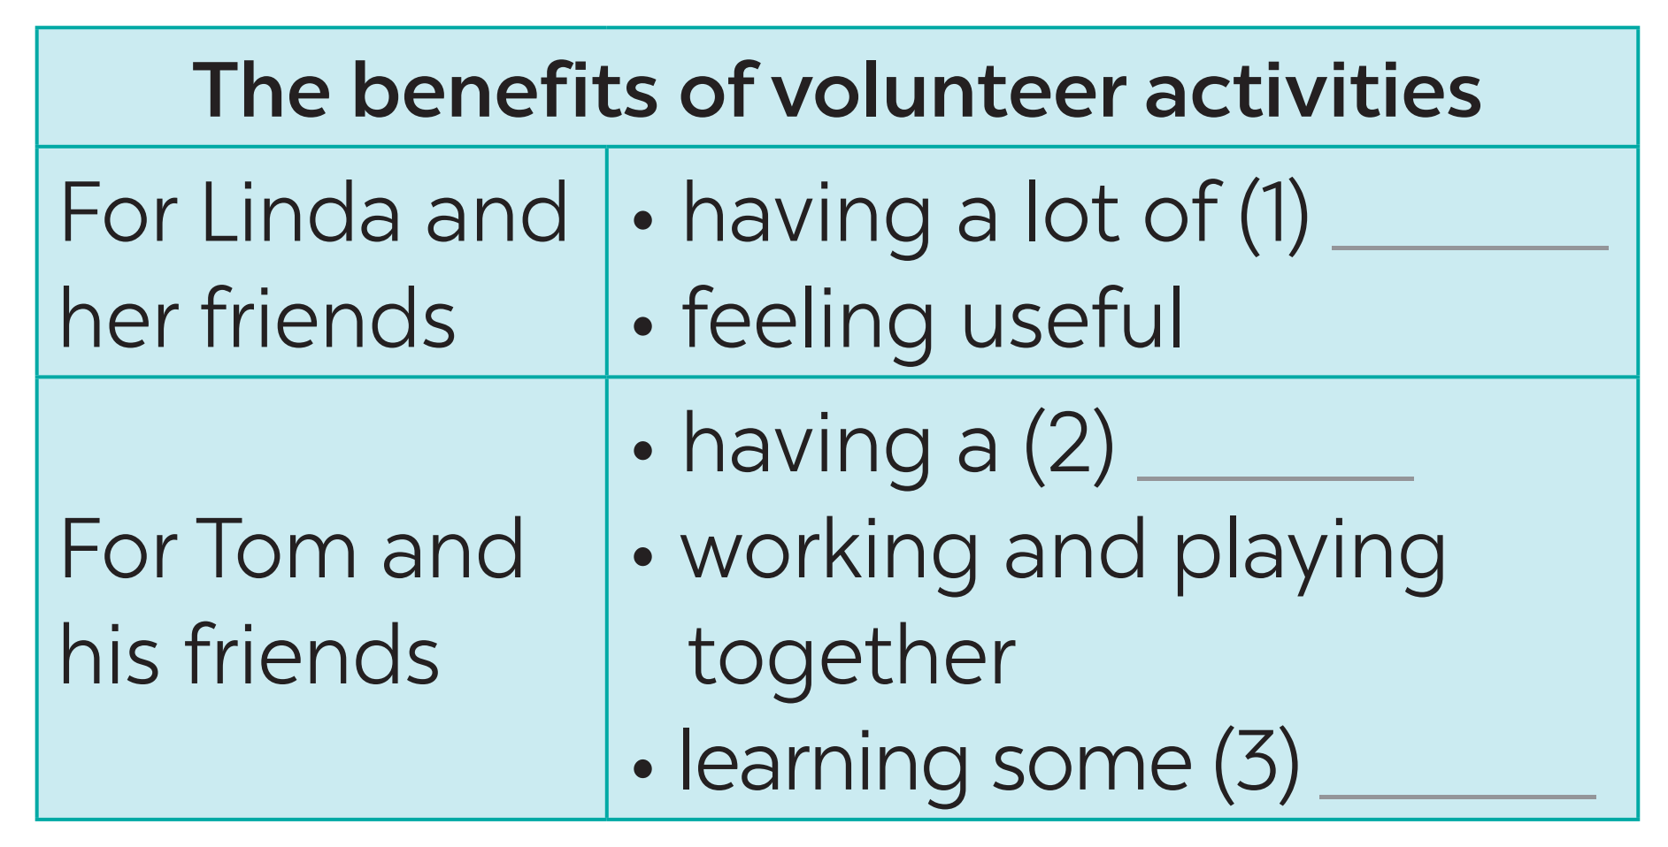
WHILE-LISTENING
3
Listen again and fill in each blank with no more than two words.
fun
good time
skills

Slide 11
LESSON 6: SKILLS 2
WARM-UP
Chatting & Homework checking
Task 1: What community activities are the children doing in the pictures?
Task 2: Circle the correct answers.
Task 3: Listen again and fill in each blank with no more than two words.
LISTENING
Task 4: Read Tom’s email to Nam about his school activities last summer.
Task 5: Write an email of about 70 words to Tom about your school activities last summer.
WRITING

Slide 12
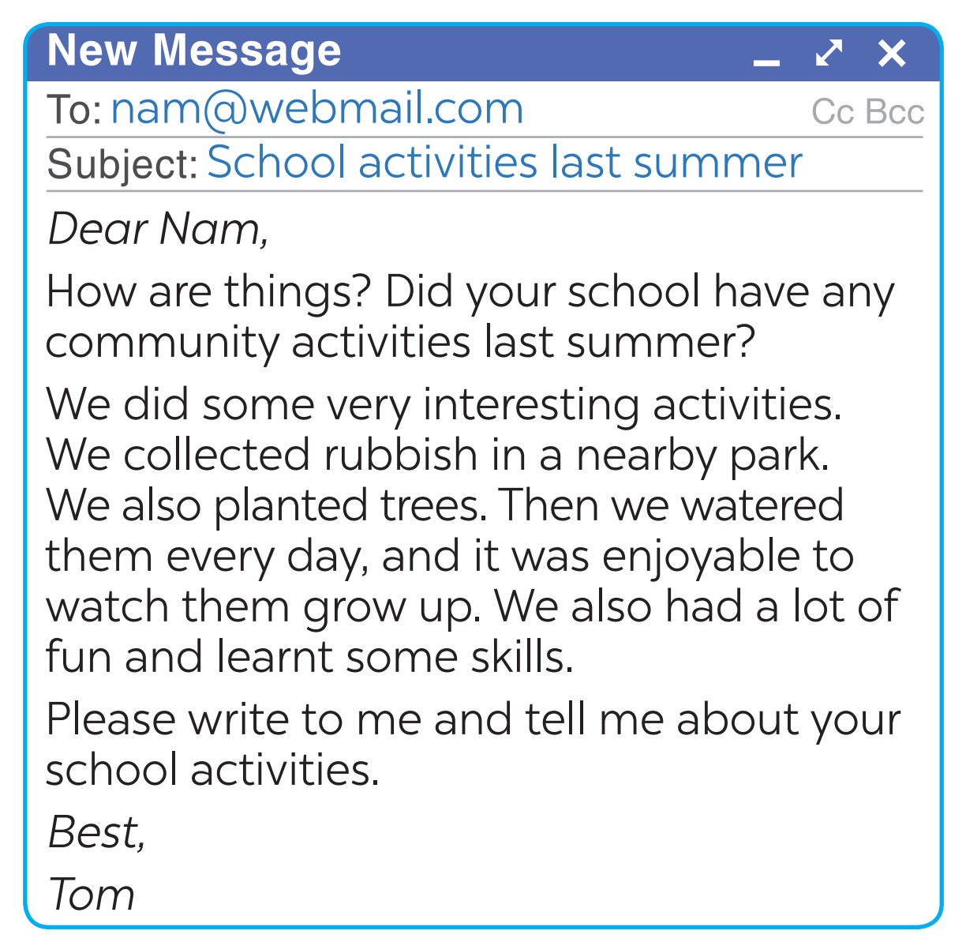
PRE-WRITING
4
Read Tom’s email to Nam about his school activities last summer.
Who is writing to whom?
What is the subject of the third paragraph of the email?

Slide 13
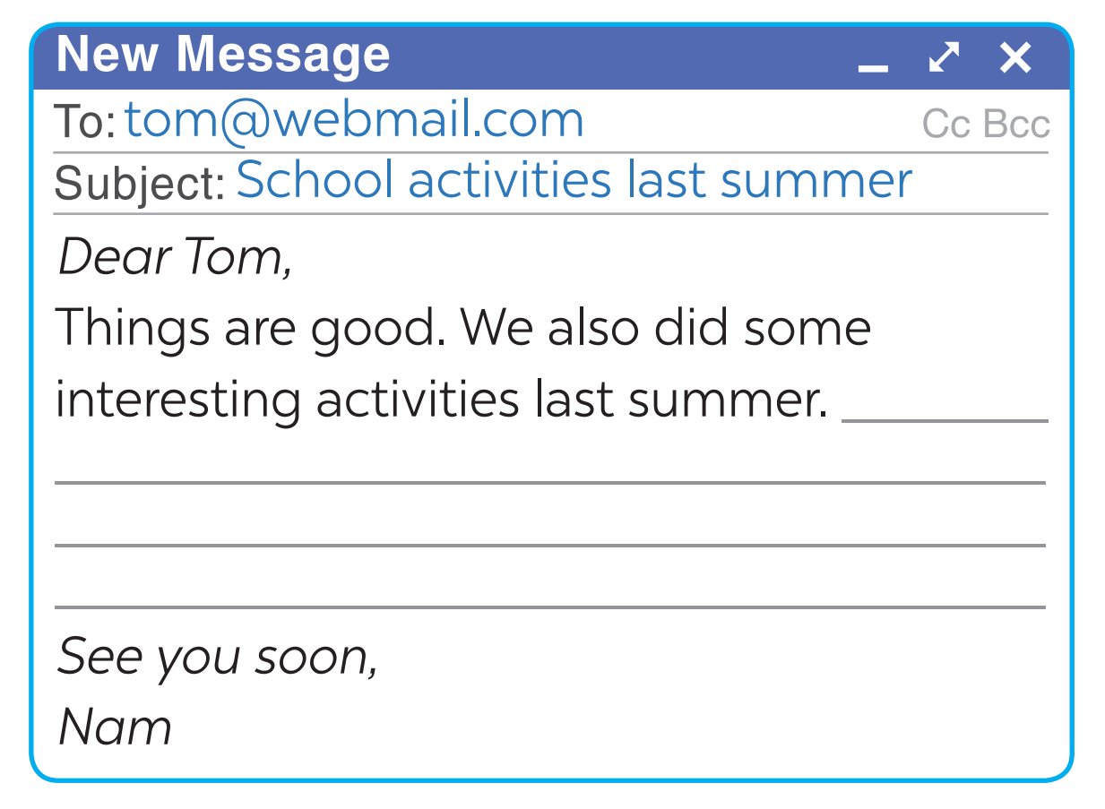
WHILE-WRITING
5
You are Nam. Now write an email of about 70 words to Tom about your school activities last summer. Start your email as shown below.

Slide 14
LESSON 6: SKILLS 2
WARM-UP
Chatting & Homework checking
Task 1: What community activities are the children doing in the pictures?
Task 2: Circle the correct answers.
Task 3: Listen again and fill in each blank with no more than two words.
LISTENING
Task 4: Read Tom’s email to Nam about his school activities last summer.
Task 5: Write an email of about 70 words to Tom about your school activities last summer.
WRITING
POST-LISTENING
& WRITING
Task 6: Class gallery

Slide 15
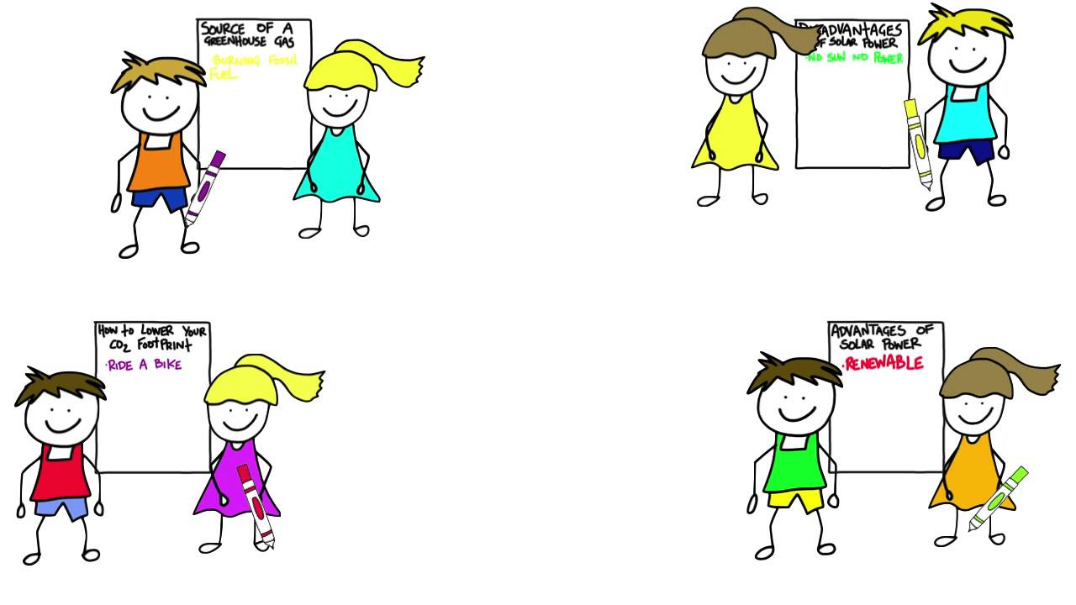
POST-LISTENING & WRITING
CLASS GALLERY
Students can:
go and see other’s work
give comments to each other

Slide 16
LESSON 6: SKILLS 2
WARM-UP
Chatting & Homework checking
Task 1: What community activities are the children doing in the pictures?
Task 2: Circle the correct answers.
Task 3: Listen again and fill in each blank with no more than two words.
LISTENING
Task 4: Read Tom’s email to Nam about his school activities last summer.
Task 5: Write an email of about 70 words to Tom about your school activities last summer.
WRITING
POST-LISTENING
& WRITING
Task 6: Class gallery
Wrap-up
Homework
CONSOLIDATION

Slide 17

CONSOLIDATION
1
WRAP-UP
In this lesson, we have learnt to:
listen for specific information about some community activities and their benefits;
write an email about community activities one did last summer.

Slide 18
CONSOLIDATION
2
HOMEWORK
Rewrite the email on your notebook.
Prepare for the next lesson: Looking back & Project

Slide 19

Website: hoclieu.vn
Fanpage: facebook.com/www.tienganhglobalsuccess.vn/

