Slide 1

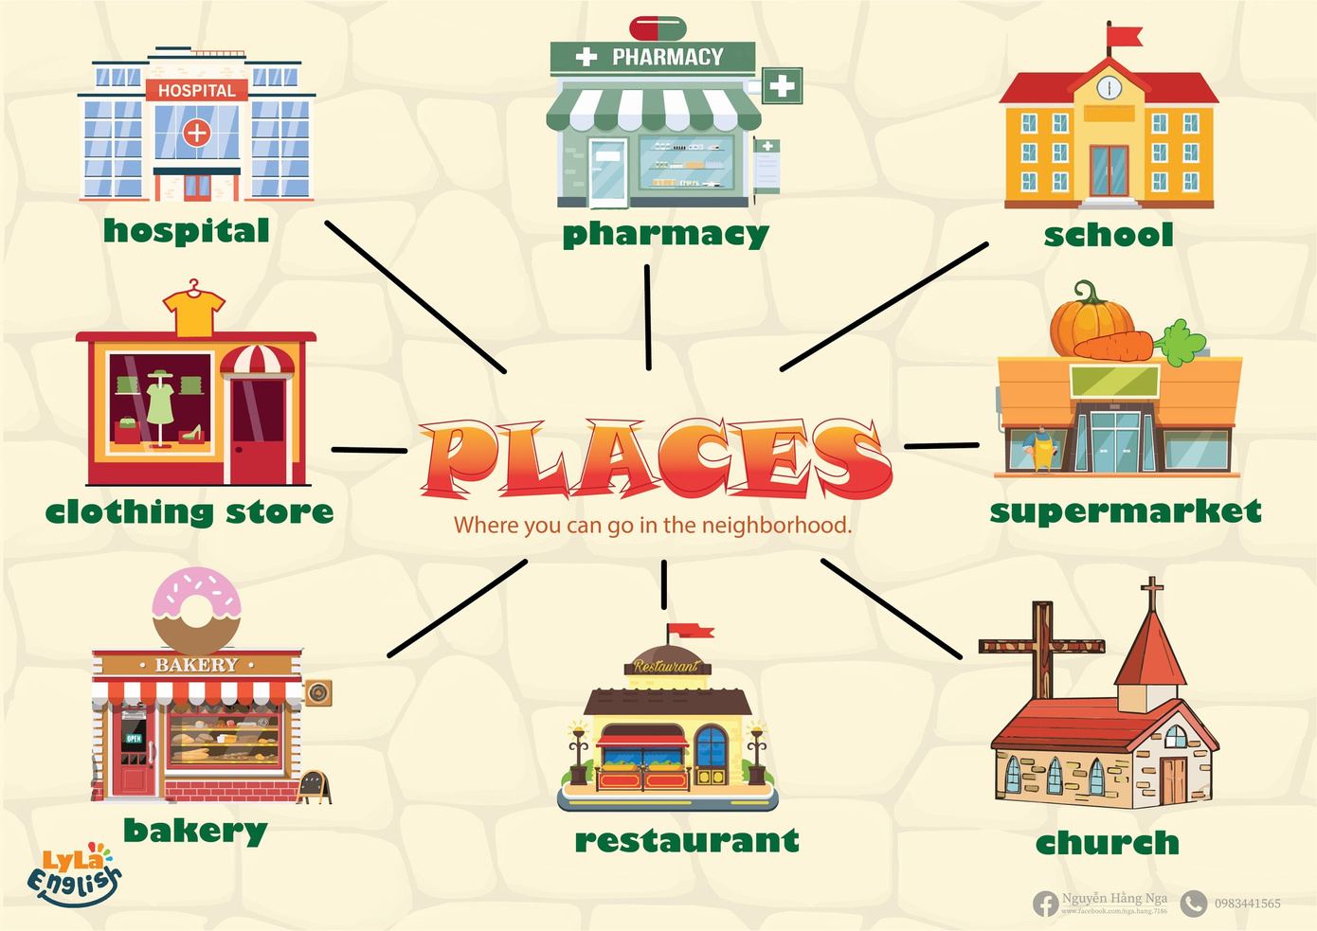


Slide 2
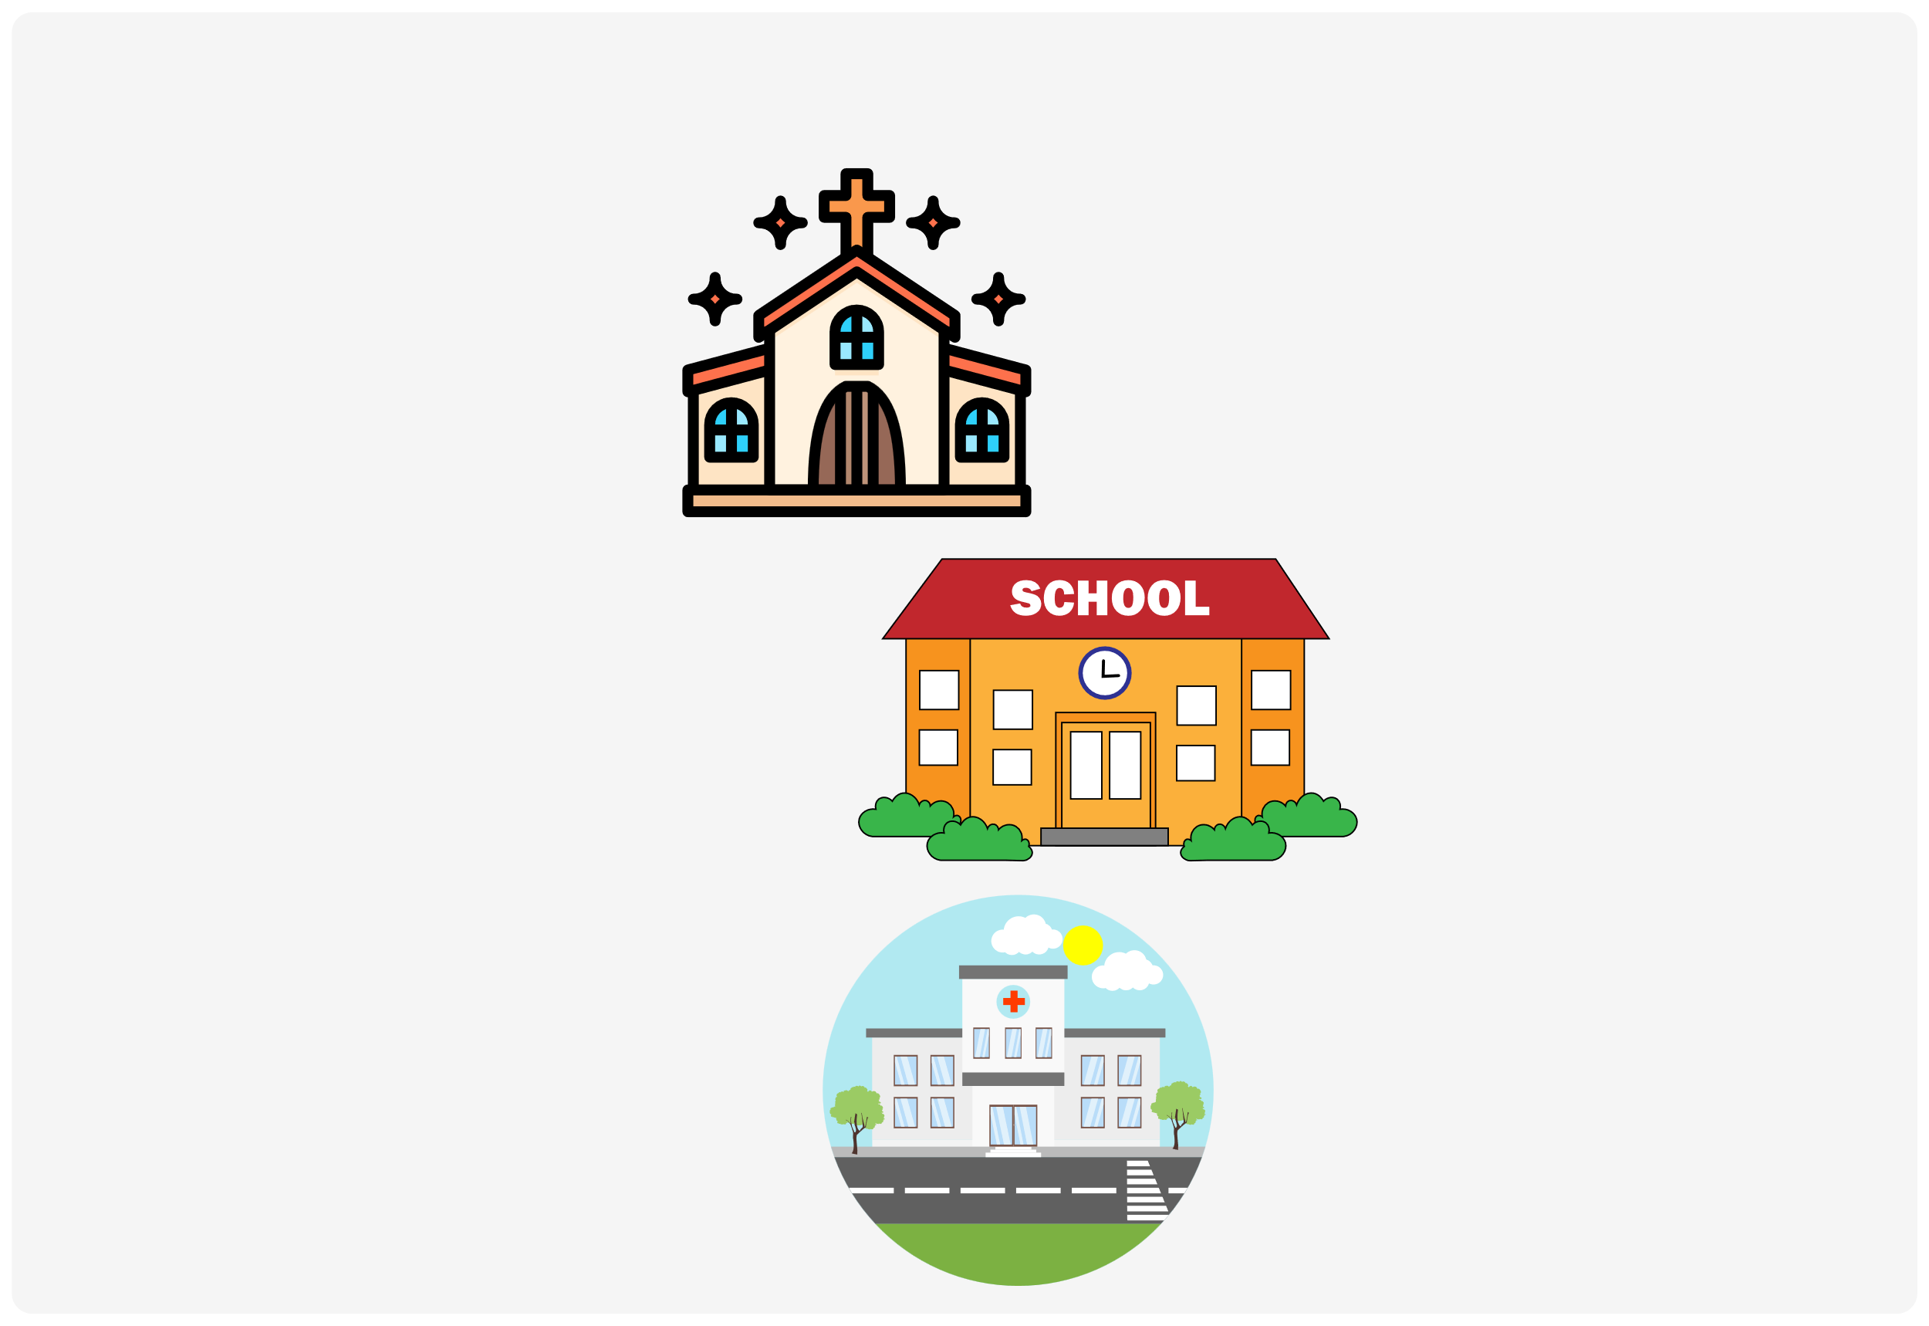

I. QUESTION
1.Where is this?
-This is...
2. Where does teacher do? -Teacher does in...
3. Where does doctor do? -Doctor does in...

Slide 3
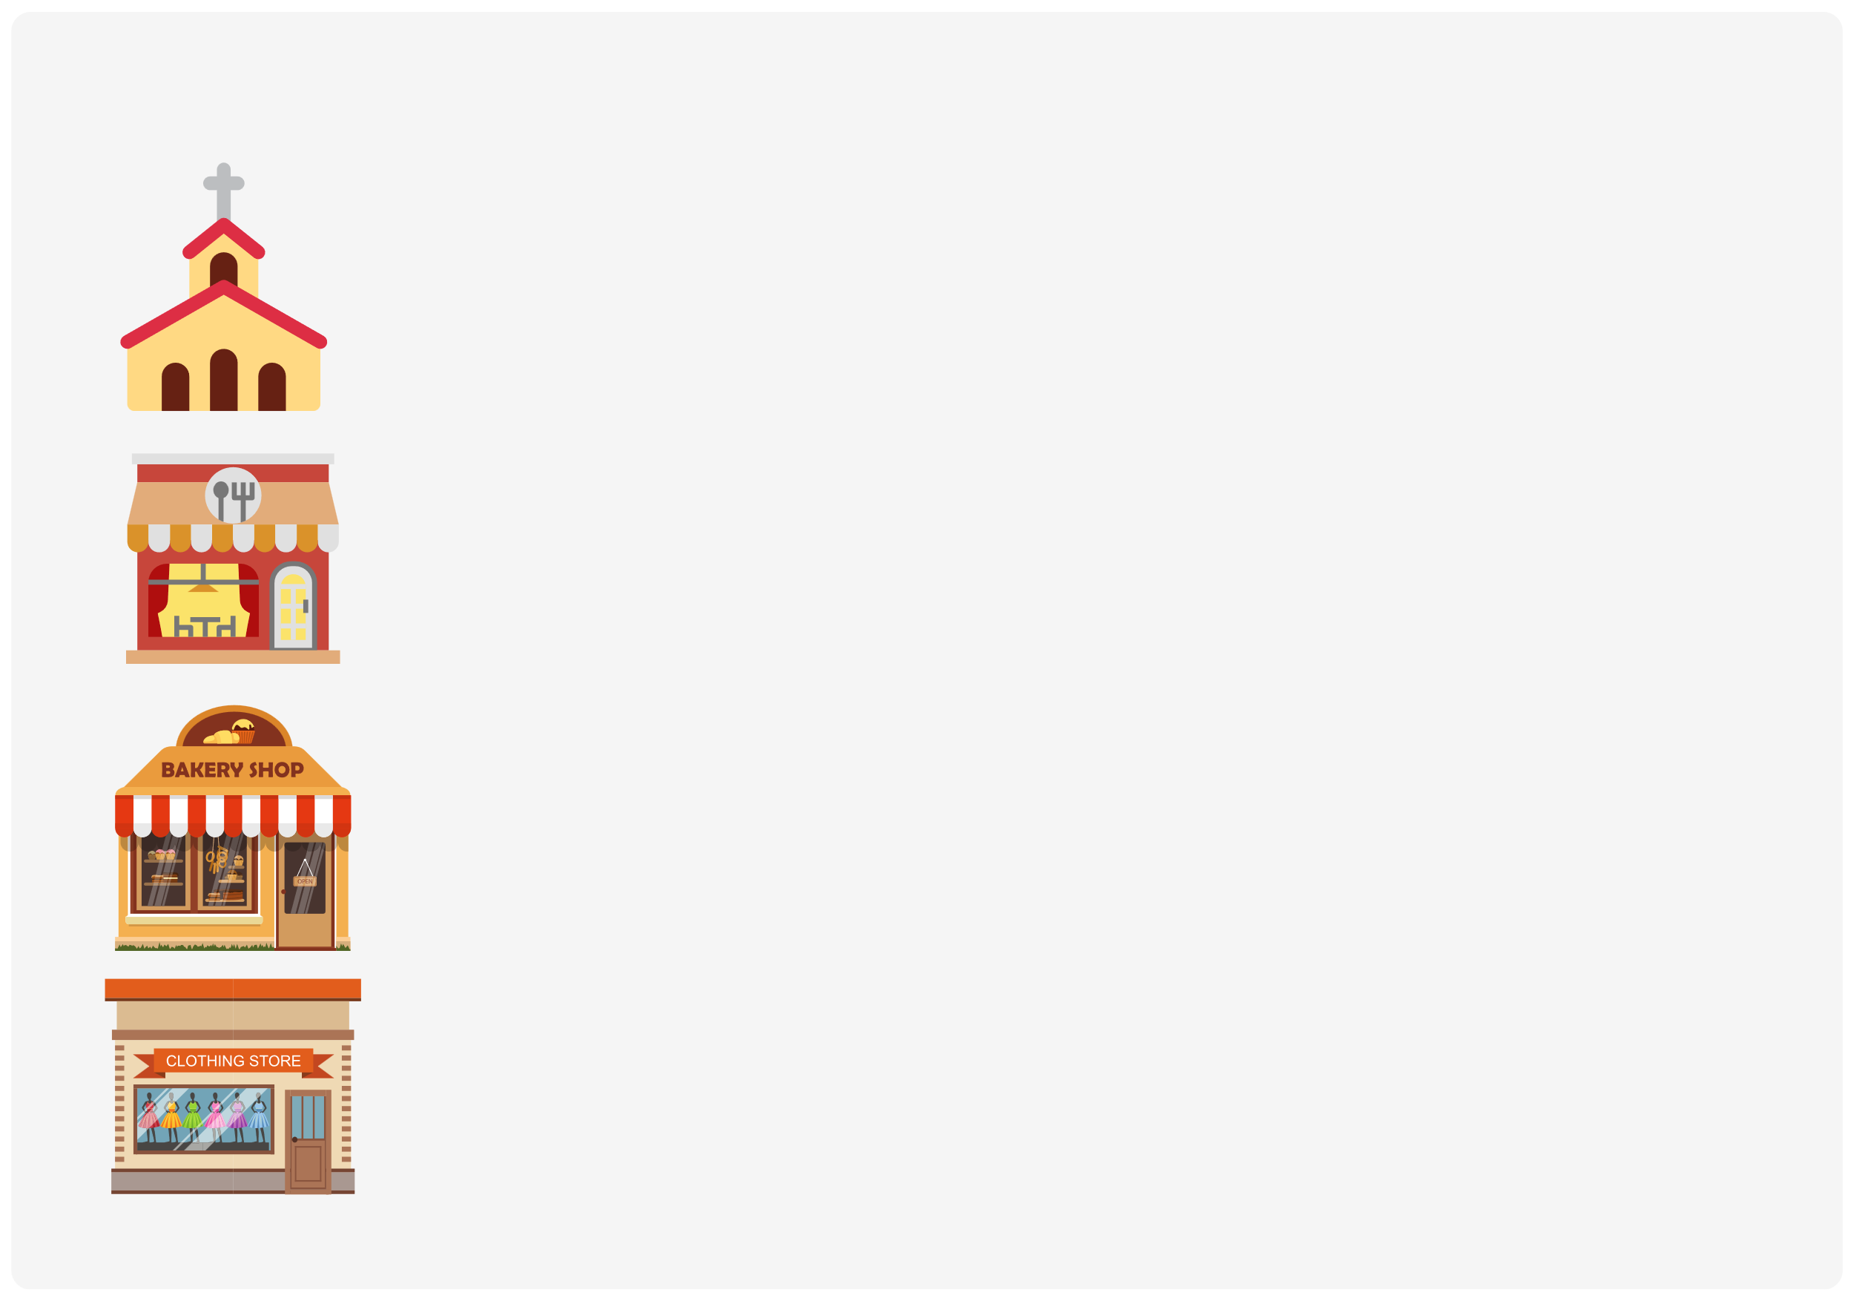
II. VOCABULARY
Church:.....................................................
Restaurant:...............................................
Bakery:.....................................................
Clothing store:............................................

Slide 4
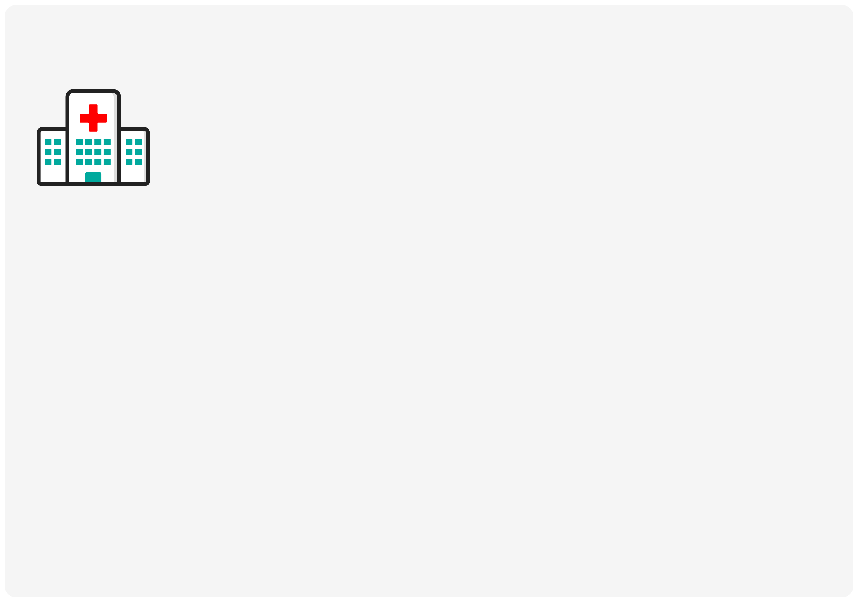
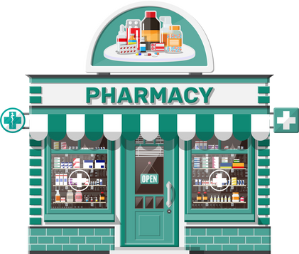
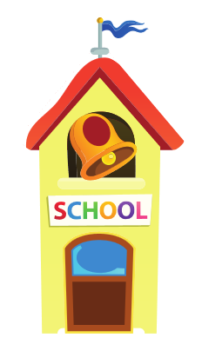

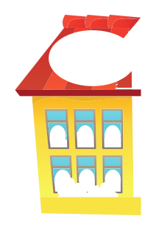
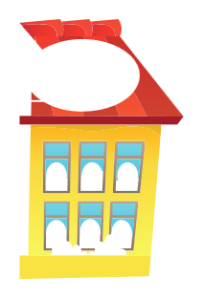







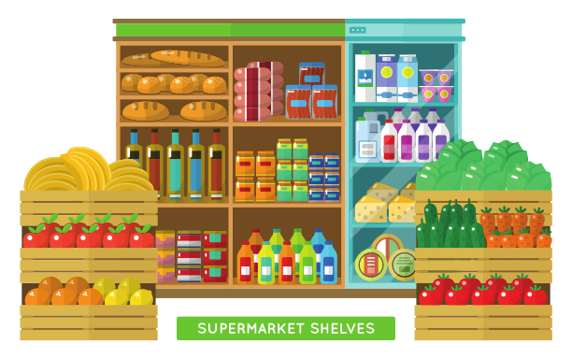
II. VOCABULARY
Hospital:.................................................
Pharmacy:..............................................
School:...................................................
Supermarket:.........................................

Slide 5
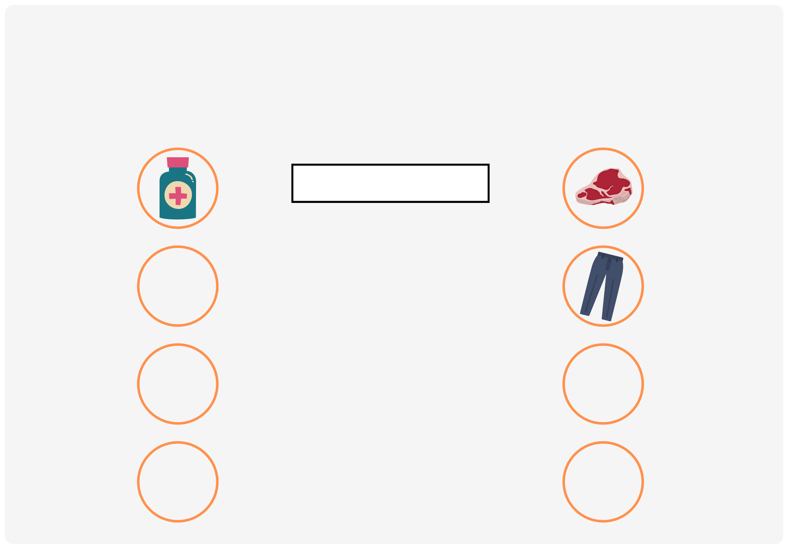

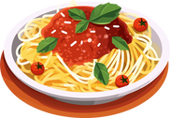
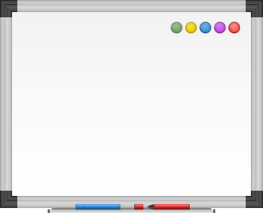
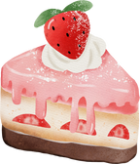

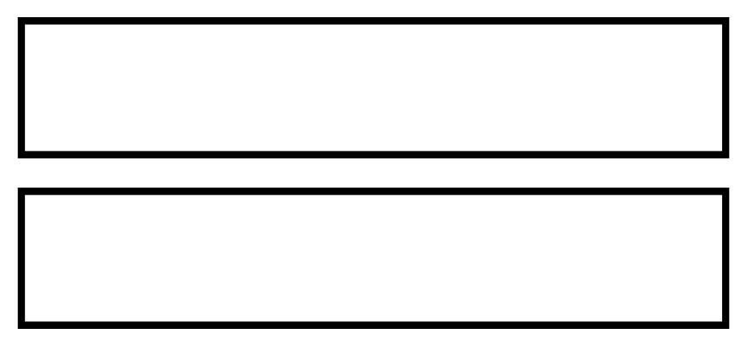
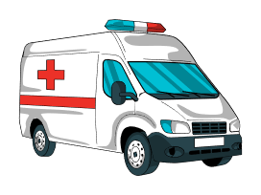
III. EXERCISES:
1.Match the things with the places listed below:
pharmacy supermarket
clothing store school
church
hospital
bakery restaurant

Slide 6
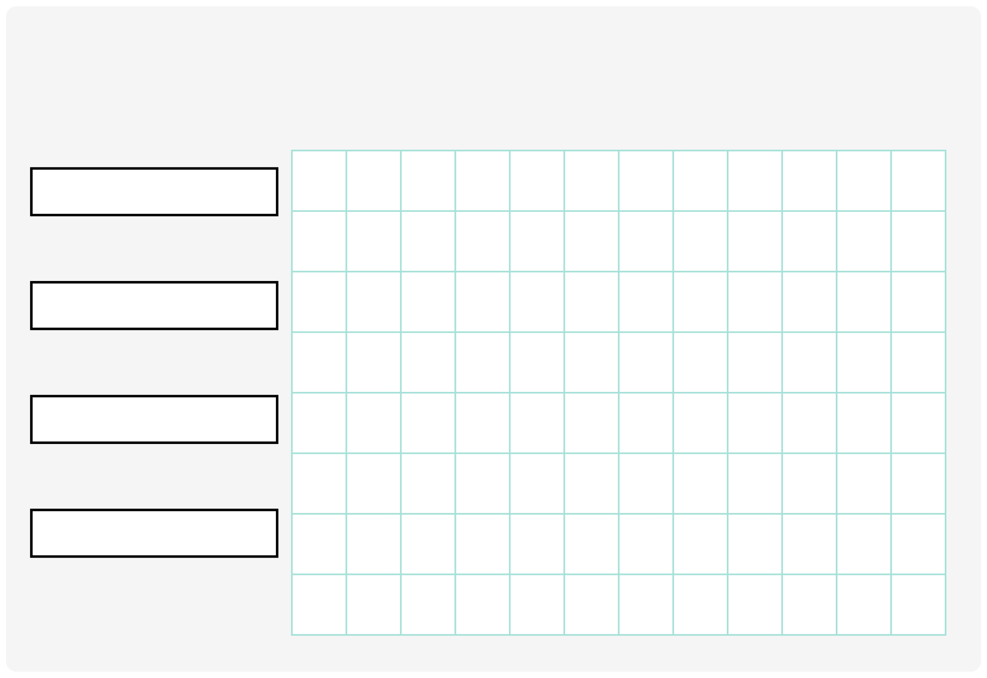
III. EXERCISES:
2. Find names of the places:
school
S
H
O
P
C
H
U
R
C
H
B
M
S
E
C
A
S
T
L
E
K
T
C
U
hospital
C
F
U
N
F
A
I
R
B
Y
Q
S
H
D
Q
C
A
M
P
S
I
T
E
E
church
O
D
T
O
W
N
H
A
L
L
T
U
O
L
I
B
R
A
R
Y
H
L
F
M
restaurant
L
R
E
S
T
A
U
R
A
N
T
B
I
O
H
O
S
P
I
T
A
L
L
L

Slide 7
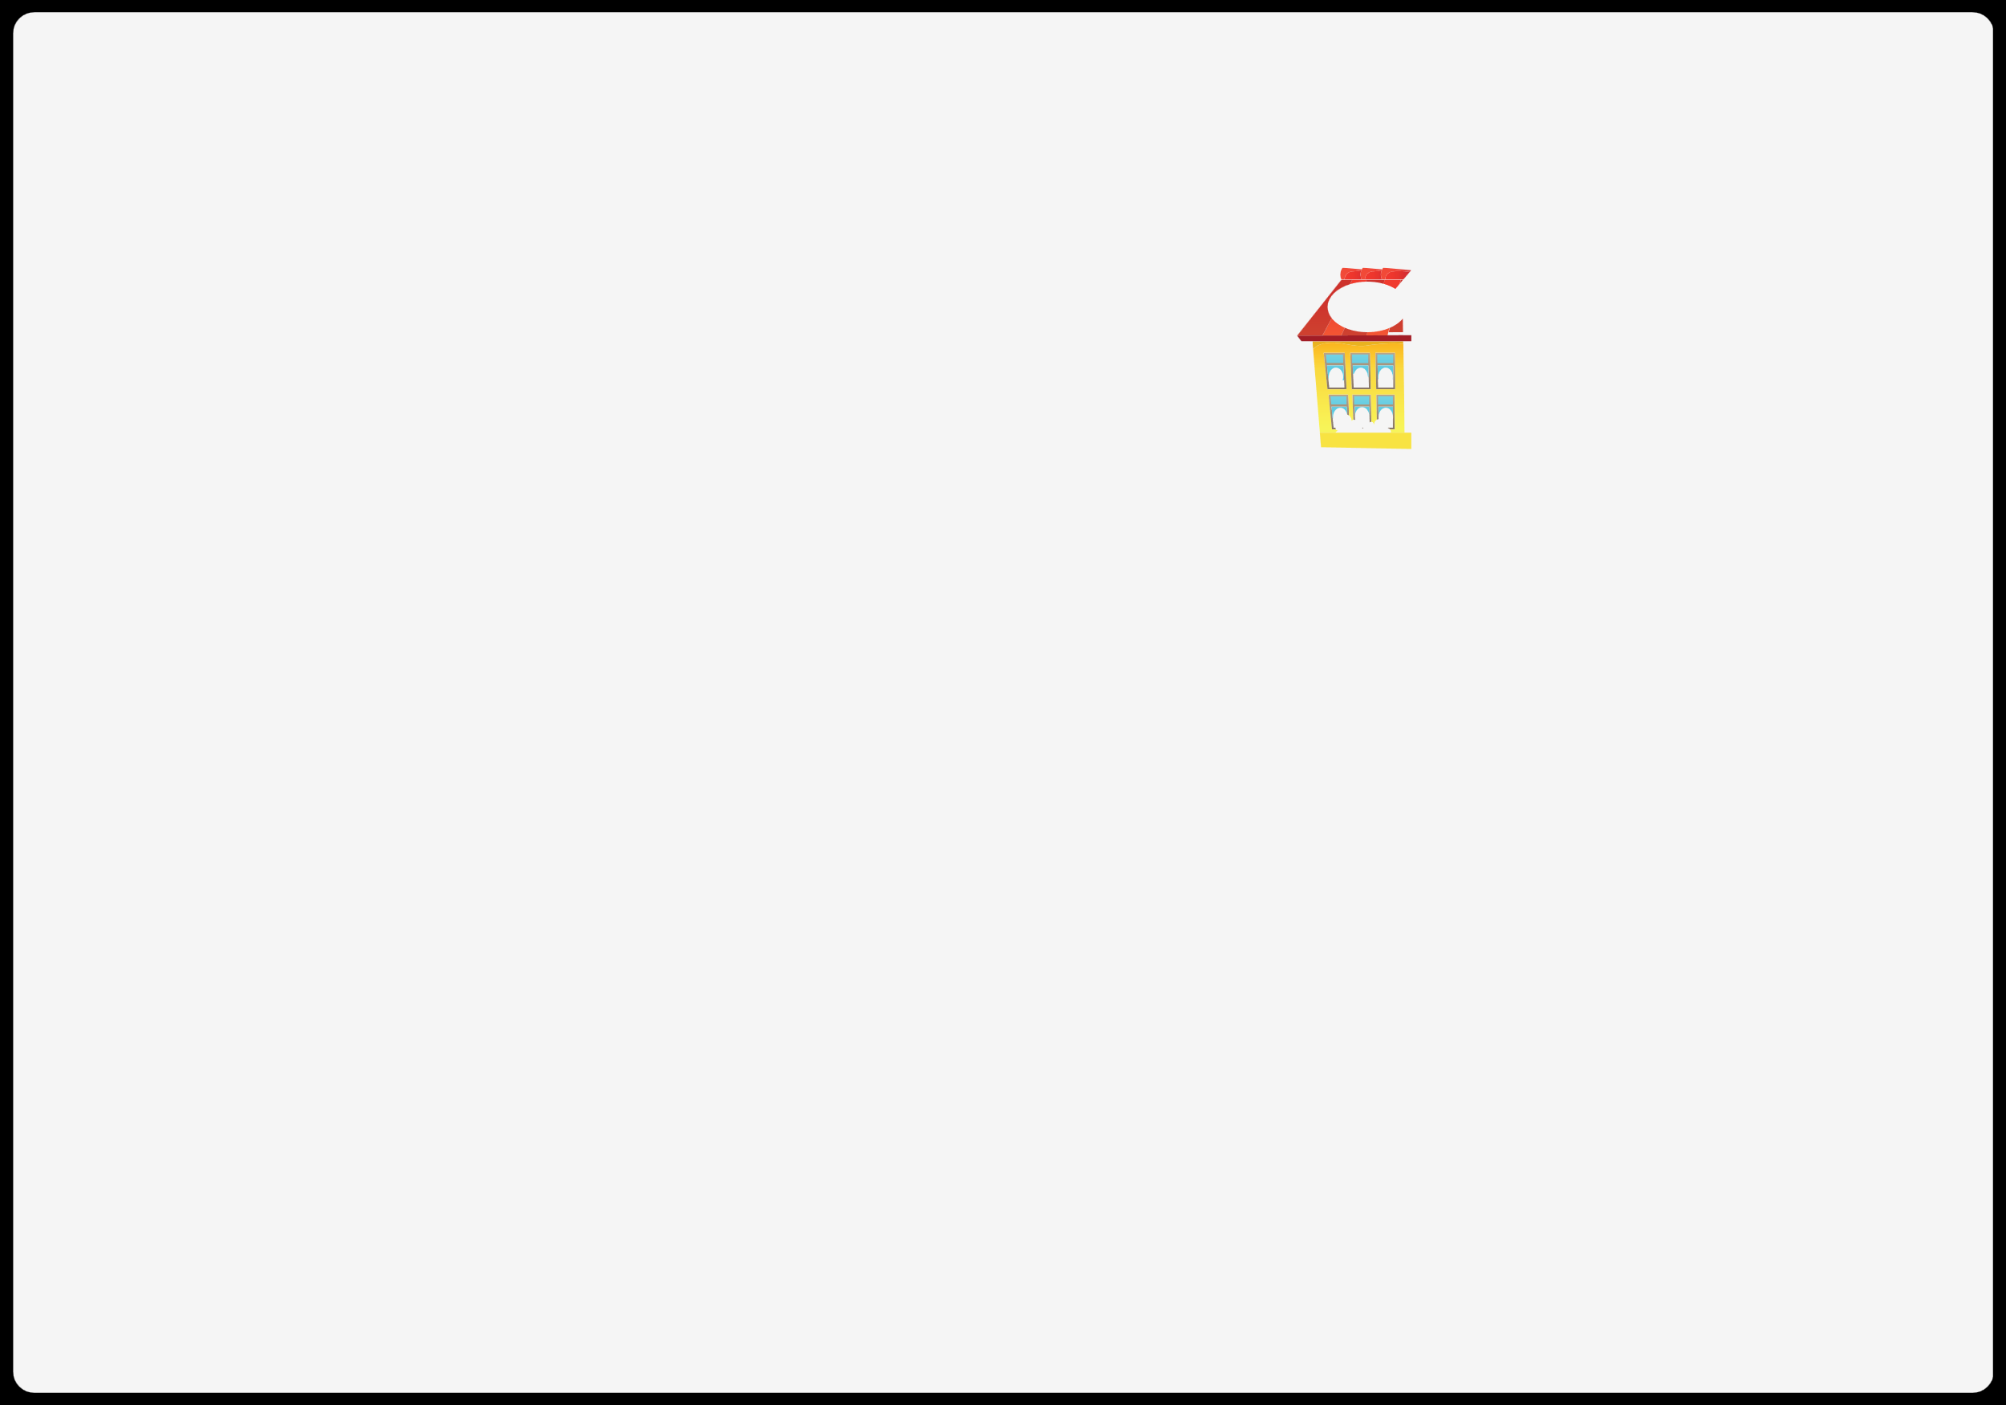
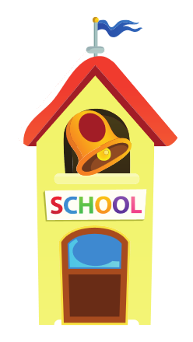

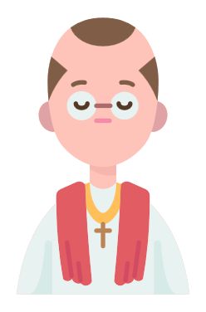
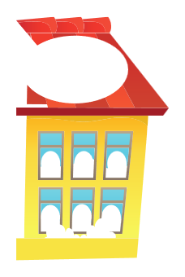



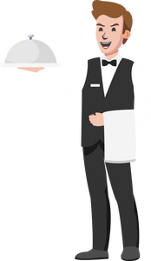
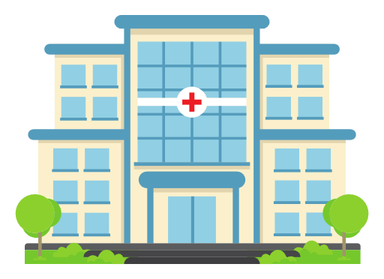

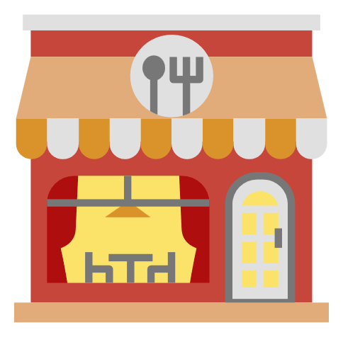


III. EXERCISES:
3. Match the jobs and places:

Slide 8
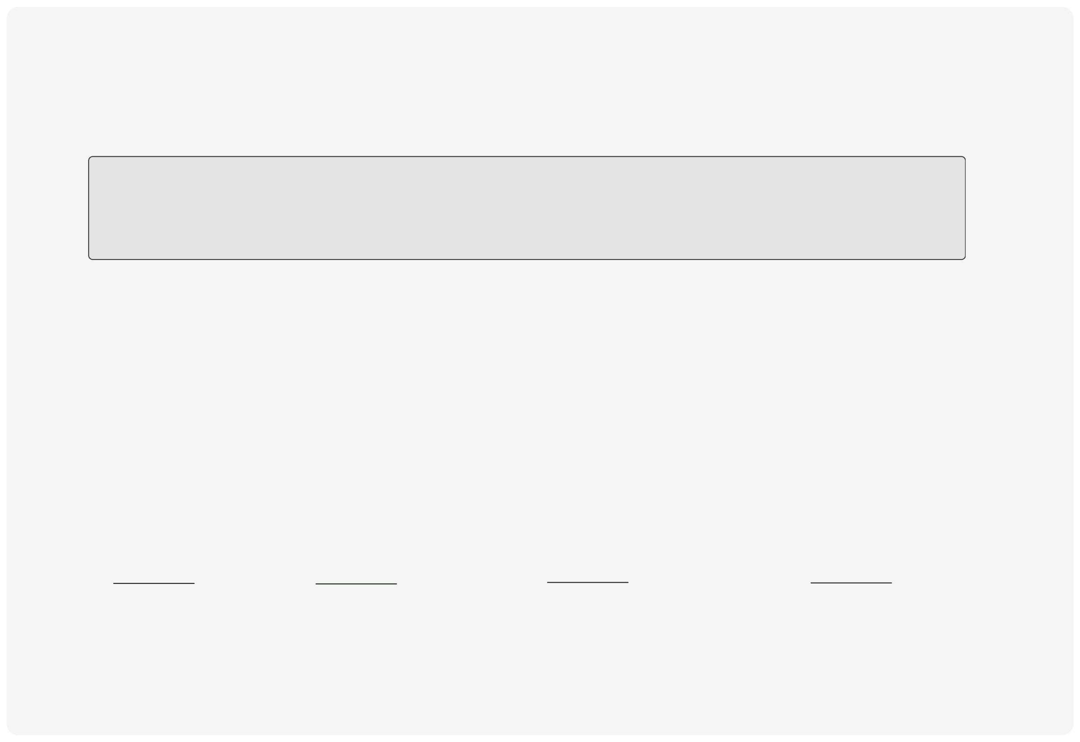
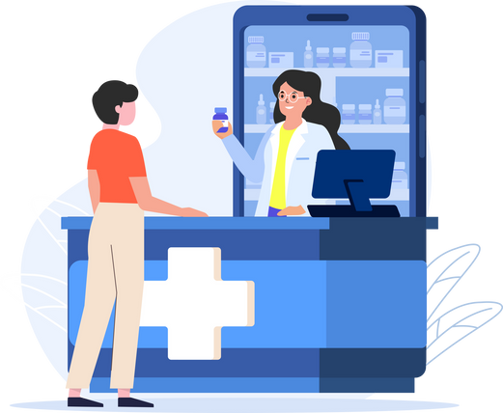
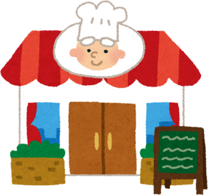
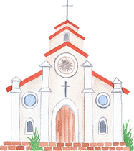
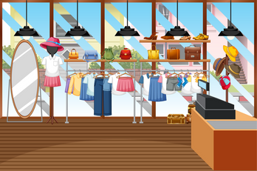
III. EXERCISES:
4. Fill the name of places:
Clothing store
Restaurant
Church
Pharmacy

Slide 9
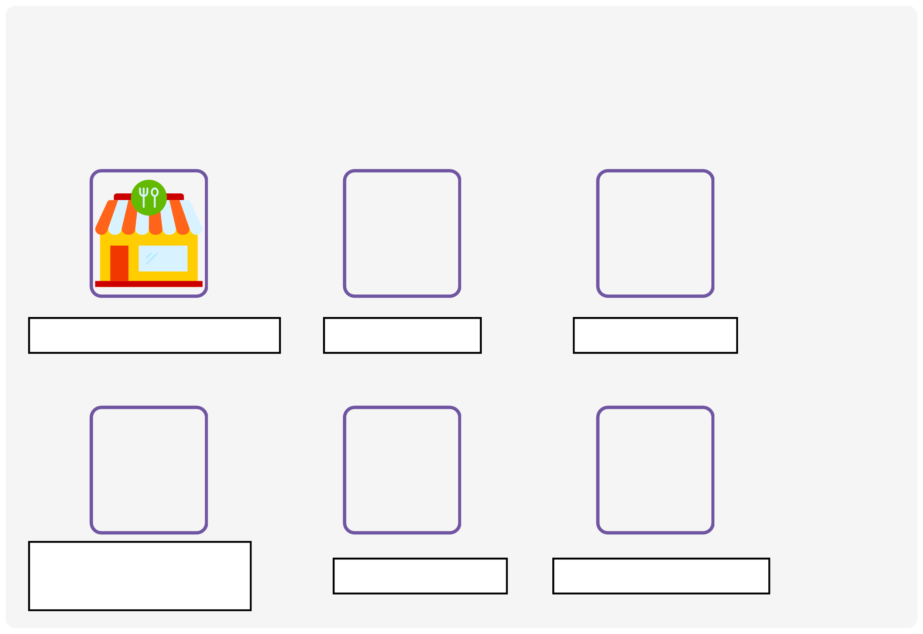
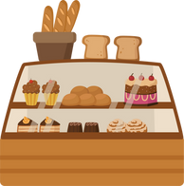
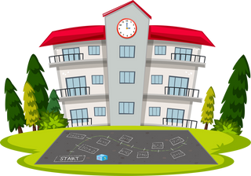
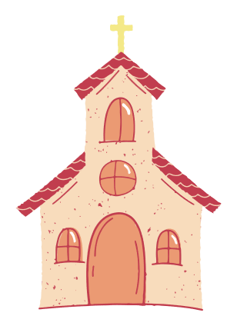
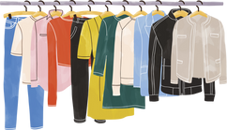
III. EXERCISES:
5. Write the missing letters:
R_ _ _ _ _ _ _ _
S_ _ _ _ _
B_ _ _ _ _
C_ _ _ _ _ _ _ store
C_ _ _ _ _
P_ _ _ _ _ _ _

Slide 10
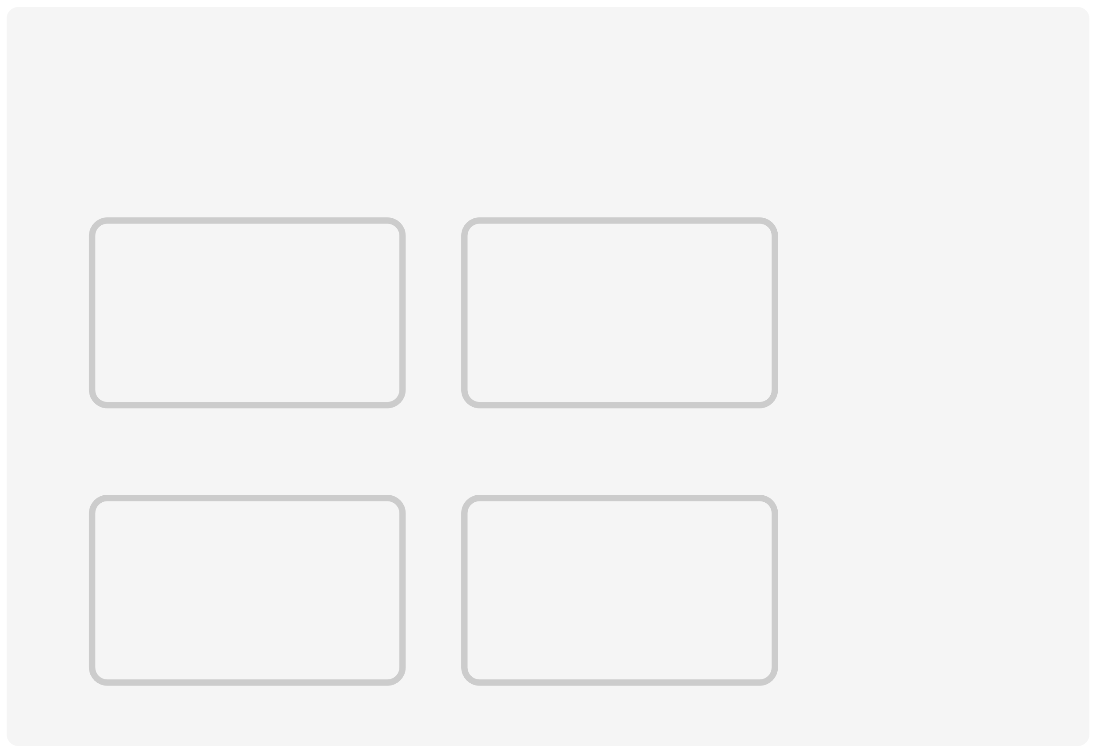

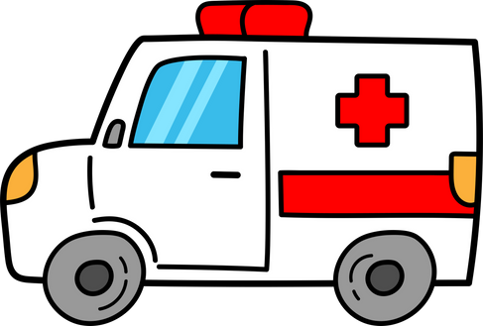
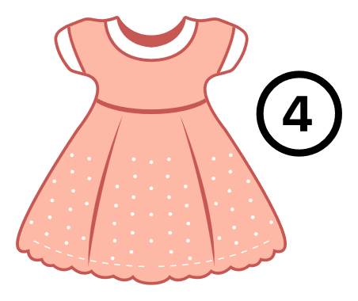

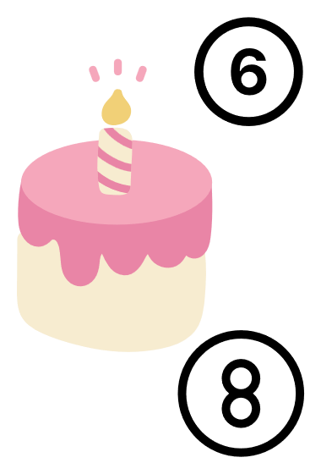
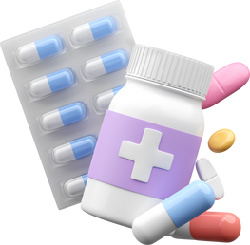
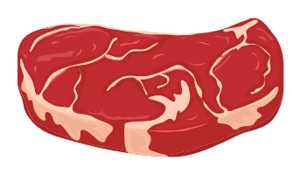
III. EXERCISES:
6. Classify the following things:
Supermarket
Clothing store
Bakery
Hospital

Slide 11
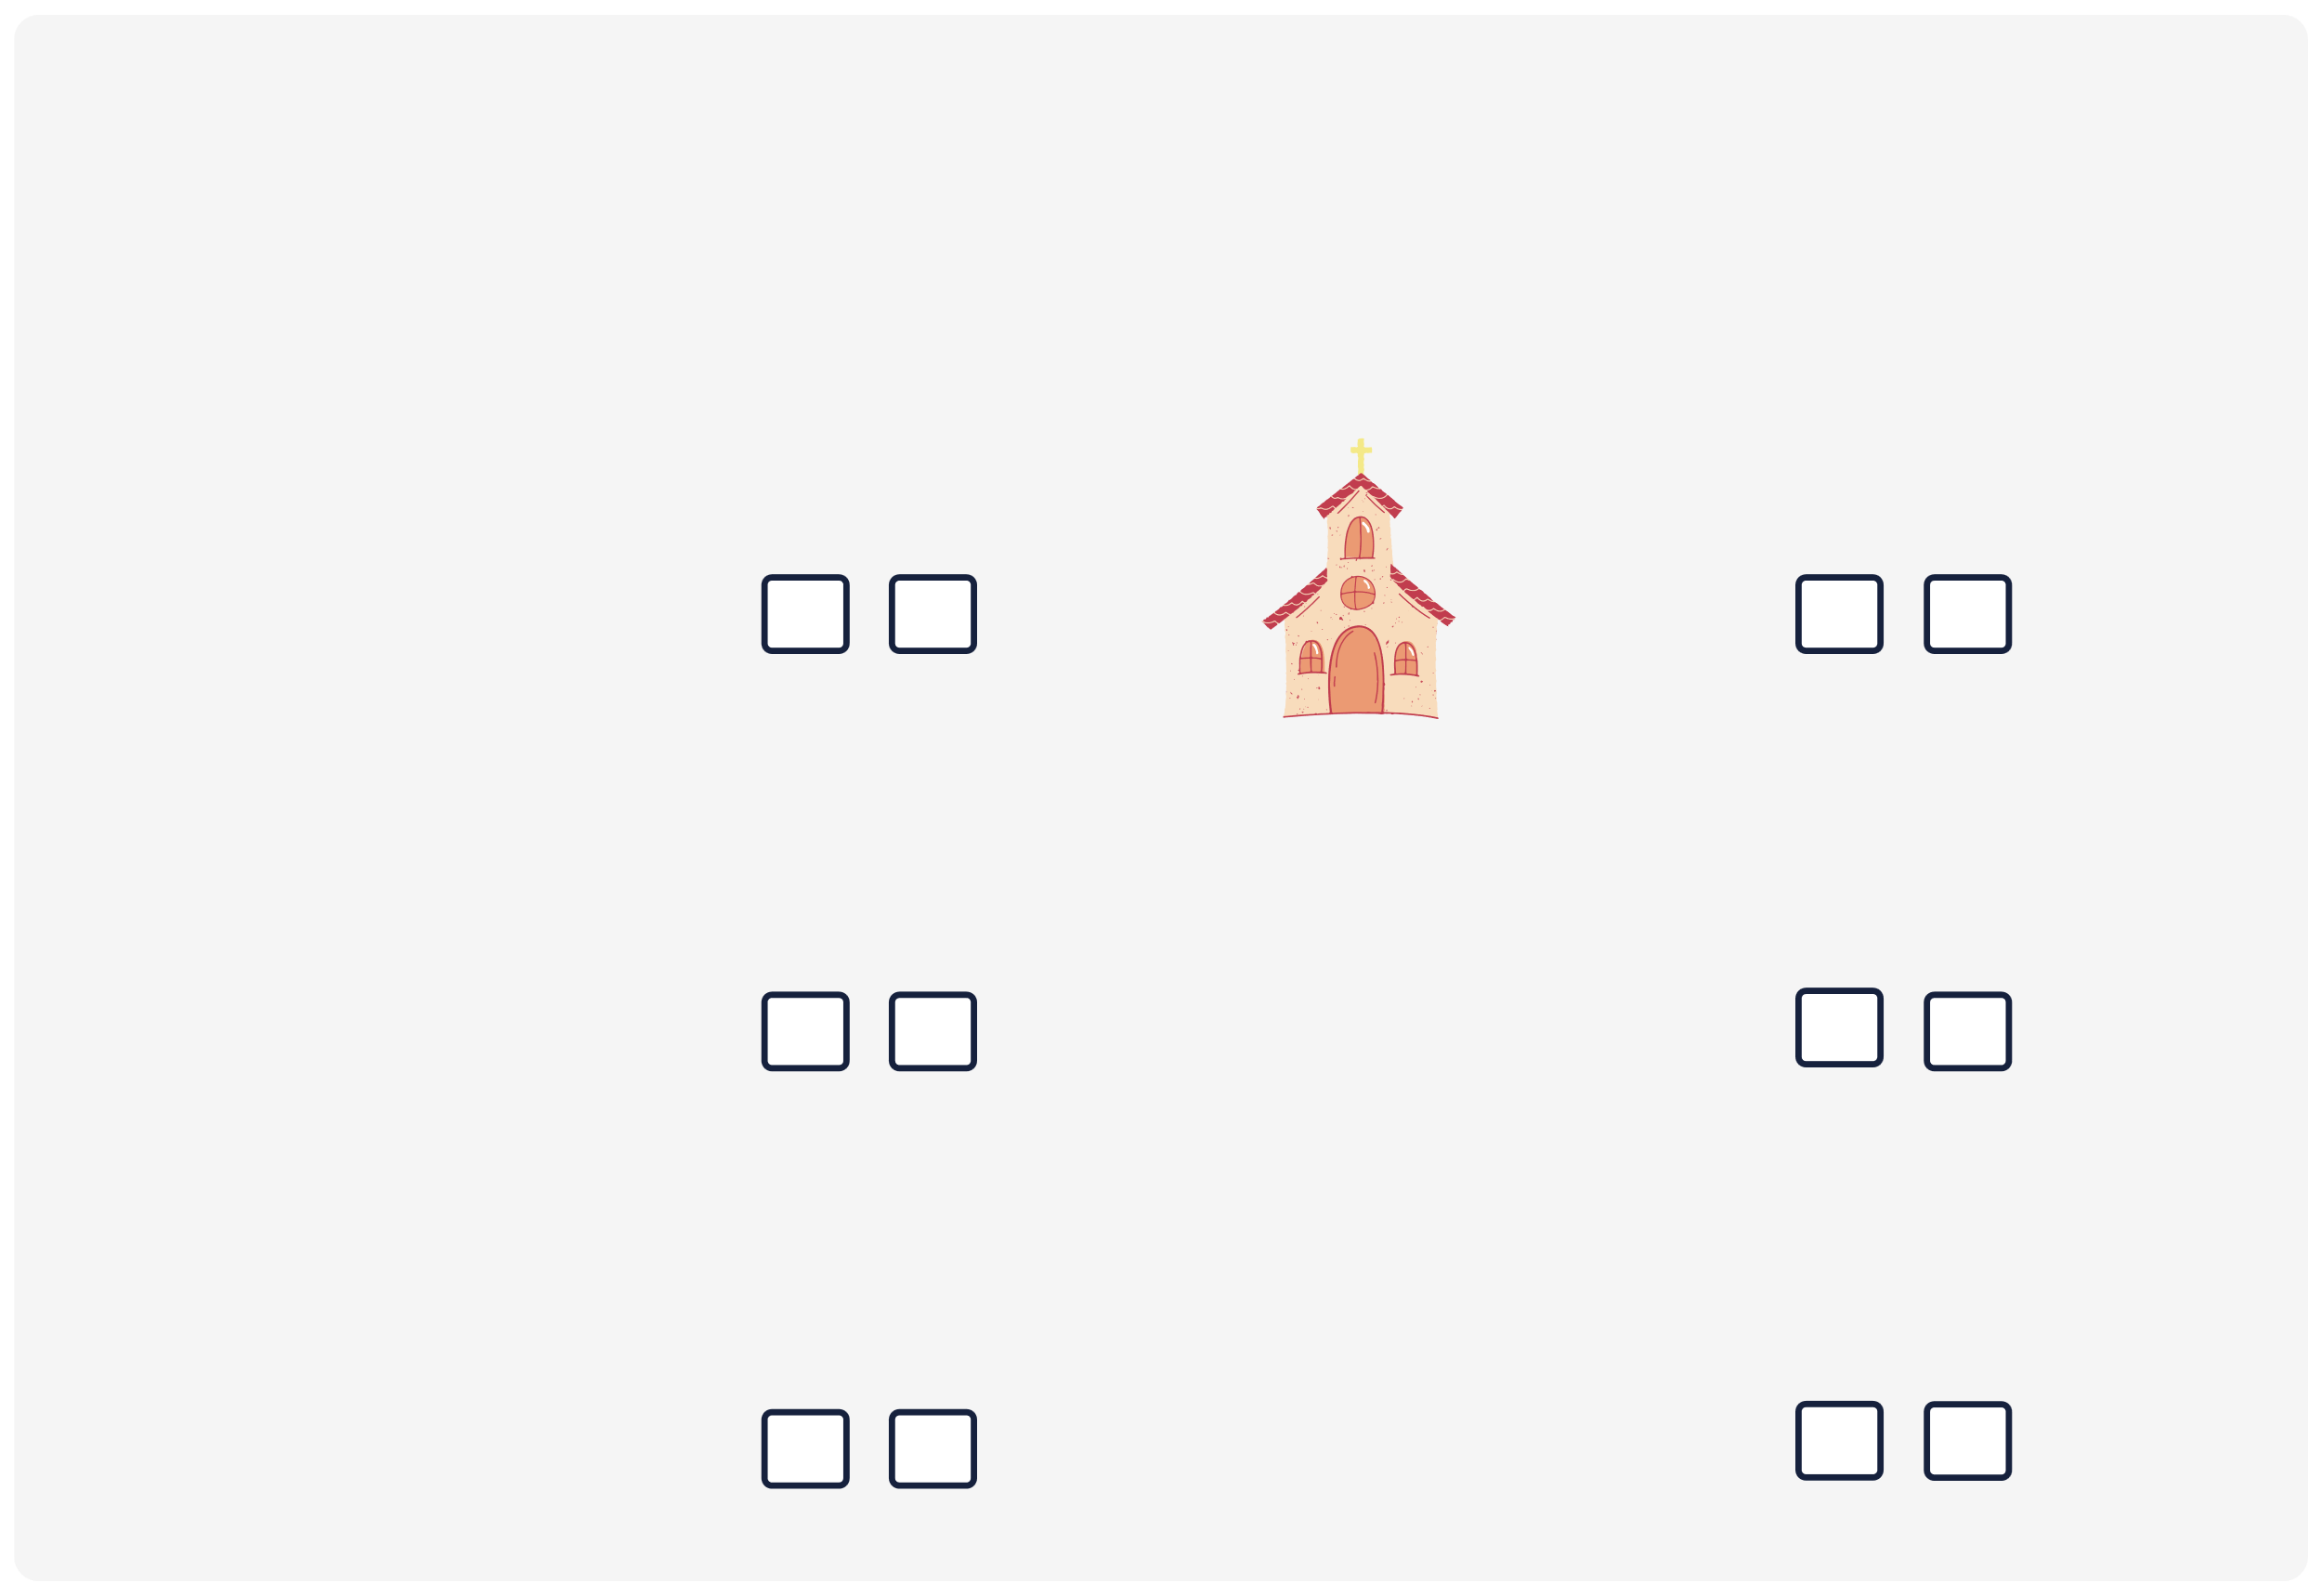
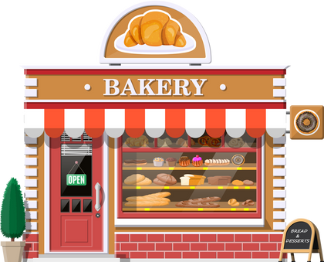

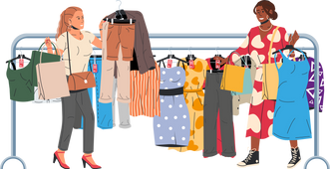
III. EXERCISES:
7. True or False:
Bakery
Hospital
School
Church
Pharmacy
Clothing store

Slide 12
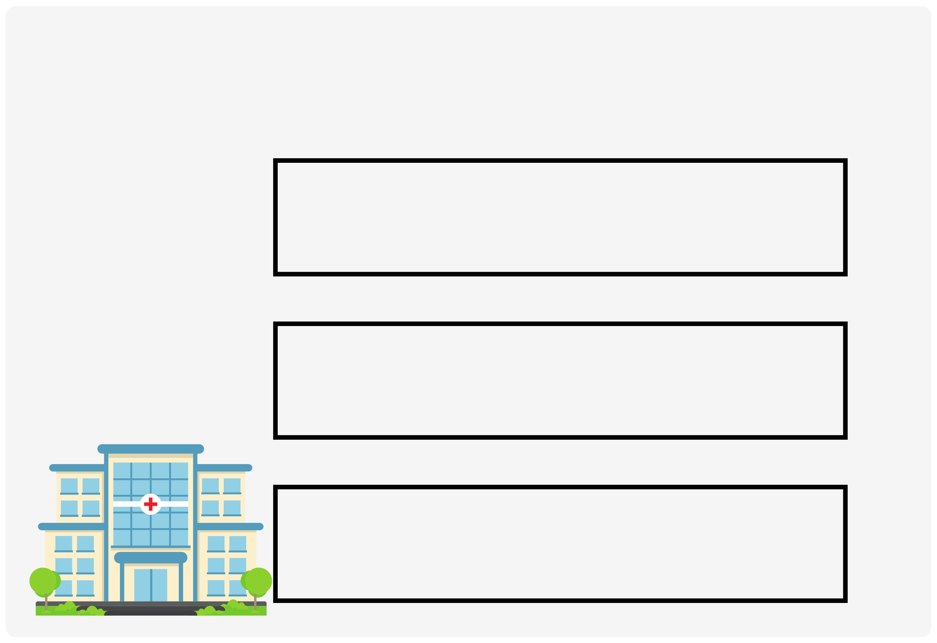
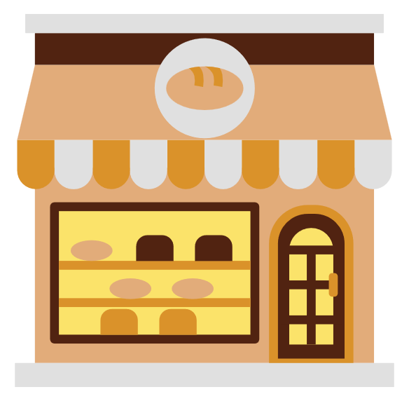
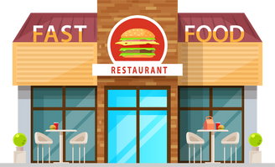
III. EXERCISES:
8. Look at the picture, circle the correct answer:
bakery
hospital
pharmacy
clothing store
restaurant
bakery
school
church
hospital

