Slide 1


Slide 2

Unit
9
1
Unit
FAMILY LIFE
Protecting the environment
LESSON 8
LOOKING BACK AND PROJECT

Slide 3

OBJECTIVES
To help students further revise sentence stress and practise speaking with a natural rhythm.
To help students revise the vocabulary items they have learnt in the unit.
To help students revise the use of reported speech.
To guide students to do research on a local or an international organization and give a group presentation about it.

Slide 4

LESSON 8
LOOKING BACK AND PROJECT
Unit
GETTING STARTED
WARM-UP
Video watching
PRONUNCIATION
PRONUCIATION: Listen and mark the stressed syllables in the words in bold.
VOCABULARY: Choose the correct word to complete each sentence.
VOCABULARY
GRAMMAR
GRAMMAR: Change the following sentences into reported speech.
PROJECT: Presentation
PROJECT
Homework
Wrap-up
Home work

Slide 5
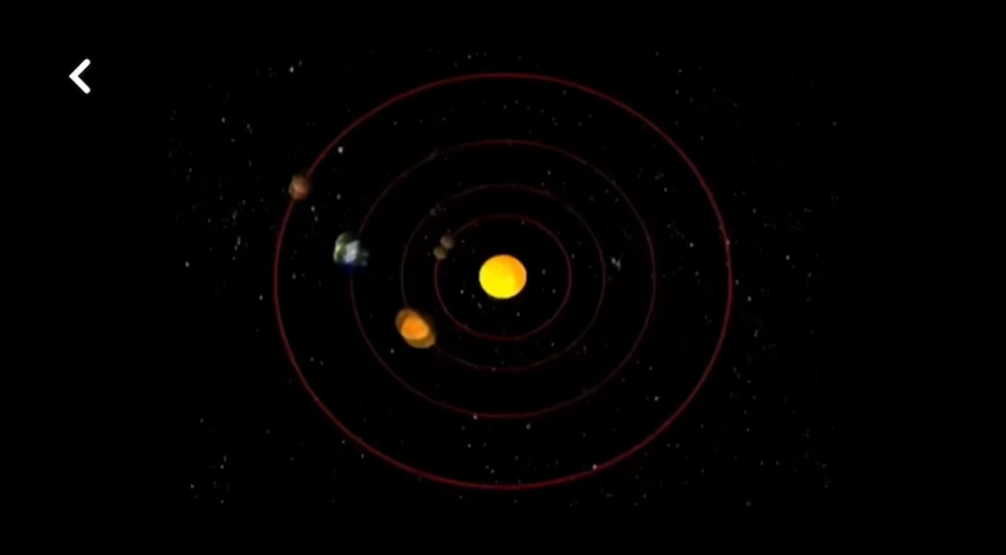
LESSON 8
LOOKING BACK AND PROJECT PROJE
Unit
GETTING STARTED
WARM-UP
Watch the video, take notes, then orally summarize the key points.

Slide 6
PRONUNCIATION
Listen and mark the stressed syllables in the words in bold. Then practise saying the sentences with a natural rhythm.
Don’t buy products that are made from wild animal parts.
What can we do to help the animals in the wild?
Large tigers tend to live in colder areas while smaller tigers live in warmer countries.
Elephants are endangered because of illegal hunting and body part trade.
Do you know why so many endangered animals are disappearing?

Slide 7
PRONUNCIATION
Answers:
1. 'Don’t 'buy 'products that are 'made from 'wild 'animal 'parts.
2. 'What can we 'do to 'help the 'animals in the 'wild?
3. 'Larger 'tigers tend to 'live in 'colder 'areas while 'smaller 'tigers 'live in 'warmer 'countries.
4. 'Elephants are en'dangered because of il'legal 'hunting and 'body 'part 'trade.
5. Do you 'know why so many en'dangered 'animals are disap'pearing?

Slide 8
VOCABULARY
Choose the correct word to complete each sentence.
Many wildlife habits/ habitats will be destroyed if people keep cutting down the forests.
Researchers are looking for ways to reduce the environmental impact/ affect of air pollution on the local community.
It is illegal to kill pandas, tigers or any other dangerous/ endangered animals.
Global warming/ climate is mainly caused by pollution and clearing of forests.

Slide 9
VOCABULARY
KEY:
Many wildlife habits/ habitats will be destroyed if people keep cutting down the forests.
Researchers are looking for ways to reduce the environmental impact/ affect of air pollution on the local community.
It is illegal to kill pandas, tigers or any other dangerous/ endangered animals.
Global warming/ climate is mainly caused by pollution and clearing of forests.

Slide 10
Grammar
Change the following sentences into reported speech
1.’The rising sea level is a result of global warming,’ the teacher explained.
2. ‘ I will take part in the competition next month,’ my friend told me.
3.’ The clearing and burning of forests lead to air pollution,’ the speaker said.
4.’Are you interested in joining the event this weekend, Minh?’ asked Tuan.
5.”When are you going to deliver your presentation on the environment, Mai?’ asked Nam.

Slide 11
Grammar
Suggested answers:
1. The teacher explained that the rising sea level was / is a result of global warming.
2. My friend told me that she would take part in the competition the following month.
3. The speaker said the clearing and burning of forests led / lead to air pollution.
4. Tuan asked Minh whether he was interested in joining the event that weekend.
5. Nam asked Mai when she was going to deliver the presentation on the environment.

Slide 12
PROJECT
PRACTICE
GROUP PRESENTATIONS ON AN ENVIRONMENTAL ORGANIZATION
Work in groups and get ready for your presentations on a local or an international environmental organization and assigned at the first lesson of unit 9.
Two or three groups give their presentations to the whole class.

Slide 13
GROUP PRESENTATION
Suggested checklist for peer assessment before delivering presentations:
 | Tick where appropriate | Comments (in English or Vietnamese)
DELIVERY
– The presenters greeted the audience
– The presenters spoke clearly and naturally
- The presenters cooperated when delivering their talk
- The presenters interacted with the audience.
– The presenters used some photos / pictures to illustrate organisation’s aims and activities.
- The presenters concluded their talk appropriately.
CONTENT: The presentation includes the following information about a local or an international environmental organisation:
– name
– when it was set up
– the organisation’s aims
– current activities

Slide 14
GROUP PRESENTATION
Suggested checklist for self-assessment after delivering presentations:
 | Tick where appropriate | Comments (in English or Vietnamese)
DELIVERY
– I greeted the audience
– I spoke clearly and naturally
- I cooperated with my group members when delivering the talk
- I interacted with the audience.
– I used some photos / pictures to illustrate organisation’s aims and activities.
- I concluded my part of the talk appropriately.
CONTENT: The presentation includes the following information about a local or an international environmental organisation:
– name
– when it was set up
– the organisation’s aims
– current activities

Slide 15
LESSON 8
LOOKING BACK AND PROJECT
Unit
GETTING STARTED
WARM-UP
Video watching
PRONUNCIATION
PRONUCIATION: Listen and mark the stressed syllables in the words in bold.
VOCABUIARY: Choose the correct word to complete each sentence.
VOCABULARY
GRAMMAR
GRAMMAR: Change the following sentences into reported speech.
PROJECT
PROJECT: Presentation
Homework
Wrap-up
Home work

Slide 16
CONSOLIDATION
1
Wrap-up
To help students further revise sentence stress and practise speaking with a natural rhythm.
To help students revise the vocabulary items they have learnt in the unit.
To help students revise the use of reported speech.
To guide students to do research on a local or an international organization and give a group presentation about it.

Slide 17
CONSOLIDATION
2
Homework
Do exercises in the Workbook

Slide 18


