Slide 1

Unit 6: Clothes
Lesson 4.1
Page 91

Slide 2
Lesson Outline
Warm-up
Vocabulary
Structure
Consolidation
Wrap-up

Slide 3
Objectives
By the end of this lesson, students will be able to talk about their school uniform.
Vocabulary: Uniform, polo shirt, sneakers, tie.
Structure: What do you wear at school?
I wear a blue tie.
Do you like your uniform?
Yes, I do./ No, I don’t.

Slide 4

WARM UP

Slide 5
Vocabulary
How to play?
- T calls out the words.
- Sts cross off ONE square that has the word.
- If you get the pattern, say BINGO, you win!
BINGO

Slide 6
Word list
dress shirt shorts
socks pants skirt
jacket jeans boots
T-shirt belt scarf
sweater pajamas skiing

Slide 7

Fill in this BINGO card with vocabulary from the list in slide 6

Slide 8
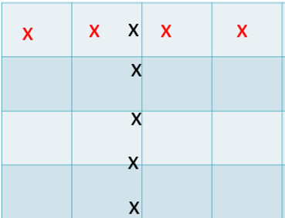
Any straight line pattern like this.

Slide 9

It’s time to learn …

Slide 10
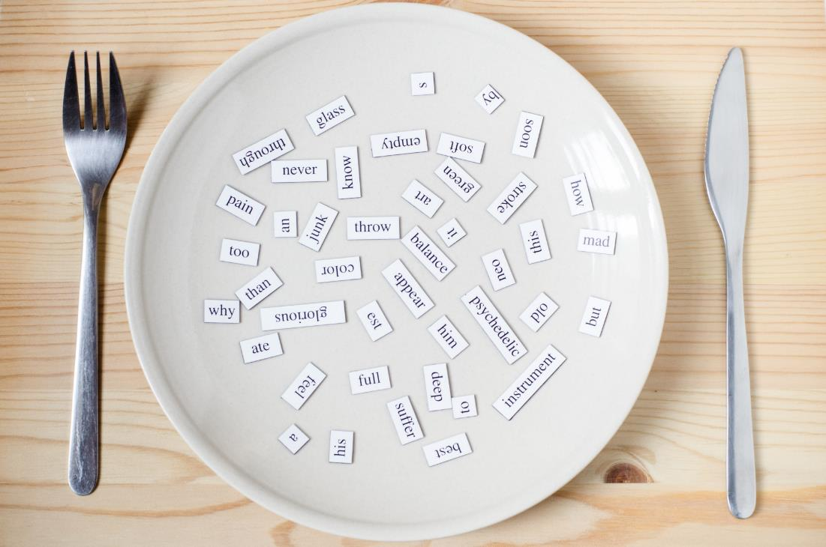
New words
uniform,
polo shirt,
sneakers,
tie.

Slide 11

Presentation

Slide 12


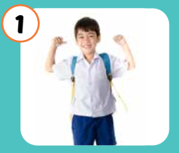
Click each word to hear the sound.
uniform
/ˈjuːnɪfɔːrm/
đồng phục

Slide 13
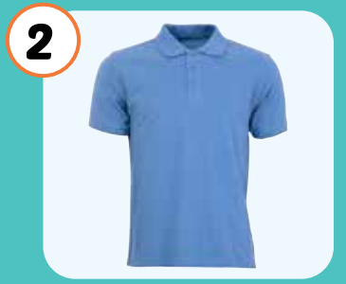
Click each word to hear the sound.
polo shirt
/ˈpəʊləʊ ʃɜːrt/
áo thun có cổ

Slide 14
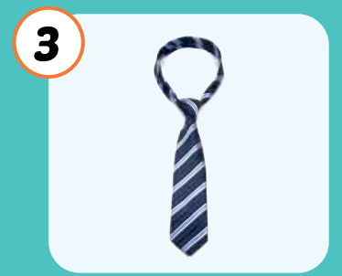
Click each word to hear the sound.
tie
/taɪ/
cà vạt

Slide 15
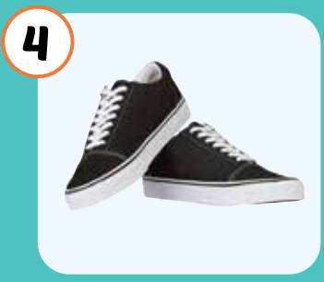
Click each word to hear the sound.
sneakers
/ˈsniːkərz/
giày thể thao

Slide 16
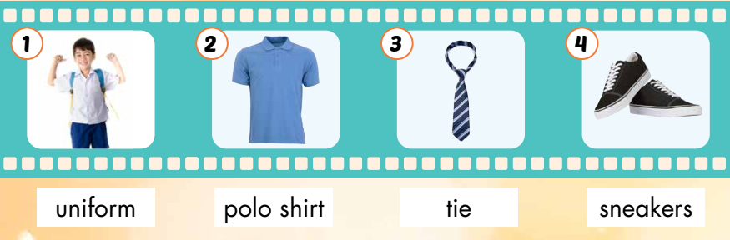
Click each picture to hear the sound.

Slide 17

Practice

Slide 18



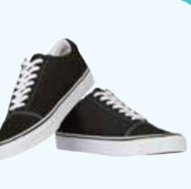
Listen and choose the correct picture.

Slide 19
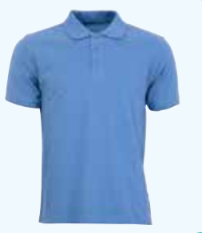
Listen and choose the correct picture.

Slide 20
Listen and choose the correct picture.

Slide 21
Listen and choose the correct picture.

Slide 22
What is it?
a tie
sneakers
a uniform
a polo shirt

Slide 23
What is it?
a tie
sneakers
a uniform
a polo shirt

Slide 24
What is it?
a tie
sneakers
a uniform
a polo shirt

Slide 25
What is it?
a tie
sneakers
a uniform
a polo shirt

Slide 26

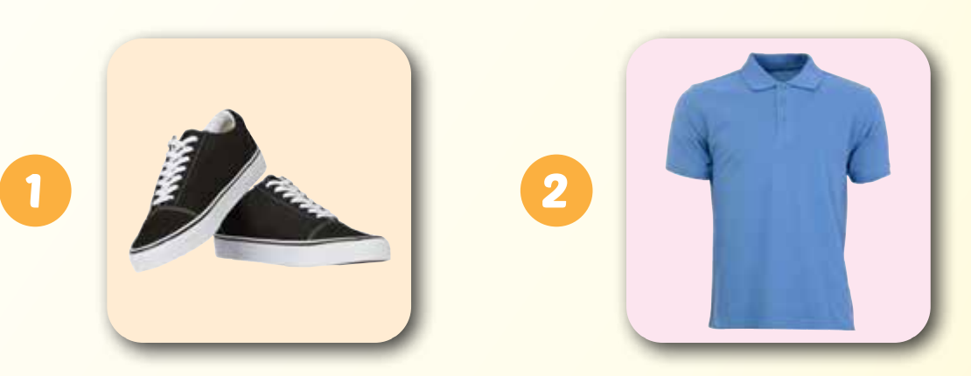
skanerse
loop thsri
sneakers
polo shirt

Slide 27
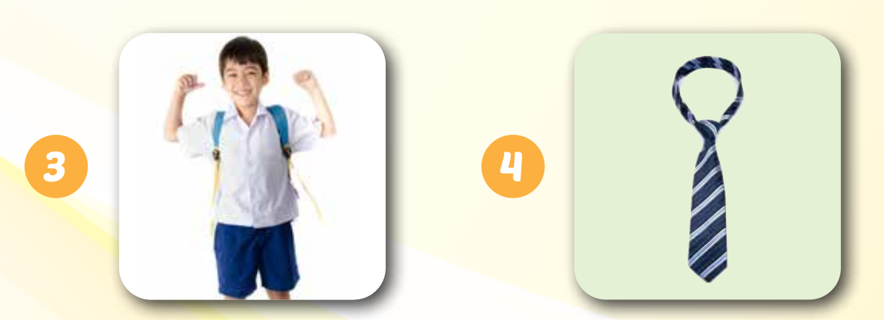
fmruoin
ite
uniform
tie

Slide 28
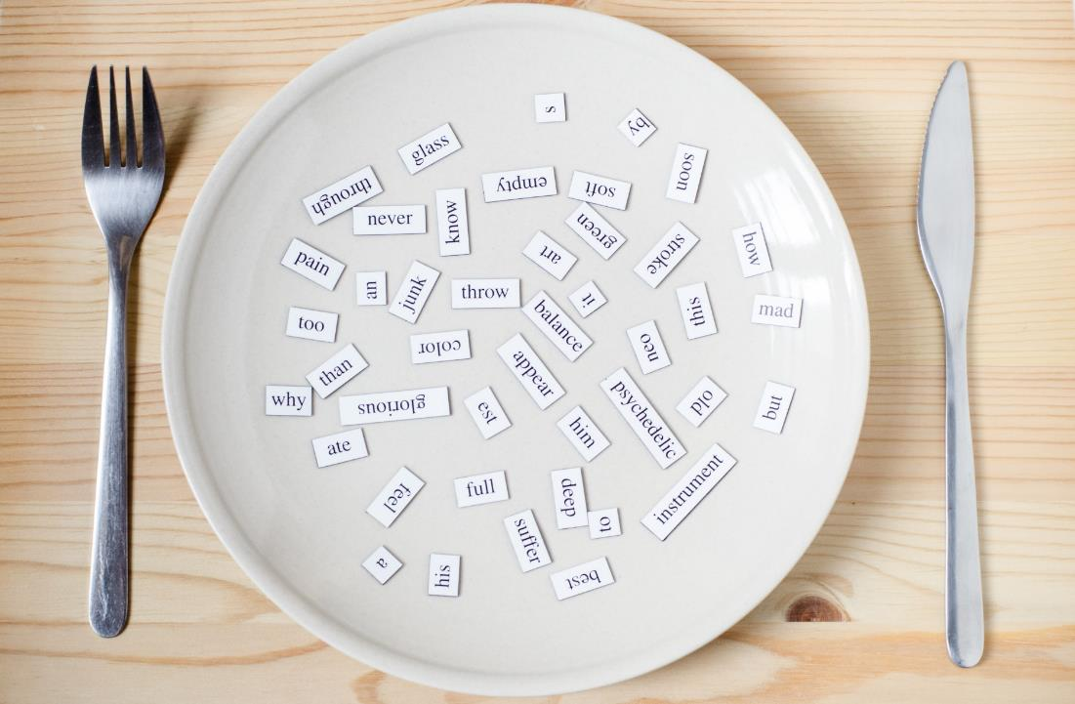
Structures
What do you wear at school?
I wear a blue tie.
Do you like your uniform?
Yes, I do.

Slide 29
Presentation

Slide 30

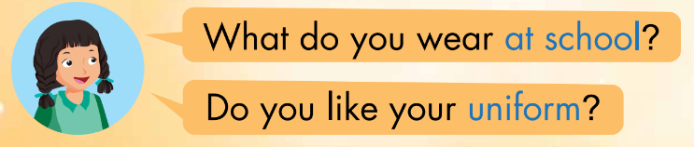
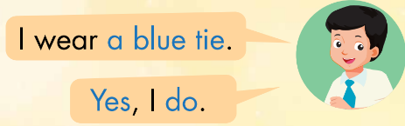
Click the earphone to hear the sound.

Slide 31
Practice

Slide 32

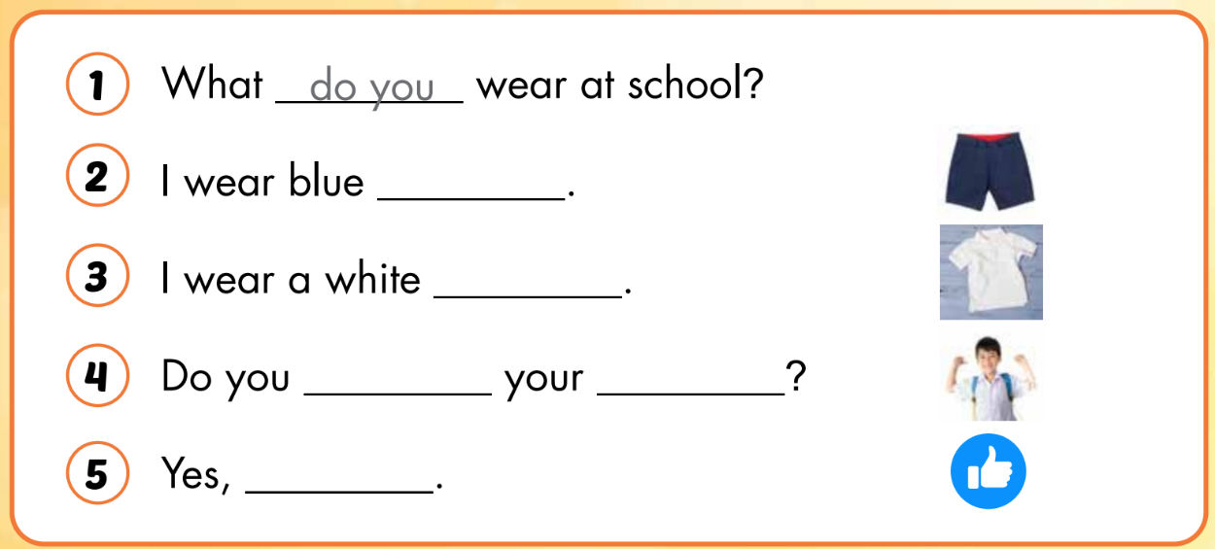
do you
shorts
polo shirt
like
uniform
I do

Slide 33

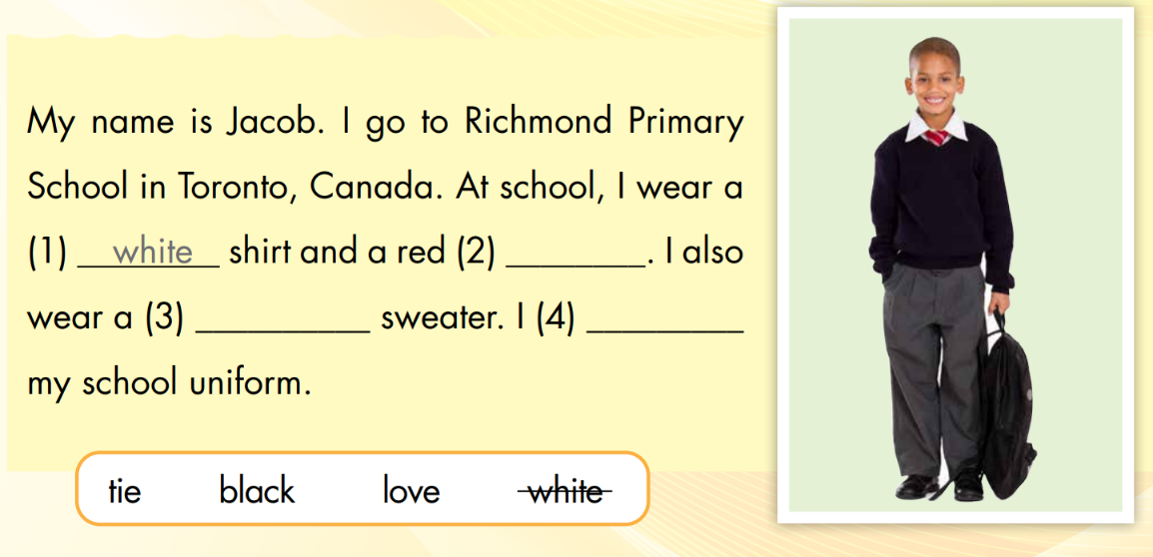
white
tie
black
love

Slide 34

CONSOLIDATION

Slide 35
tie
Áo thun có cổ
uniform
Giầy thể thao
polo shirt
Cà vạt
sneakers
Đồng phục

Slide 36
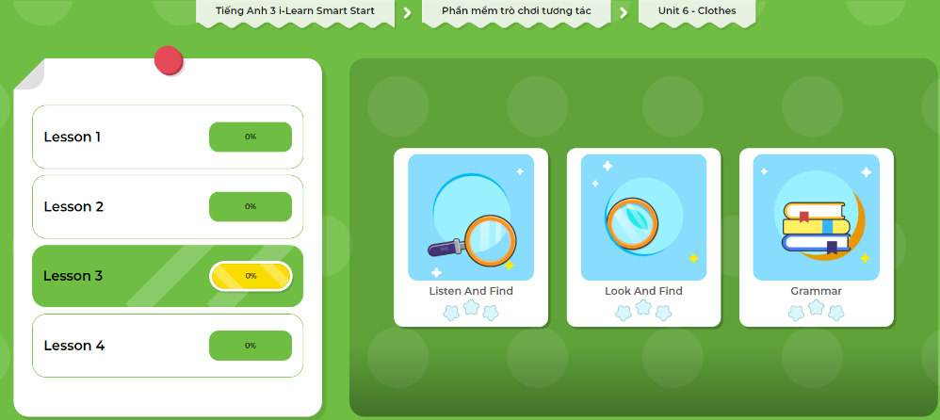
Extra Practice
DHA App
LET’S PLAY!
Click here to play the games

Slide 37

WRAP-UP

Slide 38
Lesson 3
Today’s lesson
Structures/ Sentence patterns
What do you wear at school?
I wear a blue tie.
Do you like your uniform?
Yes, I do.
Vocabularies
Uniform,
Polo shirt,
Sneakers,
Tie.

Slide 39
Lesson 3
Homework
Practice the vocabularies and structure; and make sentences using them.
Do the exercises in Tiếng Anh 3 i-Learn Smart Start WB (page 64).
Prepare the next lesson (page 92 SB).
Play the consolidation games in Tiếng Anh 3 i-Learn Smart Start DHA App on www.eduhome.com.vn

Slide 40
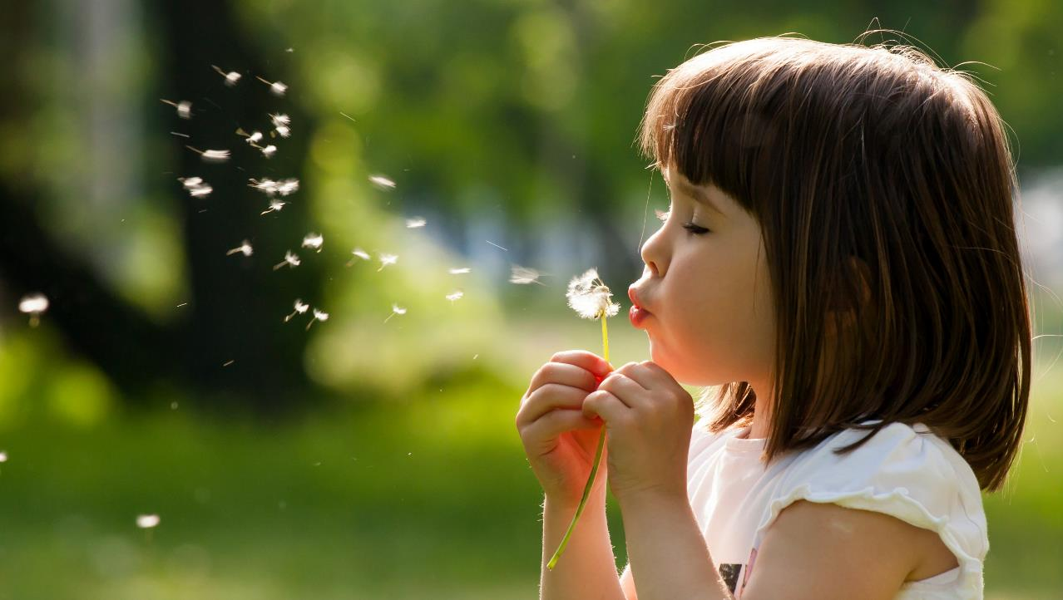
Enjoy your day!

