Slide 1

Unit 6: Be green
Lesson 6f: Skills (Cont.)
Page 105

Slide 2
Lesson Outline
Warm-up
LISTENING
Consolidation
Wrap-up

Slide 3
Objectives
By the end of this lesson, students will be able to…
- to learn vocabulary for and talk about volunteer tasks.
- to listen for key information.
- to write a diary entry about a volunteering holiday.

Slide 4

WARM-UP

Slide 5
Choose the word whose main stress is placed differently from that of the others. Practise saying them.
1. A. solution B. gorilla C. attraction D. stadium
/səˈluːʃən/ /ɡəˈrɪlə/ /əˈtrækʃən/ /ˈsteɪdiəm/
2. A. promote B. promise C. return D. attend
/prəˈməʊt/ /ˈprɒmɪs/ /rɪˈtɜːn/ /əˈtend/
3. A. electricity B. organisation C. deforestation D. environmental
/ˌelɪkˈtrɪsəti/ /ˌɔːɡənaɪˈzeɪʃən/ /diːˌfɒrɪˈsteɪʃən//ɪnˌvaɪrənˈmentəl/

Slide 6
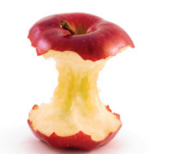
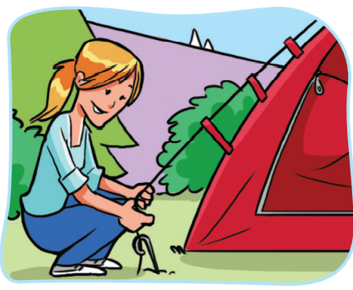

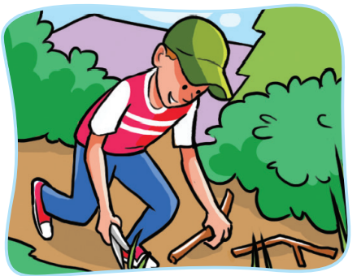
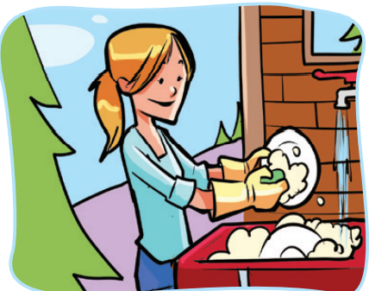

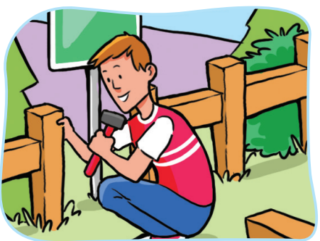
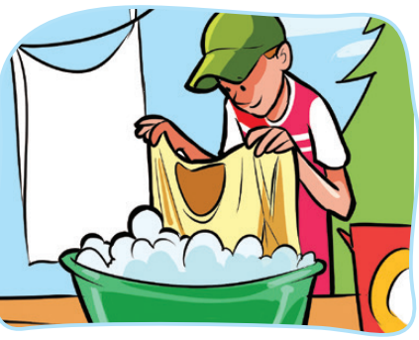
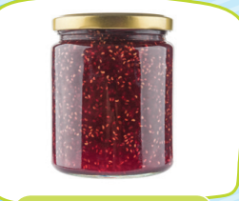


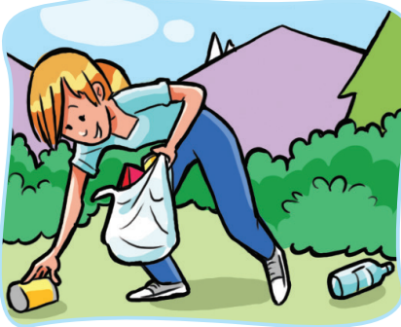
Work in groups. Each group choose an icon to see the picture behind the box. The pictures refer to the key word. The first group with the correct key word wins.
VOLUNTEER

Slide 7

It’s time to learn …

Slide 8

New words
set up tents,
clear trails,
do the washing-up,
pick up litter,
repair fences and signs,
do the laundry

Slide 9

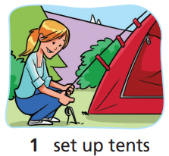
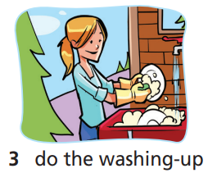
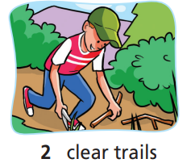
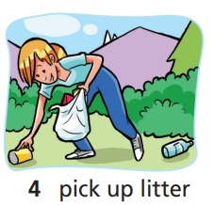
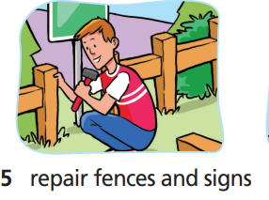
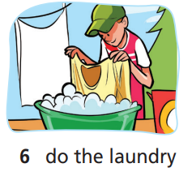
Work in pairs. Match the pictures with the correct words or phrases. Click on each phrase to hear the sound.
set up tents
clear trails
do the washing-up
pick up litter
repair fences and signs
do the laundry

Slide 10





Listen and repeat. Click each phrase to hear the sound.
set up tents (v phr) dựng lều
clear trails (v phr) /klɪə(r) treɪlz/ dọn lối đi
do the washing-up (v phr) rửa chén, rửa bát
pick up litter (v phr) nhặt rác
repair fences and signs (v phr) /rɪˈpeə fensiz ænd sainz/ sửa hàng rào và biển chỉ dẫn
do the laundry (v phr) giặt quần áo

Slide 11
Match the words in the left column to the words/phrases in the right column.
    set up
    clear
    do
    pick up
    repair
    do
the washing-up
fences and signs
litter
tents
the laundry
trails

Slide 12
Work in pairs. Student A says the first half of the phrase. Student B says the full phrase and then take your turns. Each student gets one point for every correct answer.
e.g. Student A: Do
Student B: Do the laundry
CHALLENGE GAME

Slide 13

PAIR-WORK
A: Clearing trails helps the environment/wildlife.
B: Doing the washing-up is a chore.
A: Picking up litter helps the environment/wildlife.
B: Repairing fences and signs helps the environment/wildlife.
A: Doing the laundry is a chore.

Slide 14

Listening

Slide 15
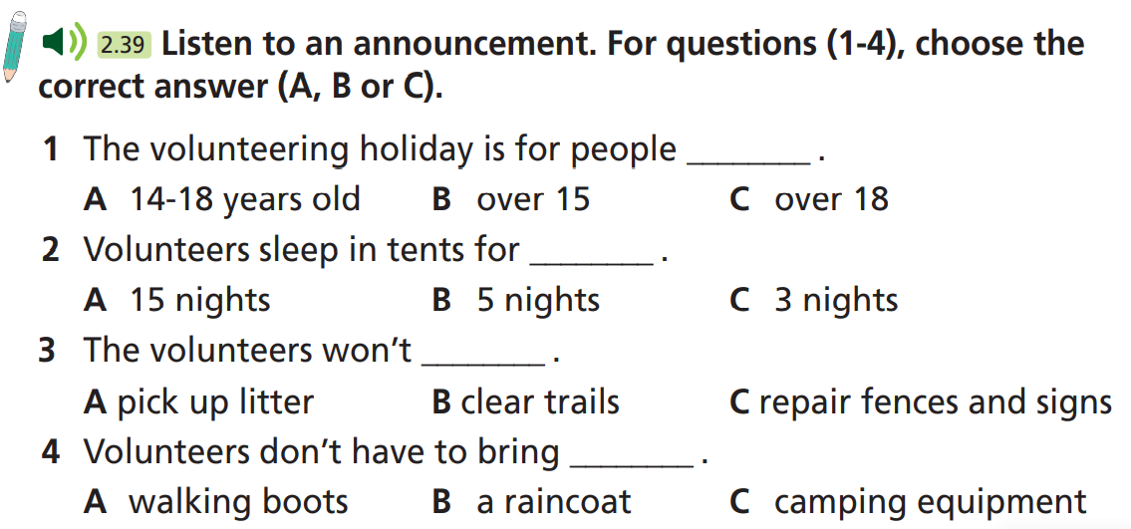
Pre-Listening
Read the instruction quickly. Underline the key words.

Slide 16

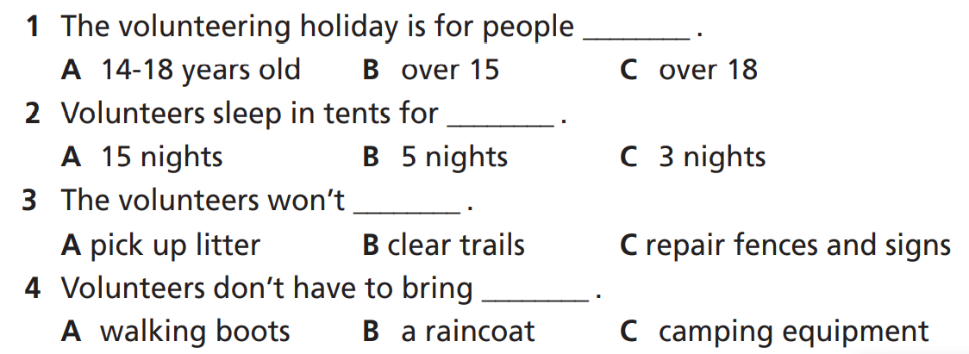
While-Listening
Now listen and choose the correct answer.  FIRST TIME
☞ WHY?

Slide 17

While - listening
Now listen again and check.  SECOND TIME
While you are listening, focus on what the speaker says.
So, this summer, we’re organising volunteering holidays for teenagers between the ages of 14 and 18.
☞ THE ANSWER IS …

Slide 18

While - listening
Now listen again and check.  SECOND TIME
While you are listening, focus on what the speaker says.
You’ll join a group of 15 other volunteers, and you’ll stay for five nights in tents in a campsite in the park.
☞ THE ANSWER IS …

Slide 19
While - listening
Now listen again and check.  SECOND TIME
While you are listening, focus on what the speaker says.
We’ll also provide three meals every day. Volunteers will repair fences and signs and pick up litter around the park.
☞ THE ANSWER IS …

Slide 20
While - listening
Now listen again and check.  SECOND TIME
While you are listening, focus on what the speaker says.
We’ll provide most of the things you’ll need – such as camping equipment – but bring walking boots and a raincoat.
☞ THE ANSWER IS …

Slide 21
Extra Task
Pre-listening
Read the instruction quickly. Underline the key words and the words before and after each gap.
☞ FIRST TIME
Listen and fill in the blanks with ONE WORD only.
Jack Moon works as a ranger for the Lake District National Park, England’s most popular national park. This summer, they are organising (1) __________ holidays for teenagers aged between 14 and 18. There are 16 volunteers in a group and they’ll stay for five nights in (2) __________ in a campsite in the park. Three meals are provided every day. Volunteers will repair fences and signs and pick up (3) __________ around the park. Camping equipment and other necessary things are also provided. However, the volunteers are required to bring walking boots and a (4) __________.

Slide 22
While - listening
Now listen again and check.  SECOND TIME
While you are listening, focus on what the speaker says.
So, this summer, we’re organising volunteering holidays for teenagers between the ages of 14 and 18.
☞ THE ANSWER IS …
Jack Moon works as a ranger for the Lake District National Park, England’s most popular national park. This summer, they are organising (1) _____________ holidays for teenagers aged between 14 and 18.
volunteering

Slide 23
While - listening
Now listen again and check.  SECOND TIME
While you are listening, focus on what the speaker says.
There are 16 volunteers in a group and they’ll stay for five nights in tents in a campsite in the park.
☞ THE ANSWER IS …
There are 16 volunteers in a group and they’ll stay for five nights in (2) __________ in a campsite in the park.
tents

Slide 24
While - listening
Now listen again and check.  SECOND TIME
While you are listening, focus on what the speaker says.
We’ll also provide three meals every day. Volunteers will repair fences and signs and pick up litter around the park.
☞ THE ANSWER IS …
Volunteers will repair fences and signs and pick up (3) _________ around the park
litter

Slide 25
While - listening
Now listen again and check.  SECOND TIME
While you are listening, focus on what the speaker says.
We’ll provide most of the things you’ll need – such as camping equipment – but bring walking boots and a raincoat.
☞ THE ANSWER IS …
However, the volunteers are required to bring walking boots and a (4) ________.
raincoat

Slide 26
Audio Scripts
Practise the talk.
My name’s Jack Moon and I work as a ranger for the Lake District National Park, England’s most popular national park. We’re doing our best to protect the park but we need your help. So, this summer, we’re organising volunteering holidays for teenagers between the ages of 14 and 18. You’ll join a group of 15 other volunteers, and you’ll stay for five nights in tents in a campsite in the park. We’ll also provide three meals every day. Volunteers will repair fences and signs and pick up litter around the park. We’ll provide most of the things you’ll need – such as camping equipment – but bring walking boots and a raincoat. To apply, email info@volunteers.org or call us at 0123-231-4162.

Slide 27

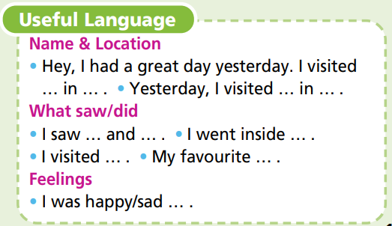
Post-Listening
Suggested ideas
What is the park’s name?
Where is it located?
What did you do?
What did you see?
How did you feel?

Slide 28
Post-Listening
SAMPLE
Last weekend, I went to Howletts national park in Kent. It was amazing! I saw a lot of animals there, but my favourite animals were the giraffes. I knew giraffes are tall, but I was still surprised about how tall they actually were! I picked up litter and fed the animals. I had a wonderful time! I was sad when it was time to go home, but I felt happy that I went there and helped. I can’t wait to go again!

Slide 29

CONSOLIDATION

Slide 30

Work in pairs and tell your partner about your imagined volunteering holiday.
What is the park’s name?
It’s Phong Nha - Kẻ Bàng National Park.
Where is it located?
Well, it is located in Quang Binh, Vietnam…

Slide 31

WRAP-UP

Slide 32
Today’s lesson
Vocabulary
set up tents
clear trails
do the washing-up
pick up litter
repair fences and signs
do the laundry
Language skills
Learn vocabulary for and talk about volunteer tasks.
Listen for key information.
Write a diary entry about a volunteering holiday.

Slide 33
Homework
Prepare the next lesson (page 106 SB).
Do the exercise in WB (page 53).
Do the exercise in TA 7 Right on Notebook (page 49).
Do Unit 6 Test 1 in Bài Tập Bổ Trợ TA 7 Right on
(pages 52 & 53).

Slide 34

Enjoy your day!

