Slide 1
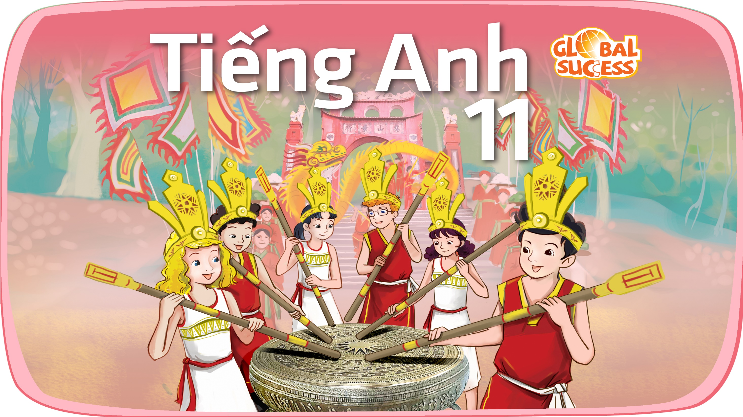

Slide 2
Unit
10
The ecosystem
Unit
FAMILY LIFE
LESSON 3
READING
U Minh Thuong – A unique national park

Slide 3
LESSON 3
READING
WARM-UP
Brainstorming
Quiz
PRE-READING
- Task 2. Read the article and match the headings (1-4) with the appropriate paragraph (A-D).
- Task 3. Read the article again and complete the sentences with no more than three words.
WHILE-READING
POST-READING
Discussion
Wrap-up
Homework
CONSOLIDATION

Slide 4
WARM-UP
QUIZ
- Work in 4 groups.
- Clues about national parks in Vietnam are shown on the slides.
- If you know the name of the national park ➔ say BINGO and grab the chance to answer.
- If the answer is correct ➔ one point.
- If the answer is incorrect ➔ the chance is for another team.
- The group with the highest points will be the winner.

Slide 5
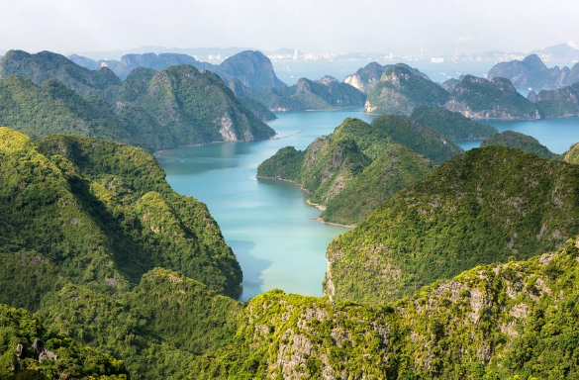
WARM-UP
Question 1
This national park has a favorable geographical position: bordering with Ha Long Bay, near Haiphong city and others Red River Delta provinces.
CAT BA NATIONAL PARK

Slide 6
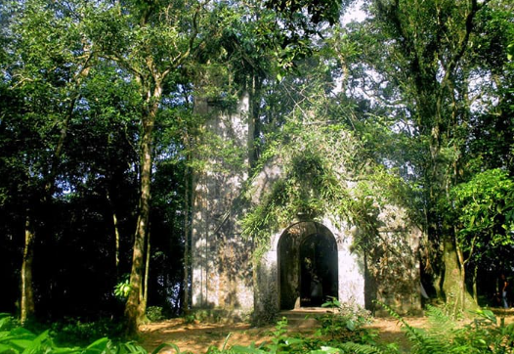
WARM-UP
Question 2
This national park has everything to offer, from an amazingly biodiverse area of tourist resorts, a string of mysterious French ruins to a host of intriguing mini-hikes and trekking trails.
BA VI NATIONAL PARK

Slide 7
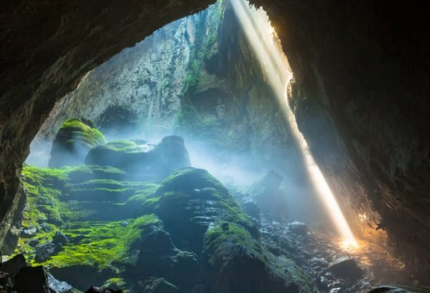
WARM-UP
Question 3
This is a national park and UNESCO World Heritage Site. It is approximately 500 km south of Hanoi or about 1,200 km north of Ho Chi Minh City.
PHONG NHA – KE BANG NATIONAL PARK

Slide 8
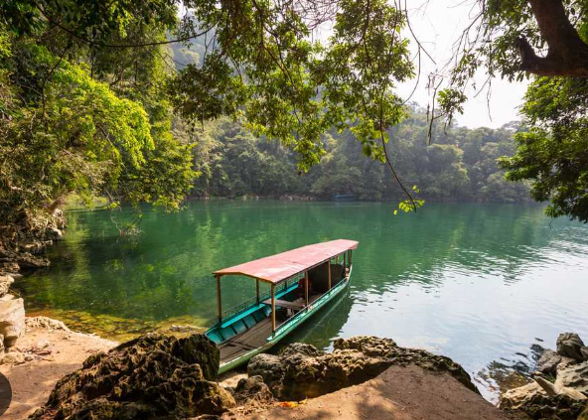
WARM-UP
Question 4
It is situated in Bac Can Province, about 240 km from Hanoi. It spans over 23,000 hectares of beautiful waterfalls, deep rivers, valleys, lakes and caves, all set amongst towering peaks.
BA BE NATIONAL PARK

Slide 9
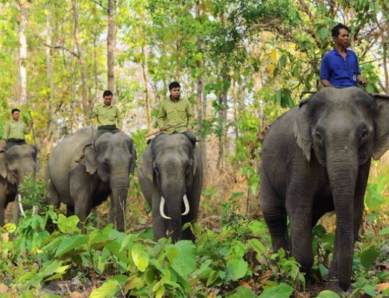
WARM-UP
Question 5
The park covers a flat plain that extends from eastern Cambodia into northern Dak Lak and southern Gia Lai provinces in Vietnam.
YOK DON NATIONAL PARK

Slide 10
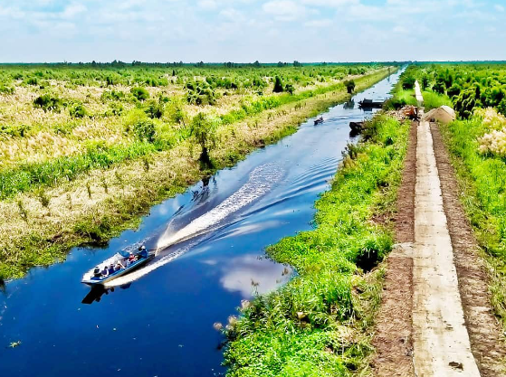
WARM-UP
Question 6
Located in Kien Giang Province, it is recognized as one of the three highest priority sites for wetland conservation in the Mekong Delta.
U MINH THUONG NATIONAL PARK

Slide 11
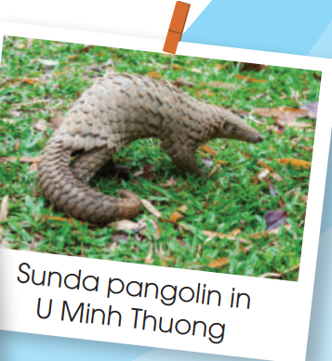
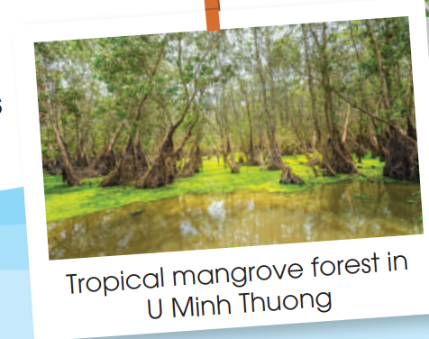
PRE-READING
1
Work in pairs. Look at the photos and discuss the questions.
+ Have you ever been to U Minh Thuong National Park? Where is it?
+ What did/can you see in the park?

Slide 12


PRE-READING
unique (adj)
/juˈniːk/
being the only one of its kind

Slide 13
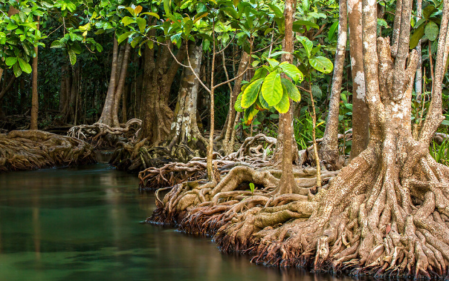
PRE-READING
mangrove (n)
/ˈmæŋɡrəʊv/
a tropical tree that grows in mud or at the edge of rivers and has roots that are above ground

Slide 14
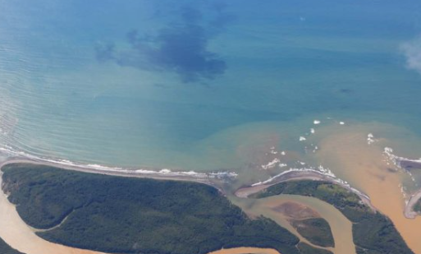
PRE-READING
delta (n)
/ˈdeltə/
an area of land, like a triangle in shape, where a river has split into several smaller rivers before entering the sea

Slide 15
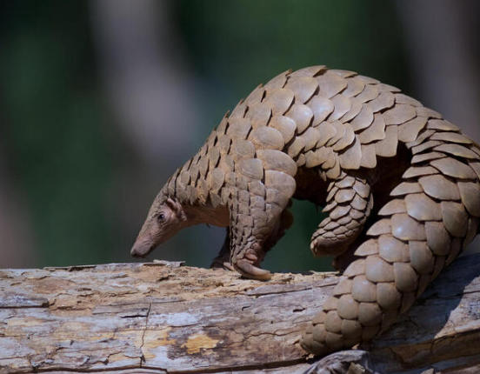
PRE-READING
pangolin (n)
/pæŋˈɡəʊlɪn/
a small animal from Africa or Asia that eats insects, and has a long nose, tongue and tail, and hard scales on its body

Slide 16
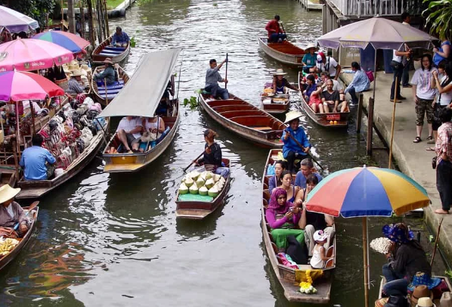
PRE-READING
floating (adj)
/ˈfləʊtɪŋ/
staying on or near the surface of a liquid and not sink

Slide 17
PRE-READING
Form | Pronunciation | Meaning | Vietnamese equivalent
1. unique (adj) | /juˈniːk/ | being the only one of its kind | Độc đáo
2. mangrove (n) | /ˈmæŋɡrəʊv/ | a tropical tree that grows in mud or at the edge of rivers and has roots that are above ground | Cây đước
3. delta (n) | /ˈdeltə/ | an area of land, like a triangle in shape, where a river has split into several smaller rivers before entering the sea | Đồng bằng
4. pangolin (n) | /pæŋˈɡəʊlɪn/ | a small animal from Africa or Asia that eats insects, and has a long nose, tongue and tail, and hard scales on its body | Con tê tê
5. floating (adj) | /ˈfləʊtɪŋ/ | staying on or near the surface of a liquid and not sink | Nổi

Slide 18
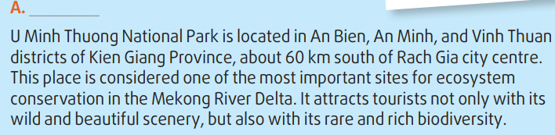
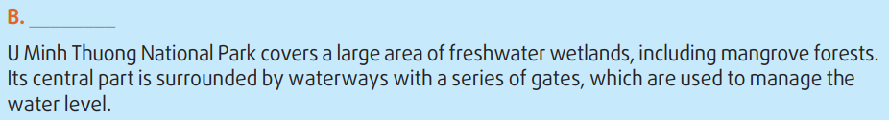
WHILE-READING
2
Read the article and match the headings (1-4) with the appropriate paragraph (A-D)
3. Location
4. Geography

Slide 19
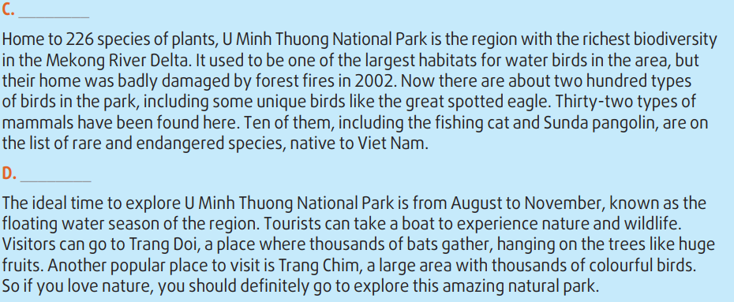
WHILE-READING
2
Read the article and match the headings (1-4) with the appropriate paragraph (A-D)
1. Flora and fauna
2. Best time to visit

Slide 20
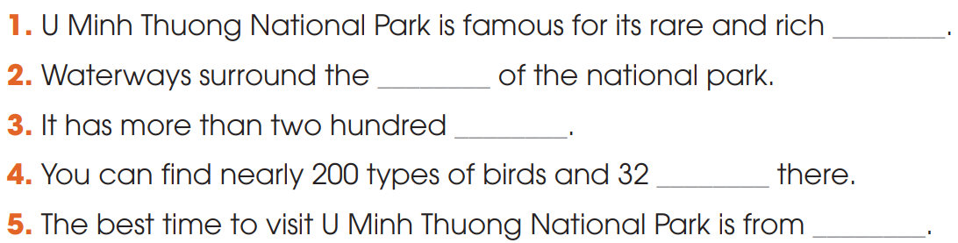
WHILE-READING
3
Read the article again and complete the sentences with no more than three words.
biodiversity
central part
mammal species
species of plants
August to November

Slide 21
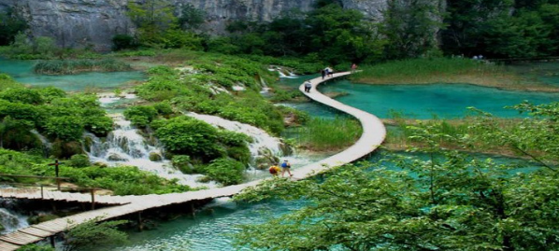
POST-READING
5
Discussion
Why do we need national parks?
What should we do to protect them?

Slide 22
CONSOLIDATION
1
Wrap-up
What have you learnt today?
Some lexical items about U Minh Thuong National Park;
Reading for main ideas and specific information

Slide 23
CONSOLIDATION
2
Homework
Do exercises in the workbook.
Prepare for Lesson 4 - Unit 10.

Slide 24

Website: hoclieu.vn
Fanpage: facebook.com/sachmem.vn/

