Slide 1

Unit 5: London Was Great!
Lesson 5e: Grammar
Page 95

Slide 2
Lesson Outline
Warm-up
Grammar
Consolidation
Wrap-up

Slide 3
Objectives
By the end of this lesson, students will be able to…
- practise the Past Simple.

Slide 4

WARM-UP

Slide 5
Match questions to the answers
What did you have for dinner yesterday?
When I was 6 years old.
I had rice, fish, and chicken soup.
Where did you go for your last holiday?
No, I didn’t.
When did you start school?
Did you get up early yesterday?
Yes, I was.
Were you at home yesterday morning?
I went to Nha Trang last holiday.

Slide 6
Write the correct Past Simple form of the following verbs:
met
meet: __________________
fly: ____________________
play: ___________________
promise: _________________
stop: ____________________
eat: ____________________
pay: ____________________
come: __________________
flew
played
promised
stopped
ate
paid
came

Slide 7

It’s time to learn …

Slide 8
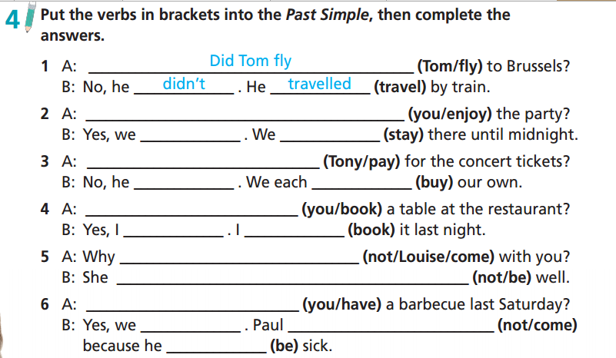
Did you enjoy
did
stayed
Did Tony pay
didn’t
bought
Did you book
did
booked
didn’t Louise come
wasn’t
Did you have
did
didn’t come
was

Slide 9
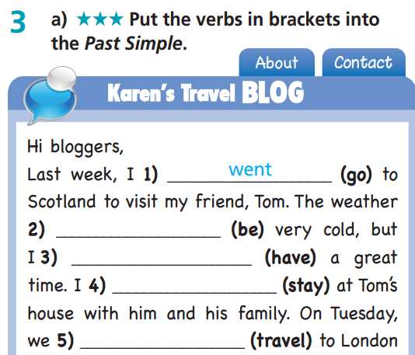
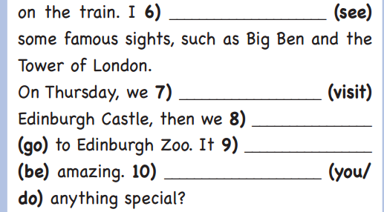
Extra-practice
WB-P. 48
saw
was
visited
had
went
stayed
was
Did you do
travelled

Slide 10
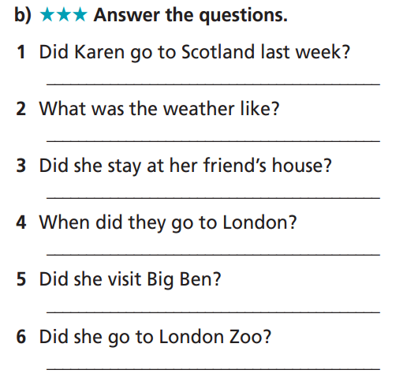
Extra-practice
WB-P. 48
Yes, she did.
It was very cold.
Yes, she did.
They went to London last Tuesday.
Yes, she did.
No, she didn’t.

Slide 11
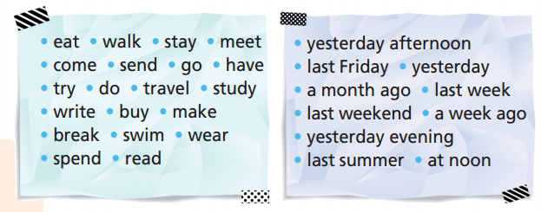
Work in pairs. Each student choose a verb/phrase and read it out loud. The other student must make a sentence with that verb/phrase.
A: Yesterday afternoon.
B: Yesterday afternoon, I played football with my friends at the park.

Slide 12



Slide 13
Suggested Answer:
A: Did you walk to school last Friday?
B: No, I didn’t. Did you read a book yesterday?
A: Yes, I did. Did you meet Jane a month ago?
B: Yes, I did. Did you come home late yesterday evening?
A: Yes, I did. Did you send a parcel last weekend?
B: No, I didn’t. Did you go to France a week ago?
A: No, I didn’t. Did you have dinner yesterday evening?
B: Yes, I did. Did you try sailing last summer?
A: Yes, I did. Did you do your homework at noon?
B: No, I didn’t. etc.

Slide 14
Choose the best answer from A, B, C.
_________ did you do yesterday? - I went shopping.
Who
Where
What

Slide 15
Choose the best answer from A, B, C.
2. Last year, I ________ 10 years old.
A. am
B. was
C. were

Slide 16
Choose the best answer from A, B, C.
3. _________ were they? - They were in the garden.
Where
When
What

Slide 17
Choose the best answer from A, B, C.
4. _________ time did you go to bed? - I went to bed at 11 p.m.
Why
How
What

Slide 18
Choose the best answer from A, B, C.
5. I _________ to Greece 3 years ago.
go
am going
went

Slide 19
Choose the best answer from A, B, C.
6. I _________ Alice in town a few days ago.
see
saw
sees

Slide 20
Choose the best answer from A, B, C.
7. What _________ you _________ last weekend?
were/do
did/did
did/do

Slide 21
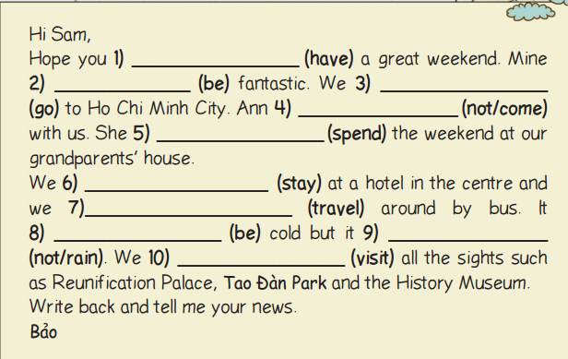
had
was
went
didn’t come
spent
stayed
travelled
was
didn’t rain
visited

Slide 22

CONSOLIDATION

Slide 23
Write a letter to your friend and tell him/her about your last weekend.
Dear…,
Hope you had a great weekend. Mine was ……………. (great/ funny/ fantastic). I went to ……….. with ……
Your name

Slide 24
Dear Trung,
Hope you had a great weekend. Mine was great. I went shopping with my friend at Diamond Plaza. We went there by bus. After that, we walked to the bookstore. I bought some comic books, and my friend bought some CDs. We also had ice cream at a café near the bookstore. We took a taxi to go home because we missed the bus. Next time, I hope you will join us.
Write back and tell me your news.
Tuan Anh

Slide 25

WRAP-UP

Slide 26
Today’s lesson
Grammar
Practise Past Simple.

Slide 27
Homework
Practise the grammar and make sentences using them.
Do the exercises in TA 6 Right on WB (p. 48).
Prepare the next lesson (p. 96 SB).

Slide 28

Enjoy your day!

