Slide 1
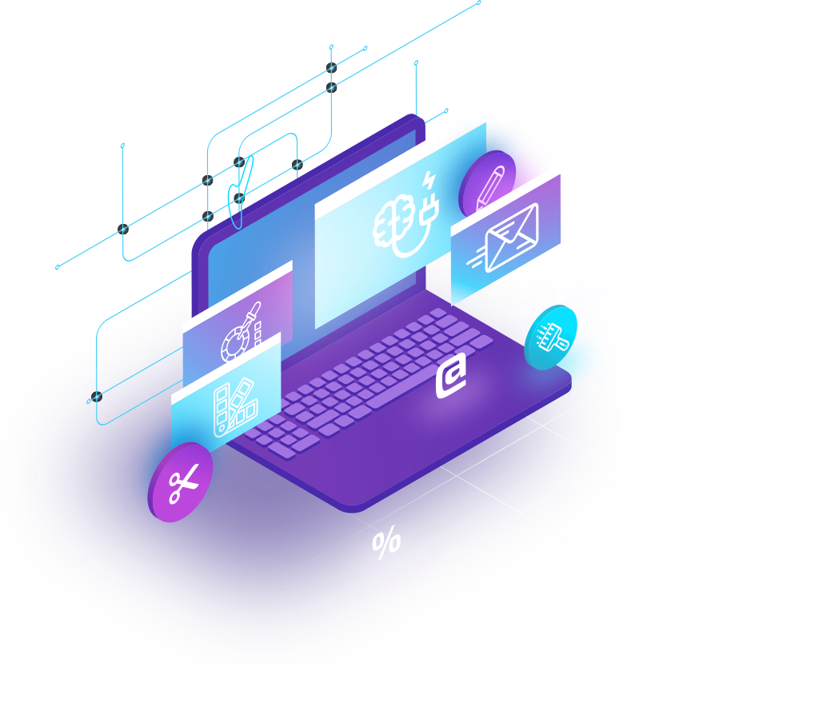
COMPUTER ENGINEERING TECHNOLOGY
JUST USE IT

Slide 2
CONTENTS OF THIS TEMPLATE
Here’s what you’ll find in this Slidesgo template:
A slide structure based on a multi-purpose presentation for education, which you can easily adapt to your needs. For more info on how to edit the template, please visit Slidesgo School or read our FAQs.
An assortment of graphic resources that are suitable for use in the presentation can be found in the alternative resources slide.
A thanks slide, which you must keep so that proper credits for our design are given.
A resources slide, where you’ll find links to all the elements used in the template.
Instructions for use.
Final slides with:
The fonts and colors used in the template.
A selection of illustrations. You can also customize and animate them as you wish with the online editor. Visit Storyset to find more.
More infographic resources, whose size and color can be edited.
Sets of customizable icons of the following themes: general, business, avatar, creative process, education, help & support, medical, nature, performing arts, SEO & marketing, and teamwork.
You can delete this slide when you’re done editing the presentation.

Slide 3
TABLE OF CONTENTS
About hardware
About software
1
2
Compilers
Operating systems
3
4
You can describe the topic of the section here
You can describe the topic of the section here
You can describe the topic of the section here
You can describe the topic of the section here

Slide 4
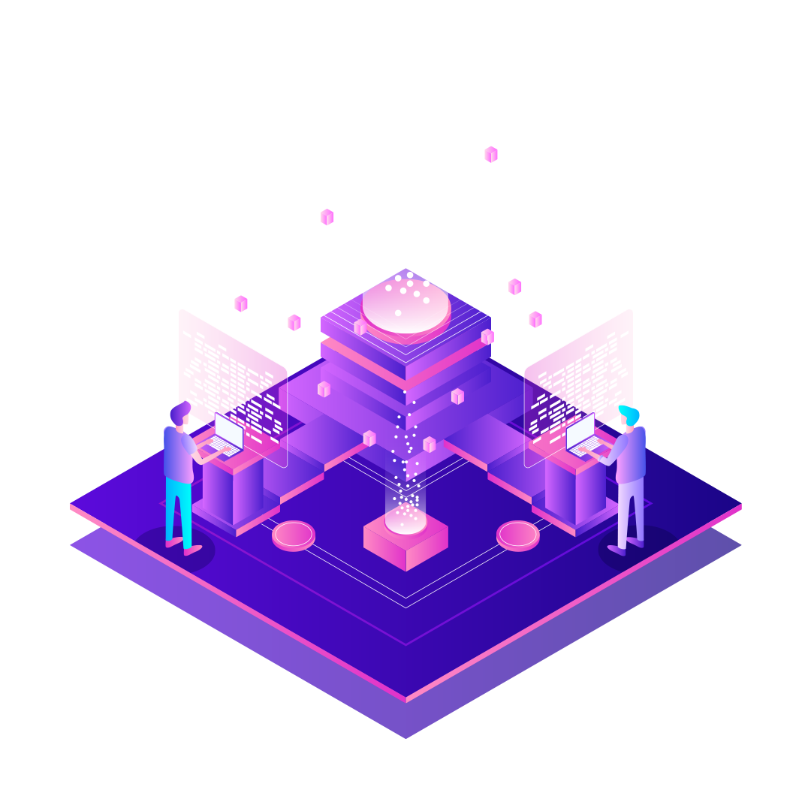
Whoa!
This can be the part of the presentation where you introduce yourself, write your email…

Slide 5
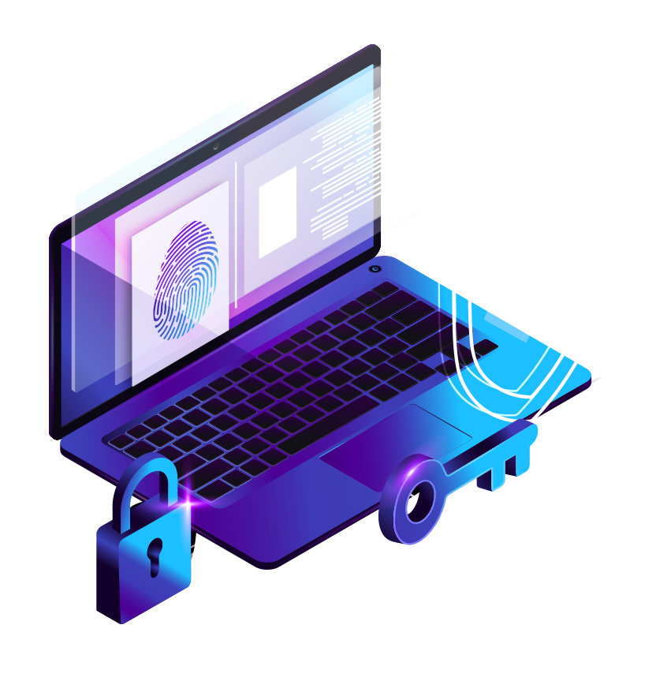
1
HARDWARE
You can enter a subtitle here if you need it

Slide 6
PROCESSOR DESIGN
Mercury
Venus
Mars
It’s the closest planet to the Sun and the smallest in the Solar System
Venus has a beautiful name and is the second planet from the Sun
Despite being red, Mars is actually a cold place. It’s full of iron oxide dust

Slide 7
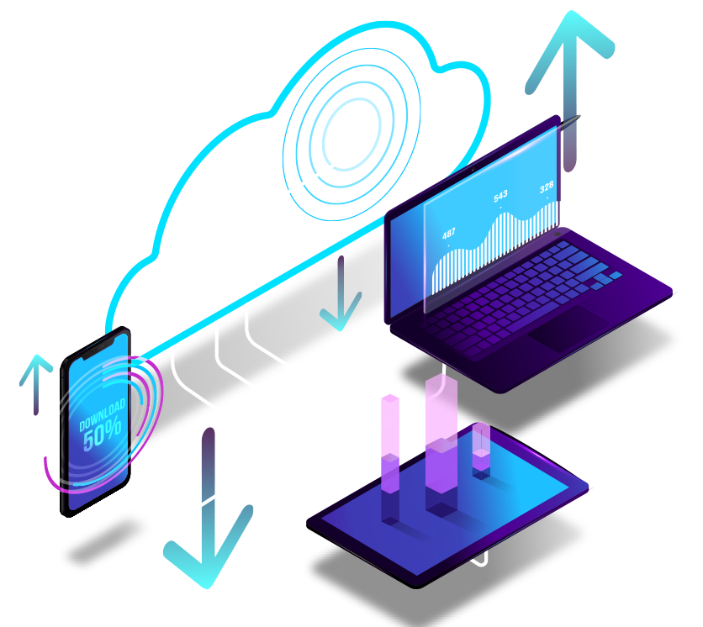
SOFTWARE ENGINEERING
Do you know what helps you make your point clear? Lists like this one:
They’re simple
You can organize your ideas clearly
You’ll never forget to buy milk!
And the most important thing: the audience won’t miss the point of your presentation

Slide 8
APPLICATIONS AND SOFTWARE
Mercury
Venus
Mercury is the closest planet to the Sun and the smallest one in the Solar System
Venus has a beautiful name, but the temperatures there are extremely high

Slide 9
OPERATING SYSTEMS
Mars
Venus
Jupiter
Saturn
Mars is actually a very cold place
It’s the second planet from the Sun
It’s the biggest planet of them all
Saturn is a gas giant and has rings

Slide 10
WIRELESS NETWORKS
Mars
Venus
Neptune
Mercury
Saturn
Jupiter
Mars is actually a very cold place
It’s the second planet from the Sun
Neptune is very far away from us
It’s the closest planet to the Sun
Saturn is a gas giant and has rings
Jupiter is the biggest planet

Slide 11
Awesome words

Slide 12
—Someone famous
“This is a quote, words full of wisdom that someone important said and can make the reader get inspired.”

Slide 13
A picture is worth a thousand words

Slide 14
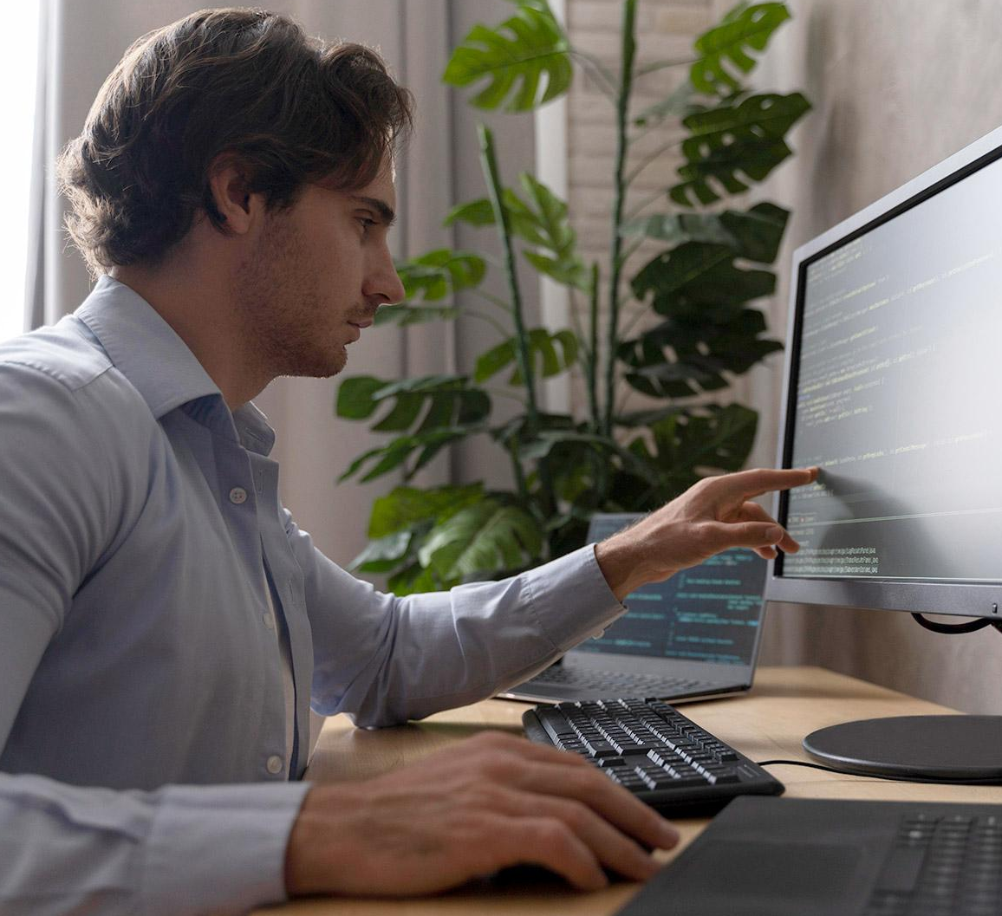
A picture always reinforces the concept
Images reveal large amounts of data, so remember: use an image instead of a long text. Your audience will appreciate it

Slide 15
4,498,300,000
Big numbers catch your audience’s attention

Slide 16
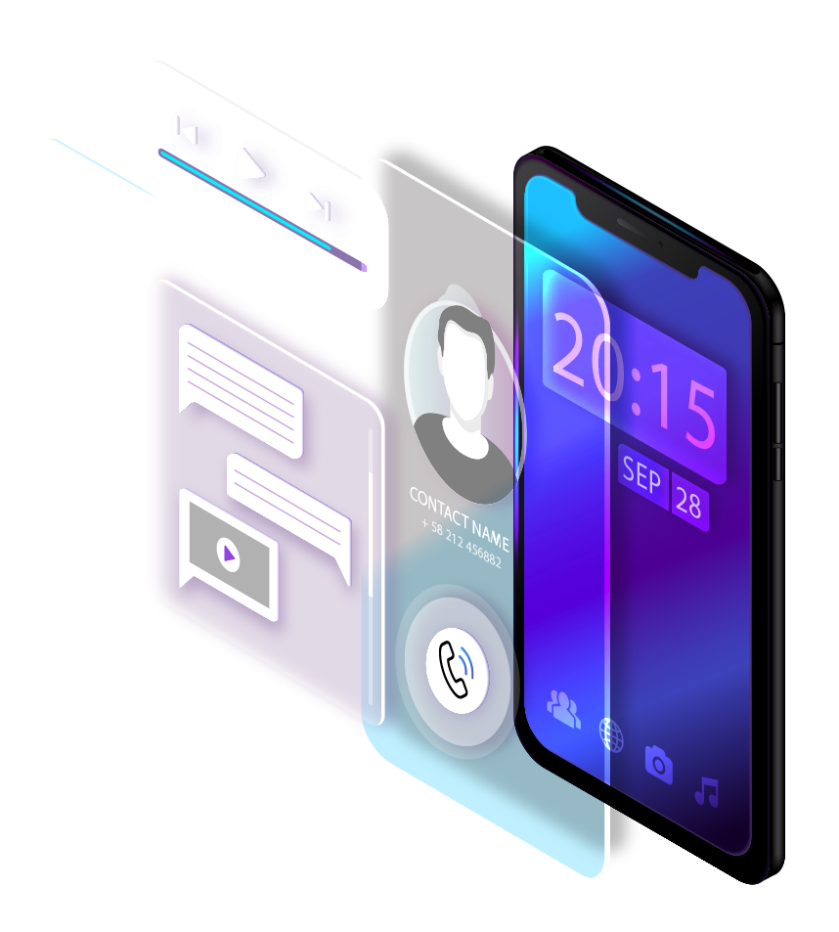
9h 55m 23s
333,000.000
386,000 km
Jupiter's rotation period
The Sun’s mass compared to Earth’s
Distance between Earth and the Moon

Slide 17
DISTRIBUTING SYSTEM STATS
10%
20%
30%
Mercury
Venus
Mars
It’s the closest planet to the Sun and the smallest of them all
Venus has a beautiful name and is the second planet from the Sun
Despite being red, Mars is a cold place. It’s full of iron oxide dust

Slide 18
DESKTOP SOFTWARE
You can replace the image on the screen with your own work. Right-click on it and then choose "Replace image" (in Google Slides) or "Change Picture" (in PPT) so you can add yours

Slide 19
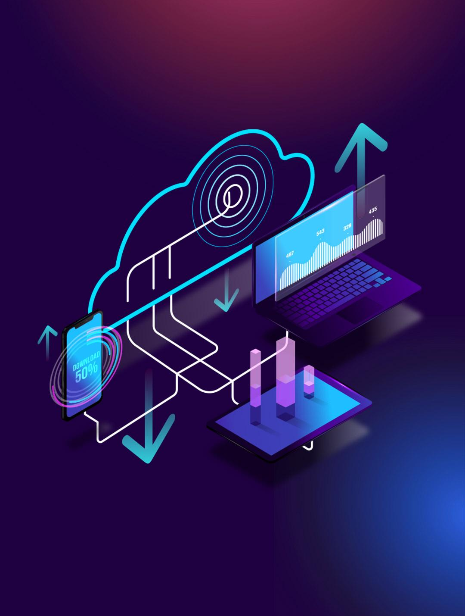
TABLET APP
You can replace the image on the screen with your own work. Right-click on it and then choose "Replace image" (in Google Slides) or "Change Picture" (in PPT) so you can add yours

Slide 20
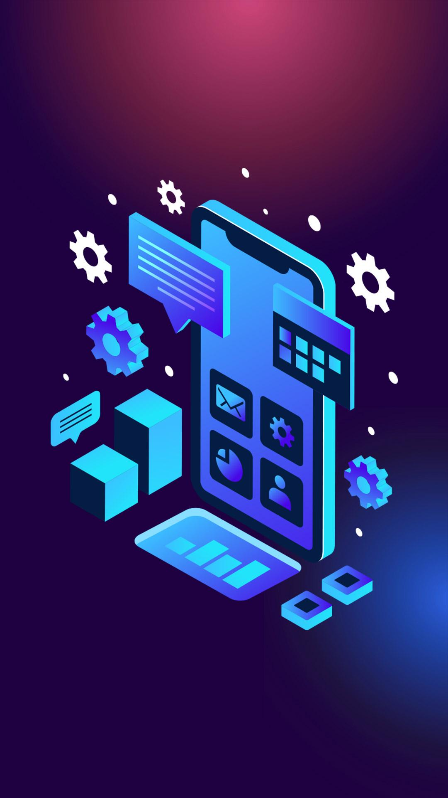
MOBILE WEB
You can replace the image on the screen with your own work. Right-click on it and then choose "Replace image" (in Google Slides) or "Change Picture" (in PPT) so you can add yours

Slide 21
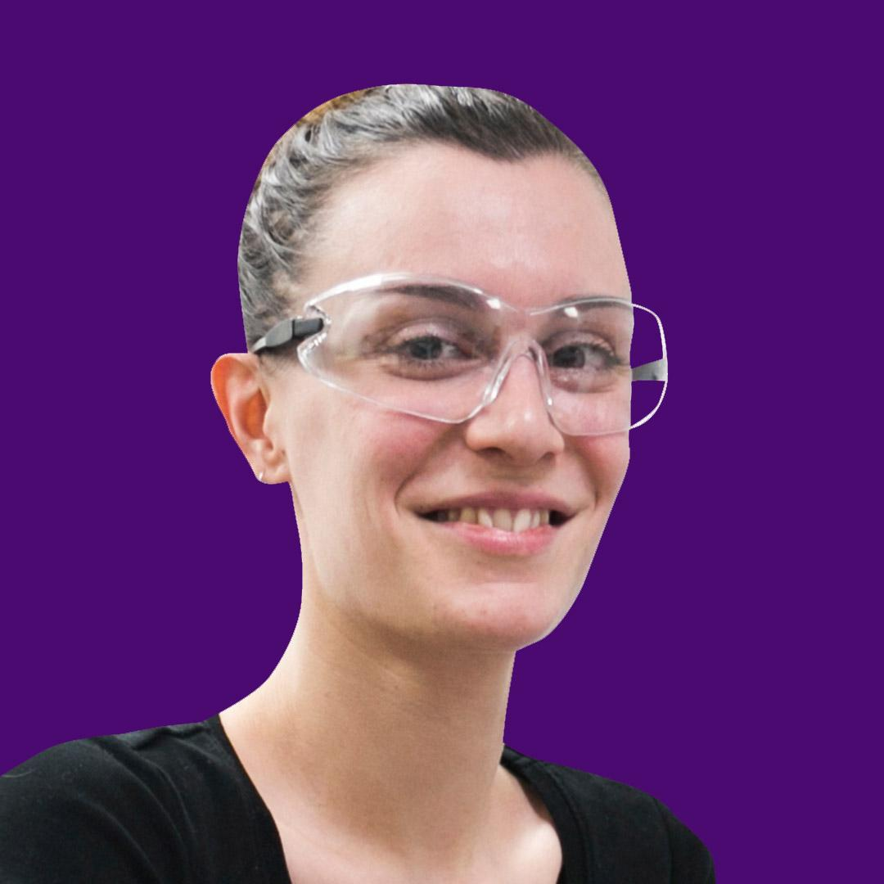
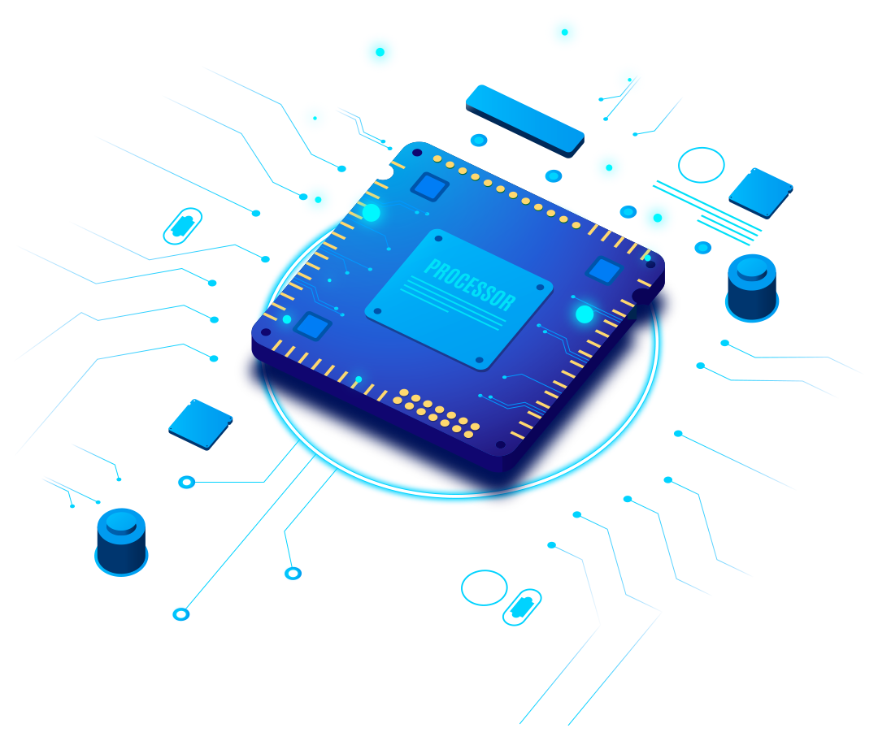
OUR PRINCIPAL TEACHERS
Sofia Hill
Peter Harris
You can talk a bit about this person
You can talk a bit about this person

Slide 22
TECH SCHOOLS
Venus
It’s the second planet from the Sun
Mars
Despite being red, Mars is a cold place

Slide 23
CIRCUIT: PROCESS
Venus
Mercury
Mars
Jupiter
Venus has a beautiful name
Mercury is the smallest planet
Mars is a very cold place
Jupiter is the biggest planet
1
2
3
4

Slide 24
QUANTUM COMPUTING
Mercury
It’s the closest planet to the Sun and the smallest in the Solar System
Venus
Venus has a beautiful name and is the second planet from the Sun
Mars
Despite being red, Mars is actually a cold place. It’s full of iron oxide dust

Slide 25
HARDWARE & SOFTWARE
Description | Hardware | Software
Mercury | Venus is the second planet from the Sun | Neptune is the farthest planet from the Sun
Earth | Jupiter is the biggest planet in the Solar System | Saturn is composed of hydrogen and helium

Slide 26
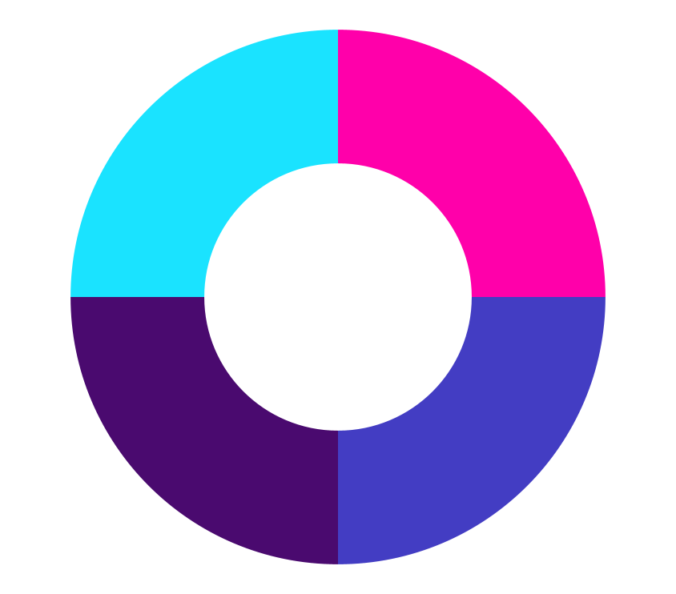
MAIN OPERATING SYSTEMS
25%
25%
25%
25%
Venus is the second planet from the Sun
Mercury is the smallest planet
Jupiter is the biggest planet
Despite being red, Mars is a cold place
Venus
Jupiter
Mercury
Mars
Follow the link in the graph to modify its data and then paste the new one here. For more info, click here

Slide 27
ABOUT SOFTWARE
2
You can enter a subtitle here if you need it

Slide 28
CALENDAR OF TESTS
Venus
Mon | Tue | Wed | Thu | Fri | Sat | Sun
 | 1 | 2 | 3 | 4 | 5 | 6
7 | 8 | 9 | 10 | 11 | 12 | 13
14 | 15 | 16 | 17 | 18 | 19 | 20
21 | 22 | 23 | 24 | 25 | 26 | 27
28 | 29 | 30 | 31
Venus has a beautiful name and is the second planet from the Sun. It’s hot and has a poisonous atmosphere

Slide 29
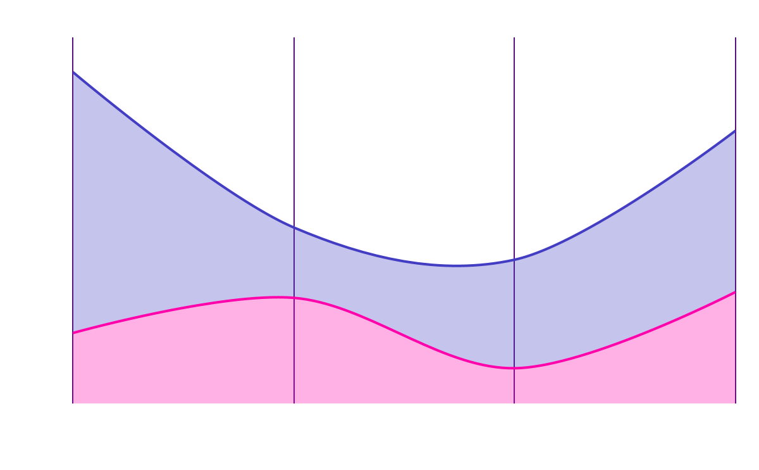
ROBOTICS THROUGH THE YEARS
Mercury
Venus
Mercury is the closest planet to the Sun and the smallest one
Venus has a beautiful name and is the second planet from the Sun
Follow the link in the graph to modify its data and then paste the new one here. For more info, click here

Slide 30
ORGANIZATION OF THE TEAM
Director
Venus is the second planet from the Sun
Teacher
Teacher
Despite being red, Mars is a cold place
Saturn is a gas giant and has several rings

Slide 31
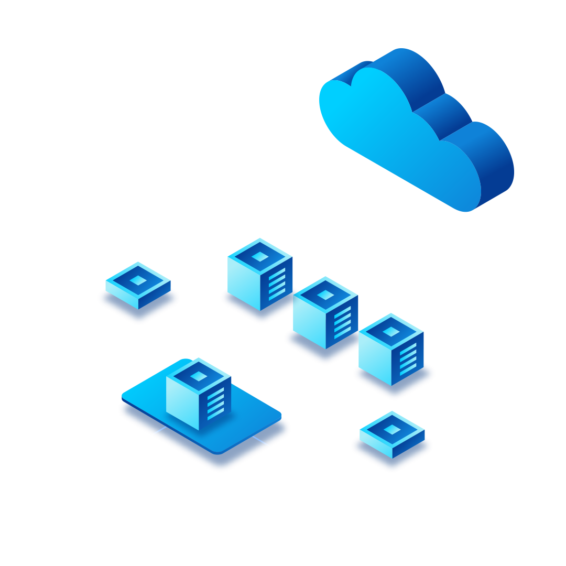
PARALLEL PROCESSING
Mercury is the closest planet to the Sun and the smallest one in the Solar System—it’s only a bit larger than the Moon

Slide 32
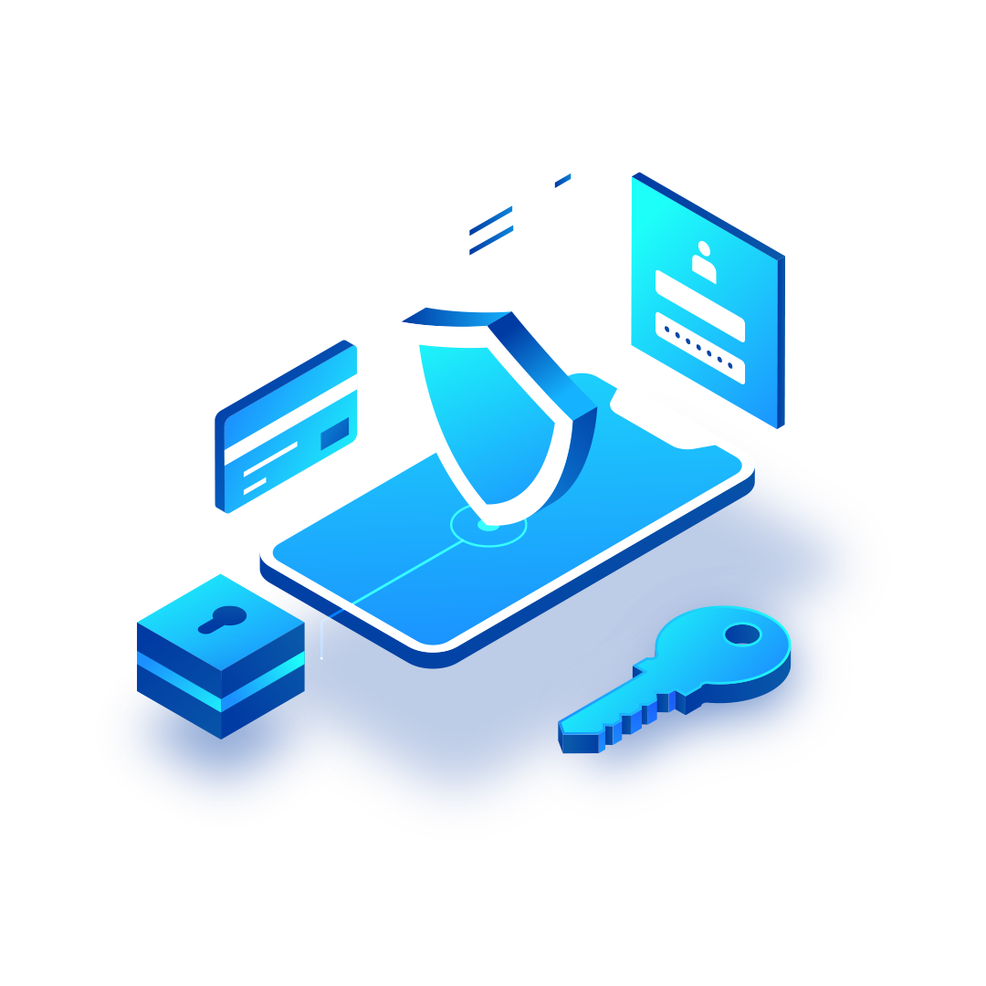
WIRELESS SECURITY INFOGRAPHIC
Mars
Mars is actually a very cold planet
Jupiter
Jupiter is the biggest planet of them all

Slide 33
COMPUTATIONAL ENGINEERING
Mars
Venus
Mercury
Saturn
Neptune
Jupiter
Mars is actually a very cold place
It’s the second planet from the Sun
It’s the closest planet to the Sun
Saturn is a gas giant and has rings
Neptune is very far away from us
Jupiter is the biggest planet

Slide 34
INTEGRATED CIRCUITS
Jupiter
Mercury
1
3
Jupiter is the biggest planet
Mercury is the smallest planet
2
Saturn
Saturn is the ringed planet

Slide 35
THANKS!
Do you have any questions?
addyouremail@freepik.com
+91 620 421 838
yourwebsite.com
Please keep this slide for attribution

Slide 36
BIG DATA ICON PACK

Slide 37
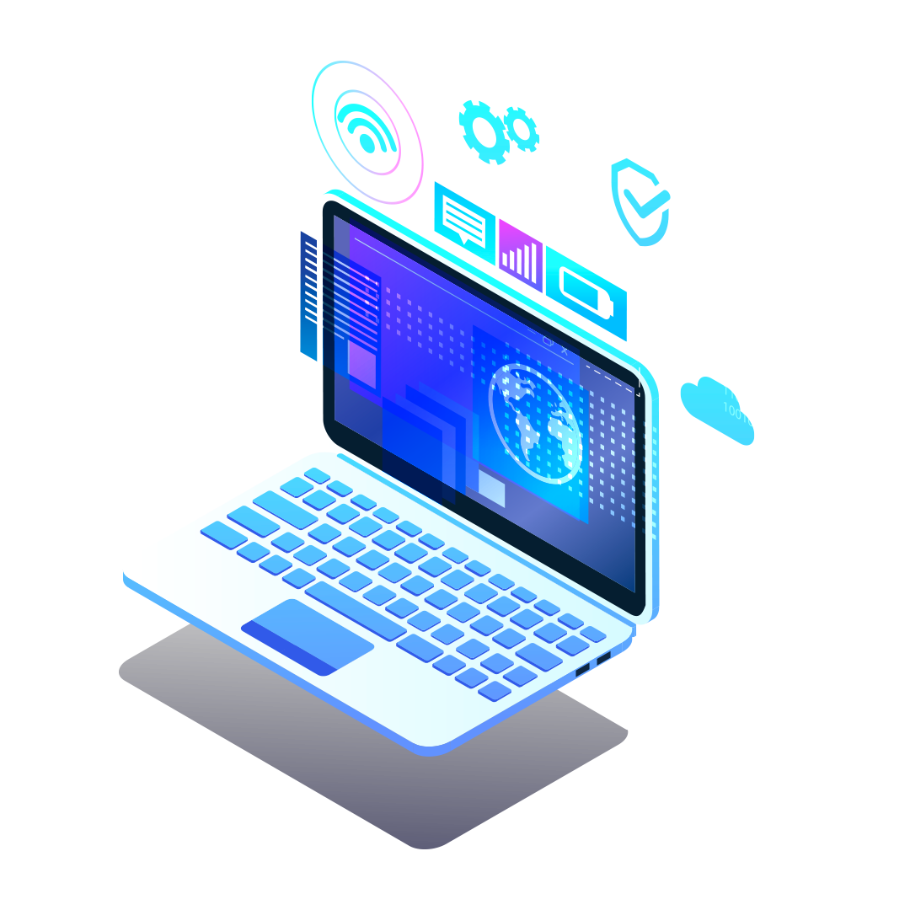
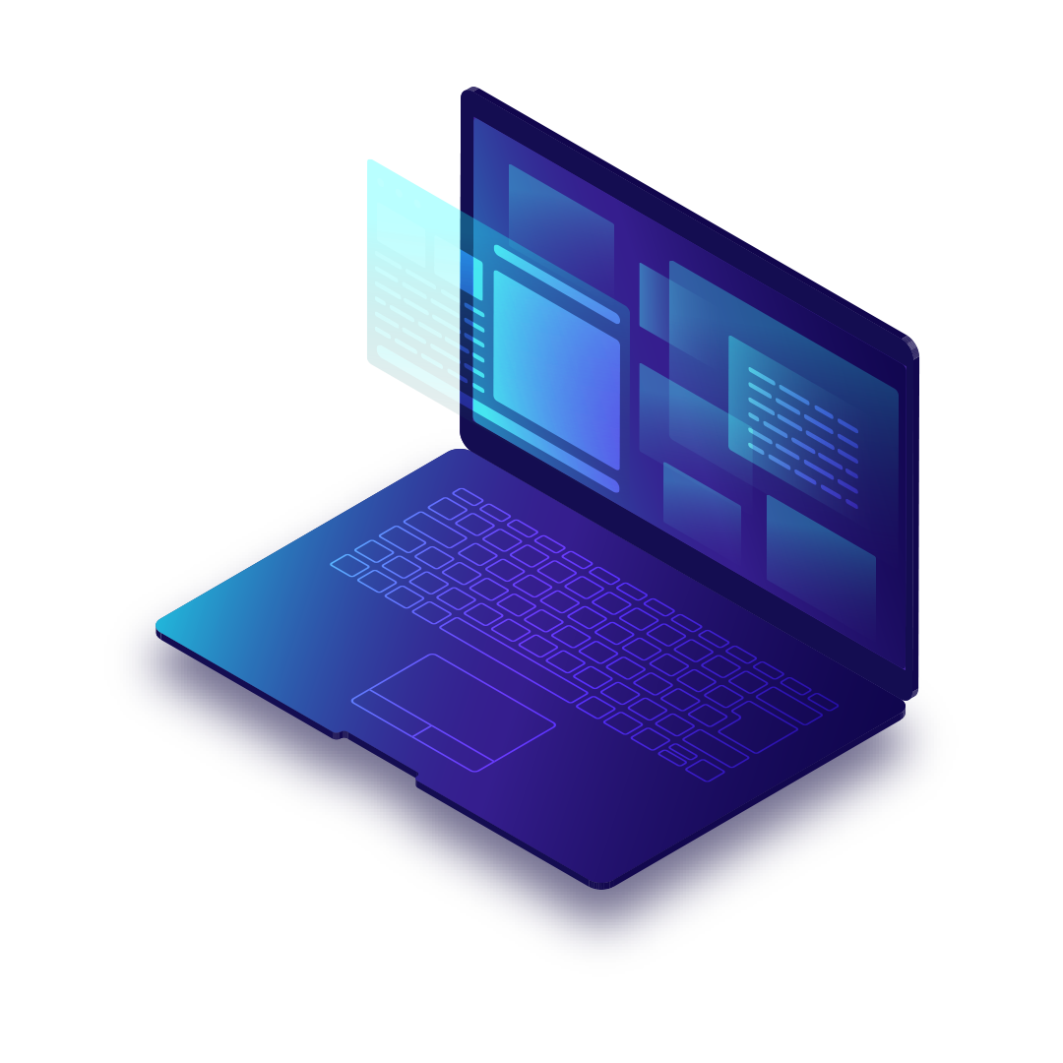
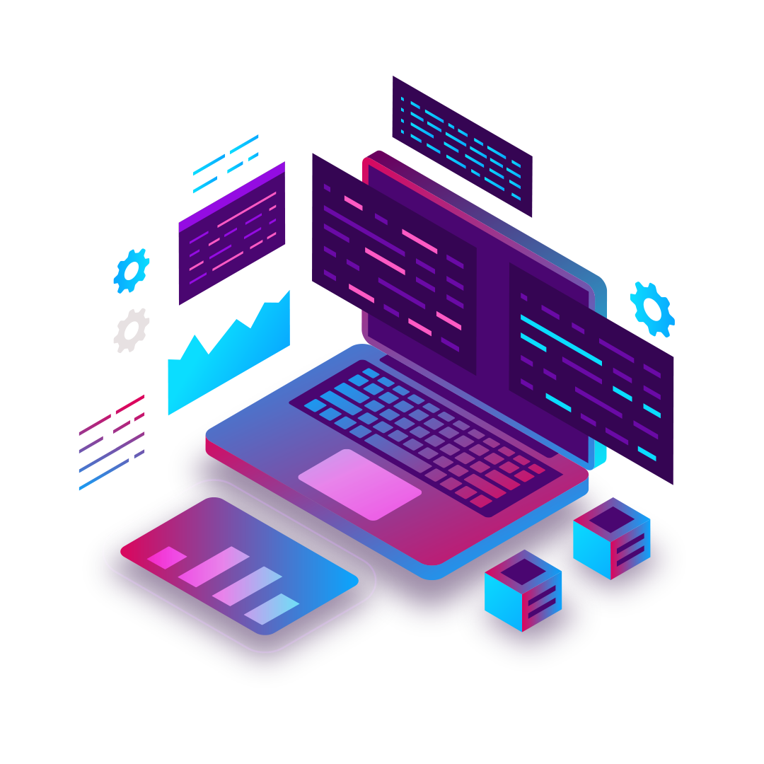
ALTERNATIVE RESOURCES
Here’s an assortment of alternative resources whose style fits that of this template
Gradient isometric laptop technology background I
Gradient isometric laptop technology background II
Isometric technology landing page template

Slide 38
RESOURCES
Did you like the resources on this template? Get them for free at our other websites.
Vectors:
Isometric technology landing page
Isometric technology template landing page
Landing page template isometric technology
Realistic microchip processor background
Isometric smartphone background
Modern landing page with isometric laptop
Realistic microchip processor background
Isometric data security background
Isometric cloud storage background
Gradient texture technology facebook template
Gradient texture technology brochure
Photos:
Front view man in casual clothes
Young man holding ethernet switches
Front view of woman using virtual reality headset
Close up programmer sitting at desk
Icons:
Big data icon pack

