Slide 1

Unit 10: Energy Sources
Lesson 1.2: Grammar
Page 77

Slide 2
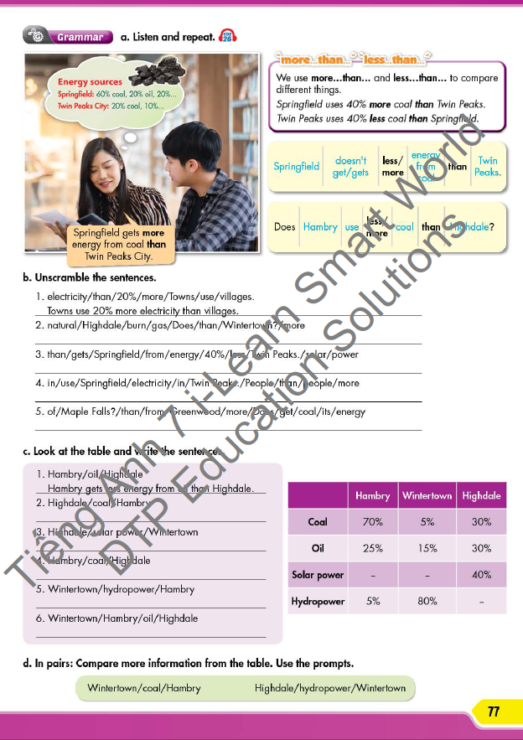


LESSON OUTLINE
Consolidation

Slide 3

By the end of this lesson, students will be able to…
- use more/less … than … to compare things.

Slide 4

WARM-UP

Slide 5

Work in pairs
1. How many boys/girls are there in your class?
2. How many doors/windows are there in your class?
3. Which is more? Boys or Girls? / Doors or Windows?

Slide 6

PRESENTATION
more … than …
less … than …

Slide 7
Students
Boys | 23
Girls | 26
There are more girls than boys in our class.
Do the same
Furniture
Doors | 2
Windows | 6
There are more windows than doors in our class.

Slide 8
Lead in
1 Which part of speech is used after more/less?
→ Noun
2 What do we use more/less … than for?
→ To compare different things

Slide 9

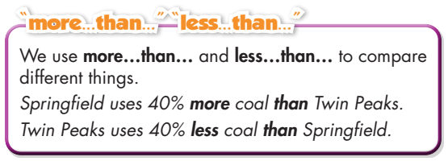
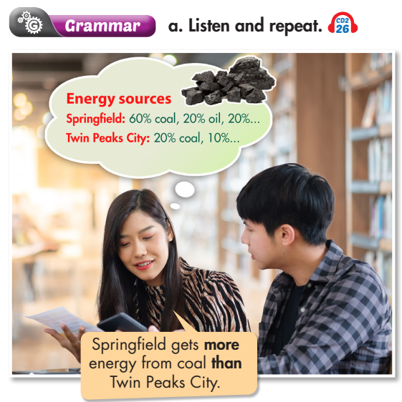
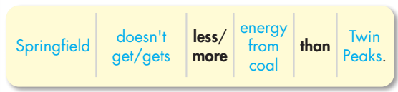
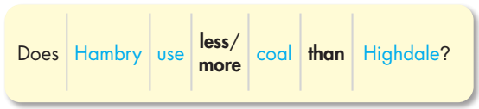
Click on the icon to hear the sound
less

Slide 10

PRACTICE

Slide 11
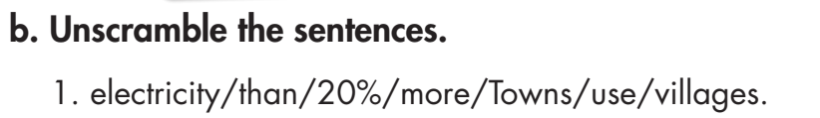
→ Towns use 20% more electricity than villages.
→ Does Highdale burn more natural gas than Wintertown?

Slide 12
→ Springfield gets 40% less energy from solar power than Twin Peaks.
→ People in Springfield use more electricity than people in Twin Peaks.
→ Does Greenwood get more of its energy from coal than Maple Falls?

Slide 13
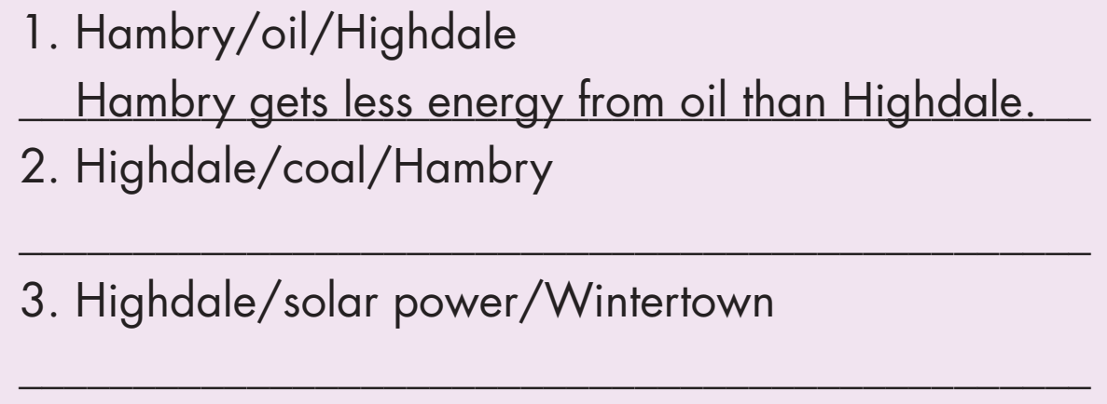
Highdale gets less energy from coal than Hambry.
Highdale gets more energy from solar power than Wintertown.

Slide 14
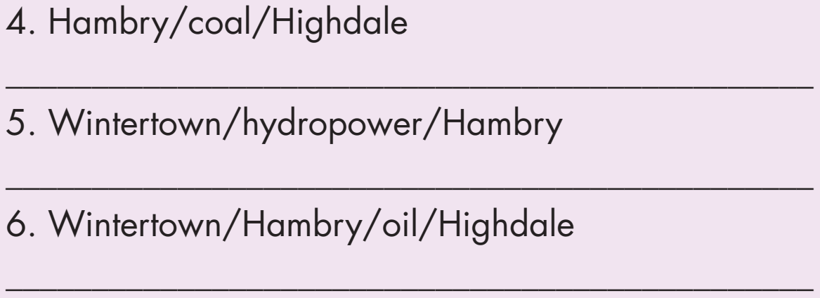
Hambry gets more energy from coal than Highdale.
Wintertown gets more energy from hydropower than Hambry.
Wintertown and Hambry get less energy from oil than Highdale.

Slide 15
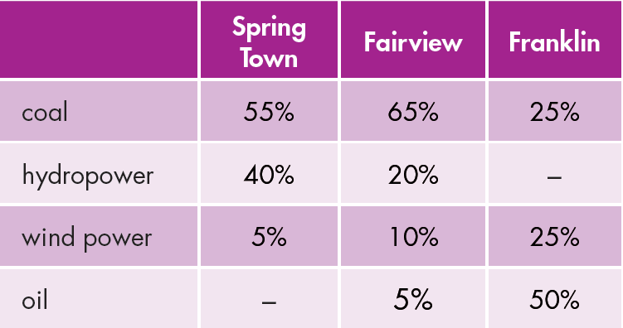
Extra Practice
WB, page 57
1. Spring Town uses _____ coal than Fairview.
2. Fairview gets _____energy from wind power than Franklin.
less
less

Slide 16
3. Fairview uses ______ wind power than Spring Town.
4. Franklin gets ______ energy from oil than Fairview.
5. Spring Town uses ______hydropower than Fairview.
more
more
more
Extra Practice
WB, page 57

Slide 17
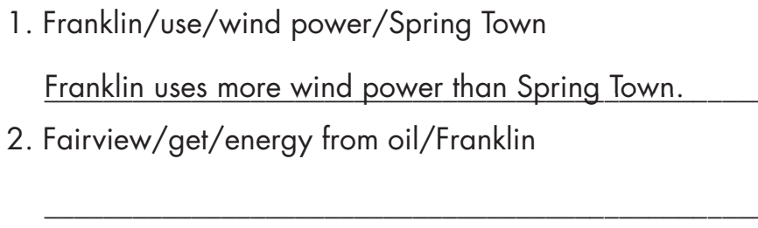
Fairview gets less energy from oil than Franklin.
Extra Practice
WB, page 57

Slide 18
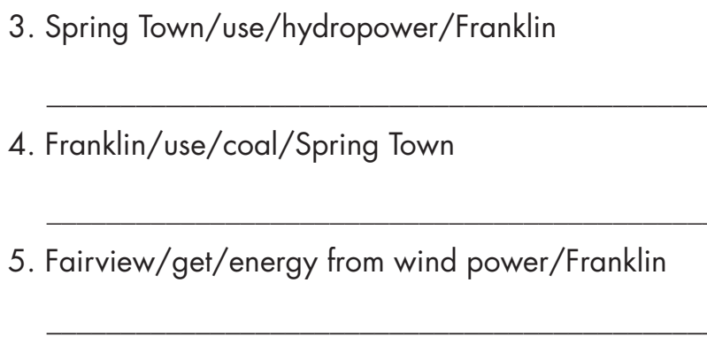
Extra Practice
WB, page 57
Spring Town uses more hydropower than Franklin.
Franklin uses less coal than Spring Town.
Fairview gets less energy from wind power than Franklin.

Slide 19

PRODUCTION

Slide 20
Wintertown gets less energy from coal than Hambry.
Highdale gets less energy from hydropower than Wintertown.

Slide 21
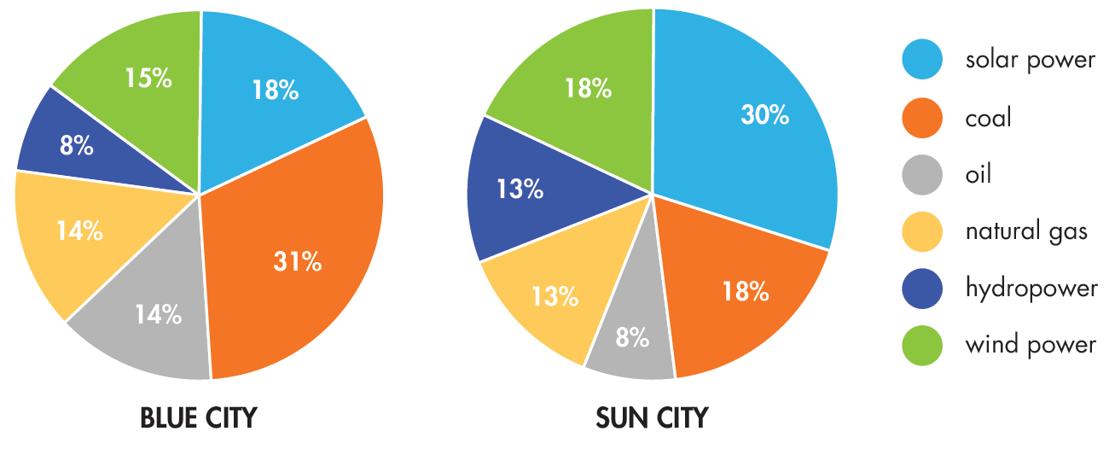
Extra Practice
WB, page 57

Slide 22
Extra Practice
WB, page 57
Sample answers:
Blue City uses less solar power than Sun City.
Sun City gets less energy from coal than Blue City.
Blue City uses more oil than Sun City.
Sun City gets less energy from natural gas than Blue City.
Sun City uses more wind power than Blue City.

Slide 23

CONSOLIDATION

Slide 24
Work in groups: Talk about which sources of energy you use more/less in your houses/at school.
Use the grammar point:
  more/less … than

Slide 25
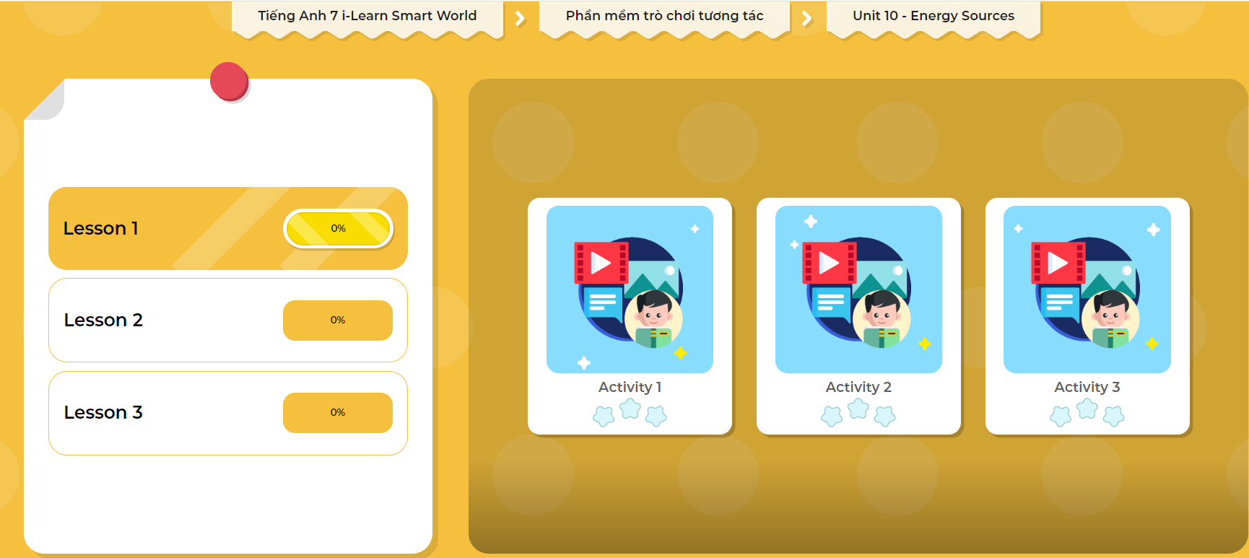
LET’S PLAY!
Click here to play the games

Slide 26

WRAP-UP

Slide 27
Today’s lesson
Grammar
more … than …
less … than …

Slide 28
Today’s lesson
Grammar:
Using "more ... than ..." and "less ... than ... " to make comparisons.
Speaking & Writing:
Comparing things.

Slide 29
Homework
Practice making sentences using more/less … than …
Do the grammar exercise in Tiếng Anh 7 i-Learn Smart World Workbook on page 57.
Complete the grammar notes in Tiếng Anh 7 i-Learn Smart World Notebook on page 61.
Prepare the next lesson (page 78 SB).
Play consolidation games in Tiếng Anh 7 i-Learn Smart World DHA App on www.eduhome.com.vn

Slide 30

Lesson 3
Stay positive and have a nice day!

